Slide 1
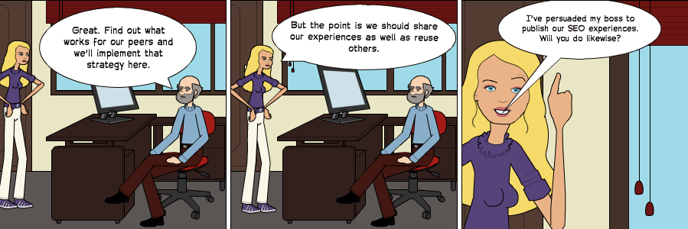
SEO Analysis of Institutional Repositories: What’s The Back Story?
How do backlinks from popular Web sites affect the visibility of papers in institutional repositories using Google and the number of downloads?
How can we compare findings across institutions in order to validate the survey methodology and inform operational practices??
A paper at OR 2012 described how Brian Kelly (UKOLN) had the largest number of downloads on Opus, the University of Bath repository. This was felt to be the result of large numbers of backlinks from popular Web sites.
Are such findings replicated in other repositories? To answer this question a number of UK Russell group universities used the same methodology and published their findings openly on the UK Web Focus blog.
Evidence suggests that back-links from popular Web sites enhanced the Google ranking of IRs. But we need more evidence and a willingness to critique such surveys in order to inform practices.
Why not publish your findings openly?
Acknowledgements are given to JISC for their funding of the Innovation Support Centre at UKOLN.
SEO Analysis of Institutional Repositories: What’s The Back Story? Brian Kelly and William Nixon, OR13, Prince Edward Island, Canada, 8-12 July 2013. http://or2013.net/content/seo-analysis-institutional-repositories-whats-back-story
Please contact Brian Kelly for further information about this work: <ukwebfocus@gmail.com>

