Slide 1
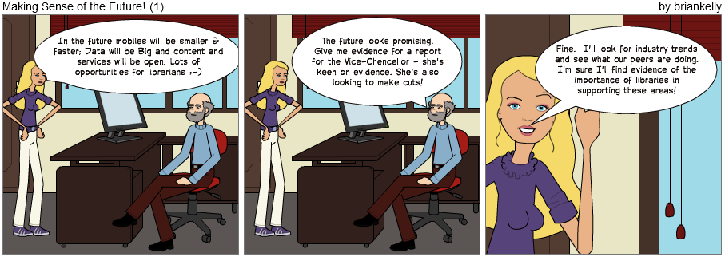
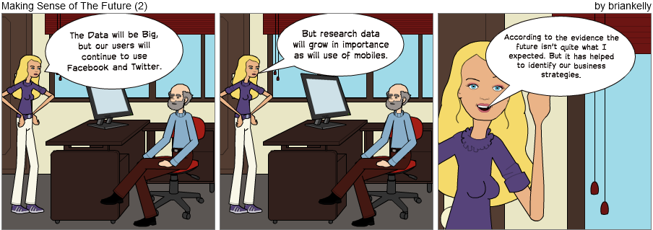
Making Sense of the Future
Preparing For The Future: Helping Libraries Respond to Changing Technological, Economic and Political Change
Brian Kelly, UKOLN
Presentation by Brian Kelly, UKOLN at the ILI 2012 conference

Slide 2
Preparing For The Future: Helping Libraries Respond to Changing Technological, Economic and Political Change
Twitter:
#???
http://www.ukoln.ac.uk/web-focus/events/workshops/york-library-2013/
Brian Kelly
UKOLN
University of Bath
Bath, UK
Acceptable Use Policy
Recording this talk, taking photos, discussing the content using Twitter, blogs, etc. is welcomed providing distractions to others is minimised.
Email:
b.kelly@ukoln.ac.uk
Blog:
http://ukwebfocus.wordpress.com/
Twitter: @briankelly
UKOLN is supported by:
This work is licensed under a Creative Commons Attribution 2.0 licence (but note caveat)

Slide 3
About Me
Introduction
Brian Kelly:
UK Web Focus: national advisory post to UK HEIs
Long-standing Web evangelist (since 1993)
Based at UKOLN at the University of Bath
Prolific blogger (1,100+ posts since Nov 2006)
User of various devices to support professional (and social) activities
Prolific speaker (~400 talks from 1996-2012)
Author of peer-reviewed papers on various Web topics
About to start life as a free-lance consultant

Slide 4
Abstract
Abstract
What technological (and social) developments might we expect to arrive which will affect the working environment of the academic library?
We can expect … But there are dangers of making plans based on technological determinism.
This workshop provides an opportunity for participants to make use of a methodology for identifying 'weak signals' of technological developments and an open sense-making process for discussing the implications of such developments.

Slide 5
In the Future
Data will be Big

Slide 6
In the Future
Content and services will be open

Slide 7
In the Future
We will own our services and content

Slide 8
In the Future
We will see a growth in use of online services

Slide 9
In the Future
We will see the importance of librarians and information professionals acknowledged

Slide 10
In the Future
We will see greater investment in libraries

Slide 11
In the Future
We will travel to work by monorail

Slide 12
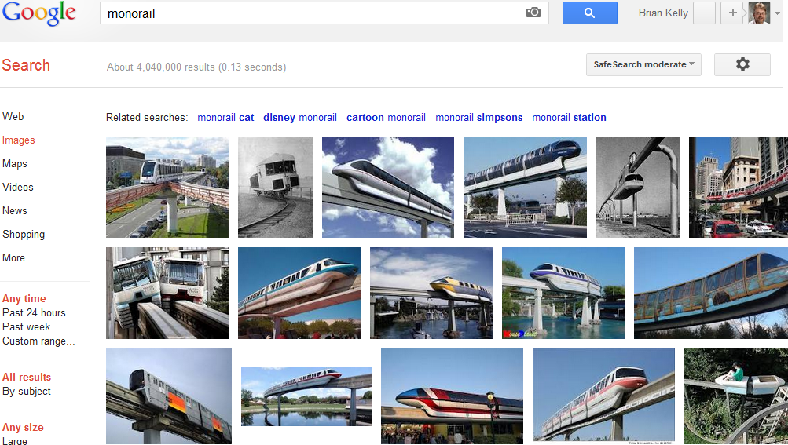
What I expected in the future
Monorails

Slide 13
In the Future
We will use jetpacks at weekends

Slide 14
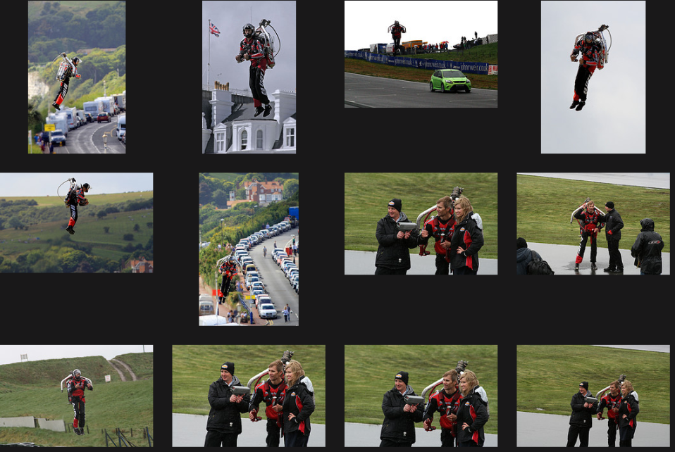
Has the Future Arrived?
Hoverpacks do exist

Slide 15
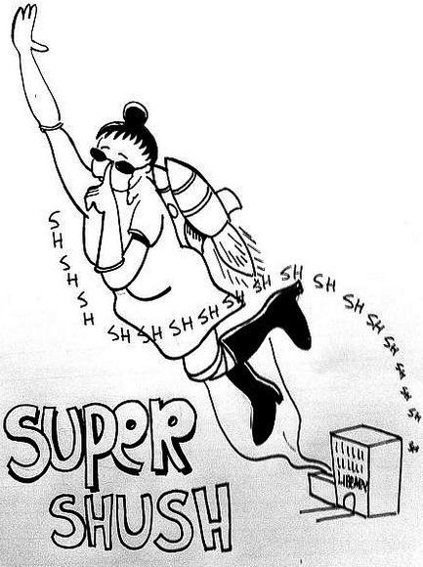
Shush!
Librarians will appropriate technological developments to support their activities!
Acknowledgements to Patrick Hochstenbach (@hochstenbach)

Slide 16
What Can We Conclude?
Assumptions of:
Inevitability of technological developments
Economic growth (we can afford them)
Political and social environment (no legal or environmental barriers)
There is a need to:
Be wary of predictions which:
Simply justify our organisation’s current approaches (cf. music industry)
Reflect personal beliefs / discipline norms
Base predictions on evidence
Acknowledge that evidence may challenge organisational or personal beliefs / prejudices

Slide 17
The Context
In the future mobiles will be smaller & faster; Data will be Big and content and services will be open. Lots of opportunities for librarians ☺

Slide 18
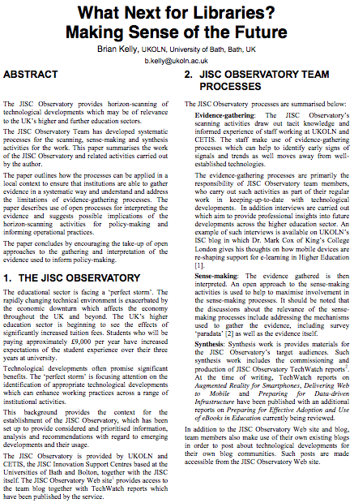
Accompanying Paper
Ideas initially described in paper presented at EMTACL (Emerging Technologies in Academic Libraries) conference
See bit.ly/emtacl12-kelly

Slide 19
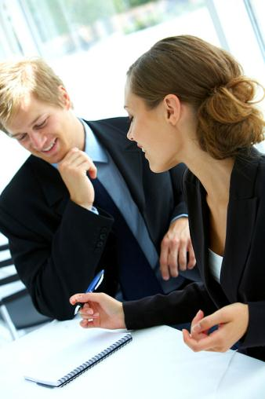
Time of Growth ☺
1990s & early 2000s saw:
Increased funding across education sector
Significant developments in IT sector
Willingness by senior managers & funding bodies to invest in innovative IT developments (e.g. JISC development programmes)
“Great proposal – we’ll fund it”
Image from Flickr. CC BT-NC-SA licence: http://www.flickr.com/photos/inlinguamanchester/5036313154/

Slide 20
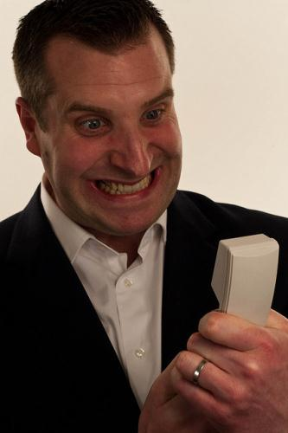
Time of Growth is Over ☹
Late 2000s and beyond:
Decreased funding across education & public sector
Acknowledgements that innovation can provide growth and cost savings
Significant developments continue in IT sector
Investment in innovative IT developments need to be based on evidence of benefits & likleyhood of success
“You want how much? And no evidence it will work! You’re crazy!”
Image from Flickr. CC BY-NC-ND licence: http://www.flickr.com/photos/drewleavy/339489258//

Slide 21
Lessons From The Past
Importance of open standards:
Open standards are essential for interoperability; preservation; …
Therefore use SMIL and SVG (open standards from W3C) and not Flash (proprietary)
The need to be realistic
What happened to SMIL and SVG?
The marketplace didn’t embrace the open standards
Adoption of open standards would have been costly
Flash is now being superceded by HTML5
Flash’s demise due to lack of support by Apple on mobile devices

Slide 22
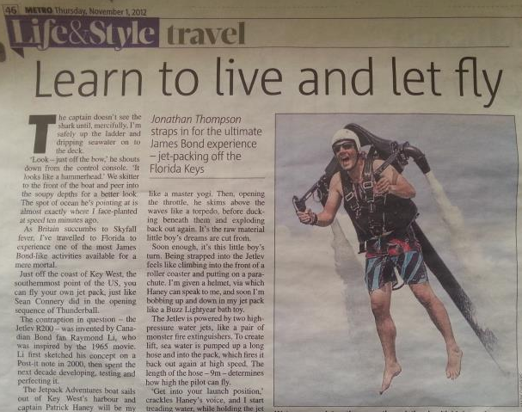
Why Future-Watch?
Sometimes:
Technologies may be slow-burners
May still be irrelevant to our businesses
Metro, 1 Nov 2012

Slide 23
Why Future-Watch?
Need for future-watching to help identify tomorrow’s key technologies:
Changes to existing business processes
Decisions on assigning resources to find out more (e.g. commissioning reports)
Investing in training & development in new areas
Exploring ways of deprecating existing services (cf WH Smith’s decision to stop selling CD singles in 2004)
…

Slide 24
Group Exercise
In about 5 groups:
Identify 4 technology / technology-related trends which you feel will have a significant impact on your work in 2-5 years time

Slide 25
Group Exercise
In about 5 groups:
Identify 4 technology / technology-related trends which you feel will have a significant impact on your work in 2-5 years time
Share your 4 technologies with the other groups (only 4!)

Slide 26
Group Exercise
In about 5 groups:
Identify 4 technology / technology-related trends which you feel will have a significant impact on your work in 2-5 years time
Share your 4 technologies with the other groups (only 4!)
Agreed on a vote on the other groups’ list:
3 = Yes, this is important
2 = Could be important
1 = Doubtful; sceptical
0 = No way!
(no half marks; no single transferable votes!)

Slide 27
Previous Examples
From previous workshops the following technological / societal developments were used:
Mainstream areas
Niche areas
HTML5
EPUB
“BYOD”
“Openness”

Slide 28
JISC Observatory
JISC Observatory:
JISC-funded initiative
Systematises processes for anticipating and responding to projected future trends & scenarios
Provided by JISC Innovation Support Centres at UKOLN and CETIS
See <http://blog.observatory.jisc.ac.uk/>
Note:
JISC Observatory work about to close due to cessation of JISC core funding for UKOLN & CETIS
Therefore need for institutional understanding of processes

Slide 29
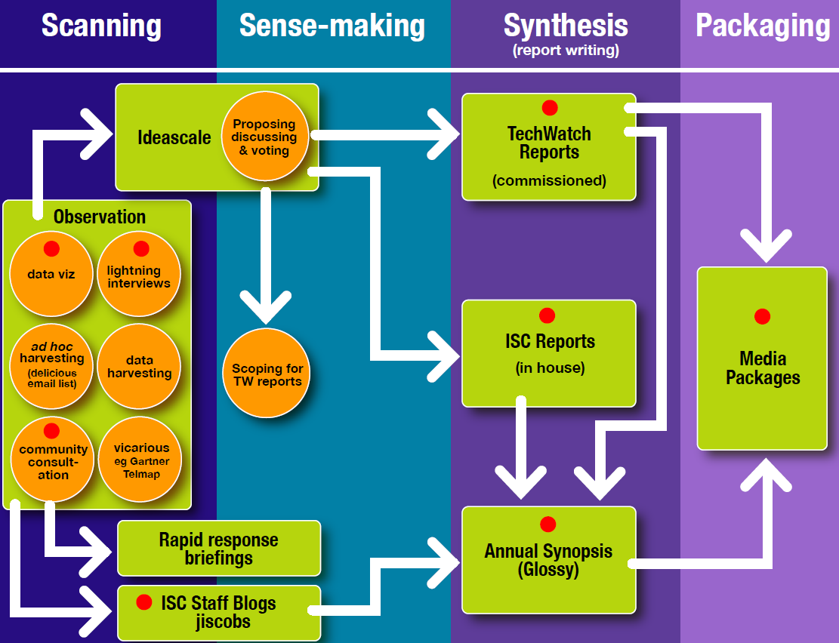
JIS Observatory process
JIS Observatory process

Slide 30
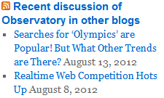
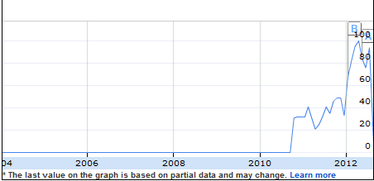
Scanning Activities
Blog posts: Posts published on JISC Observatory blog and on existing blogs.
Monitoring trends: Monitoring trends in order to:
Benchmark current usage patterns
Identify trends
Identify emerging patterns of usage
Google searches for “learning analytics” took off in 2010.
Possible indicator of relevance across sector & need for further investigation.

Slide 31
Sense-making
Need to:
Understand limitations of evidence-gathering techniques (including documenting ‘paradata’ so survey findings are reproducible & can be critiqued)
Provide suggestions of implications of developments for the sector
In addition need to encourage feedback on:
Evidence-gathering techniques
Interpretation of findings
Implications of developments
In order to inform:
Further investigation
Policy-making, planning and funding

Slide 32
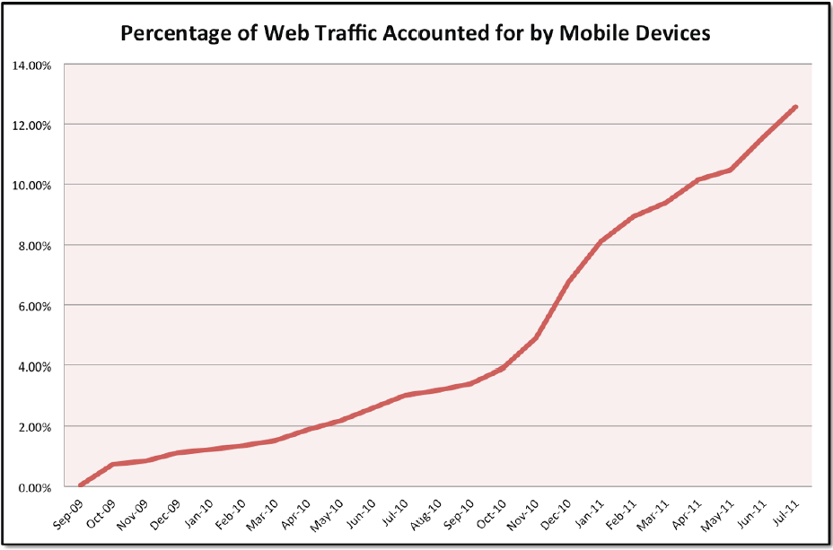
Significant Trends: Mobile
Tecmark Digital Marketing Agency
We now know of the importance of Mobile

Slide 33
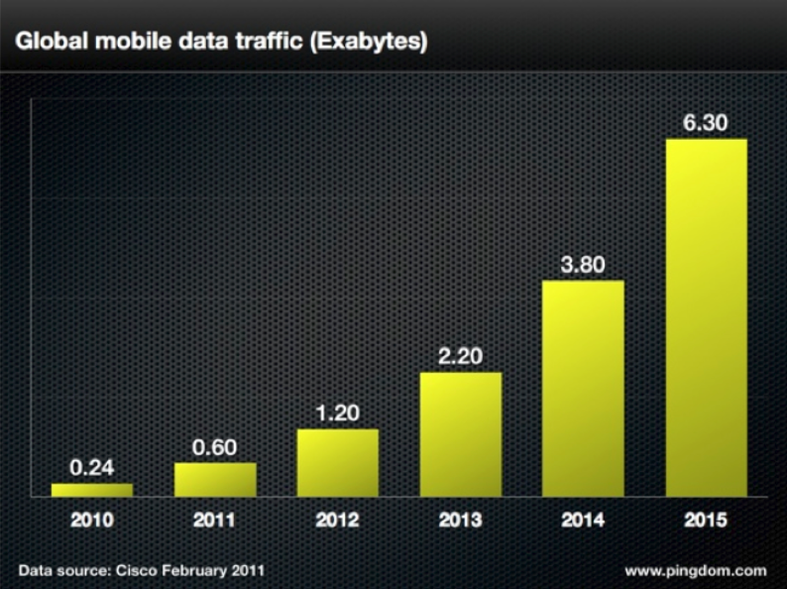
Significant Trends: Mobile
Cisco
We now know of the importance of Mobile

Slide 34
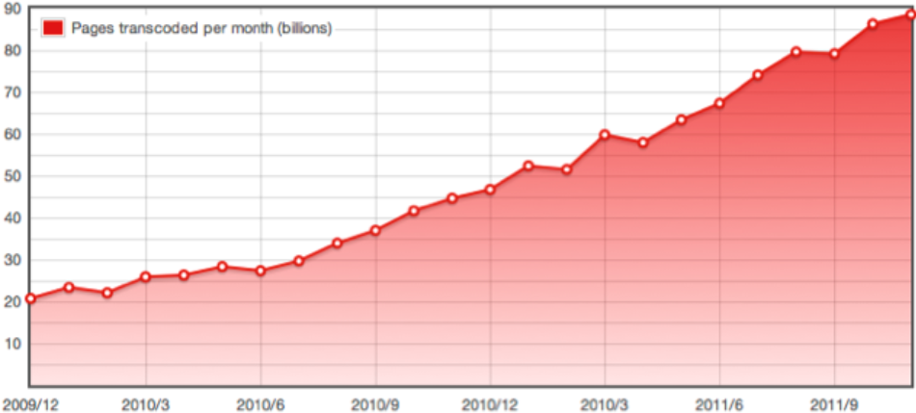
Significant Trends: Mobile
Opera
We now know of the importance of Mobile: but did we say the same when WAP came along?

Slide 35
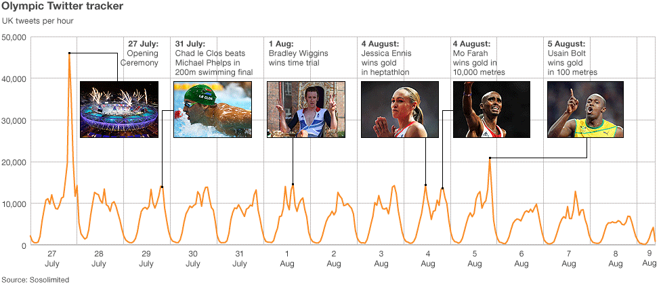
Significant Trends: Social Media
There were “more than 150 million Tweets about the Olympics over the past 16 days”. [Twitter blog]

Slide 36
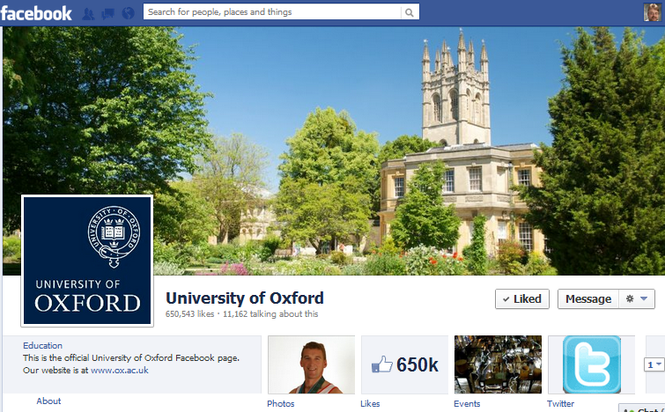
Significant Trends: Social Media
Survey in Aug 2012 of institutional use of Facebook across the 24 Russell Group universities found >1M ‘Likes’ followers

Slide 37
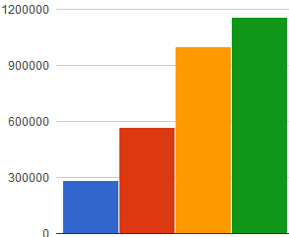
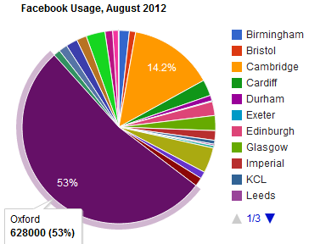
Behind The Data
Trends in Fb ‘Likes’ for Russell group Unis since Jan 2011 show steady increase
But note increase in Jul 2012 due to addition of 4 new universities!
Jan 11 Sep 11 May 12 Jul 12
But might trends hide a more complex story:
Usage & growth dominated by one significant player.
More modest usage generally

Slide 38
Need for Paradata and Discussion
Surveys carried out to monitor usage & trends for:
Institutional use of social media
Use of researcher profiling services (e.g. Google Scholar, Academia.edu, …) across institutions
Observations (and feedback):
Differing results found if quotes used
Possible inclusion of wrong Unis (e.g. Newcastle University, Australia)
Personalised results depending on client environment
Need to provide paradata and encourage feedback on processes and intrepretation of findings

Slide 39
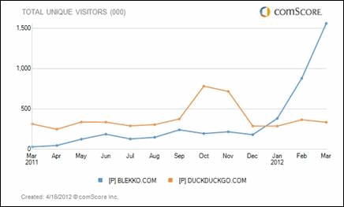
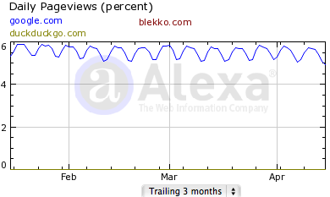
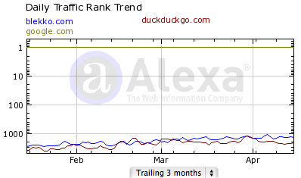
Lies, Damned Lies and Graphs
“#Blekko traffic goes through the roof – for good reason. Try it out!”
Based on blog post entitled “Blekko’s Traffic Is Up Almost 400 Percent; Here Are The CEO’s Five Reasons Why” (includes dissatisfaction with Goole)
Is Blekko’s Traffic Really Going Through The Roof? Will It Challenge Google?, UK Web Focus blog, 18 April 2012

Slide 40
Open Sense-making
Importance of open approaches to interpretation of signals:
Evidence-gathering methodologies may have flaws
Incorrect or inappropriate implications may be made
This may lead to wrong decisions being made
Open sense-making approaches may be difficult – your marketing department may wish a consistent, positive message to be made.

Slide 41
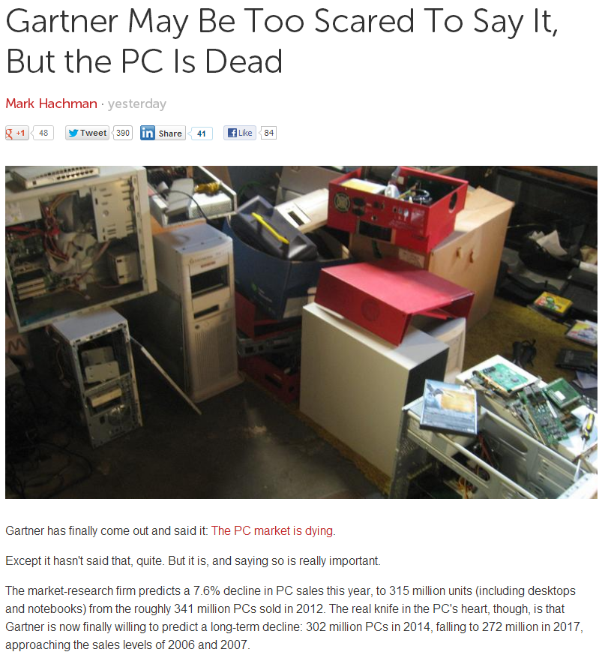
Beware vested interests who may be threatened by implications of predictions
Developments may
Be aligned with current plans
Challenge current plans

Slide 42
Group Exercise 2
Agree on a hot topic and describe how you would:
Gather evidence of its importance
Interpret the evidence
Address personal / departmental / institutional biases
Identify reasons to engage (e.g. actions needed now; actions needed in the future; risks if actions not taken; …)
Examples:
What should we be doing with mobile?
Should we have a Library Facebook page?
Should we provide cover pages for printouts from the IR?

Slide 43
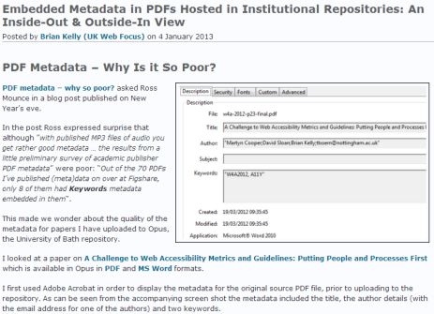
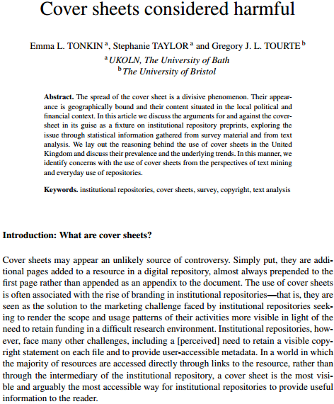
Informing Practice
Cover pages in IRs may:
Corrupt embedded metadata
Degrade workflow practices if paper subsequently uploaded to another IR
Question:
“what’s so bad about a cover sheet from a user’s POV?”
Survey across IR sector:
Branding is the main motivation for use of cover sheets
Mostly created manually
Can inhibit text-mining and Google SEO

Slide 44
Sense-Making: Use of Fb
Session at IWMW 2013:
Librarian 1 (research-intensive Uni): Students keep telling us to “keep out of our social space”
Librarian 2 (teaching Uni): We set up a Library Facebook page. It works because “we need a presence where students hangout”
Personal perspectives. How do we:
Gather evidence which informs policies and practices?
Make the evidence-based decisions?

Slide 45
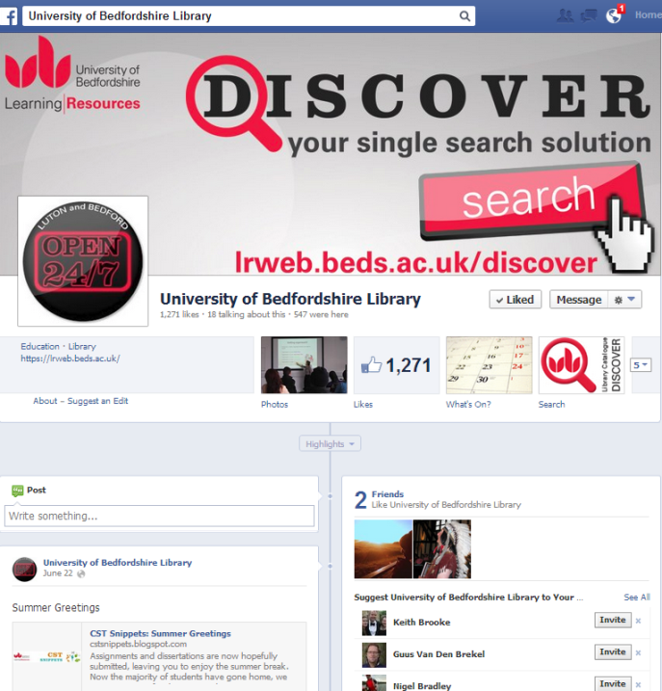
University of Bedford Library Facebook page
University of Bedford Library Facebook page

Slide 46
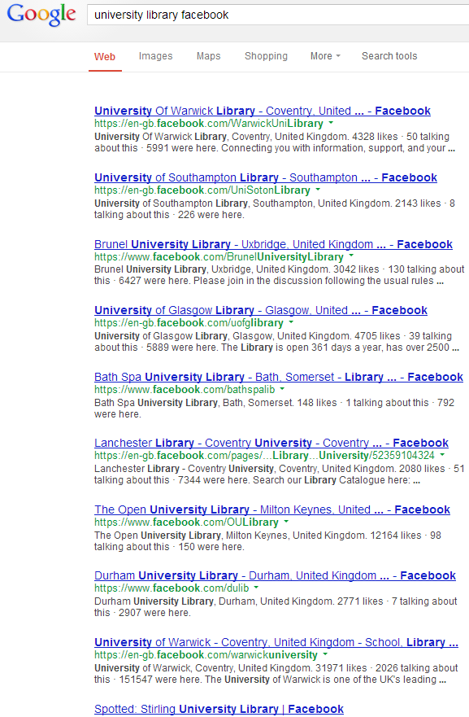
Across the Sector
Look beyond the host institution, institutional and departmental culture and personal prejudices
Opportunities
Risks

Slide 47
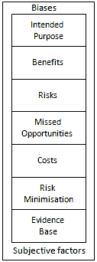
Opportunities and Risks
Risks averse:
Public sector
Libraries
Risks of being risk-averse
Missed opportunities
Criticisms from users
Advantages to competitors
Need for a managed approach to:
Assessing risks
Risk mitigation
Acceptance of risks
Kelly, B. and Oppenheim, C., 2009. Empowering users and their institutions: A risks and opportunities framework for exploiting the potential of the social web.

Slide 48
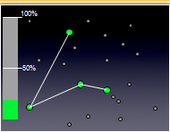
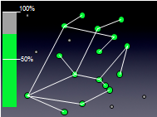
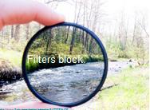
“It’s About Nodes and Connections”
Theory
Cameron Neylon keynote at OR 2012: “Networks qualitatively change our capacity”
With only 20% of a community connected only limited interaction can take place
This increases drastically as numbers of connected nodes grows
Examples:
Phone networks (no use with only 1 user!)
Tweeting at events
Galaxy Zoo
Implications:
Importance of best practices for popular & well-used channels e.g. Twitter/Facebook and not Identi.ca/Diaspora
“Filters block. Filters cause friction”
Need for client-side, not supply-side filters.

Slide 49
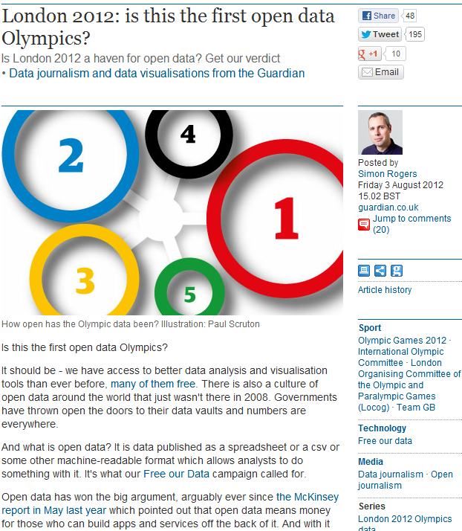
Open Data
“Is London 2012 a haven for open data?”
Conclusions:
“Not this time”
“But it is the first data Olympics”
“It's hard to see that by [Rio] 2016 this won't emerge as data we can all use”

Slide 50
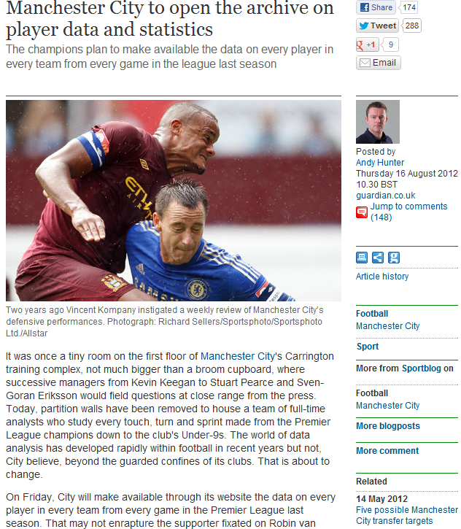
Open Data
“Manchester City to open the archive on player data and statistics”
Example of:
Public interest in open data
Interest from commercial sector

Slide 51
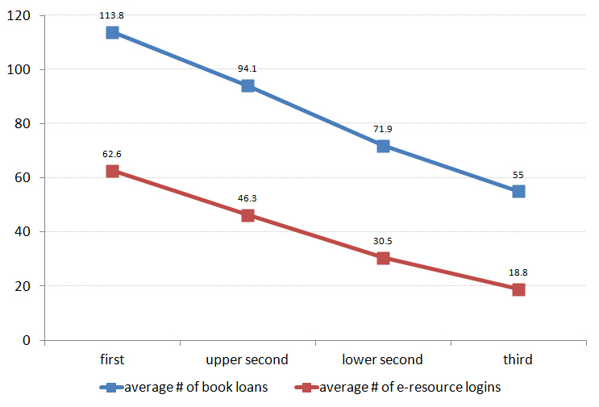
Use of Open Data in Libraries
Trends in reusing Library usage data, e.g. JISC’s Library Impact Data Project
Average number of books borrowed and e-resource logins for ~33,000 students in final year of studies
Image & data provided by Dave Pattern under a CC BY-NC-SA licence

Slide 52
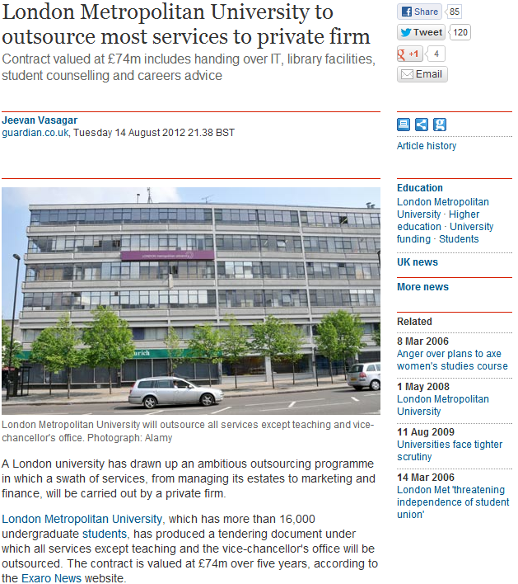
Early Signals?
News stories (Aug 2012) about plans for privatisation at London Metropolitan University

Slide 53
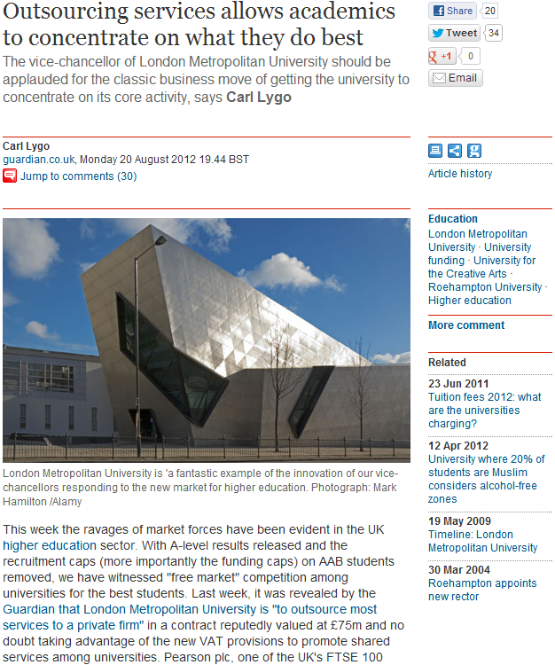
Early Signals?
Follow-up comment (20 Aug 2012):
“VC should be applauded for the classic business move of getting the university to concentrate on its core activity”
Carl Lygo is chief executive of the 'for profit' BPP Professional Education group and principal of BPP University College

Slide 54
Recap
Within your organisation / sector there is a need to have mechanisms for identifying technological developments which may have an impact on the business:
Observing trends and signals
Observing signals from diversity of sources
Interpreting the implications
Identifying changes which may be needed within the organisation
Inviting feedback and critiques of the evidence-gathering processes and the interpretations of the findings

Slide 55
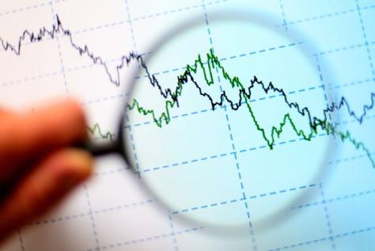
Challenge For Librarians
In time of uncertain futures:
Use evidence-based approaches to understanding the future
Understand the changing environment
Engage with opportunities in areas of growth and institutional importance
Be open and encourage discussion on analysis & interpretation of findings

Slide 56
Serenity prayer
Serenity prayer:
God, grant me the serenity to accept the things I cannot change, Courage to change the things I can, And wisdom to know the difference.
Tim Berners-Lee didn’t accept the evidence of the popularity of Gopher!

Slide 57
Conclusions
The Data will be Big, but our users will continue to use Facebook and Twitter
But research data will grow in importance as will use of mobiles.
According to the evidence the future isn’t quite what I expected. But it has helped to identify our business strategies.

