Slide 1
Building and Sustaining a Community using the Social Web
Brian Kelly,
UKOLN

Slide 2
Building and Sustaining a Community using the Social Web
Twitter: #ucsoc12
http://www.ukoln.ac.uk/web-focus/events/meetings/bath-library-2012-03/
Brian Kelly
UKOLN
University of Bath
Bath, UK
Acceptable Use Policy
Recording this talk, taking photos, having discussions using Twitter, etc. is encouraged - but try to keep distractions to others minimised.
Blog:
http://ukwebfocus.wordpress.com/
Twitter: @briankelly / @ukwebfocus
UKOLN is supported by:
This work is licensed under a Creative Commons attribution 2.0 licence (but note caveat)

Slide 3
Idea from Cameron Neylon
You are free to:
copy, share, adapt, or re-mix;
photograph, film, or broadcast;
blog, live-blog, or post video of
this presentation provided that:
You attribute the work to its author and respect the rights and licences associated with its components.
Slide Concept by Cameron Neylon, who has waived all copyright and related or neighbouring rights. This slide only CCZero.
Social Media Icons adapted with permission from originals by Christopher Ross. Original images are available under GPL at:
http://www.thisismyurl.com/free-downloads/15-free-speech-bubble-icons-for-popular-websites
3

Slide 4
About Me
Introduction
Brian Kelly:
UK Web Focus: national advisory post to UK HEIs
Long-standing Web evangelist
Based at UKOLN at the University of Bath
Prolific blogger (1,000+ posts since Nov 2006)
User of social media to support work activities
Prolific speaker (~380+ talks from 1996-2011)
Part of UKOLN’s Innovation Support Centre
UKOLN:
Supporting innovation across higher & further education
Funded by JISC

Slide 5
Contents
Computing Service culture
Is ‘Social’ a term to worry us?
Community & collaboration
Tools for sharing:
■ Blogs  Twitter
Addressing barriers
Context
Reduced funding
User as customer
Technological developments
Increasing expectations
Need to work differently

Slide 6
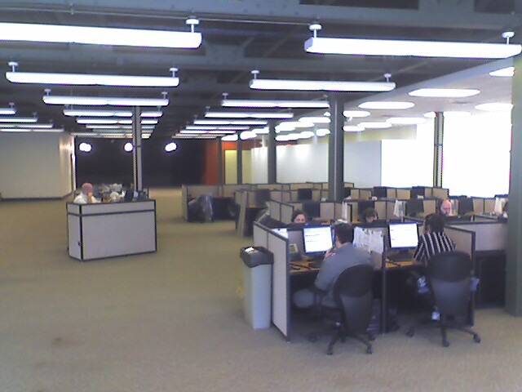
X
Management Information Systems
Taken from slide by Wildish & Howell, UCISA CISG 2008
http://www.flickr.com/photos/pwz/2096587340/sizes/o
http://www.flickr.com/photos/pwz/2096587340/sizes/o

Slide 7
Management Information Systems
“Our needs”
“Business Processes”
“Security”
“Risk analysis”
“Data Protection”
Taken from slide by Wildish & Howell, UCISA CISG 2008
http://www.flickr.com/photos/pwz/2096587340/sizes/o
http://www.flickr.com/photos/pwz/2096587340/sizes/o

Slide 8
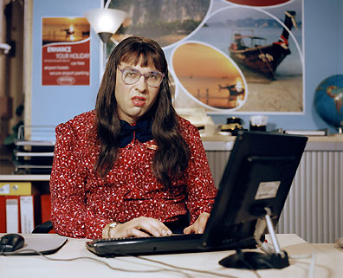
“Computer Says No”
Computer Says No!
Time to ditch this catch phrase
X

Slide 9
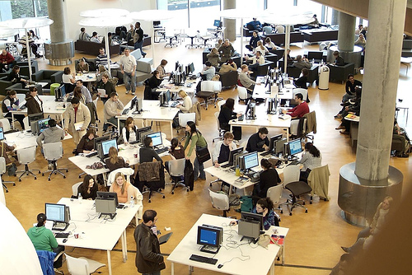
IT Service Culture
Traditionally the need to:
Manage scarce resources
Ensure resources used for ‘scholarly purposes’

Slide 10
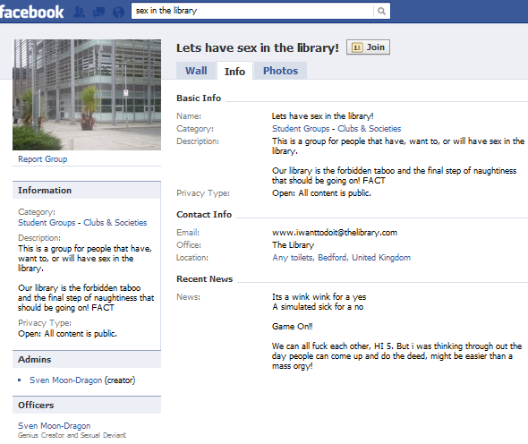
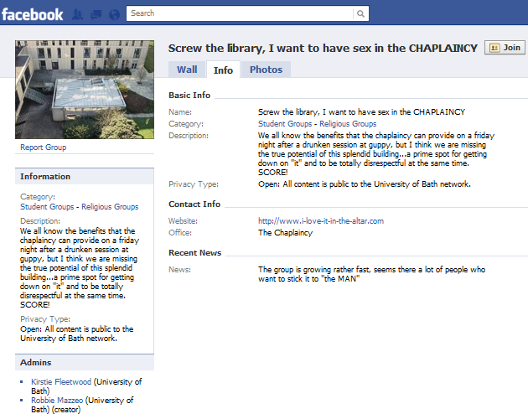
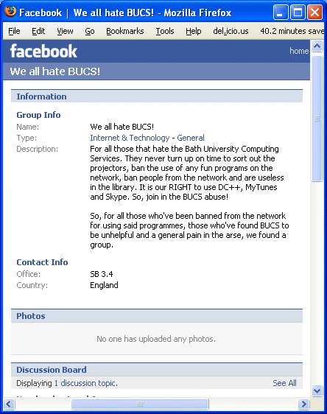
What Is Social Media?
Technologies which:
Distract for teaching, learning & research purposes
Can be used to bully (including staff)

Slide 11
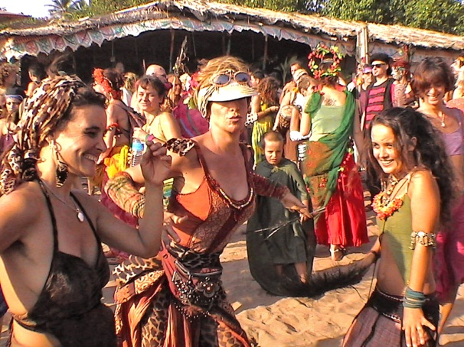
The Problem With ‘Social’
Does ‘Social’ mean:
Trivial
Personal
Unrelated to academia
Or:
Collaborative
Collective
Team working
The term social refers to a characteristic of living organisms as applied to populations humans and other animals. It always refers to the interaction of organisms with other organisms and to their collective co-existence, irrespective of whether they are aware of it or not, and irrespective of whether the interaction is voluntary and involuntary.
Wikipedia

Slide 12
Redefining ‘Social’
Social media / Social web:
Collaborative technologies
Interactive technologies
which support:
Social constructivism / social constructionism theories of knowledge: “individual's learning that takes place because of their interactions in a group”

Slide 13
Another View
Social networks get better as numbers increase (cf telephones) Remember 1-9-90 rule.

Slide 14
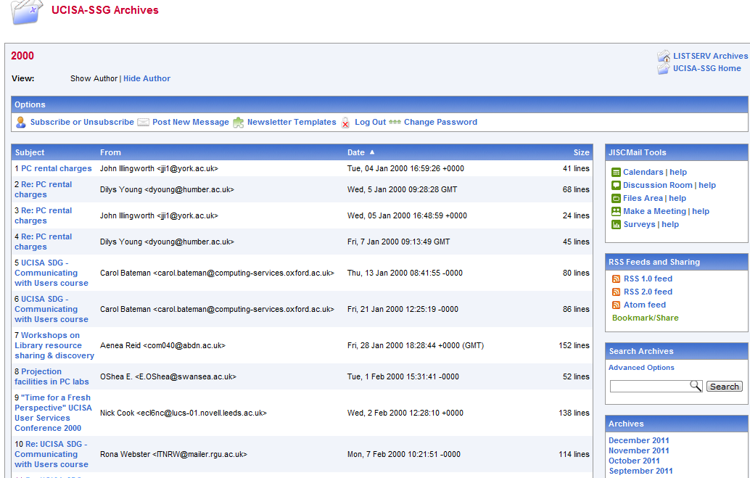
Collaboration & IT Services
JISCMail lists
UCISA events
…

Slide 15
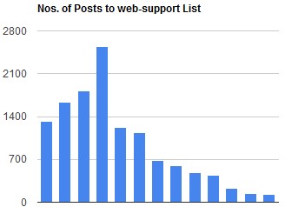
Today’s Environment
Today we are seeing:
Decline in mailing lists
Better understanding of diversity of needs: (indicating, informing, alerting, sharing, collaborating, critiquing, …)
Wide variety of social media tools for carrying out diversity of functions (e.g. Twitter for indicating: “About to install Debian. Any1 else done this?”
List now used mainly for ads for events, jobs, etc.
1999-2011
See posts on The Decline in JISCMail Use Across the Web Management Community and Are Mailing Lists Now Primarily A Broadcast Medium?

Slide 17
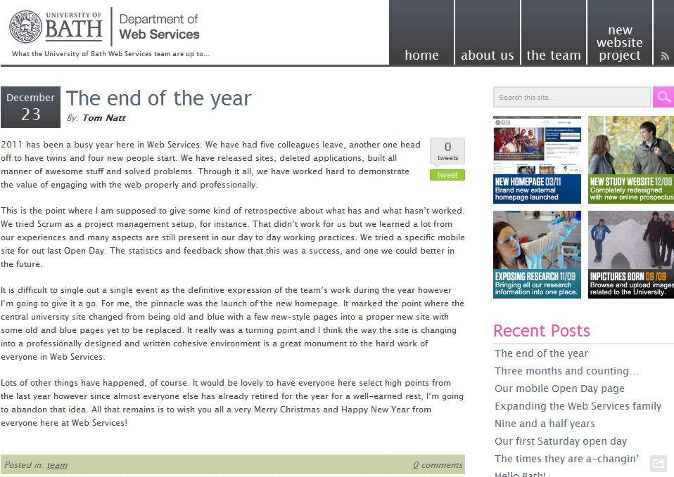
Blogging
Blogging provides an easy-to-use way of providing public documentation

Slide 18
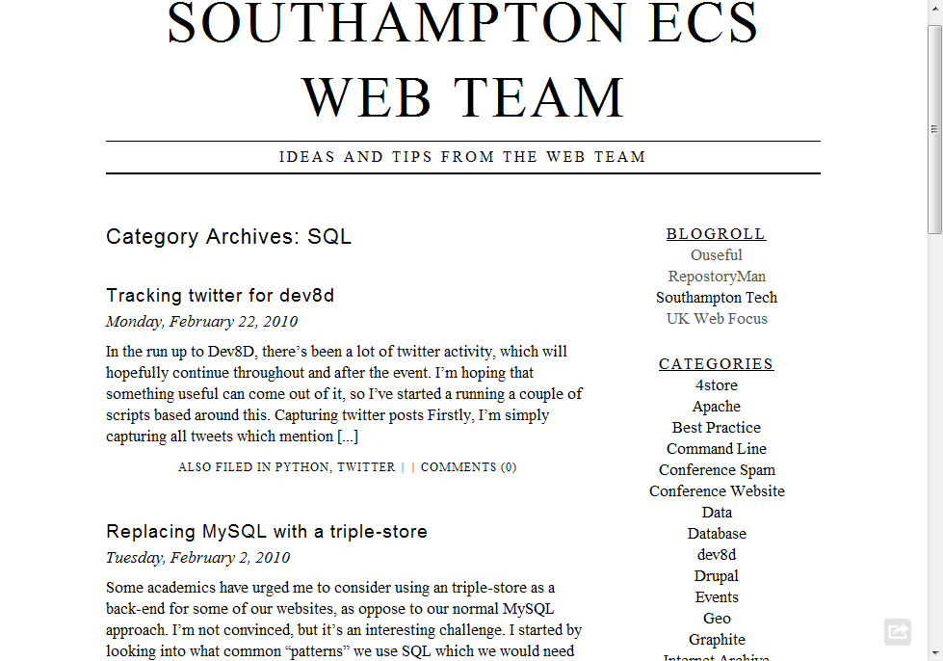
Blogs can also be technical

Slide 19
There are many social media services but we can’t ignore Twitter!

Slide 20
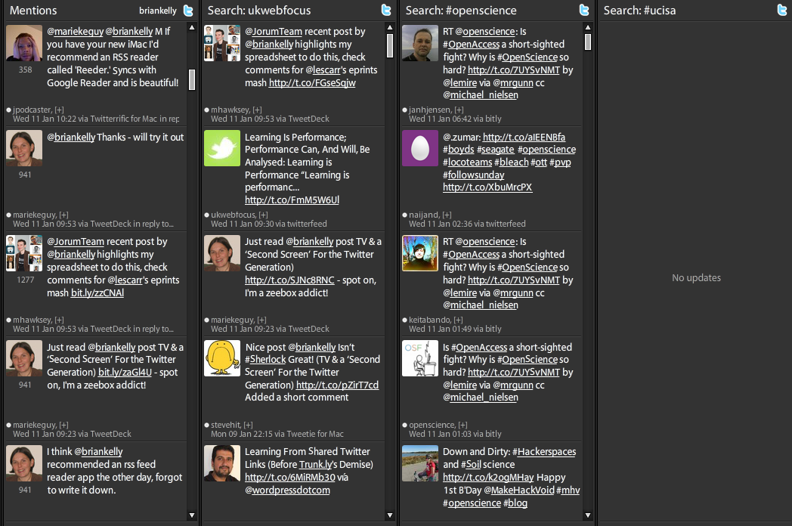
Twitter
A dedicated Twitter client can provide rich filtering.
How have people got the time to read and write long emails? ☺

Slide 21
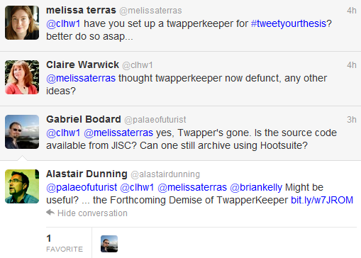
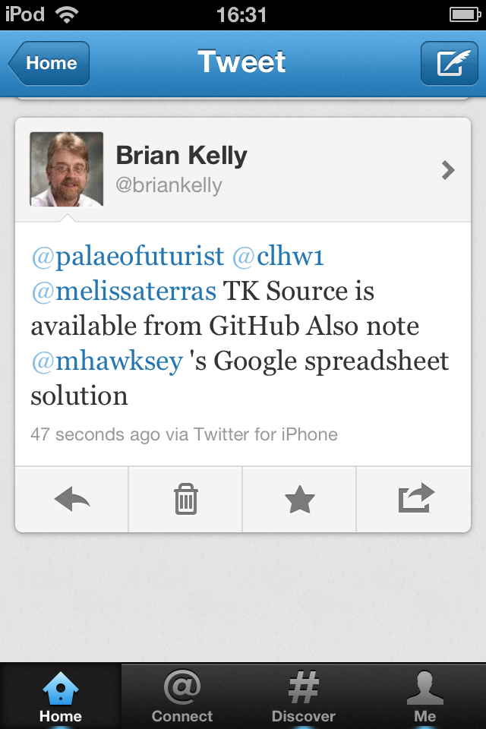
Rapid Support from Peers
Twitter can provide rapid support from one’s professional learning network (PLN)
3:58pm
4:17pm
4:23pm
4:30pm
4:27pm
To maximise opportunities you need to develop filtering skills (e.g. click ‘Read all’ in Twitter client)

Slide 22
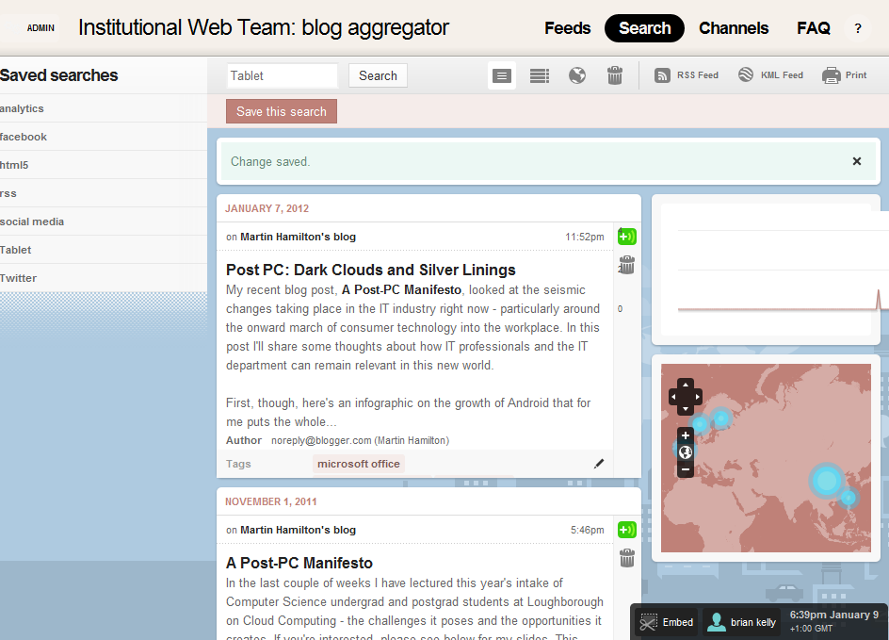
Filtering is the Challenge
Don’t fail to write because you’re worried that people will be too busy to read. Filtering tools are available.
[Need more posts on ’tablet computers’.]

Slide 23
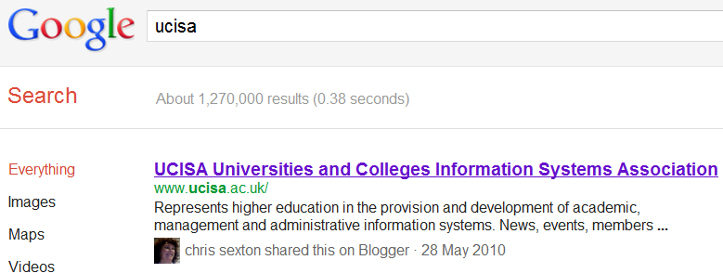
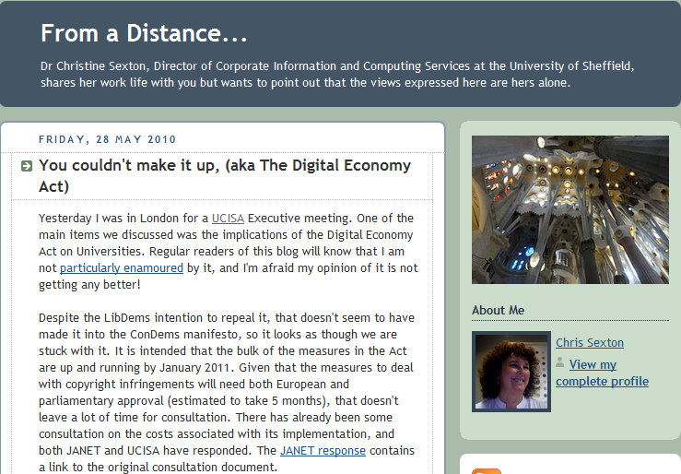
Social Search
“Know any good pubs in Birmingham?”
Who do you ask:
Google?
Your friend, whom you trust?
Invisible Library Support – Now You Can’t Afford Not to be Socials?
“you could start to make frictionless recommendations by influencing the search engine results returned to your patrons ”
Tony Hirst, ouseful.info blog
Privacy implications: so use e.g. Ixquick for anonymous searching

Slide 24
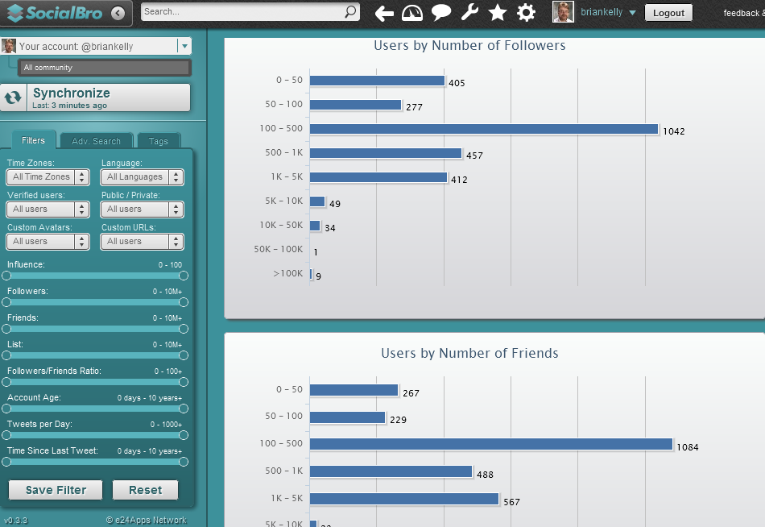
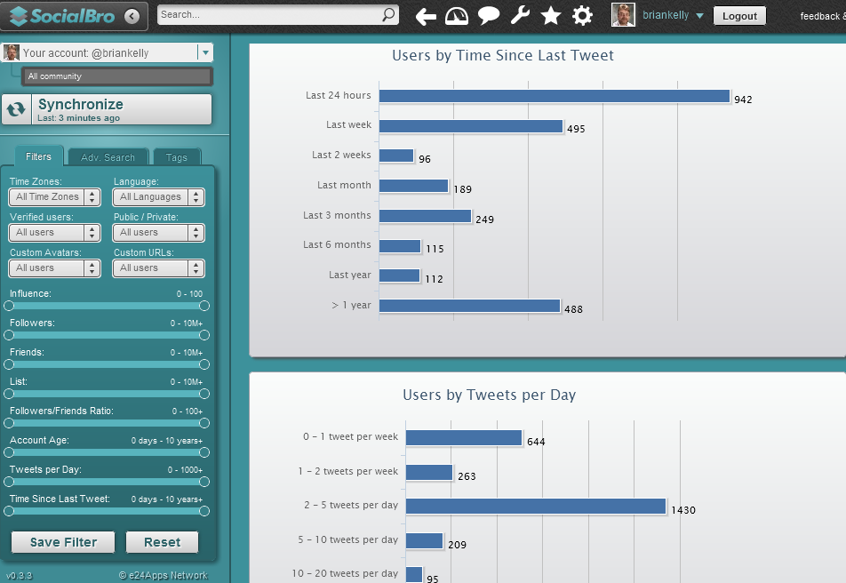
Understanding Social Media
We need to understand how we use social media in order to identify successful patterns
Info captured on Mon, 9 Jan 2012

Slide 25
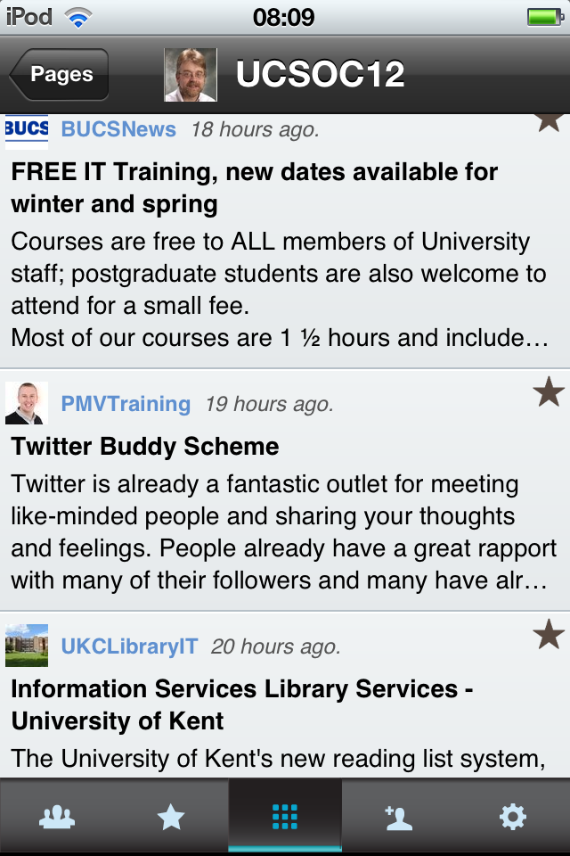
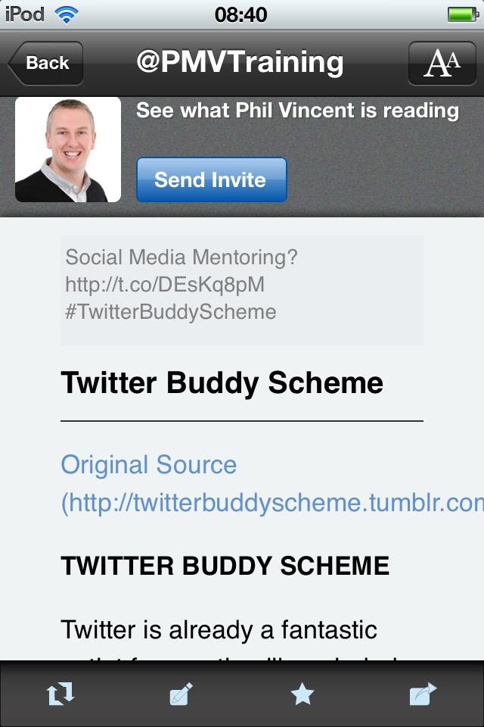
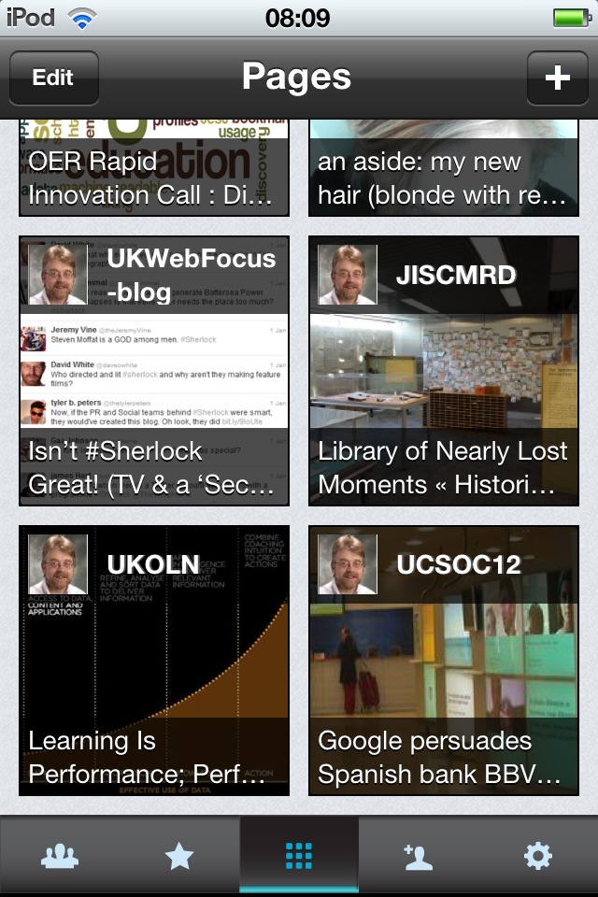
The Mobile Environment
Access to information on Mobile Devices is growing in importance
Personalised newspapers (Smartr, Flipboard, etc.) provide access to RSS feeds, tweets, etc. on mobile devices.
This is a few of the links tweeted by members of my Twitter lists (formal JISC twitter accounts; JISCMRD projects; UCSOC12 participants; …)
Twitter provides access to quality resources selected by people I have chosen to follow (plus serendipitous resources)

Slide 26
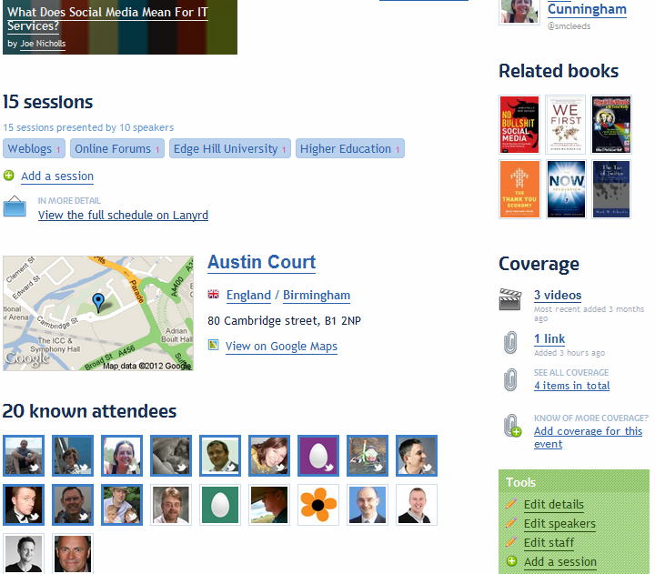
Growing Your Community
The challenge:
Developing connections with peers
The opportunity:
Join Twitter
Follow others (via Lanyrd page for event )

Slide 27
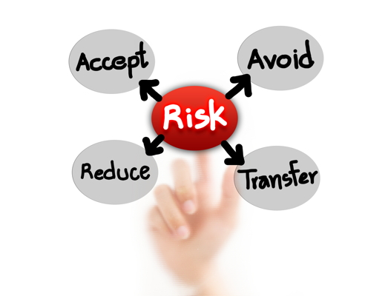
Challenges (1)
Concerns:
“I’m too busy”
Nonsense! 5 tweets a day?
“I wouldn’t know what to say”
First tweet is the hardest.
“My boss disapproves”
Is this still the case?
“Access is blocked”
Is this still the case?
“I don’t agree that there are benefits”
Still need for case studies & evidence

Slide 28
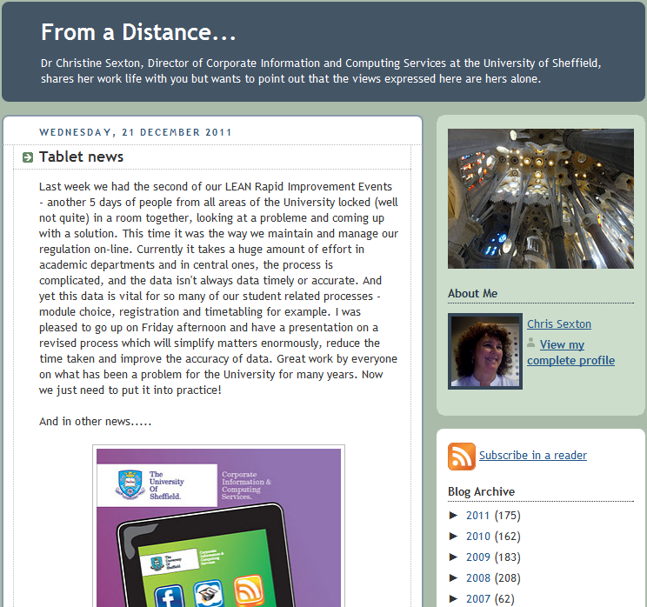
Too Busy To Blog?
Chris Sexton, IT Services Director at Sheffield University and former UCISA chair posts ~3 posts per week over ~5 years.

Slide 29
Challenges (2)
“I’ll get addicted”
That’s a challenge of success!
“I can’t keep up with tweets, & blog posts ☹”
“I want to blog. How do I start?”
“I can see the merit – but it’s not for me”

Slide 30
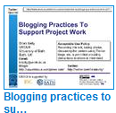
Challenges (2)
“I’ll get addicted”
That’s a challenge of success!
“I can’t keep up with tweets, & blog posts ☹”
Don’t! It’s a stream for you to dip into and contribute to. Learn when it’s useful to take a dip
“I want to blog. How do I start?”
See UK Web Focus blog & talk
“I can see the merit – but it’s not for me”
OK – but don’t block others who wish to do it
”Plants” and “Resource investigators” in Belbin model may welcome opportunities provided by social media

Slide 31
UCISA Community of Practice
Community of Practice (from Wikipedia):
Group of people who share a craft and/or a profession.
Can evolve naturally because of the common interests in a particular area, or can be created specifically with the goal of gaining knowledge related to their field.
Through the process of sharing information & experiences with the group that the members learn from each other, and have an opportunity to develop themselves personally and professionally

Slide 32
UCISA Community of Practice
Social media provides opportunity to develop an effective community of practice:
Open sharing of resources, experiences, successes & failures
Exploit sectors expertise in IT
Ability to inform users of experiences gained
Ability to use experiences in personal lives
Keep aspect is culture of openness: a willingness to share, rather than the technologies
Photo from http://www.flickr.com/photos/mag3737/1914076277/

Slide 33
Conclusions
Social Web:
Is about communication, community & collaboration
Can get better as numbers of users reaches critical mass
Provides diversity of tools for differing requirements and preferences
Will not go away; will grow!
Opportunity for IT Services to play a leading role
Openness fits with transparency agenda
And the Sex in the Library; Screw the Library, Let’s Have Sex in the Chaplaincy and We All Hate BUCS! Fb groups quickly became defunct

Slide 34
Questions
Any questions or comments?

