Slide 1
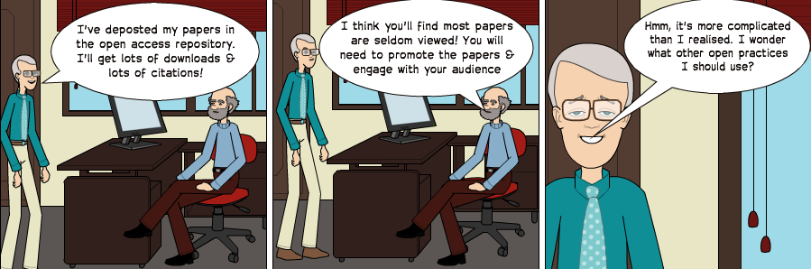
Open Practices for the Connected Researcher
Managing Your Research Profile
Workshop facilitated by Brian Kelly, UKOLN on 25 June 2013 for an Information Science Pathway's Day event on “Alt-metrics: Achieving and Measuring Success in Communicating Research in the Digital Age” held at the University of Edinburgh
Presentation by Brian Kelly, UKOLN on 25 October 2012 for an Open Access Week event at the University of Exeter

Slide 2


Managing Your Research Profile: Introduction
http://www.ukoln.ac.uk/web-focus/events/workshops/sgs-dtc-edinburgh-2013-06/
Brian Kelly
UKOLN
University of Bath
Bath, UK
Acceptable Use Policy
Recording this talk, taking photos, having discussions using Twitter, etc. is encouraged - but try to keep distractions to others minimised.
Blog:
http://ukwebfocus.wordpress.com/
Twitter: @briankelly / @ukwebfocus
UKOLN is supported by:
Caveat: images may not be available with a CC licence. Where possible, links to source of images are provided to help you assess risks of reuse.
This work is licensed under a Create Commons Attribution 2.0 licence (but note caveat)

Slide 3









Idea from Cameron Neylon
You are free to:
copy, share, adapt, or re-mix;
photograph, film, or broadcast;
blog, live-blog, or post video of
this presentation provided that:
You attribute the work to its author and respect the rights and licences associated with its components.
Slide Concept by Cameron Neylon, who has waived all copyright and related or neighbouring rights. This slide only CCZero.
Social Media Icons adapted with permission from originals by Christopher Ross. Original images are available under GPL at:
http://www.thisismyurl.com/free-downloads/15-free-speech-bubble-icons-for-popular-websites
3

Slide 4
About Me
Introduction
Brian Kelly:
  UK Web Focus: national advisory post to UK HEIs
  Long-standing Web evangelist (since 1993)
  Based at UKOLN at the University of Bath
  Prolific blogger (1,100+ posts since Nov 2006)
  User of various devices to support professional (and social) activities
  Prolific speaker (~400 talks from 1996-2012)
Research profile:
  Peer-reviewed papers published on Web accessibility, standards, preservation, …
  Largest no. of downloaded papers from Bath IR
  Highly-cited papers in Web accessibility (e.g. W4A)

Slide 5
About This Workshop: Aims
Introduction
Session aims:
Provide an understanding of how social media can:
  Enhance the visibility of research outputs
  Enable researchers to develop their professional networks with their peers & potential collaborators
  Provide mechanisms for observing & participating in discussions about one’s research
This session also provides an opportunity to:
  Use of a variety of social media tools e.g. LinkedIn, ResearchGate, Academia.edu, Twitter, …
  Monitor interest in research outputs
  Understand strengths & limitations of such metrics
  Appreciate personal, cultural & other barriers

Slide 6
Learning Objectives
By the end of the session you should:
  Be aware of the importance of being able to develop your professional network and maximise awareness of your research outputs
  Have made use of a variety of tools which can support these aims
  Be aware of the need to be able to evaluate effective usage of such tools
  Have made use of a variety of tools which can support these aims

Slide 7
About This Workshop: Format
The format of the workshop session:
  Open: Resources are available with a Creative Commons licence
  Interactive: There will be an opportunity for hands-on use of the tools and services described
  Participative: Participants will be encouraged to:
    Ask questions
    Provide examples of their use of social media
    Be sceptical – ask questions if you are uncertain or doubtful

Slide 8
About This Workshop: Timetable
Timetable (subject to change)
Time | Title | About
13.30-13.35 | Introduction
13.35-13.45 | About You
13.45-14.00 | Social Media – Why Is It Valuable? | Case studies
14.00-14.45 | Doing it for yourself (part 1) | Hands-on exercises
14.45-15.00 | Coffee break
15.00-15.45 | Doing it for yourself (part 2) | Exercises
15,45-16.00 | Reflections
16.00-16.15 | What About The Barriers?
16.15-16.25 | Open Discussion
16.25-16.30 | What Next?
16.30 | Close

Slide 9
About You
Please introduce yourself and summarise your interests
  Your name
  What you do
  Your previous use of social web tools
  What you hope to gain from today’s session

Slide 10
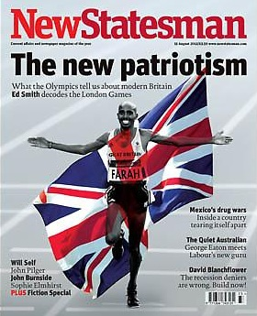
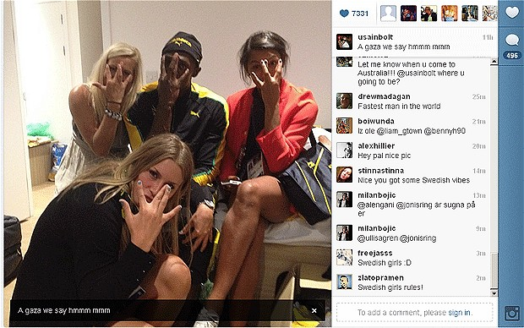
Are you a Roundhead or a Cavalier?
Are you a Roundhead or a Cavalier?
“In the century, Britain was devastated by a civil war that divided the nation into two tribes – the Roundheads and the Cavaliers. The Cavaliers represent a Britain of panache, pleasure and individuality. They are confronted by the Roundheads, who stand for modesty, discipline, equality and state intervention.”
Who do you admire most?
  Mo Farrah for winning the 5,000 and 10,000m?
  Usain Bolt for partying with Swedish handball team after winning 100m, & before 200m & relay?

Slide 11

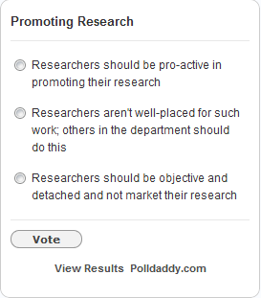
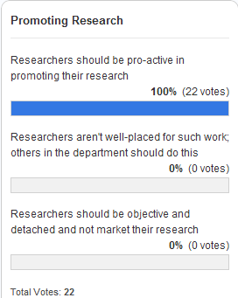
Do You Want to Change the World?
Introduction
“Hitherto, philosophers have sought to
understand the world; the point, however,
is to change it”
Do you seek to change the world through your research or simply understand the world:
  Will you want to market your research?
  Will you want others to market your research?
  Will you have a detached view of your research?

Slide 12
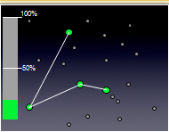
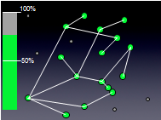
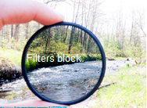
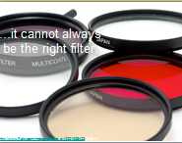
“It’s About Nodes and Connections”
Introduction
Cameron Neylon keynote at OR 2012:
“Networks qualitatively change our capacity”
  With only 20% of a community connected only limited interaction can take place
  This increases drastically as numbers of connected nodes grows
Examples:
  Phone networks (no use with only 1 user!)
  Tweeting at this event
  Galaxy Zoo
“Filters block. Filters cause friction”
Need for client-side, not supply-side filters.

Slide 13


SEO (Search Engine Optimisation)
Web sites
Google
(Live Search
Bing, …)
Real
world
Databases
Summary of key approaches:
  Apply various techniques to Web resources to make resources easier to find in Google, …
  Resources may include organisational Web suites, third party Web sites, databases, …
  Resources may also include real world objects and ideas (i.e. your museum, your research ideas, …)
  Based on understanding of importance of Google to end users
Directories

Slide 14



Beyond SEO, SMO
Web sites
Social Services
(Facebook,
Slideshare,
Twitter, …)
Real
world
Databases (e.g. IRs)
Summary of key approaches:
  Make use of social networking services which people may use of discuss your services
  Services may include Facebook, LinkedIn, Slideshare, Twitter, …
  No need to touch your Web sites (therefore useful if you can’t!)
  Based on understanding of popularity of SNs and people’s interests in chatting and sharing
Directories

Slide 15
Give Me The Evidence!
The Evidence

Slide 16
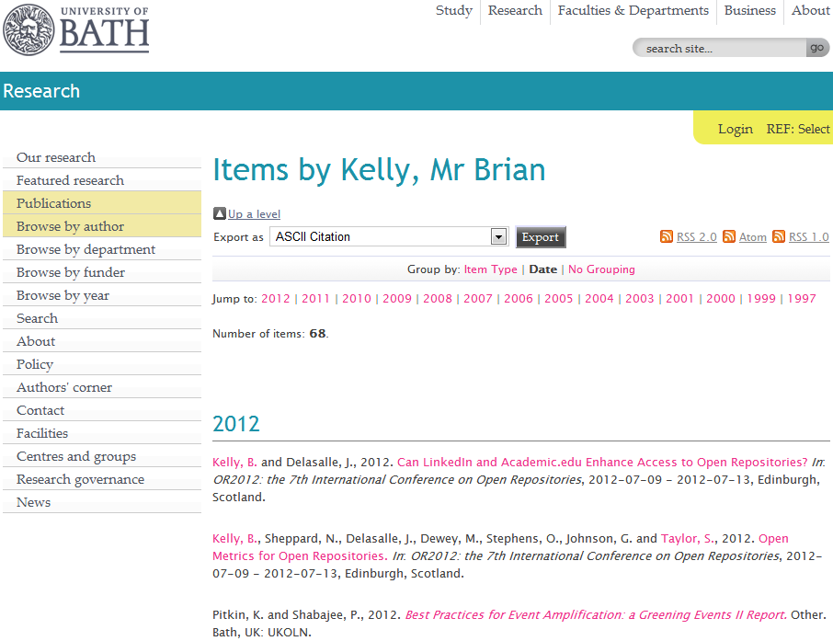
My Papers
My papers in the University of Bath Opus repository

Slide 17
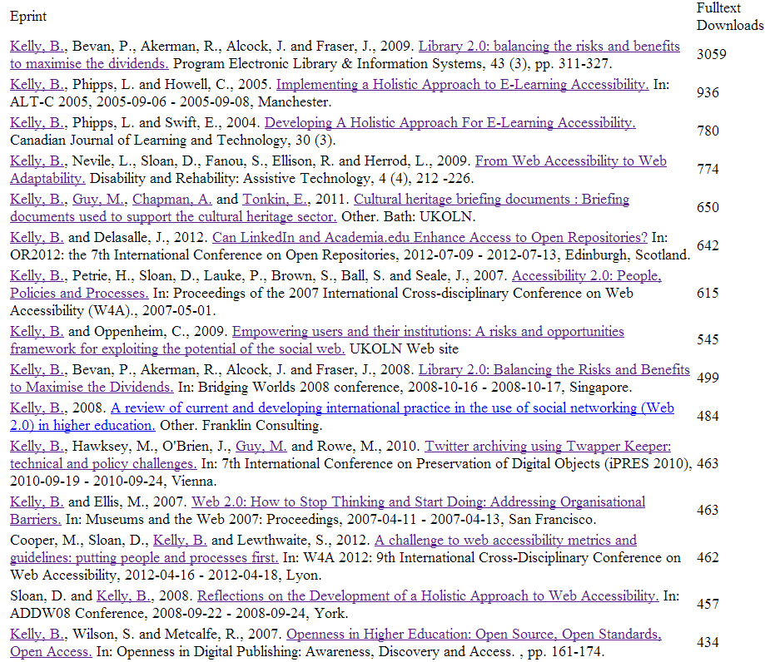
Open Access enhances access
Downloads for Brian Kelly
Download figures for my papers
11 Jun 2013

Slide 18
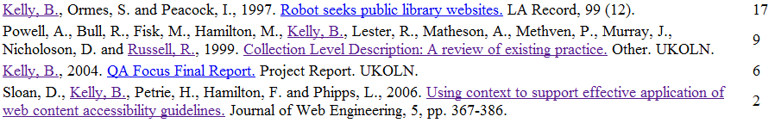
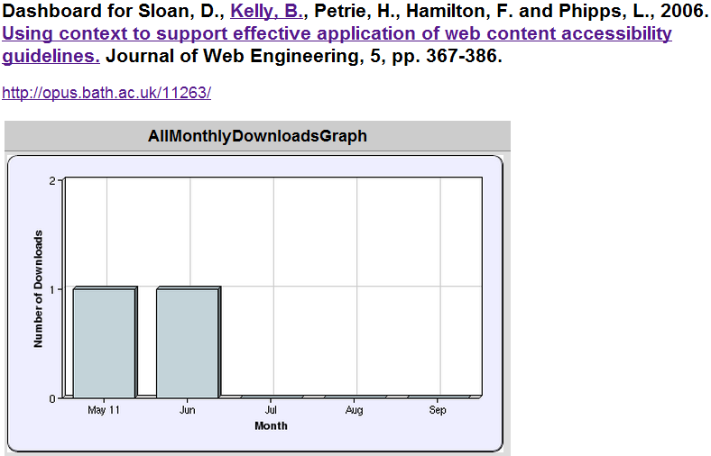
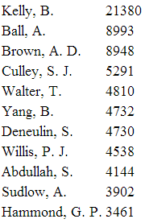
Least Downloaded Papers
Will papers in a repository be seldom seen?
What can be learn from approaches taken for the popular and unpopular papers?
Most downloaded papers in Bath IR

Slide 19
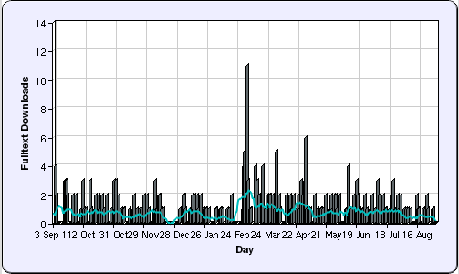
Learning From Success
Evidence
“Library 2.0: balancing the risks and benefits to maximise the dividends”
Sixth most downloaded paper in repository ☺
But only recent download statistics available ☹
2012

Slide 20
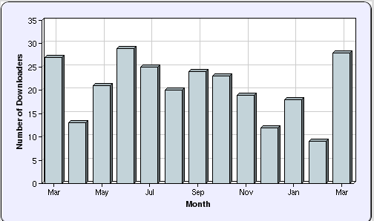

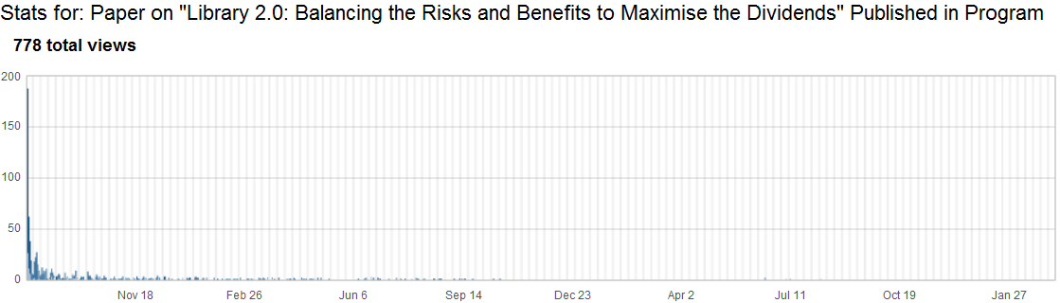

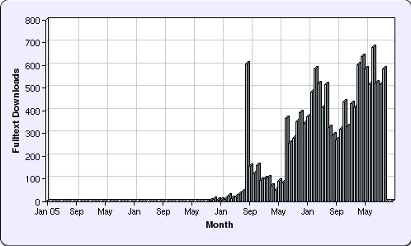
Evidence
Evidence
How do we find out more?
  Peak statistics for repository
  only available for 1 year
But:
  Blog post about availability in Opus published on 11 August 2009
Further investigation (of all my paper downloads) confirms large peak in August 2009
Conclusion: Blog post responsible for initial popularity

Slide 21
Beyond the Edge Cases
Evidence
Little-downloaded paper:
  Uploaded to repository 6 years after paper written
  I was not lead author
  Only PDF version uploaded
  Never blogged about; never tweeted
Most popular paper:
  Available in IR on launch of journal issue
  I was lead author
  Blog post published on day of launch
  Available in PDF, MS Word & HTML formats
  Link to paper subsequently tweeted & retweeted
  About Web 2.0, so likely to be read by bloggers
But what about the majority of papers?

Slide 22

SEO or SMO
Evidence
SEO:
  Helping Google find your papers through:
    Writing style, document structure, …
    In-bound links
SMO:
  Helping other people find your papers through:
    Viral marketing
    Sharing on social media services
SMO: Good for new papers, but not relevant for popular papers written from 2004-8
SEO: Document structure consistent. Difference appears to be significant nos. of in-bound links

Slide 23
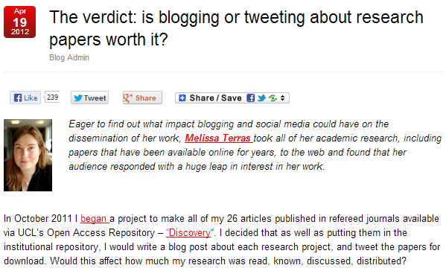
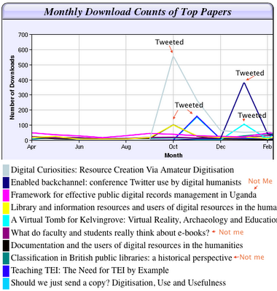
Further Evidence
Blog post by Melissa Terras, 19 April 2012
The findings

Slide 24
Tip No. 1: Be Pro-active
Try it for yourself
Tip No. 1:
Be pro-active

Slide 25
Hands-on Session
Exercises:
  A: Core Services: search and CVs
  B: Resource sharing services
  C: Researcher identifier services
  D: Researcher profile services
  E: Blogs
  F: Twitter analytics services
  G: Twitter metrics
  H: Altmetric tools and services
  I: Citation analysis

Slide 26
Tip No. 7: Develop Your Network
About The Hands-on Exercises
Tip No. 5:
Develop your network

Slide 27
A: Core Services (Google and CVs)
Exercises
Google:
  Good/popular at search (general & research)
  Not so good at social services
  But “Google+ isn’t a social network: it’s the Matrix”
LinkedIn:
  Most widely used CV services
  Very popular in the US
  Provides Googlable results for individuals
  What future employers / collaborators may find about you
  Simple to create a CV and provide links to key resources

Slide 28
B: Resource Sharing
Exercises
Resource-sharing:
  Part of a culture of openness
  Can develop a network around resources shared (music, photos, etc. as well as research resources)
Slideshare:
  Enhance the audience for your talks
  Embed research presentations in teaching and learning context (34K views for Goble’s slides )
  Metrics available (and used in altmetrics context)
Delicious:
  Sharing bookmarks
  Dated – but may revive?
  Used in altmetrics context

Slide 29
C: Researcher ID services
Exercises
Researcher identifier services:
  Avoid ambiguities (Dr John Smith)
  Associate papers with researcher
  Explore connections (co-authors, …)
  Can be used by altmetrics tools
Tools:
  Initially proprietary / discipline-specific
  Open solution: ORCID
  Takes 30 seconds to claim ORCID ID
  Why would you not claim an ORCID ID?

Slide 30
D: Researcher Profile Services
Exercises
Researcher profile services:
  Who’s working in my area of research?
  What have they published?
and beyond:
  What are they talking about?
  What are they reading / bookmarking?
Examples:
  ResearchGate (aggressive in contacting co-authors?)
  Academia.edu
  Mendeley (?)

Slide 31
E: Blogs
Exercises
Using blogs:
  Engage in discussions with peers
  Disseminate (impact)
  Provide Google juice (inbound and to resources elsewhere)
Issues:
  Does it come naturally?
  Do you want to set up your own blog? (NB you can do it in 60 seconds on Wordopress.com)
  Do you want to contribute to community blogs?

Slide 32
F: Twitter Metrics
Exercises
Twitter metrics :
  How am I doing with my use of Twitter?
  How have things evolved over time?
  How well do I engage with others?
  Do others share my tweets?
Tools:
  Topsy (I use to provide evidence of tweets to my resources)
  Tweetreach shows potential reach
  Twentyfeet shows trends (but free version sends a tweet weekly)

Slide 33
G: Twitter Analytics Services
Exercises
Twitter analytics services:
  How do I compare with others?
  What is the ‘score’ for my use of Twitter, Facebook, …?
  Algorithms may be relevant in other uses of social media (celebrities, advertising, …)
  May be ‘gamed’ e.g. encourage spam followers
  But are altmetric services similar?
Twitter analytics services:
  Klout: best-known
  PeerIndex: used in survey of institutional Twitter use, but functionality has changed.

Slide 34
H: Altmetric Tools
Exercises
Altmetric tools:
  Growing interest in (some sectors) for use by researchers
  May be relevant for (a) researchers; (b) co-authors; (c) funders; (d) publishers; …
  Trust is a big issue
  Cf top University league tables
Tools:
  ImpactStory
  Altmetric.com
  …

Slide 35
I: Citation Analysis
Exercises
Citation analysis tools:
  Tools such as Google Scholar and Microsoft Academic search can provide:
    Citation analyses e.g. h-index
    Visualisations of co-authors
  But
    Automatically-harvested data may be incorrect
    Edits to data may be time-consuming or not accepted

Slide 36
Tip No. 1: Be Pro-active
Implementation Plan
Tip No. 1:
Be pro-active

Slide 37
W4A 2012 Paper
Implementation
Case study:
  Paper on “A challenge to web accessibility metrics and guidelines: putting people and processes first” given at W4A 2012 conference in Lyon in Apr 2012
Four co-authors agreed:
  To collaborate in raising awareness of paper and presentation of the paper
How:
  Writing blog posts on or just before conference
  Participate on conference Twitter hashtag (e.g. responding to comments while speaker is presenting)
Benefits:
  Reaching out to a wider audience based on our 4 professional networks

Slide 38
Preparation
We:
  Uploaded paper to repository so URL was known
  Provided a link to the paper in speaker’s slides
  Uploaded holding slide to Slideshare so URL was known (slides were finalised shortly before talk)
We could then:
  Prepare blog posts in advance
  Create short URLs in advance
Implementation
Examples of approaches to follow

Slide 39
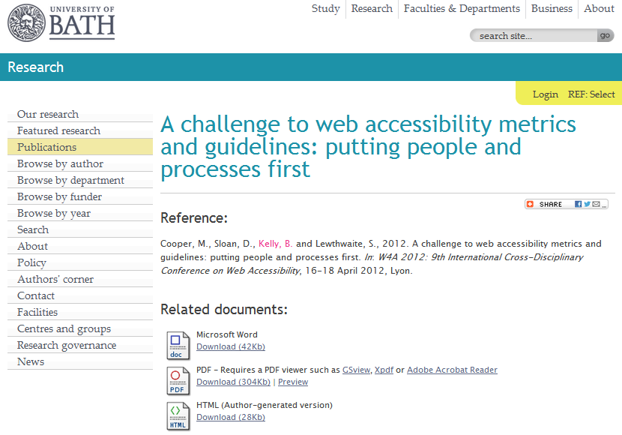
Opus Repository
Paper uploaded to Opus repository
Implementation
http://opus.bath.ac.uk/29190/

Slide 40
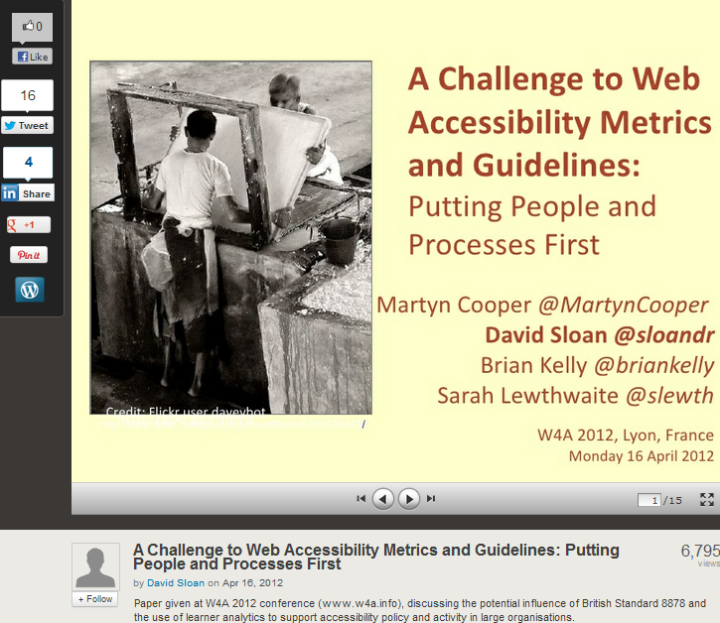
http://www.slideshare.net/sloandr/w4a12-coopersloankellylewthwaite
Implementation
Metadata provided to give context to slides

Slide 41
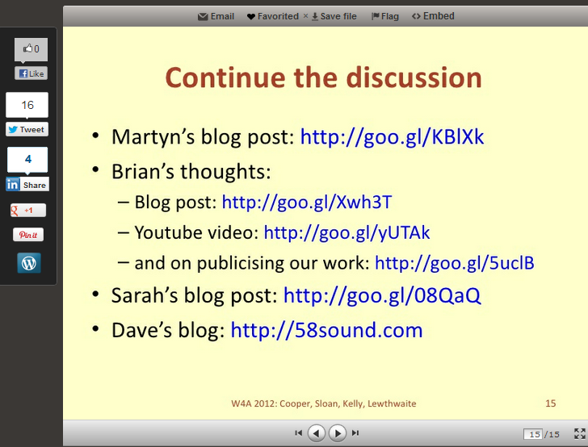
Implementation
Final slide provides (active) links to related work

Slide 42
Tip No. 3: Monitor What Works
Gathering and Interpreting Evidence
Tip No. 2:
Monitor what works (for you)

Slide 43
Capture Statistics
On 18 Apr 12:
  1,391 views on Slideshare
  Other slides had 3 and 311 views
By 24 Oct 12:
    7,247 views on Slideshare
“Lies, damned lies & statistics” – but my most downloaded paper in 2012

Slide 44
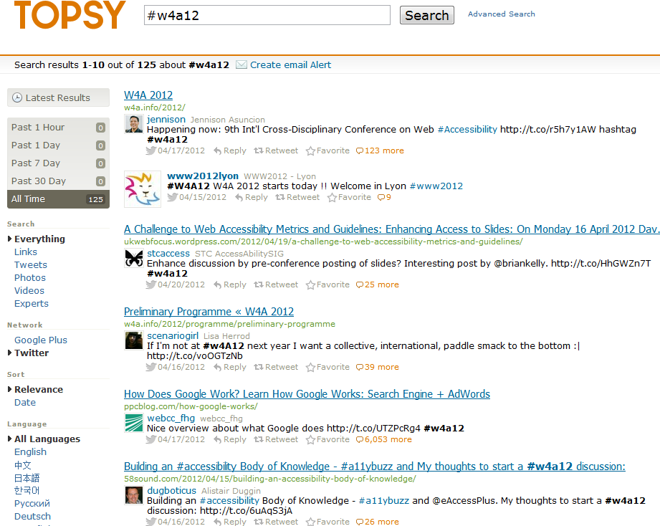
Topsy and Event Hashtag
Buzz around event hashtag captured by Topsy

Slide 45
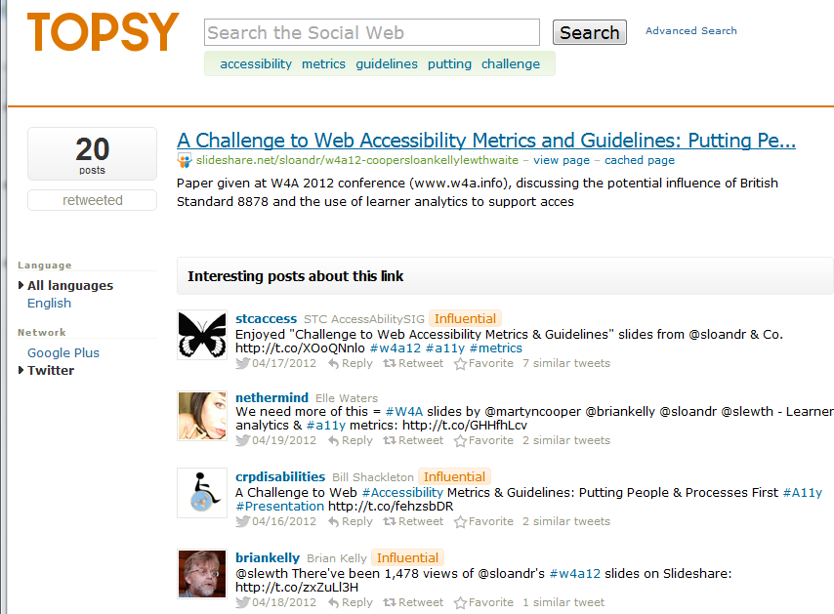
Topsy & Discussion About Slides
Topsy recorded discussions about slides

Slide 46
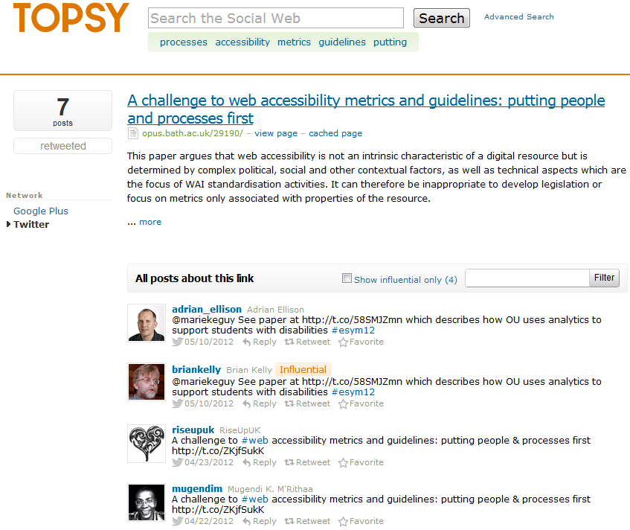
Topsy & Discussion About Paper
Topsy recorded discussions about paper
Note tweets about event (25) and slides (20) more popular than paper (7)

Slide 47
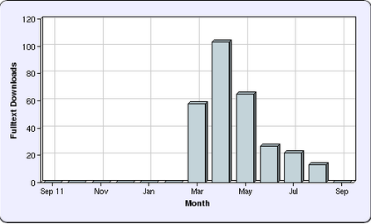
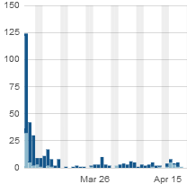
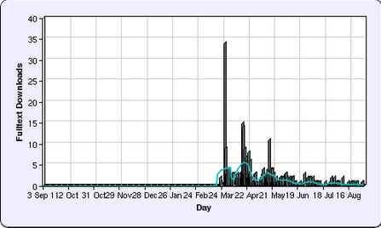
Repository Statistics
Opus repository stats:
  Views began in March (before conference). Publish on embargo date didn’t work!
  Largest downloads took place on 7 March, day blog post published
  Post about collaborative tools for writing paper, not contents of paper

Slide 48
Tip No. 4: Don’t Forget the Links!
Personal Professional Profiles
Tip No. 3:
Don’t forget the links

Slide 49
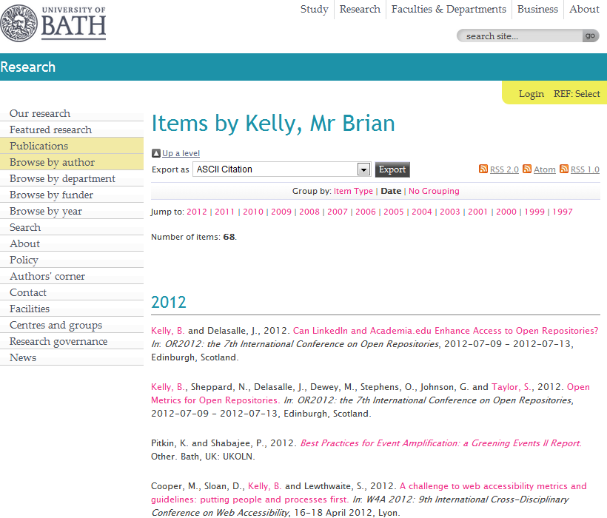
The IR
Your papers should be hosted on your institutional repository

Slide 50
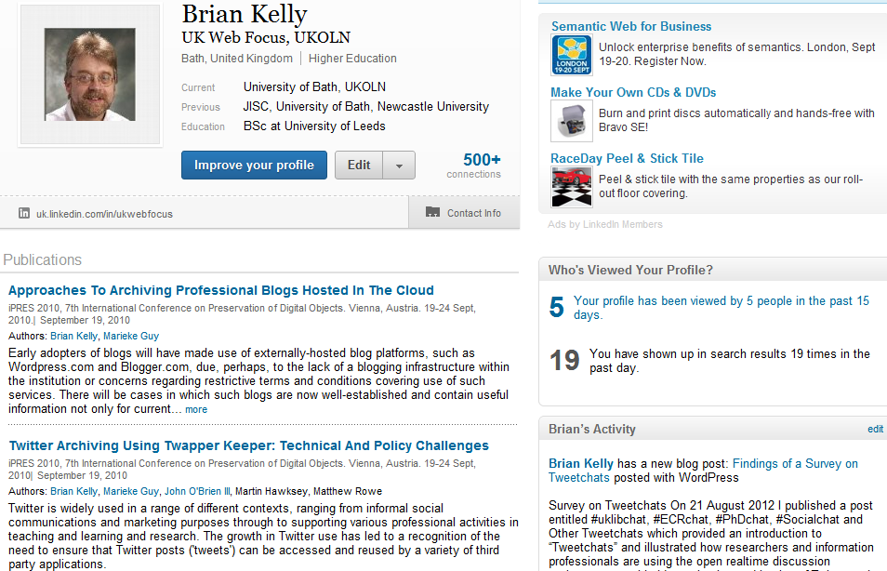
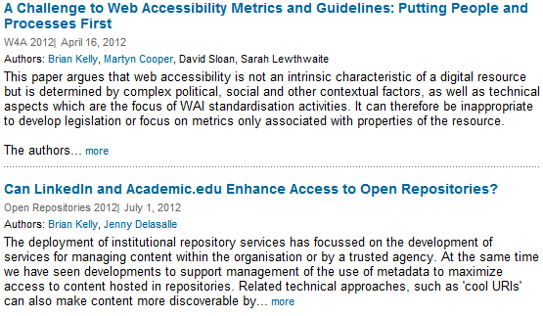
LinkedIn
Links to paper added to
  LinkedIn
  Academia.edu
  My pages on UKOLN Web site and blog
  …

Slide 51
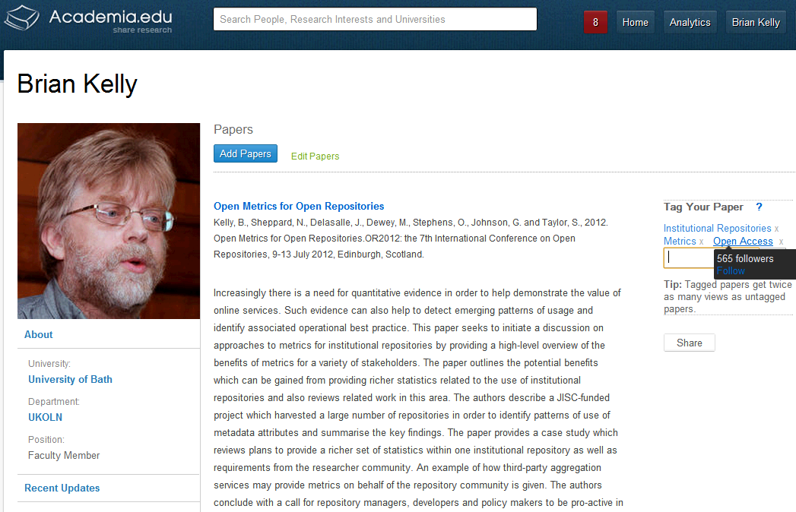
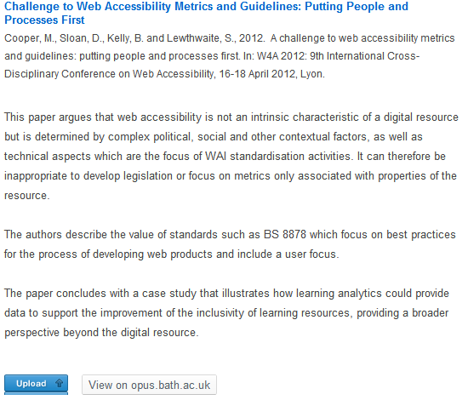
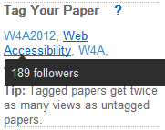
Academia.edu
Academia.edu
Academia.edu users may find my papers here and LinkedIn users in LinkedIn. Why would I make it difficult for them?
Note:
  Links to papers in IR (not uploaded)
  Importance of tags

Slide 52
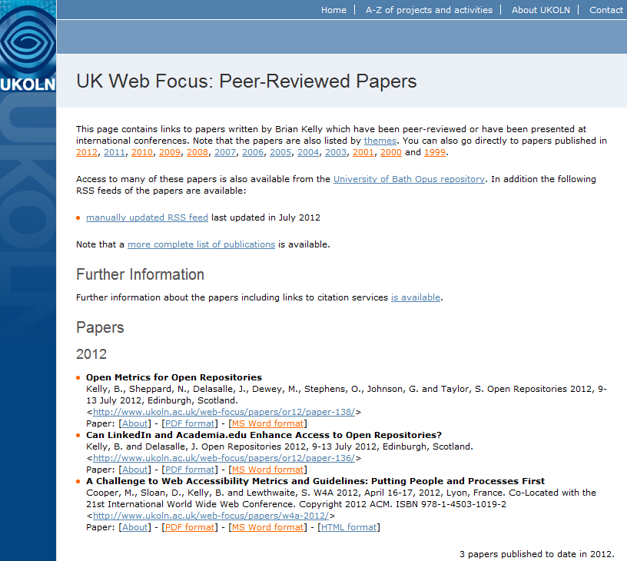
The Institutional Web Site
You may also wish to provide links on your institutional Web site
Note direct links to paper in various formats

Slide 53
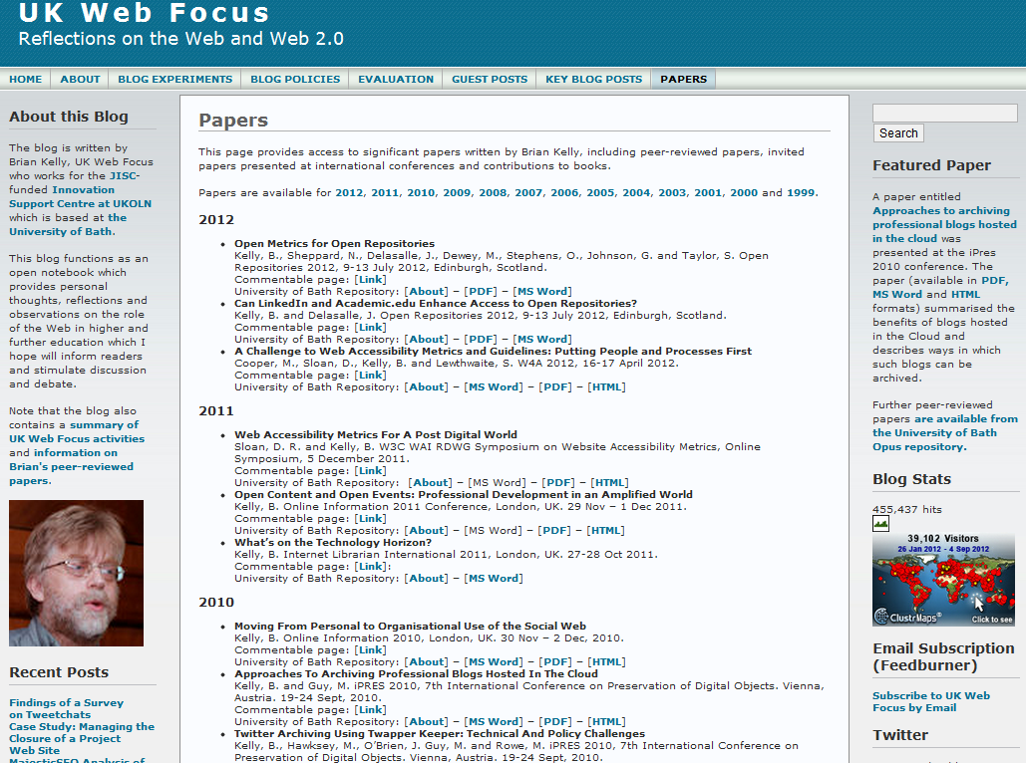
The Blog
If you have a blog you can provide links to your papers (again to all formats)

Slide 54
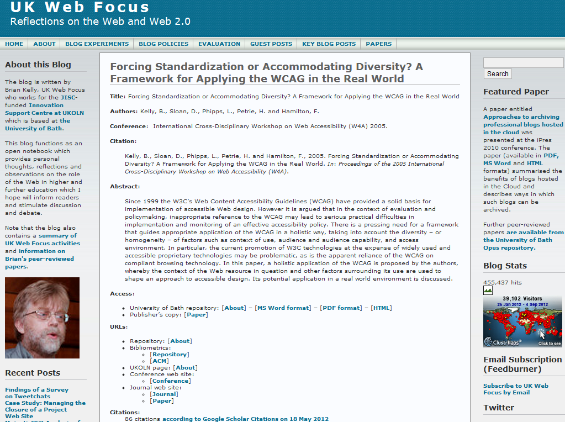
Commentable Pages on Blog
Recent development:
Commentable pages for papers with links to key resources (IR & publisher’s copy, metrics, citations, …)

Slide 55
Tip No. 5: Don’t Forget the Google Juice!
Importance of Google
Tip No. 4:
Don’t forget the Google juice!

Slide 56
Importance of Google
Context:
  Between 50-80% of traffic to IRs are from Google (may be higher if direct links to PDFs not recorded by Google Analytics)
What provides ‘Google juice’:
  On-page SEO techniques
  (structure, writing style, …)
  Links to pages, especially
  from highly-ranking sites

Slide 57
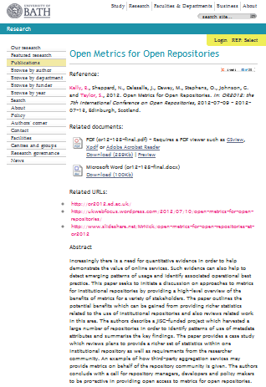
Importance of Google
Context:
  Between 50-80% of traffic to IRs are from Google (may be higher if direct links to PDFs not recorded by Google Analytics)
What provides ‘Google juice’:
  On-page SEO techniques
  (structure, writing style, …)
  Links to pages, especially
  from highly-ranking sites
What’s different about IRs?
  Same page structure
  Therefore importance of links
  to repository

Slide 58
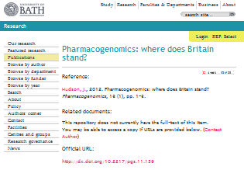
Importance of Google
Context:
  Between 50-80% of traffic to IRs are from Google (may be higher if direct links to PDFs not recorded by Google Analytics)
What provides ‘Google juice’:
  On-page SEO techniques
  (structure, writing style, …)
  Links to pages, especially
  from highly-ranking sites
What’s different about IRs?
  Same page structure
  Therefore importance of links
  to repository

Slide 59
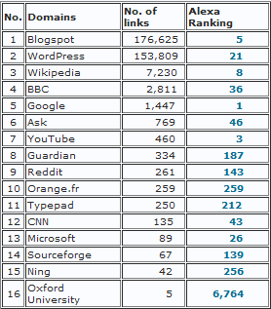
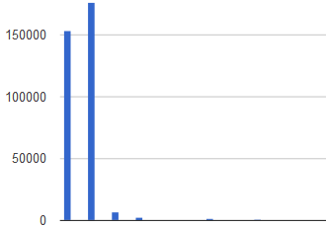
What Delivers Google Juice?
Survey of SEO ranking of 24 Russell Group IRs carried out in August 2012.
Findings:
  Google, YouTube, Blogspot, Wikipedia and Microsoft are highest ranking domains with links to IRs
Blogspot.com & WordPress.com have significantly larger number of links to IRs
Blogspot.com
Wordpress.com
Links from institutional domain (e.g. locally-hosted blogs) provide little Google juice!

Slide 60
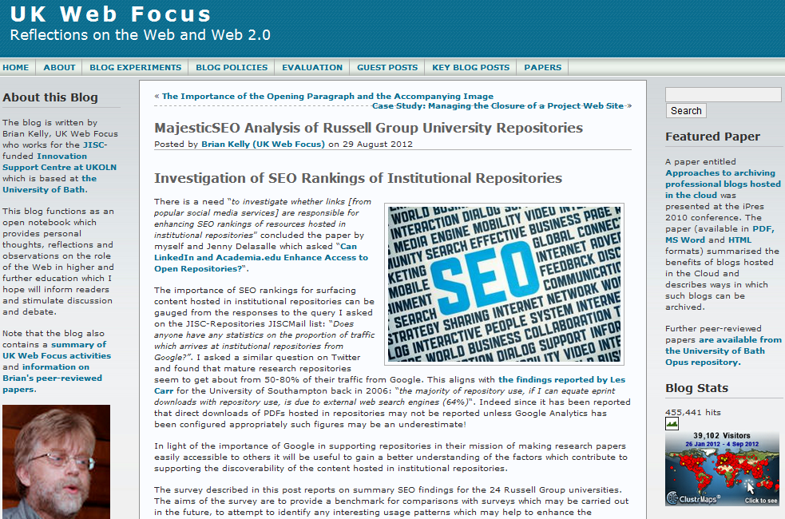
UK Web Focus has links to all papers
UK Web Focus has timely blog posts about papers
UK Web Focus blog has a rotating Featured Paper link

Slide 61
Health Warning!
Suggestions given can help to enhance the visibility of one’s research.
Highly visible and popular research is not necessarily an indication of quality!

Slide 62
Tip No. 7: Develop Your Network
Understanding and Addressing Barriers
Tip No. 5:
Develop your network

Slide 63
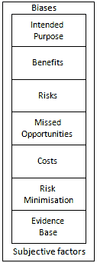
But …
But what about:
  Legal, ethical & privacy concerns
  My boss doesn’t approve
  My institution doesn’t approve
  It doesn’t work in my discipline
  It doesn’t work for me
Risks and opportunities framework:
  It’s not about ‘social media’ it’s about ‘social media for a particular purpose’
  Be clear of potential benefits & associated risks
  Remember the risks of not doing things
  There will be costs (but may be small)
  Adopt risk minimisation strategies
  Base decisions on evidence
  Be aware of biases and subjective factors

Slide 64
Tip No. 7: Develop Your Network
Discussion
Tip No. 5:
Develop your network

Slide 65
Discussion
Time for open discussion

Slide 66
Tip No. 7: Develop Your Network
Misc
Tip No. 5:
Develop your network

Slide 67
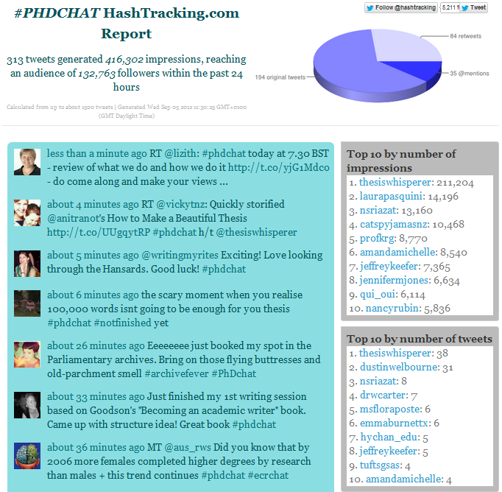
Tweetchat
Tweetchats:
  Discussions on Twitter
  Specific topic covered at specified time
  Use hashtags e.g. #PhDchat, #ECRchat Summary at
Survey findings:
  “give a community & shared space to explore ideas”
  “regular opportunity to network with a wide range of people I wouldn’t otherwise meet”
  “have very interesting and thought-provoking discussions/debate”

Slide 68
Conclusions
Be pro-active
Monitor what works for you
Don’t forget the links
Don’t forget the Google juice
Develop your network
Other important tips:
Encourage feedback and discussion
Understand your network
Know your limits
Seek improvements
Be ethical
Participate
More comprehensive version of this talk is available at http://www.ukoln.ac.uk/web-focus/events/seminars/exeter-open-access-week-2012/

Slide 69
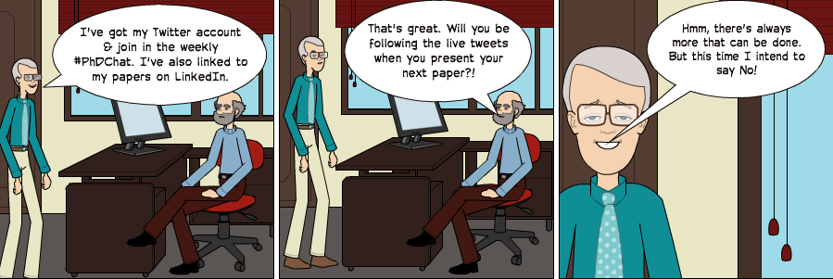
Any Questions?
Cartoon

