Slide 1
Open Practices for the Connected Researcher
Open Practices and Social Media for the Connected Researcher
Presentation by Brian Kelly, UKOLN on 25 October 2012 for an Open Access Week event at the University of Exeter
Presentation by Brian Kelly, UKOLN on 25 October 2012 for an Open Access Week event at the University of Salford

Slide 2
Open Practices and Social Media for the Connected Researcher
Twitter: #OAweek
http://www.ukoln.ac.uk/web-focus/events/seminars/salford-open-access-week-2012/
Brian Kelly
UKOLN
University of Bath
Bath, UK
Acceptable Use Policy
Recording this talk, taking photos, having discussions using Twitter, etc. is encouraged - but try to keep distractions to others minimised.
Blog:
http://ukwebfocus.wordpress.com/
Twitter: @briankelly / @ukwebfocus
UKOLN is supported by:
This work is licensed under a Create Commons Attribution 2.0 licence (but note caveat)

Slide 3
Idea from Cameron Neylon
You are free to:
copy, share, adapt, or re-mix;
photograph, film, or broadcast;
blog, live-blog, or post video of
this presentation provided that:
You attribute the work to its author and respect the rights and licences associated with its components.
Slide Concept by Cameron Neylon, who has waived all copyright and related or neighbouring rights. This slide only CCZero.
Social Media Icons adapted with permission from originals by Christopher Ross. Original images are available under GPL at:
http://www.thisismyurl.com/free-downloads/15-free-speech-bubble-icons-for-popular-websites
3

Slide 4
About Me
Introduction
Brian Kelly:
UK Web Focus: national advisory post to UK HEIs
Long-standing Web evangelist
Based at UKOLN at the University of Bath
Prolific blogger (1,140+ posts since Nov 2006)
User of various devices to support professional (and social) activities
Prolific speaker (~400 talks from 1996-2012)
Member of UKOLN’s Innovation Support Centre
ISC at UKOLN:
Supporting innovation across higher & further education
Funded by JISC

Slide 5
About This Talk
Introduction
Open access:
Benefits for researchers understood
Arguments will continue
This seminar goes beyond open access:
Open practices: sharing ideas on blogs
Open engagement: the role of Twitter
Dissemination: getting your research read
Gathering the evidence: social media metrics
Making it work: identifying best practices
This talk provides 5 tips for the connected researcher
Based on evidence gained from personal experiences

Slide 6
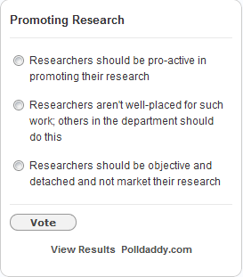
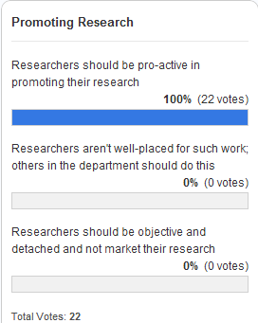
Are You A Marxist?
Introduction
“Hitherto, philosophers have sought to understand the world; the point, however, is to change it”
Do you seek to change the world through your research or simply understand the world:
Will you want to market your research?
Will you want others to market your research?
Will you have a detached view of your research?

Slide 7
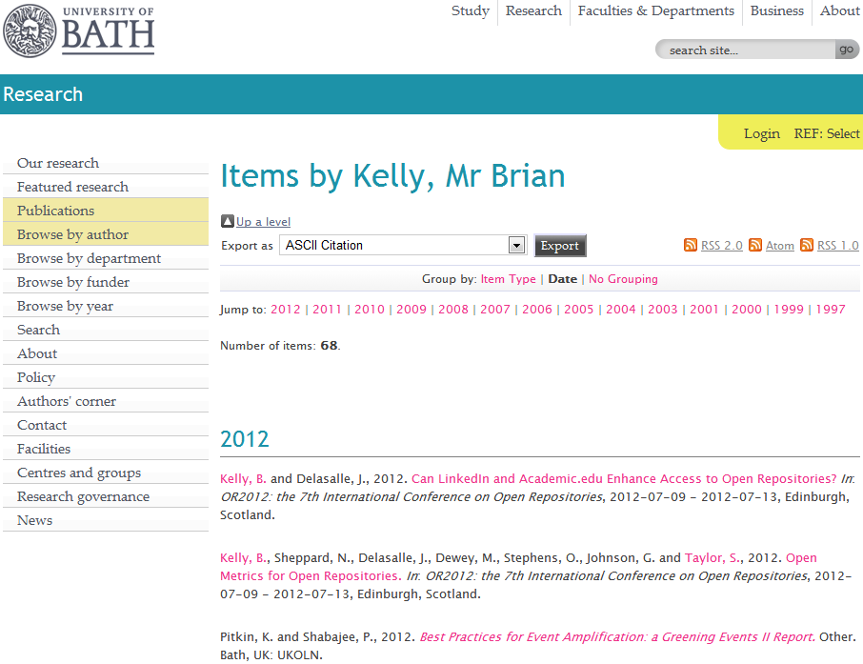
My Papers
My papers in the University of Bath Opus repository

Slide 8
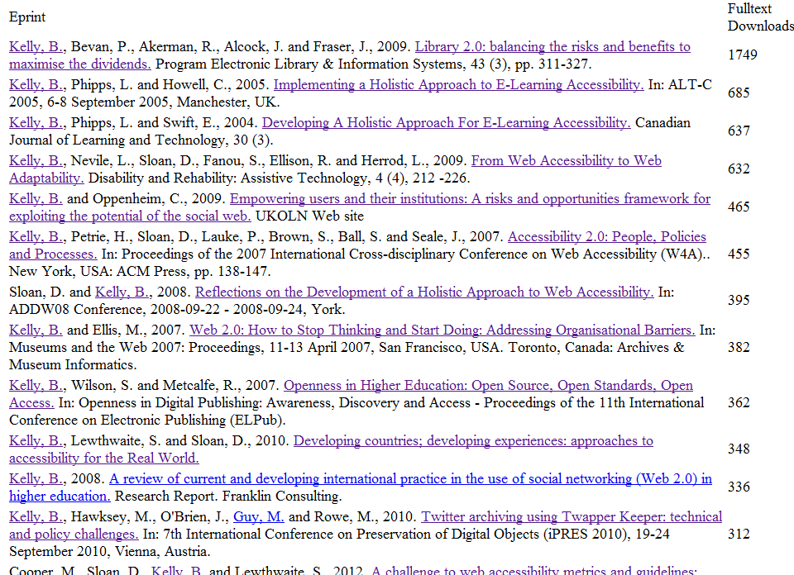
Open Access enhances access
Largets downloads

Slide 9
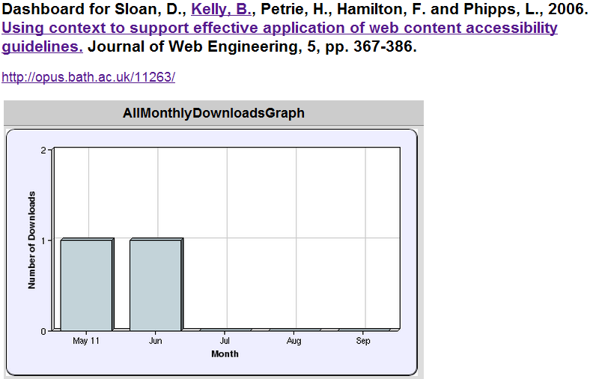
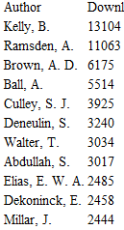
Least Downloaded Papers
Will papers in a repository be seldom seen?
What can be learn from approaches taken for the popular and unpopular papers?

Slide 10
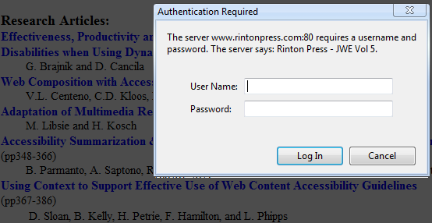
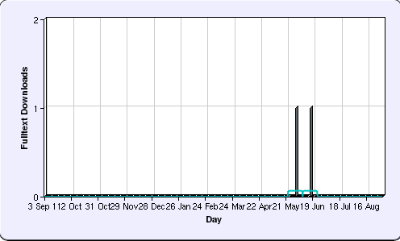
Learning from Mistakes
“Using Context to Support Effective Application of Web Content Accessibility Guidelines”, Sloan, Kelly et al, JWE (5), 2006
Submitted in July 2005
Reviewers comments received in April 2006
Published in JWE in December 2006
PDF uploaded to repository in May 2012
Forgotten paper when bulk uploads made
Reflections on implications given in “If a Tree Falls in a Forest” post

Slide 11
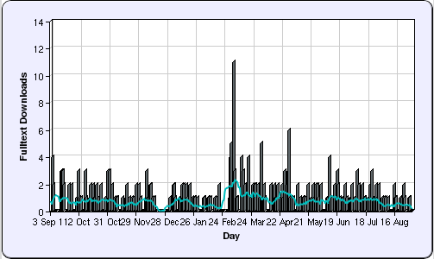
Learning From Success
“Library 2.0: balancing the risks and benefits to maximise the dividends”
Sixth most downloaded paper in repository ☺
But only recent download statistics available ☹
2012

Slide 12
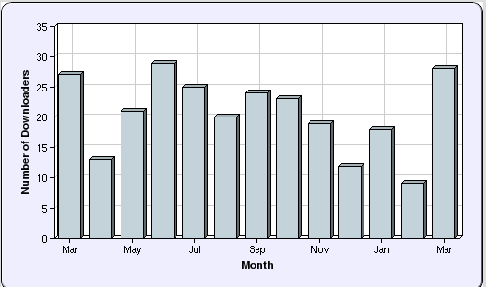
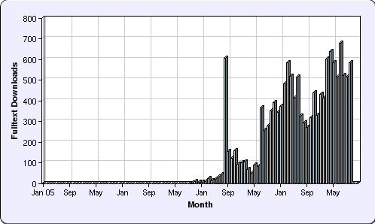
Evidence
How do we find out more?
Peak statistics for repository only available for 1 year
But:
Blog post about availability in Opus published on 11 August 2009
Further investigation (of all my paper downloads) confirms large peak in August 2009
Conclusion: Blog post responsible for initial popularity

Slide 13
Beyond the Edge Cases
Little-downloaded paper:
Uploaded to repository 6 years after paper written
I was not lead author
Only PDF version uploaded
Never blogged about; never tweeted
Most popular paper:
Available in IR on launch of journal issue
I was lead author
Blog post published on day of launch
Available in PDF, MS Word & HTML formats
Link to paper subsequently tweeted & retweeted
About Web 2.0, so likely to be read by bloggers
But what about the majority of papers?

Slide 14
SEO or SMO
SEO:
Helping Google find your papers through:
Writing style, document structure, …
In-bound links
SMO:
Helping other people find your papers through:
Viral marketing
Sharing on social media services
SMO: Good for new papers, but not relevant for popular papers written from 2004-8
SEO: Document structure consistent. Difference appears to be significant nos. of in-bound links

Slide 15
Tip No. 1: Be Pro-active
Tip No. 1:
Be pro-active

Slide 16
W4A 2012 Paper
Case study:
Paper on “A challenge to web accessibility metrics and guidelines: putting people and processes first” given at W4A 2012 conference in Lyon in Apr 2012
Four co-authors agreed:
To collaborate in raising awareness of paper and presentation of the paper
How:
Writing blog posts on or just before conference
Participate on conference Twitter hashtag (e.g. responding to comments while speaker is presenting)
Benefits:
Reaching out to a wider audience based on our 4 professional networks

Slide 17
Preparation
We:
Uploaded paper to repository so URL was known
Provided a link to the paper in speaker’s slides
Uploaded holding slide to Slideshare so URL was known (slides were finalised shortly before talk)
We could then:
Prepare blog posts in advance
Create short URLs in advance
Examples of approaches to follow

Slide 18
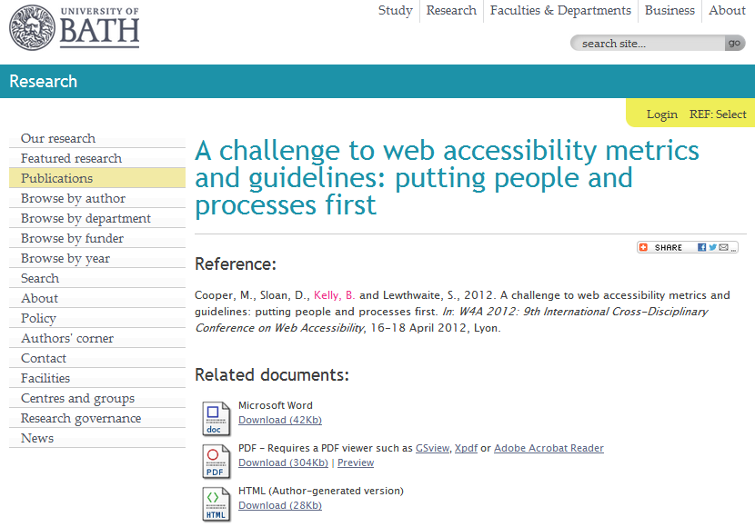
Opus Repository
Paper uploaded to Opus repository
http://opus.bath.ac.uk/29190/

Slide 19
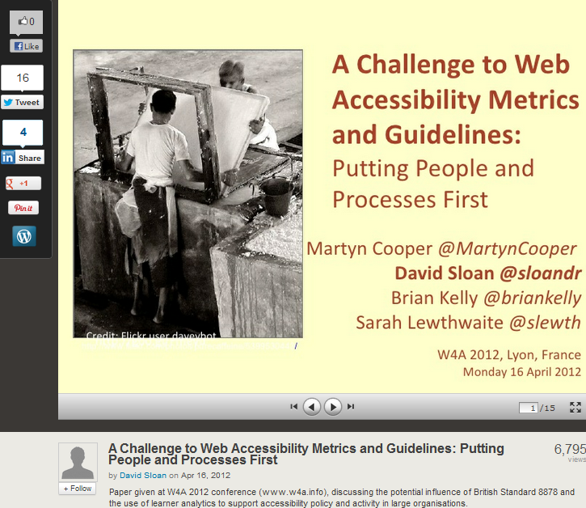
http://www.slideshare.net/sloandr/w4a12-coopersloankellylewthwaite
Metadata provided to give context to slides

Slide 20
Final slide provides (active) links to related work

Slide 21
Tip No. 3: Monitor What Works
Tip No. 2:
Monitor what works (for you)

Slide 22
Capture Statistics
On 18 Apr 12:
1,391 views on Slideshare
Other slides had 3 and 311 views
By 24 Oct 12:
7,247 views on Slideshare
“Lies, damned lies & statistics” – but my most downloaded paper in 2012

Slide 23
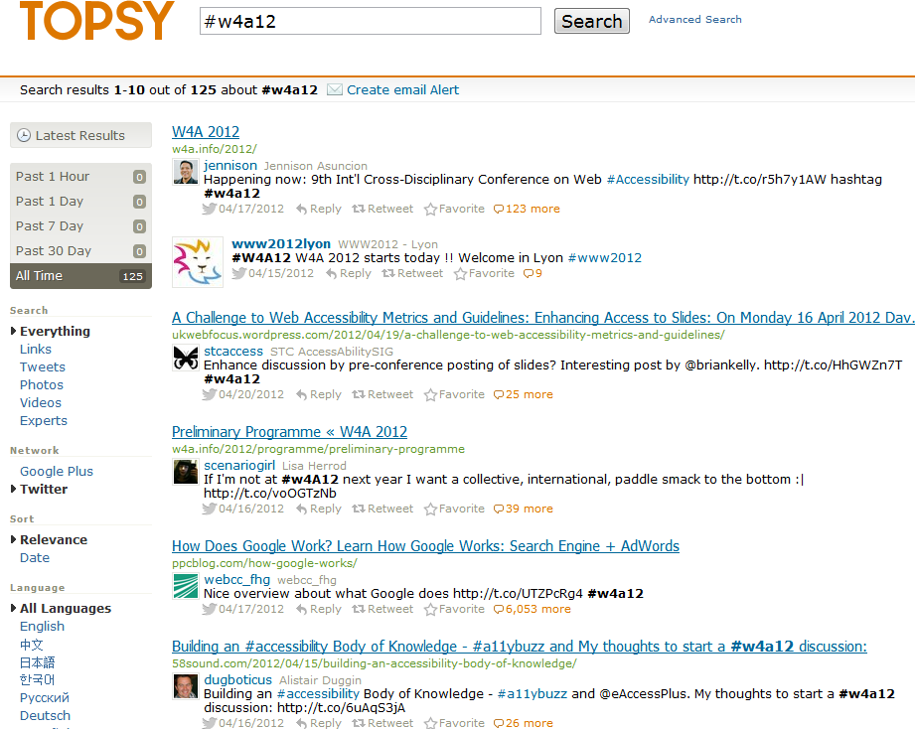
Topsy and Event Hashtag
Buzz around event hashtag captured by Topsy

Slide 24
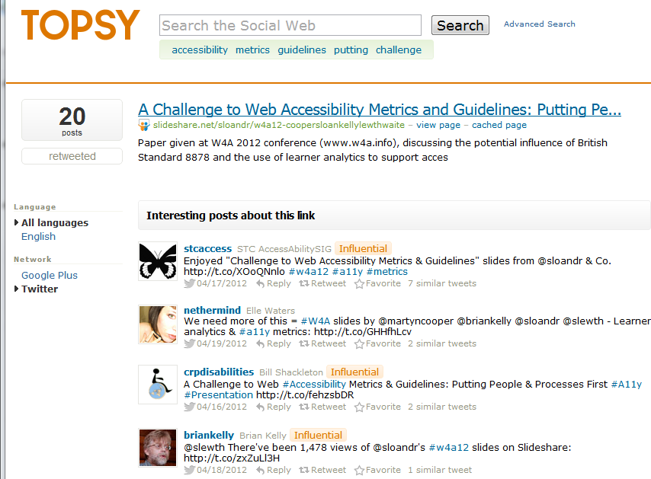
Topsy & Discussion About Slides
Topsy recorded discussions about slides

Slide 25
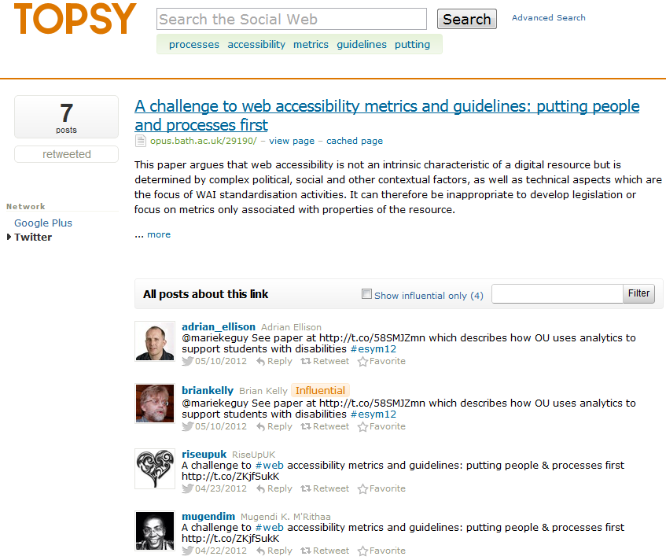
Topsy & Discussion About Paper
Topsy recorded discussions about paper
Note tweets about event (25) and slides (20) more popular than paper (7)

Slide 26
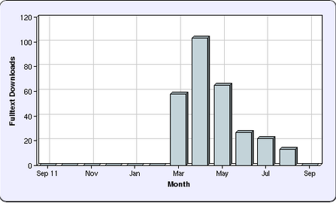
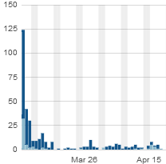
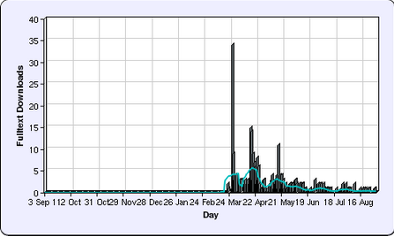
Repository Statistics
Opus repository stats:
Views began in March (before conference). Publish on embargo date didn’t work!
Largest downloads took place on 7 March, day blog post published
Post about collaborative tools for writing paper, not contents of paper

Slide 27
Tip No. 4: Don’t Forget the Links!
Tip No. 3:
Don’t forget the links

Slide 28
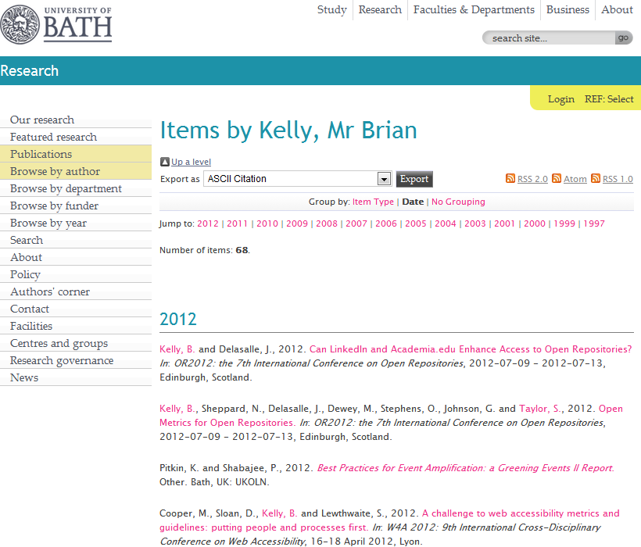
The IR
Your papers should be hosted on your institutional repository

Slide 29
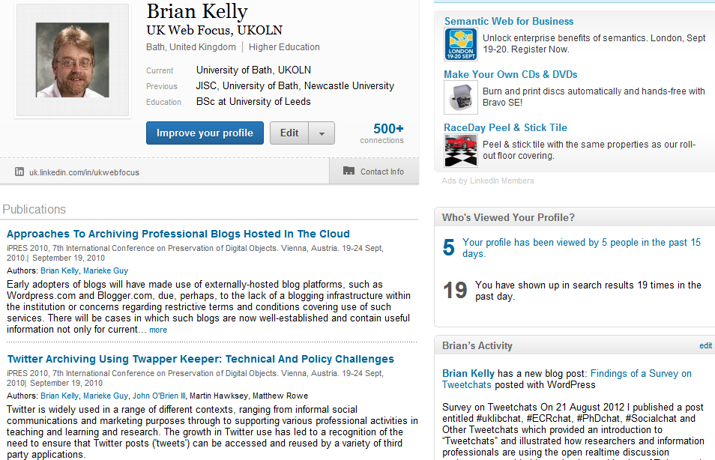
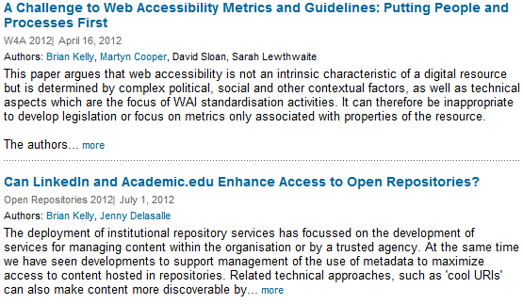
LinkedIn
Links to paper added to
LinkedIn
Academia.edu
My pages on UKOLN Web site and blog
…

Slide 30
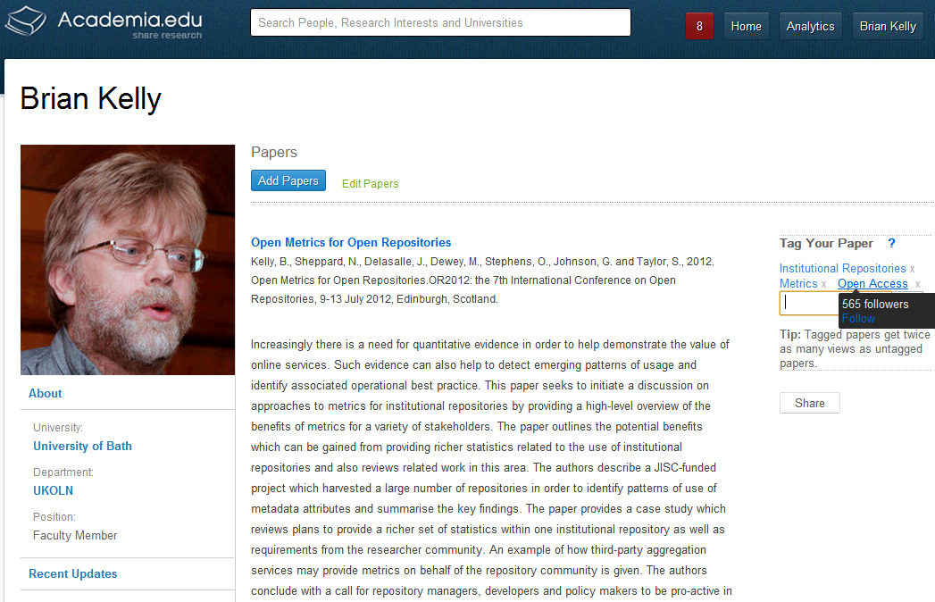
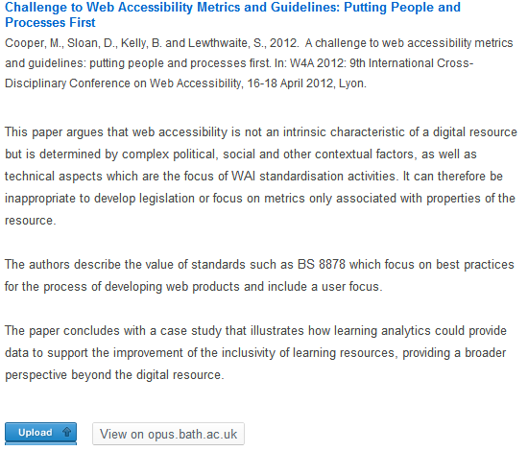
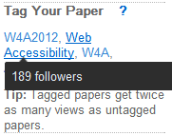
Academia.edu
Academia.edu
Academia.edu users may find my papers here and LinkedIn users in LinkedIn. Why would I make it difficult for them?
Note:
Links to papers in IR (not uploaded)
Importance of tags

Slide 31
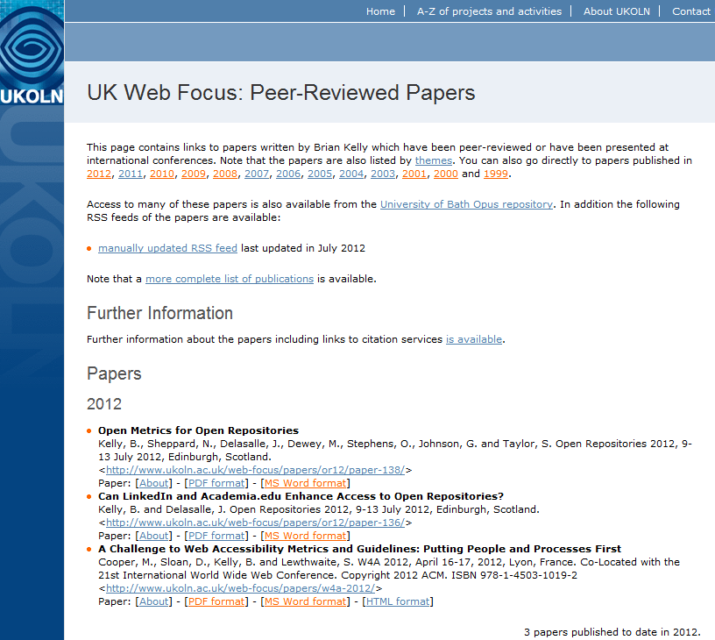
The Institutional Web Site
You may also wish to provide links on your institutional Web site
Note direct links to paper in various formats

Slide 32
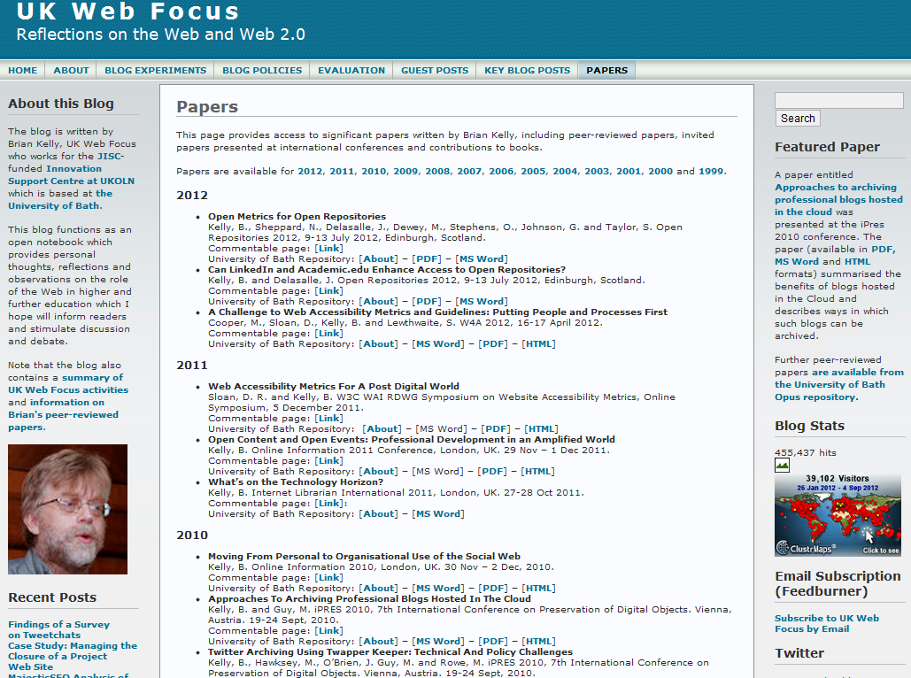
The Blog
If you have a blog you can provide links to your papers (again to all formats)

Slide 33
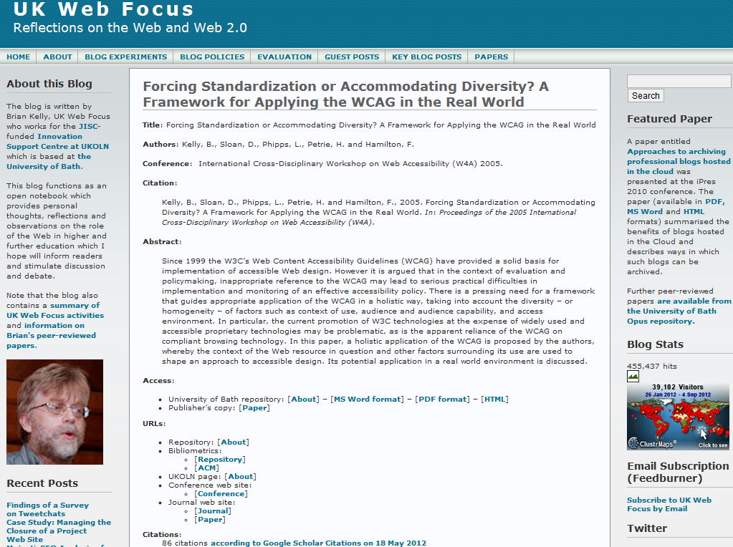
Commentable Pages on Blog
Recent development:
Commentable pages for papers with links to key resources (IR & publisher’s copy, metrics, citations, …)

Slide 34
Tip No. 5: Don’t Forget the Google Juice!
Tip No. 4:
Don’t forget the Google juice!

Slide 35
Importance of Google
Context:
Between 50-80% of traffic to IRs are from Google (may be higher if direct links to PDFs not recorded by Google Analytics)
What provides ‘Google juice’:
On-page SEO techniques (structure, writing style, …)
Links to pages, especially from highly-ranking sites

Slide 36
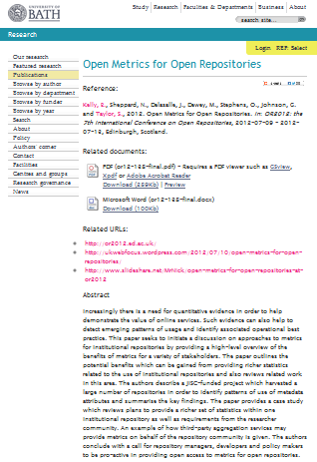
Importance of Google
Context:
Between 50-80% of traffic to IRs are from Google (may be higher if direct links to PDFs not recorded by Google Analytics)
What provides ‘Google juice’:
On-page SEO techniques (structure, writing style, …)
Links to pages, especially from highly-ranking sites
What’s different about IRs?
Same page structure
Therefore importance of links to repository

Slide 37
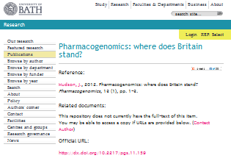
Importance of Google
Context:
Between 50-80% of traffic to IRs are from Google (may be higher if direct links to PDFs not recorded by Google Analytics)
What provides ‘Google juice’:
On-page SEO techniques (structure, writing style, …)
Links to pages, especially from highly-ranking sites
What’s different about IRs?
Same page structure
Therefore importance of links to repository

Slide 38
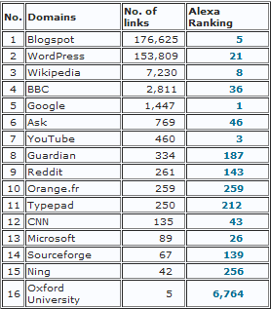
What Delivers Google Juice?
Survey of SEO ranking of 24 Russell Group IRs carried out in August 2012.
Findings:
Google, YouTube, Blogspot, Wikipedia and Microsoft are highest ranking domains with links to IRs
Blogspot.com & WordPress.com have significantly larger number of links to IRs
Blogspot.com
Wordpress.com
Links from institutional domain (e.g. locally-hosted blogs) provide little Google juice!

Slide 39
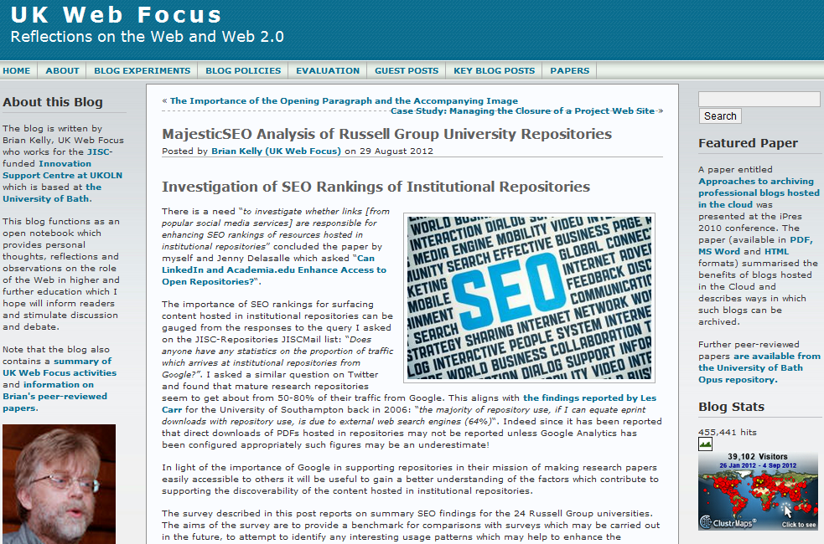
UK Web Focus has links to all papers
UK Web Focus has timely blog posts about papers
UK Web Focus blog has a rotating Featured Paper link

Slide 40
Tip No. 7: Develop Your Network
Tip No. 5:
Develop your network

Slide 41
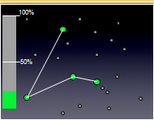
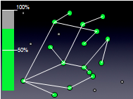
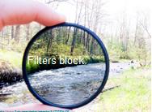
“It’s About Nodes and Connections”
Cameron Neylon keynote at OR 2012: “Networks qualitatively change our capacity”
With only 20% of a community connected only limited interaction can take place
This increases drastically as numbers of connected nodes grows
Examples:
Phone networks (no use with only 1 user!)
Tweeting at this seminar
Galaxy Zoo
“Filters block. Filters cause friction”
Need for client-side, not supply-side filters.

Slide 42
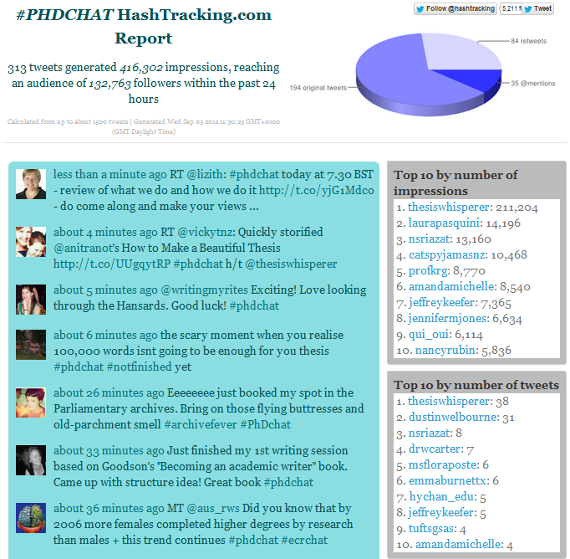
Tweetchat
Tweetchats:
Discussions on Twitter
Specific topic covered at specified time
Use hashtags e.g. #PhDchat, #ECRchat Summary at
Survey findings:
“give a community & shared space to explore ideas”
“regular opportunity to network with a wide range of people I wouldn’t otherwise meet”
“have very interesting and thought-provoking discussions/debate”

Slide 43
Health Warning!
Suggestions given can help to enhance the visibility of one’s research.
Highly visible and popular research is not necessarily an indication of quality!

Slide 44
Conclusions
Be pro-active
Monitor what works for you
Don’t forget the links
Don’t forget the Google juice
Develop your network
Other important tips:
Encourage feedback and discussion
Understand your network
Know your limits
Seek improvements
Be ethical
Participate
More comprehensive version of this talk is available at http://www.ukoln.ac.uk/web-focus/events/seminars/exeter-open-access-week-2012/

Slide 45
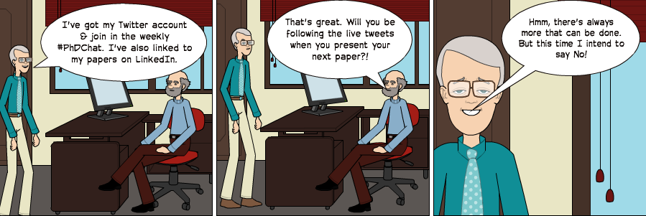
Any Questions?
Cartoon

