Slide 1
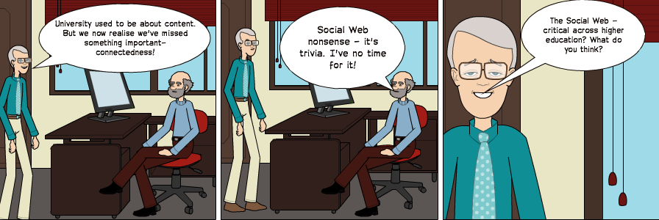
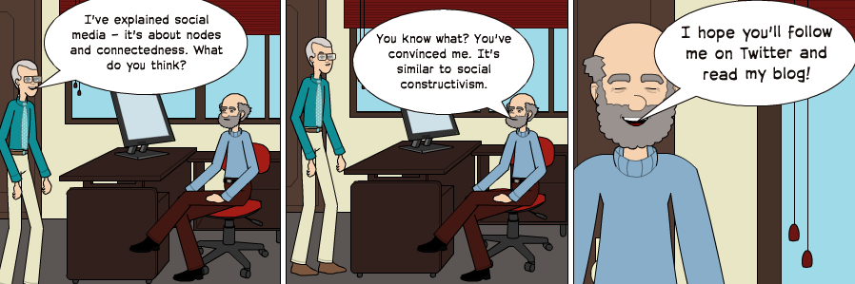
Being a 'connected educator': the Role of Social Media in Facilitating Collaboration and Enhancing Impact
Being a ‘Connected Educator’: the Role of Social Media
in Facilitating Collaboration and Enhancing Impact
Brian Kelly, UKOLN
Presentation by Brian Kelly, UKOLN at the University of Dundee

Slide 2


Being a ‘Connected Educator’: the Role of Social Media in Facilitating Collaboration and Enhancing Impact
http://www.ukoln.ac.uk/web-focus/events/seminars/dundee-2012/
Brian Kelly
UKOLN
University of Bath
Bath, UK
Acceptable Use Policy
Recording this talk, taking photos, discussing the content using Twitter, blogs, etc. is welcomed providing distractions to others is minimised.
Email: b.kelly@ukoln.ac.uk
Blog: http://ukwebfocus.wordpress.com/
Twitter: @briankelly
UKOLN is supported by:
This work is licensed under a Creative Commons Attribution 2.0 licence (but note caveat)

Slide 3









Idea from Cameron Neylon
You are free to:
copy, share, adapt, or re-mix;
photograph, film, or broadcast;
blog, live-blog, or post video of
this presentation provided that:
You attribute the work to its author and respect the rights and licences associated with its components.
Slide Concept by Cameron Neylon, who has waived all copyright and related or neighbouring rights. This slide only CCZero.
Social Media Icons adapted with permission from originals by Christopher Ross. Original images are available under GPL at:
http://www.thisismyurl.com/free-downloads/15-free-speech-bubble-icons-for-popular-websites
3

Slide 4
About Me
Introduction
Brian Kelly:
  UK Web Focus: national advisory post to UK HEIs
  Long-standing Web evangelist
  Based at UKOLN at the University of Bath
  Prolific blogger (1,140+ posts since Nov 2006)
  User of various devices to support professional (and social) activities
  Prolific speaker (~400 talks from 1996-2012)
ISC at UKOLN:
  Supporting innovation across higher & further education
  Funded by JISC

Slide 5
About You
Introduction
What are your role(s)?
  Teaching (academic) • Teaching (support)
  Research • Student
  Administration • Marketing
  Other
What use do you make of Social Media?
  Make use of blogs, Twitter, social bookmaking, … to support my professional activities
  Make use of Facebook, … for personal use
  Interested in seeing how (& whether) social media has a useful role to play
  Sceptical (but willing to listen)

Slide 6
About This Talk
Introduction
This talk covers:
  Role of social media for the researcher
  How individual researchers are using social media to support their research activities
  Institutional use of social media
  Examples of institutional use of social media for marketing and engagement purposes
  Social media at events
  Case studies of how social media can be used at ‘amplified events’
  Understanding and addressing the tensions
  How social media challenges mainstream approaches to engagement and dissemination and how resulting tensions can be addressed

Slide 7
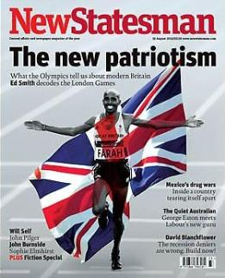
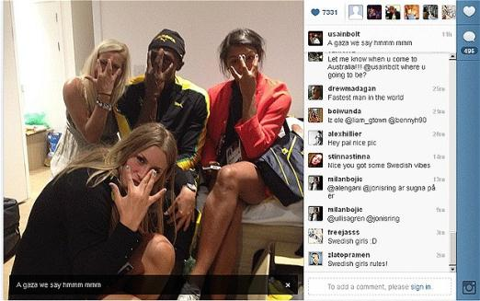
About You
Are you a Roundhead or a Cavalier?
“In the century, Britain was devastated by a civil war that divided the nation into two tribes – the Roundheads and the Cavaliers. The Cavaliers represent a Britain of panache, pleasure and individuality. They are confronted by the Roundheads, who stand for modesty, discipline, equality and state intervention.”
Who do you admire most?
  Mo Farrah for winning the 5,000 and 10,000m?
  Usain Bolt for partying with Swedish handball team after winning 100m, & before 200m & relay?

Slide 8
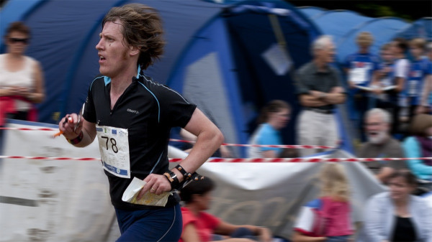
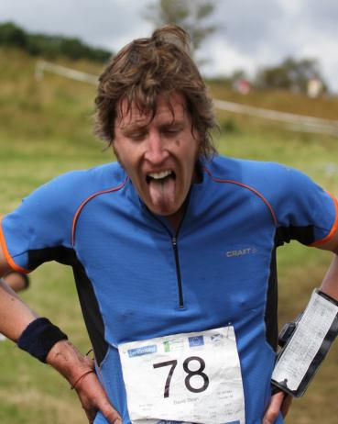
About You
Orienteering: a “family of sports that requires navigational skills using a map and compass to navigate from point to point in diverse and usually unfamiliar terrain, and normally moving at speed”.
In Scotland, orienteers often run in the rain!

Slide 9
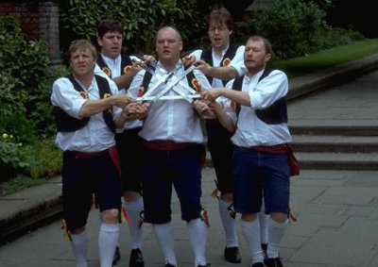
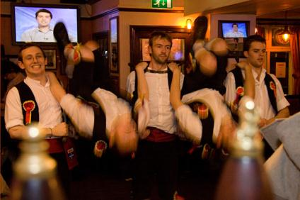
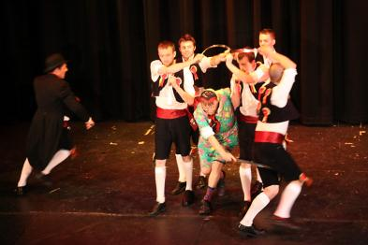
About Me
Rapper sword dance:
“requires five performers who coordinate
themselves whilst using "rapper swords" made from flexible steel. Accompanies with traditional folk music, the dancers wear specially-designed shoes that allow for percussive foot movements. Mental alertness, in additional to physical agility, is required in order for dance participants to effectively utilize the swords without causing harm to themselves or the other performers”
Rapper sword dancers often dance in the pubs (often for free beer!)

Slide 10
Key Drivers
The Researcher
Some key drivers for researchers:
  Maximising numbers of citations
  Maximising downloads of papers by peers who may cite work
  Maximising downloads of papers by practitioners who may implement ideas (“impact”)
  Developing professional networks with people who may be potential collaborators, co-authors, funders or future employers
  Exposing ideas to ‘many eyes’ who can validate / critique one’s research

Slide 11

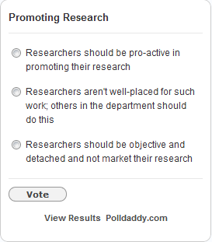
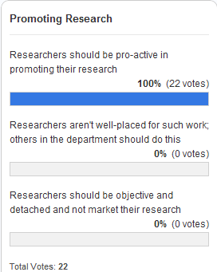
Are You A Marxist?
The Researcher
“Hitherto, philosophers have sought to
understand the world; the point, however, is to change it”
Do you seek to change the world through your research or simply understand the world:
  Will you want to market your research?
  Will you want others to market your research?
  Will you have a detached view of your research?

Slide 12
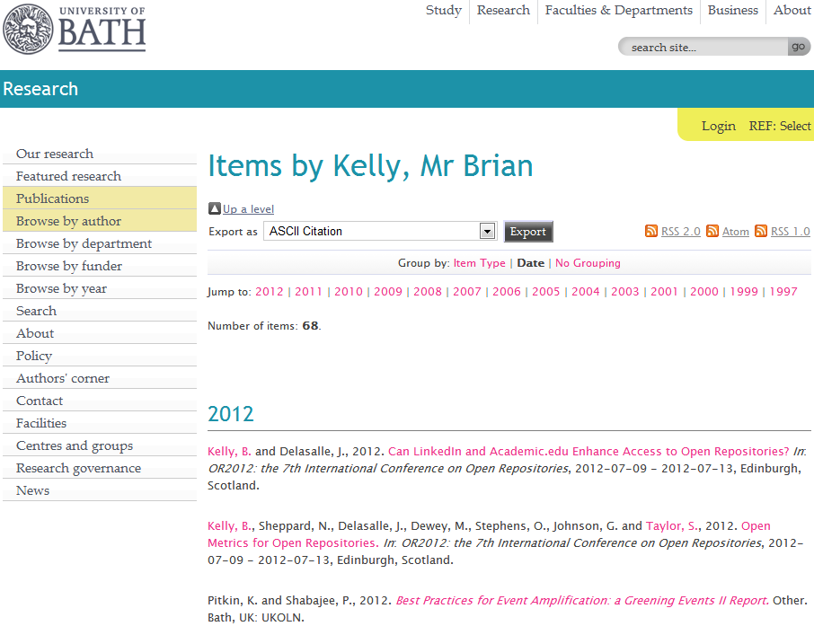
My Papers
My papers in the University of Bath Opus repository

Slide 13
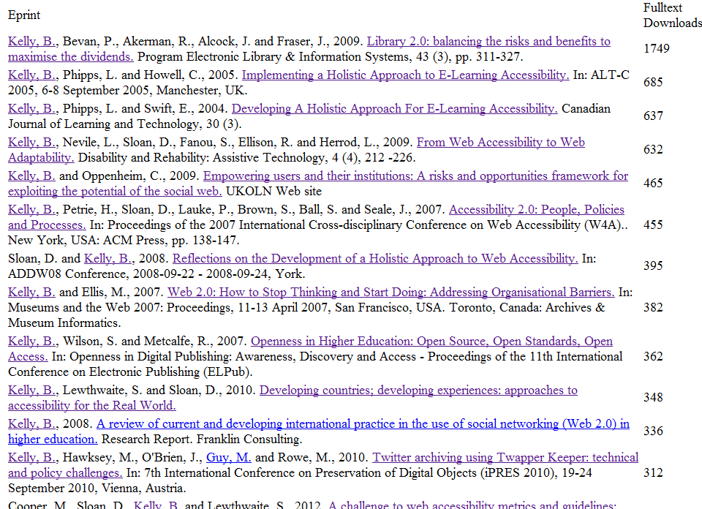
Open Access enhances access
Largets downloads

Slide 14
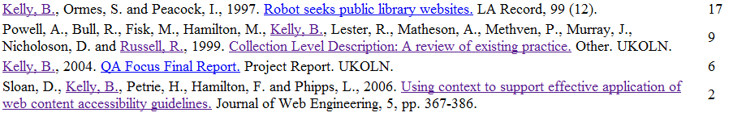
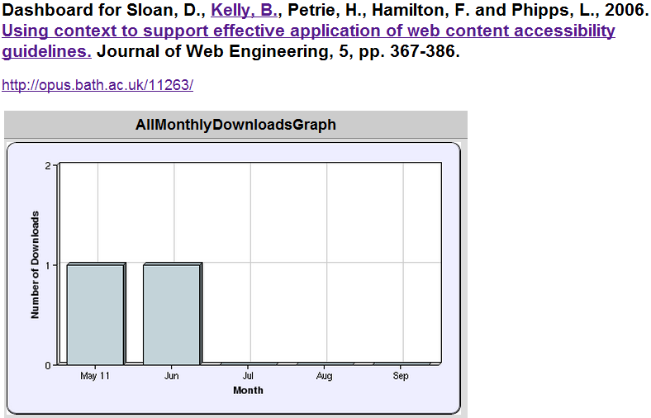
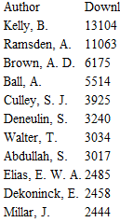
Least Downloaded Papers
Will papers in a repository be seldom seen?
What can be learn from approaches taken for the popular and unpopular papers?

Slide 15
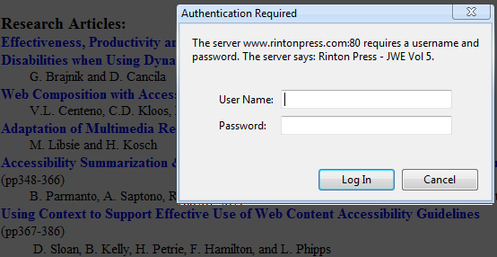
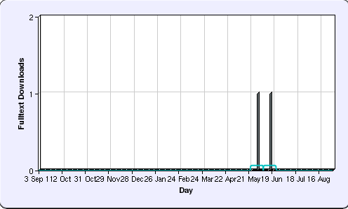
Learning from Mistakes
“Using Context to Support Effective Application of Web Content Accessibility Guidelines”, Sloan, Kelly et al, JWE (5), 2006
  Submitted in July 2005
  Reviewers comments received in April 2006
  Published in JWE in December 2006
  PDF uploaded to repository in May 2012
  Forgotten paper
  when bulk uploads
  made
Reflections on implications given in “If a Tree Falls in a Forest” post

Slide 16
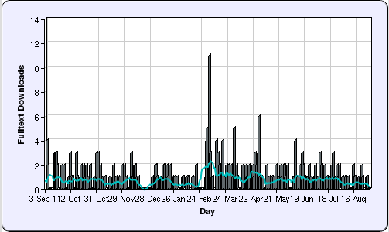
Learning From Success
“Library 2.0: balancing the risks and benefits to maximise the dividends”
Sixth most downloaded paper in repository ☺
But only recent download statistics available ☹
2012

Slide 17
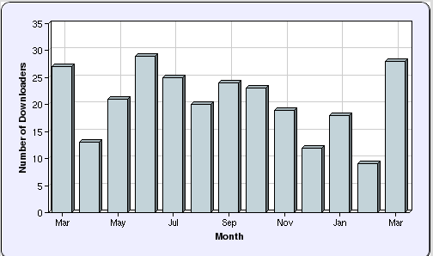

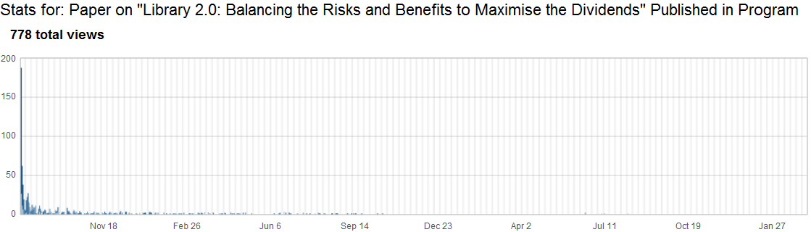

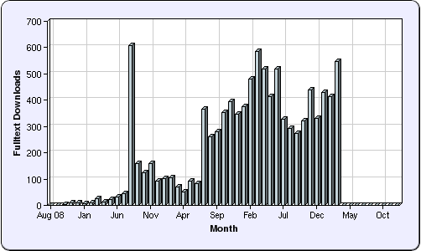
Evidence
How do we find out more?
  Peak statistics for repository
  only available for 1 year
But:
  Blog post about availability in Opus published on 11 August 2009
Further investigation (of all my paper downloads) confirms large peak in August 2009
Conclusion: Blog post responsible for initial popularity

Slide 18
Beyond the Edge Cases
Little-downloaded paper:
  Uploaded to repository 6 years after paper written
  I was not lead author
  Only PDF version uploaded
  Never blogged about; never tweeted
Most popular paper:
  Available in IR on launch of journal issue
  I was lead author
  Blog post published on day of launch
  Available in PDF, MS Word & HTML formats
  Link to paper subsequently tweeted & retweeted
  About Web 2.0, so likely to be read by bloggers
But what about the majority of papers?

Slide 19

SEO or SMO
SEO:
  Helping Google find your papers through:
    Writing style, document structure, …
    In-bound links
SMO:
  Helping other people find your papers through:
    Viral marketing
    Sharing on social media services
SMO: Good for new papers, but not relevant for popular papers written from 2004-8
SEO: Document structure consistent. Difference appears to be significant nos. of in-bound links

Slide 20
Tip No. 1: Be Pro-active
Tip No. 1:
Be pro-active
Tip No. 1:
Be pro-active
Tips used in talks given in Open Access Week 2012 and summarised in post on “Top 10 tips on how to make your open access research visible online” posted on JISC blog

Slide 21
W4A 2012 Paper
Case study:
  Paper on “A challenge to web accessibility metrics and guidelines: putting people and processes first” given at W4A 2012 conference in Lyon in Apr 2012
Four co-authors agreed:
  To collaborate in raising awareness of paper and presentation of the paper
How:
  Writing blog posts on or just before conference
  Participate on conference Twitter hashtag (e.g. responding to comments while speaker is presenting)
Benefits:
  Reaching out to a wider audience based on our 4 professional networks

Slide 22
Preparation
We:
  Uploaded paper to repository so URL was known
  Provided a link to the paper in speaker’s slides
  Uploaded holding slide to Slideshare so URL was known (slides were finalised shortly before talk)
We could then:
  Prepare blog posts in advance
  Create short URLs in advance
Examples of approaches to follow

Slide 23
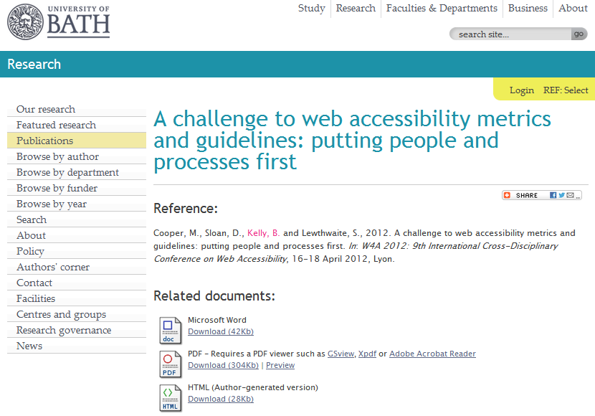
Opus Repository
Paper uploaded to Opus repository
http://opus.bath.ac.uk/29190/

Slide 24
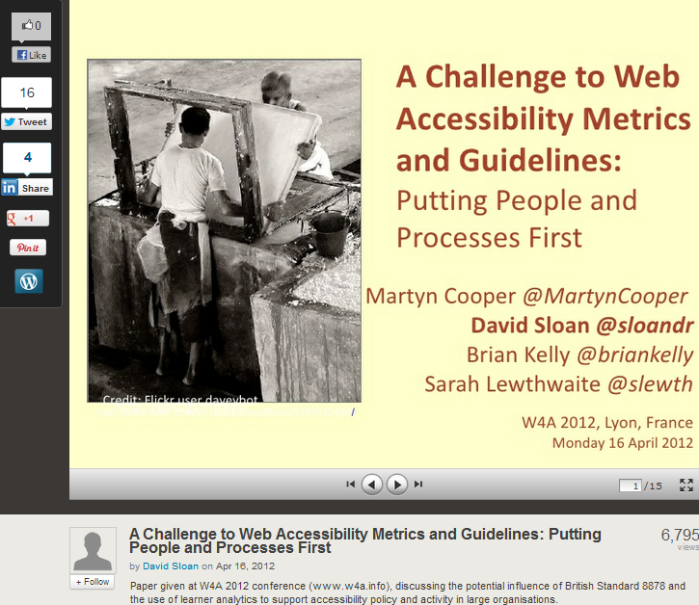
http://www.slideshare.net/sloandr/w4a12-coopersloankellylewthwaite
Metadata provided to give context to slides

Slide 25
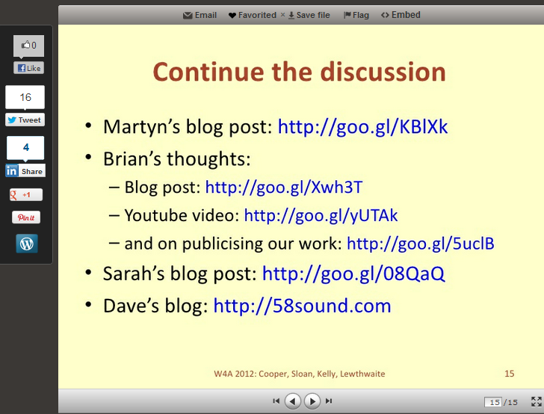
Final slide provides (active) links to related work

Slide 26
Tip No. 3: Monitor What Works
Tip No. 2:
Monitor what works (for you)

Slide 27
Capture Statistics
On 18 Apr 12:
  1,391 views on Slideshare
  Other slides had 3 and 311 views
By 5 Nov12:
    7,582 views on Slideshare
“Lies, damned lies & statistics” – but my most downloaded paper in 2012

Slide 28
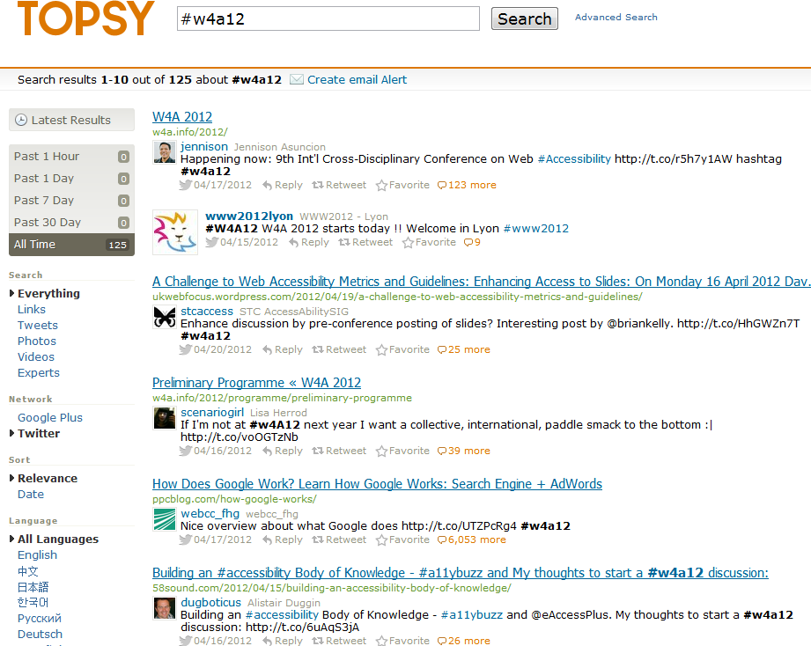
Topsy and Event Hashtag
Buzz around event hashtag captured by Topsy

Slide 29
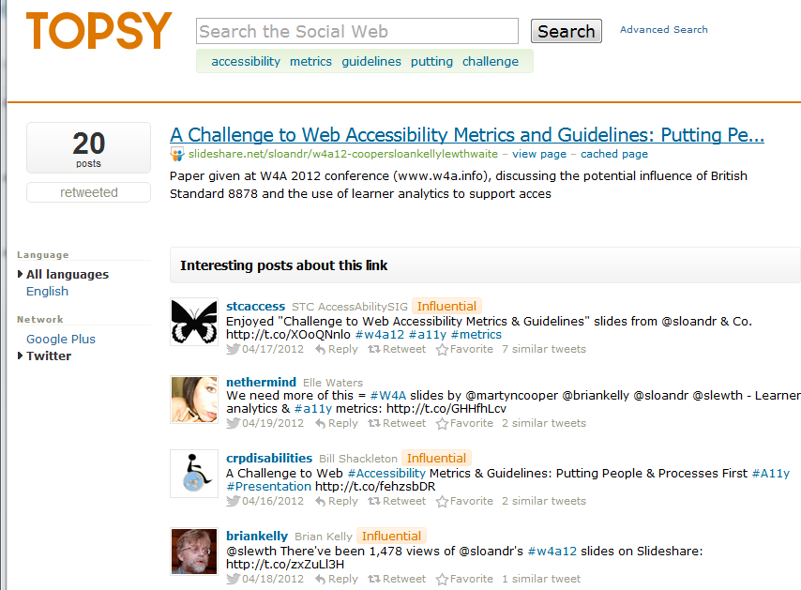
Topsy & Discussion About Slides
Topsy recorded discussions about slides

Slide 30
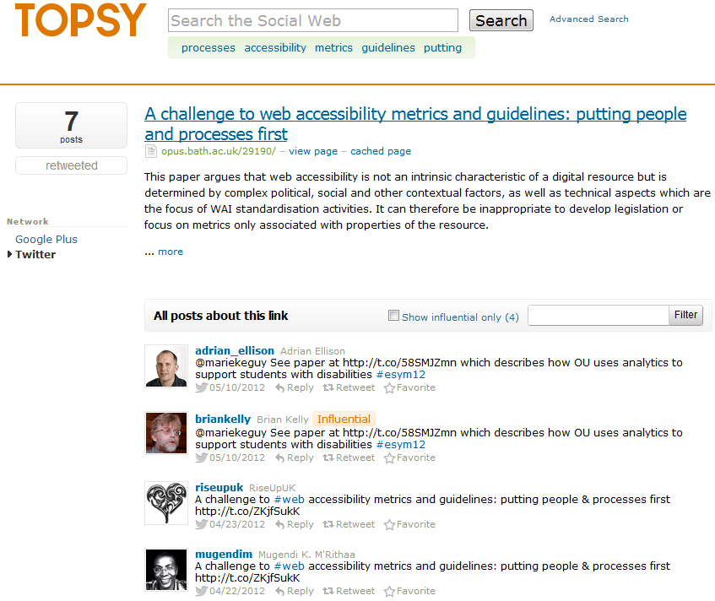
Topsy & Discussion About Paper
Topsy recorded discussions about paper
Note tweets about event (25) and slides (20) more popular than paper (7)

Slide 31
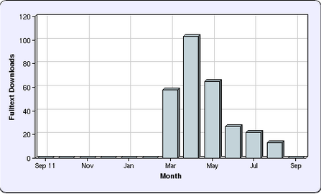
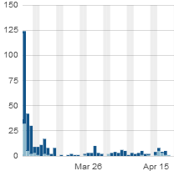
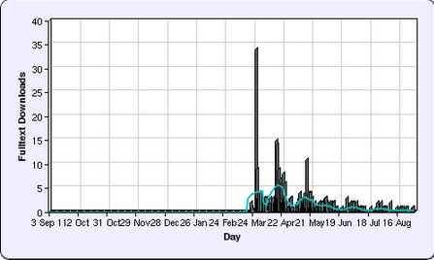
Repository Statistics
Opus repository stats:
  Views began in March (before conference). Publish on embargo date didn’t work!
  Largest downloads took place on 7 March, day blog post published
  Post about collaborative tools for writing paper, not contents of paper

Slide 32
Tip No. 4: Don’t Forget the Links!
Tip No. 3:
Don’t forget the links
or
Make it easy for users (even in bed)

Slide 33
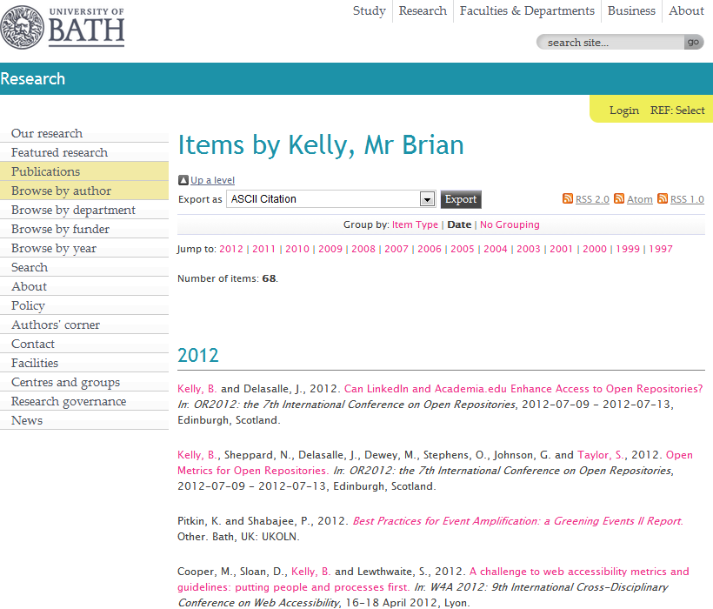
The IR
Your papers should be hosted on your institutional repository

Slide 34
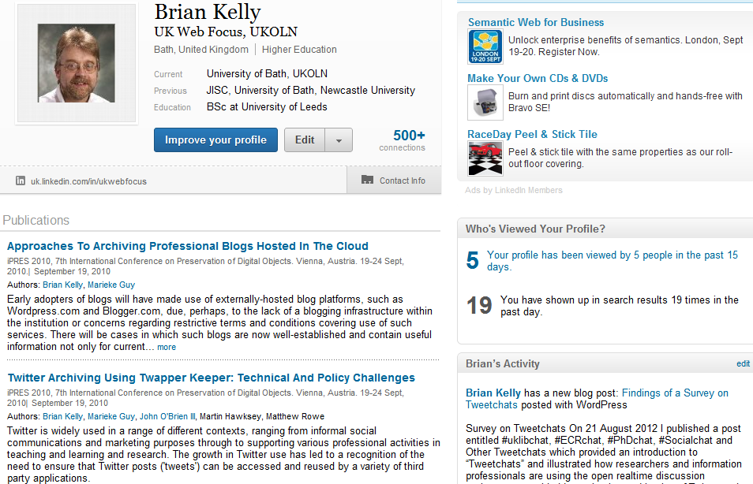
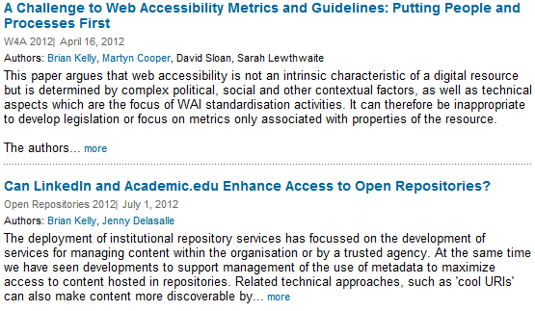
LinkedIn
Make it easy for others to find and access your research
Links to paper added to
  LinkedIn
  Academia.edu
  My pages on UKOLN Web site and blog
  …

Slide 35
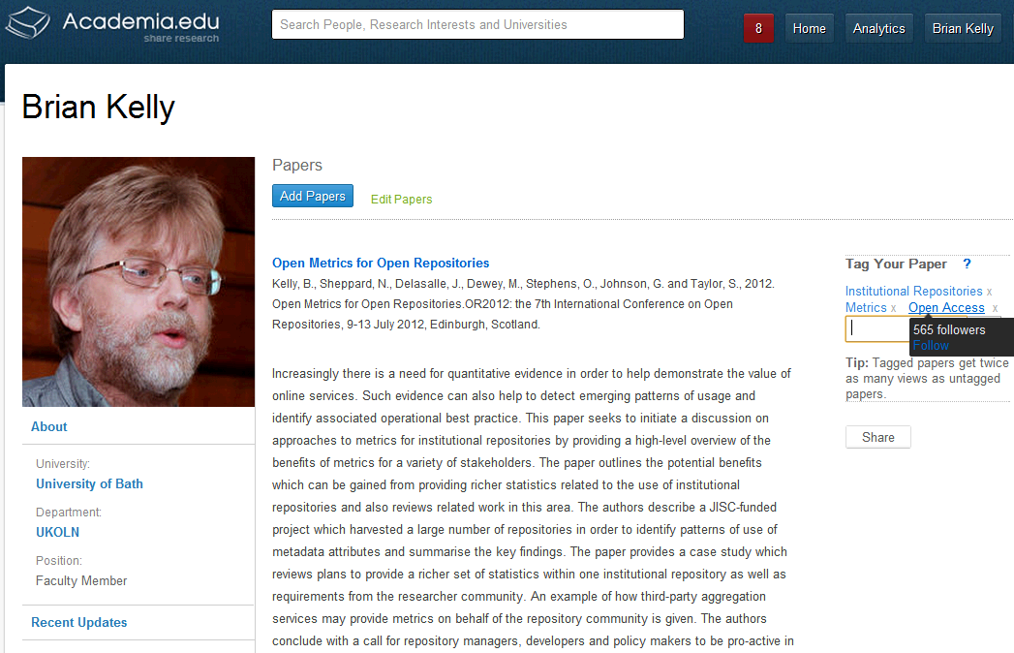
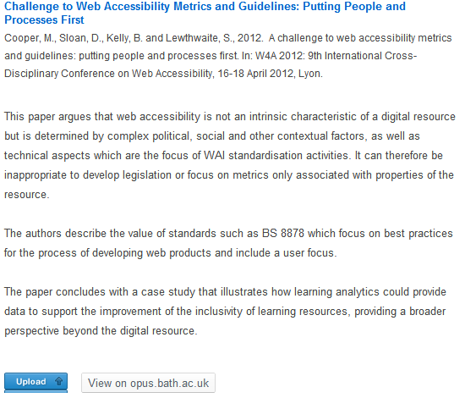
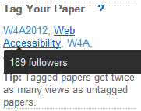
Academia.edu
Academia.edu
Academia.edu users may find my papers here and LinkedIn users in LinkedIn. Why would I make it difficult for them?
Note:
  Links to papers in IR (not uploaded)
  Importance of tags

Slide 36
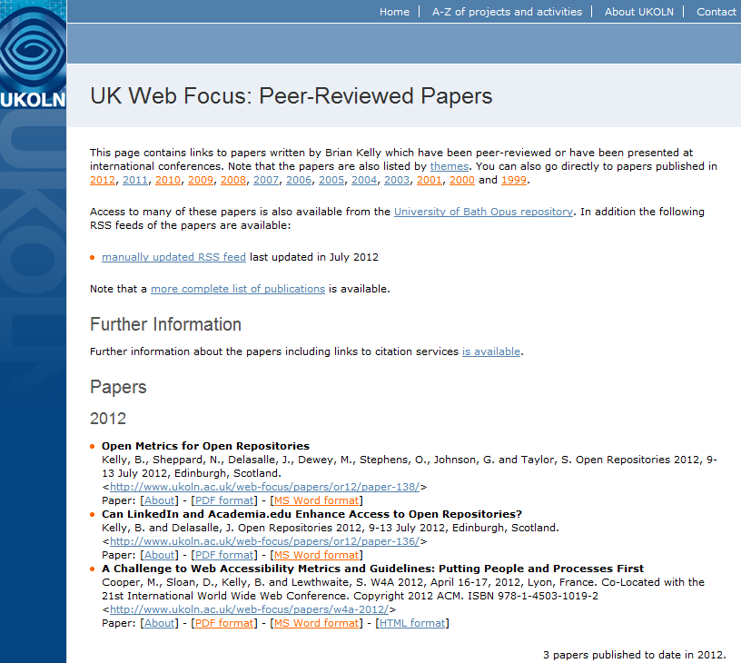
The Institutional Web Site
You may also wish to provide links on your institutional Web site
Note direct links to paper in various formats

Slide 37
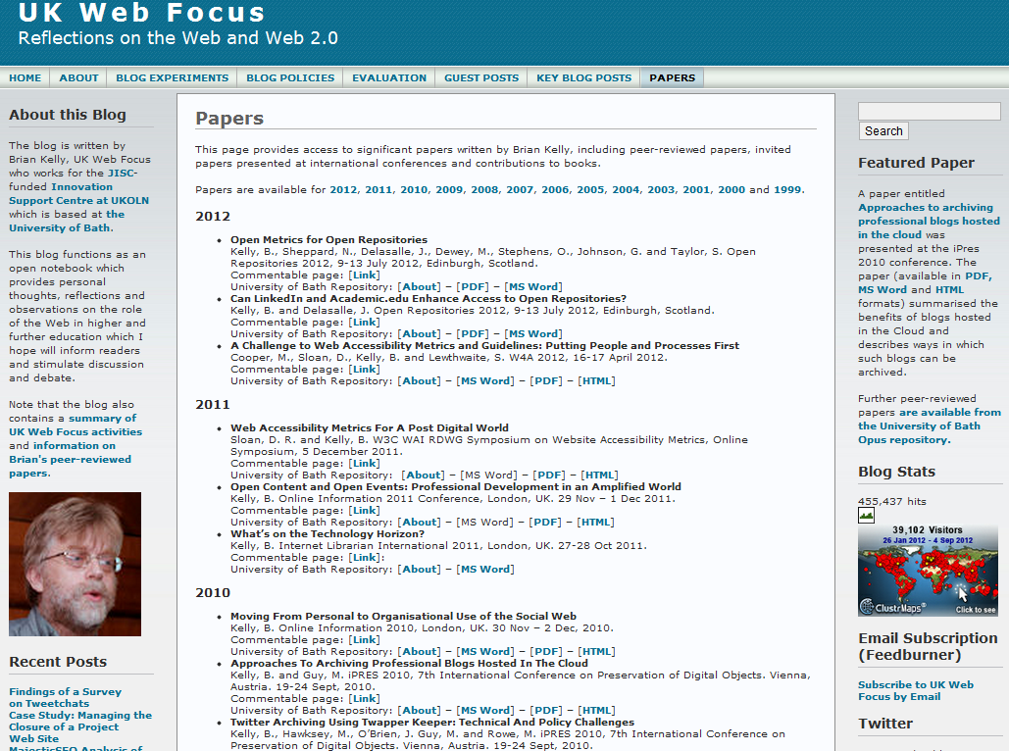
The Blog
If you have a blog you can provide links to your papers (again to all formats)

Slide 38
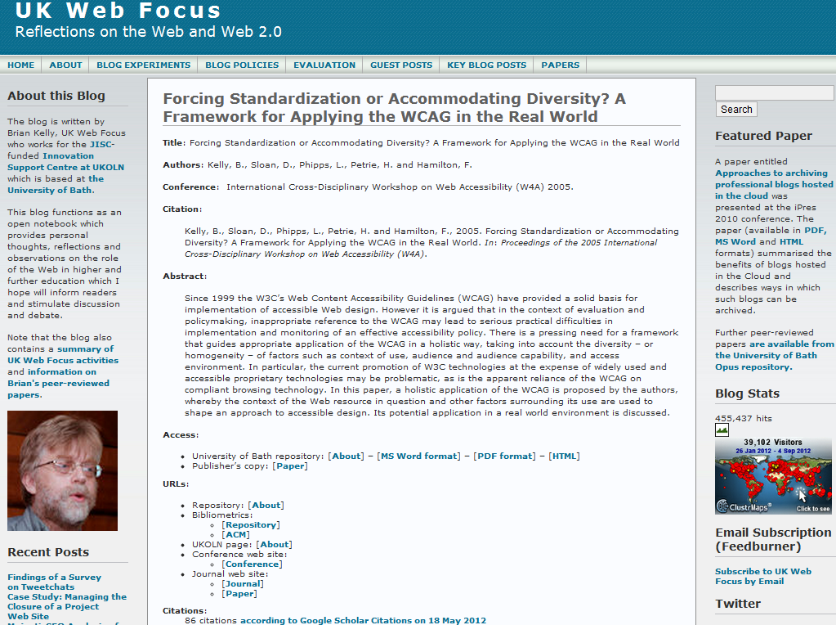
Commentable Pages on Blog
Recent development:
Commentable pages for papers with links to key resources (IR & publisher’s copy, metrics, citations, …)

Slide 39
Tip No. 5: Don’t Forget the Google Juice!
Tip No. 4:
Don’t forget the Google juice!
or
Make it easy for Google (it never sleeps)

Slide 40
Importance of Google
Context:
  Between 50-80% of traffic to IRs are from Google (may be higher if direct links to PDFs not recorded by Google Analytics)
What provides ‘Google juice’:
  On-page SEO techniques
  (structure, writing style, …)
  Links to pages, especially
  from highly-ranking sites

Slide 41
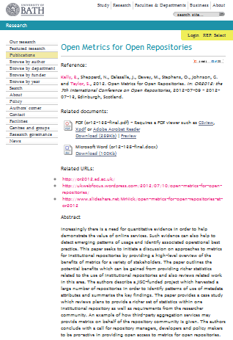
Importance of Google
Context:
  Between 50-80% of traffic to IRs are from Google (may be higher if direct links to PDFs not recorded by Google Analytics)
What provides ‘Google juice’:
  On-page SEO techniques
  (structure, writing style, …)
  Links to pages, especially
  from highly-ranking sites
What’s different about IRs?
  Same page structure
  Therefore importance of links
  to repository

Slide 42
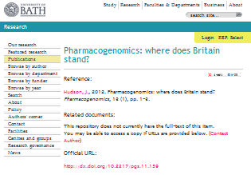
Importance of Google
Context:
  Between 50-80% of traffic to IRs are from Google (may be higher if direct links to PDFs not recorded by Google Analytics)
What provides ‘Google juice’:
  On-page SEO techniques
  (structure, writing style, …)
  Links to pages, especially
  from highly-ranking sites
What’s different about IRs?
  Same page structure
  Therefore importance of links
  to repository

Slide 43
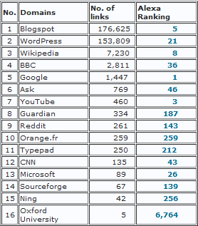
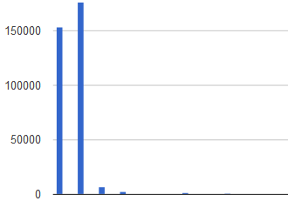
What Delivers Google Juice?
Survey of SEO ranking of 24 Russell Group IRs carried out in August 2012.
Findings:
  Google, YouTube, Blogspot, Wikipedia and Microsoft are highest ranking domains with links to IRs
Blogspot.com & WordPress.com have significantly larger number of links to IRs
Blogspot.com
Wordpress.com
Links from institutional domain (e.g. locally-hosted blogs) provide little Google juice!

Slide 44
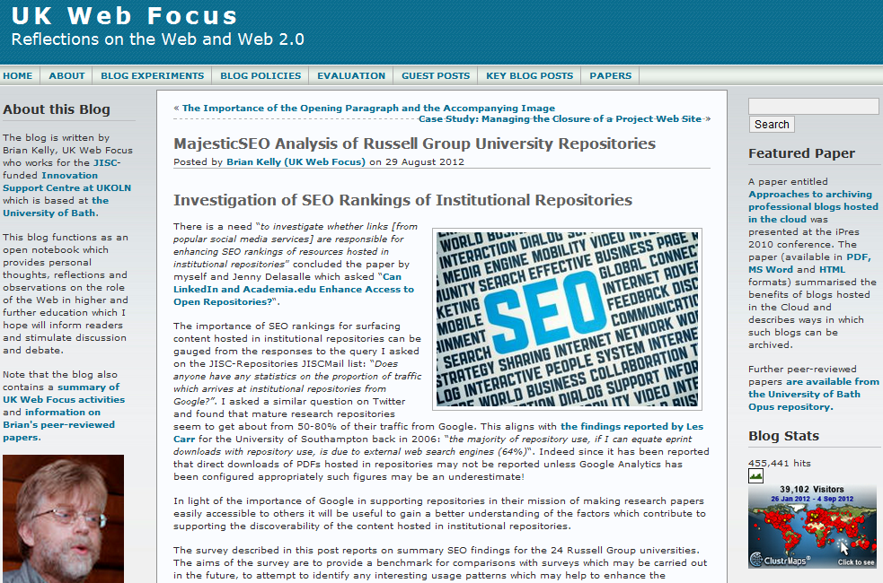
UK Web Focus has links to all papers
UK Web Focus has timely blog posts about papers
UK Web Focus blog has a rotating Featured Paper link

Slide 45
Tip No. 7: Develop Your Network
Tip No. 5:
Develop your network

Slide 46
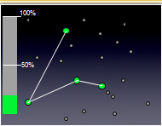
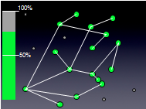
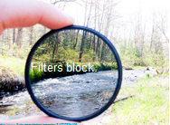
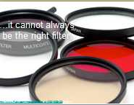
“It’s About Nodes and Connections”
Cameron Neylon keynote at OR 2012:
“Networks qualitatively change our capacity”
  With only 20% of a community connected only limited interaction can take place
  This increases drastically as numbers of connected nodes grows
Examples:
  Phone networks (no use with only 1 user!)
  Tweeting at this seminar
  Galaxy Zoo
“Filters block. Filters cause friction”
Need for client-side, not supply-side filters.

Slide 47
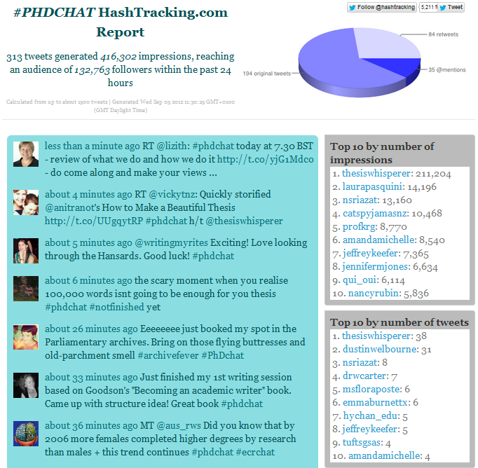
Tweetchat
Tweetchats:
  Discussions on Twitter
  Specific topic covered at specified time
  Use hashtags e.g. #PhDchat, #ECRchat Summary at
Survey findings:
  “give a community & shared space to explore ideas”
  “regular opportunity to network with a wide range of people I wouldn’t otherwise meet”
  “have very interesting and thought-provoking discussions/debate”

Slide 48
Health Warning!
Suggestions given can help to enhance the visibility of one’s research.
Highly visible and popular research is not necessarily an indication of quality!

Slide 49
Key Drivers
The Institution
Three key drivers for institutions:
  Marketing the institution
  To highlight positive aspects of the institution across its range of activities
  Attracting students to the institution
  To ensure (fee-paying) students choose the institution for their course
  Enhancing the online visibility of the institution
  So that general searches find institutional resources

Slide 50
What’s Happening?
The Institution
How are institutions currently using social media?
  Institutional Use of Facebook
  Surveys since 2007
  Institutional Use of Twitter
  Surveys since 2007
  Institutional Use of YouTube
  Surveys since 2007
  Alternative?
  What alternative may there be?

Slide 51


Would You Kill for a Million Users?
Survey (9 Oct 2010) showing growth in nos. of Facebook fans for first UK University Facebook pages between 2008 & 2010
Survey (9 Oct 2010) showing growth in nos. of Facebook ‘likes’ for Russell Group University Facebook pages
See Survey of Institutional Use of Facebook (May 2012) and Over One Million ‘Likes’ of Facebook Pages for the 24 Russell Group Universities posts (Aug 2012)

Slide 52

Russell Group Use of Twitter
The Institution
Survey (Jan 2011) of official Twitter accounts for Russell Group universities helped identify emerging use patterns

Slide 53


Social Analytics Tools
Survey in August 2012 used Social Analytics tools (e.g. Klout & PeerIndex) to provide quantitative comparisons.
Such metrics:
  Can be misleading (is LSE’s account much better than Liverpool’s?)
  Can be useful for trend analysis & comparisons with peers
Can be more useful if go beyond a single score

Slide 54

Use of YouTube
The Institution
Early institutional uses of YouTube recorded in Oct 2010

Slide 55

Use of iTunes
Statistics on use patterns for institutional use of iTunes not readily available.
Is this:
  Good, as statistics are confusing and obscures how services are used?
  Bad, as we don’t have a objective understanding of extent of usage?

Slide 56
Tip No. 7: Develop Your Network
Tip No. 6:
Monitor your peers – don’t get left behind
(in Social networks:
“Blessed are the early adopters!”)

Slide 57
Event Amplification
An amplified conference is:
a conference or similar event in which the talks and discussions at the conference are 'amplified' through use of networked technologies in order to extend the reach of the conference deliberations
Wankel’s definition:
The extension of a physical event (or a series of events) through the use of social media tools for expanding access to (aspects of) the event beyond physical and temporal bounds. Such amplification takes place in the context of intent to make the most of the intellectual content, discussion, networking, and discovery initiated by the event through the process of sharing with co-attendees, colleagues, friends and wider informed publics.
Event Amplification
From Wikipedia

Slide 58




Constraints of Space & Time
58
Amplified events can be regarded as a way of avoiding the constraints of space and time!
Notes:
58

Slide 59

What will you do when most people at a conference or at a lecture has a mobile device?

Slide 60
View from 2003
Hot or Not? Welcome to Realtime Peer Review
“about 10 per cent of the audience had laptops - one person was heard to say that the noise of tapping keyboards drowned the speaker out at the back of the room. … it can be very distracting having someone typing quickly and reading beside you, rather than watching the speaker” “ There can also be a feeling of being excluded … by not being part of a particular online group” “ It is probable that the speakers will find it hardest to adjust. It may be disconcerting to know that members of your audience are, as you speak, using the web to look at your CV , past work and checking any data that seems a bit dubious”
THE, 1 August 2003

Slide 61
View from 2003
“… these technologies are likely to be beneficial. The added possibilities for collective learning and analysis, comprehensive notes with insights and links, often far more extensive than the speaker might have, are advantages previously unimaginable. Perhaps the richest potential lies in the interaction between members of the audience, particularly if you believe that learning and the generation of knowledge are active, engaging and social processes”
THE (emphasis added)

Slide 62


Sharing or Over-sharing?
Call for librarians to share at ILI 2012 conference

Slide 63
Conclusions
Be pro-active
Monitor what works for you
Don’t forget the links
Don’t forget the Google juice
Develop your network
Other important tips:
Encourage feedback and discussion
Understand your network
Know your limits
Seek improvements
Be ethical
Participate
Taken from advice to researchers – see http://www.ukoln.ac.uk/web-focus/events/
seminars/exeter-open-access-week-2012/

Slide 64
You Questions
Questions, comments, concerns, …

