Slide 1
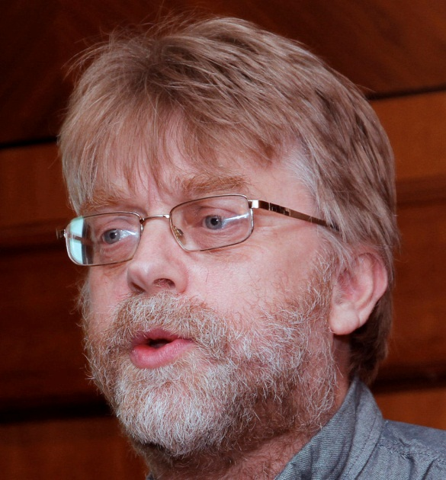
Social Web and Libraries
Brian Kelly
UKOLN
University of Bath
Bath, UK
Blog:
http://ukwebfocus.wordpress.com/
Twitter:
@briankelly: personal and professional use
1
Notes:
The title of this talk is “Social Web and Libraries”. My name is Brian Kelly and, as you might expect, I make use of social web services including my UK Web Focus blog and my @briankelly Twitter account.

Slide 2
About Me
Brian Kelly:
UK Web Focus: national advisor to UK HE and FE sector
Long-standing Web evangelist
Prolific speaker (~380 talks from 1997-2011)
User of social media to support professional activities
Prolific blogger (1,000+ posts since Nov 2006)
Based at Innovation Support Centre at UKOLN, University of Bath
UKOLN Innovation Support Centre (ISC):
Funded by JISC (Joint Information Systems Committee)
Supporting innovation across higher & further education
Notes:
My job title is UK Web Focus: national advisor to the UK’s higher & further education sector.
I am a long-standing Web evangelist, having set up my first web site in 1993.
I am a prolific speaker having given about 380 talks since 1997.
I also use social media to support my professional activities
I am a prolific blogger having written over 1,000+posts since I launched my blog in 2006.
I am based at the Innovation Support Centre in UKOLN, which is based at the University of Bath and funded by JISC to support innovation across the sector.

Slide 3
Contents
How the Social Web is being used for creating content, understanding content, enhancing access to content and supporting librarians in their role in facilitating access to content.
Background:
Web (1.0), Web 2.0 and the Social Web
The Library Context
Use of the Social Web in Libraries
The Key Technologies
Beyond the Technologies
Looking to the Future
Notes:
This talk will describe how the Social Web is being used for creating and understanding content, enhancing access to content and supporting librarians in their role in facilitating access to content.
The talk briefly looks at the history of the development of the web, from its roots through to Web 2.0 and the Social Web.
I will describe how the social web is being used in a library context and discuss key social web technologies and the softer characteristics of the social web and then conclude by looking into the future.

Slide 4
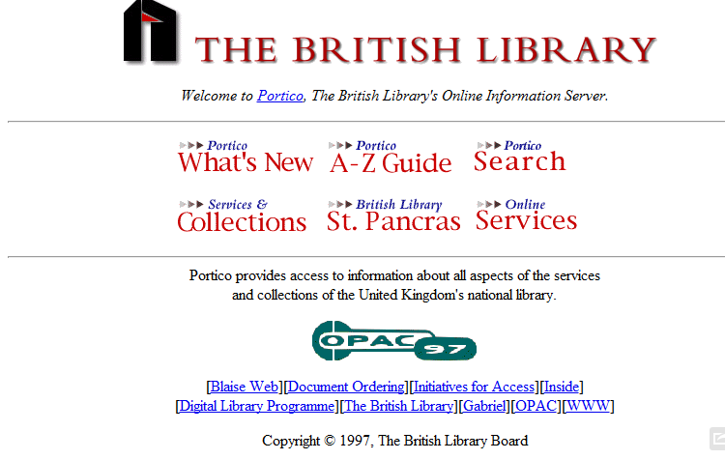
History of the Web: Web (1.0)
Web in the 1990s
Web became popular in mid-1990s
Initially “brochure-ware”: static information about the library
Then databases added with web interface: typically the OPAC and online searching
The Internet Archive’s Wayback Machine enables old web sites to be viewed. The oldest entry for the British Library captured in 1997 shows information about the library and provides access to the OPAC and a number of other online services
Notes:
The Web became popular in mid-1990s
Initially web sites were typically “brochure-ware”; providing access to static information about the library.
Then databases and other online services could be accessed using a with web interface: typically this included the library OPAC and other online databases. Search facilities for these databases and searching other local databases were provided.
The library web site often contained links to quality web sites. Such links were felt to be important as search engines, such as AltaVista, where in their infancy
The characteristics of this first generation of Web sites, which we might now call Web 1.0 were:
Static information.
Content hosted locally and managed centrally.
Links to quality resources were identified and managed by Library staff.
The end user was a passive consumer of resources provided by the library.

Slide 5
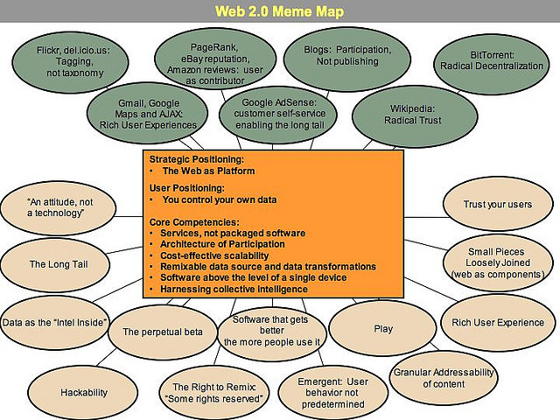
History of the Web: Web 2.0
By 2005 new different ways of using the web were being observed
This was coined “Web 2.0” at the O’Reilly 2005 conference
Technological characteristics
Social web characteristics
Attitudinal characteristics
Notes:
By 2005 new different ways of using the web were being observed.
Such new patterns of usage was coined “Web 2.0” at the O’Reilly conference held in 2005.
The characteristics of Web 2.0 included:
Technical aspects:
The Web as a platform, meaning the Web can host applications (such as email applications, mapping applications and social sharing and social networking services) as well as simply hosting information.
Content syndication using technologies such as RSS
APIs which enable software developers to access services provided by others (e.g. embed customised Google Map within a local web site)
New technological applications areas: including blogs and wikis.
Non-technical aspects including:
A focus on the openness of resources which allows content to be reused by others.
Web 2.0 was sometimes referred to as “an attitude not a technology”.
Over time the term Social Web became popular to describe services in which the user as a creator of content and not just a passive consumer and services which benefited from what is known as the ‘network effect’ – they get better as the number of users increases.

Slide 6
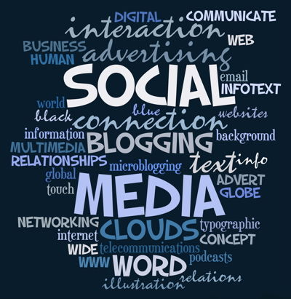
The Social Web
The term ‘social web’ became popular to identify the aspects of Web 2.0 which were of particular relevance to:
the creation of content by users
The services which ‘became better as the numbers of users grew”
Notes:
We now hear terms such as the ‘social web’, ‘social media’ and ‘social networks’ being widely used to refer to a wide variety of applications
Let us now explore one of the key characteristics of the social web.

Slide 7
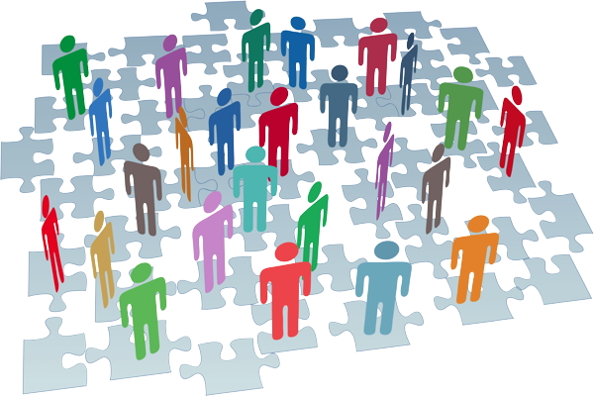
Another View
Social networks get better as numbers increase (cf telephones). Remember the 1-9-90 ‘law’.
Notes:
Social networks benefit from the ‘network effect’: they get better as numbers increase. An example of the network effect can be seen from the history of telephones. The telephone clearly wasn’t much use when there was only a single phone. However when in the 60s most households and offices had landlines we could rely on the phone for social and business purposes. And then when most people had a mobile phone, this provided new opportunities, such as being more flexible when meeting friends.
The 1-9-90 law has been used to describe how in many social networks for every 100 participants, 90 will be lurkers, 9 participate occasionally and 1 will be an active participant. Effective social networks can therefore benefits from the global reach of popular services, with the ‘long tail’ meaning that even niche areas of interest may attract sustainable networks.

Slide 8
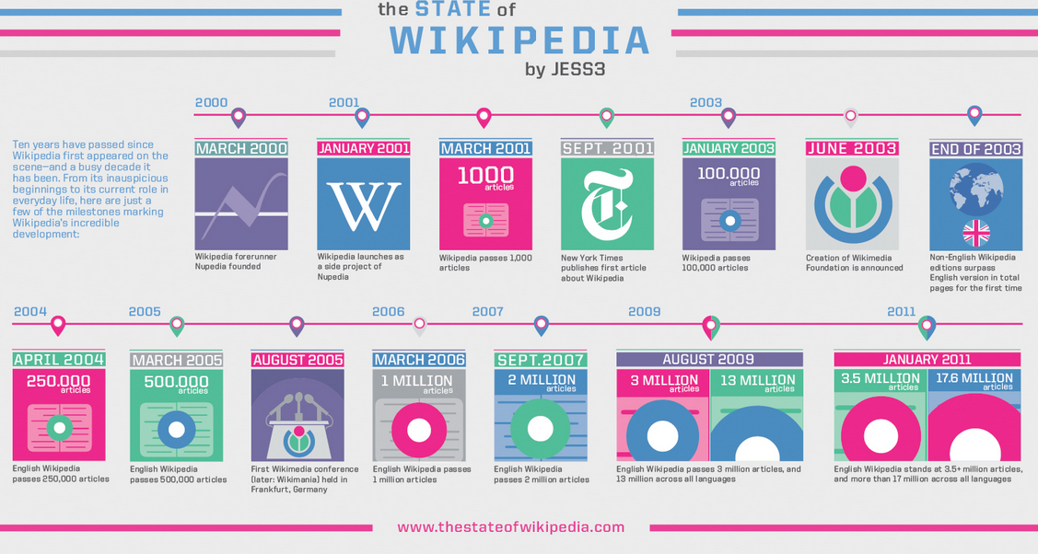
Wikipedia infographic
‘Radical trust’: trusting large numbers to create quality content (the good drives out the bad)

Slide 9
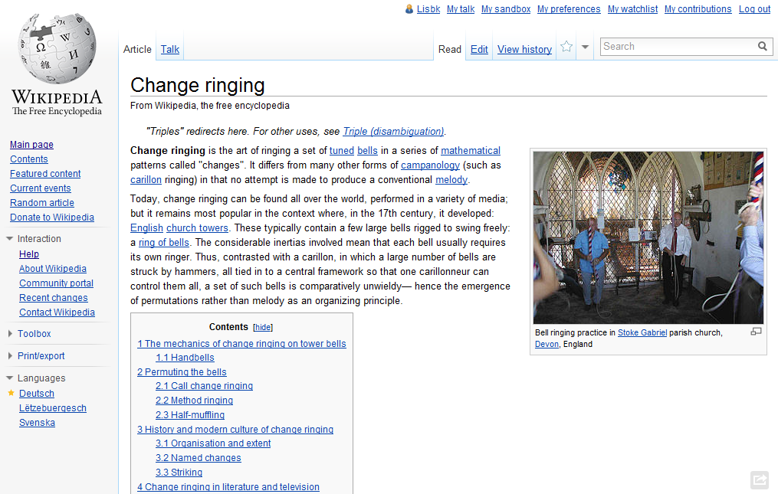
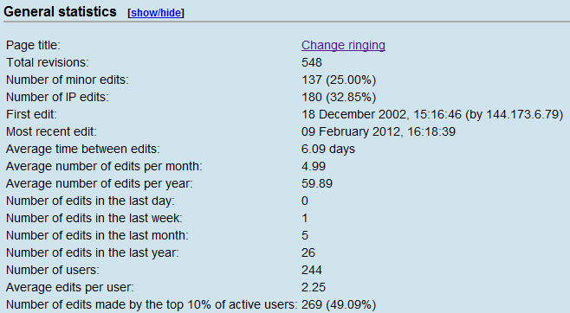
Bell-ringing article
Notes:
If you have an interest in bell-ringing, for example, you’ll discover a well-written Wikipedia page, with a large number of contributors.

Slide 10
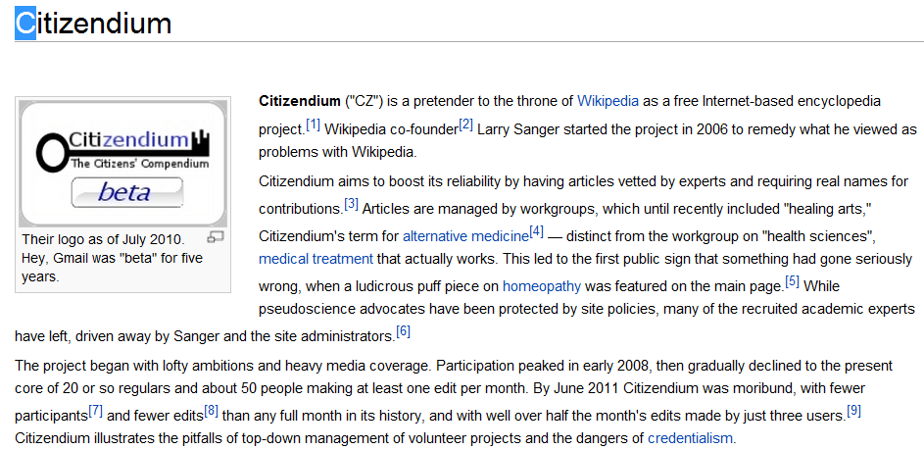
Citizendium
If you don’t trust your users they may fail to engage

Slide 11
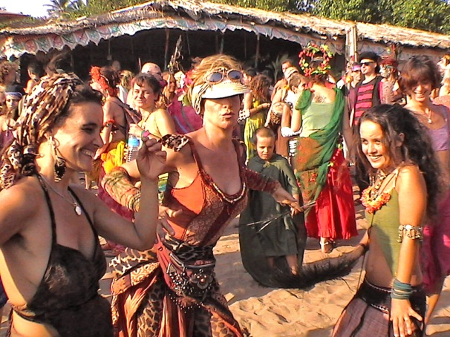
The Problem With ‘Social’
Does ‘Social’ mean:
Trivial
Personal
Unrelated to professional or scholarly activities
Or:
Collaborative
Collective
Team working

Slide 12
Redefining ‘Social’
Social media / Social web / Social networks:
Collaborative technologies
Interactive technologies
Culture of openness and sharing
which support:
Social constructivism / social constructionism theories of knowledge: “individual's learning that takes place because of their interactions in a group”
Wikipedia

Slide 13
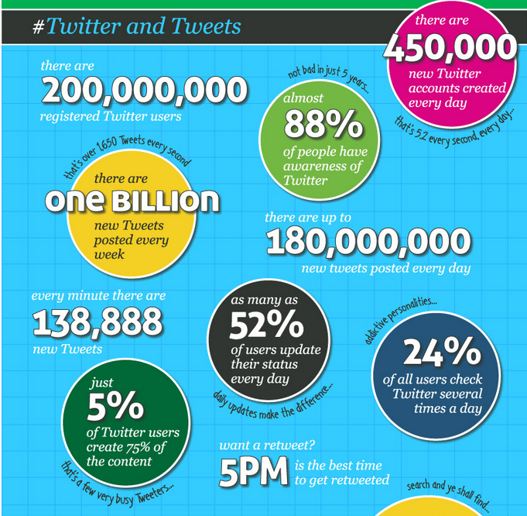
Twitter is valuable because of, not despite the scale of use.

Slide 14
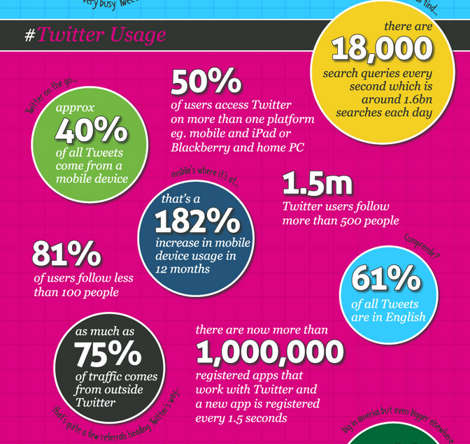
Twitter statistics show the importance of searching – an area in which librarians have expertise
As Important As Google?
In 2010: ‘Twitter [Did] 19 Billion Searches Per Month [600M/day], Beating Yahoo & Bing’

Slide 15
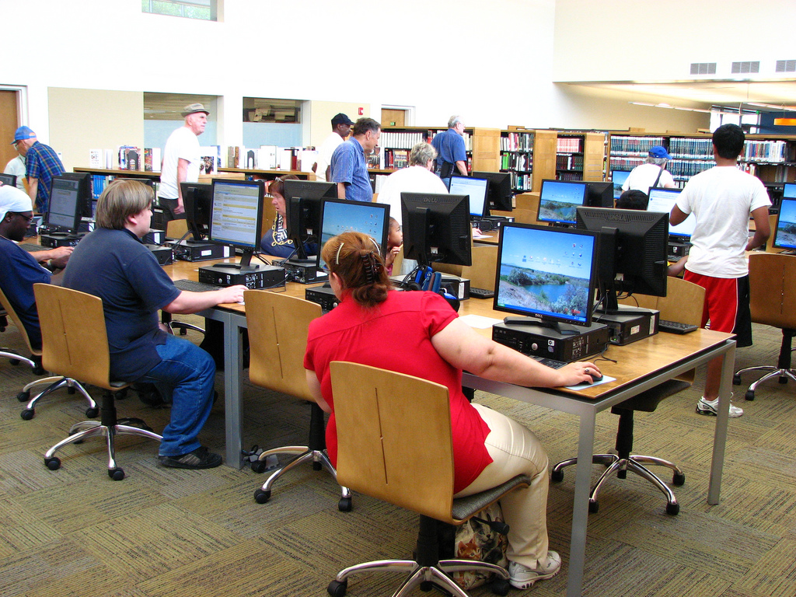
Use of Social Web in Libraries
Use of Social Web in Libraries or for Libraries

Slide 16
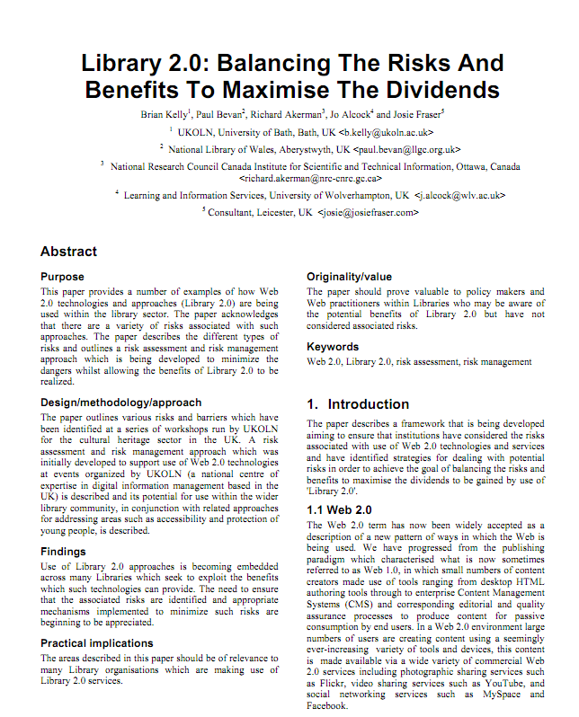
http://opus.bath.ac.uk/15260/
Paper on “Library 2.0: Balancing the Risks and Benefits to Maximise the Dividends” published in Program, 2009 highlighted early example of use of social web by some library 2.0 pioneers, including National Library of Wales

Slide 17
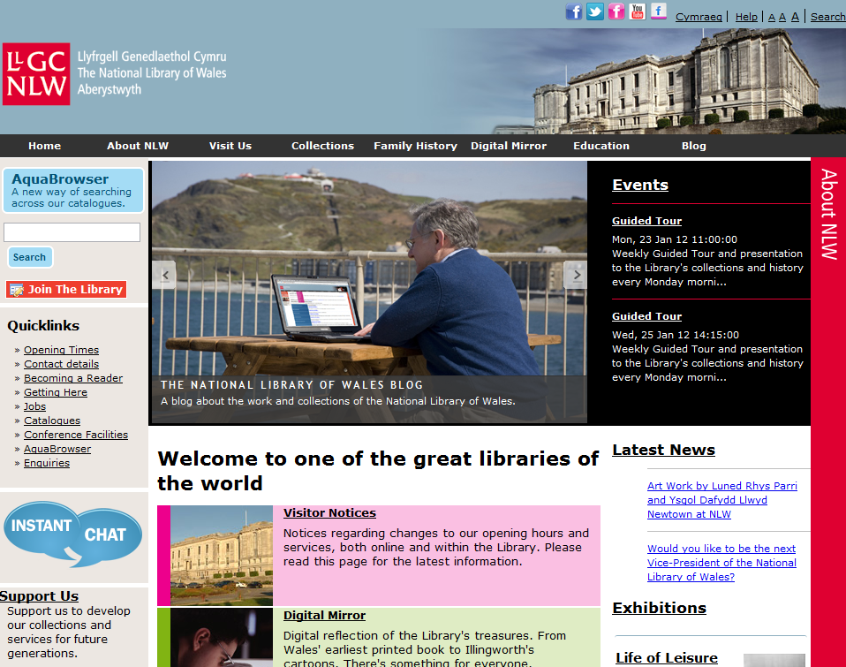
National Library
National Library of Wales

Slide 18
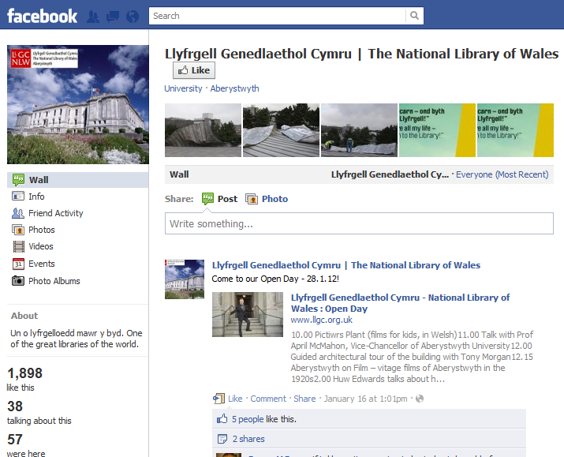
NLW Facebook Page
The Natiopnal Library of Wales has a presence on Facebookxxx

Slide 19
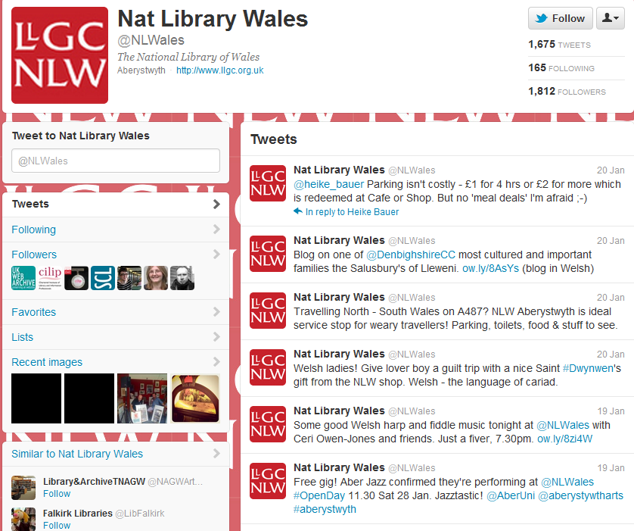
NLW Twitter Feed
The National Library of Wales has a Twitter account

Slide 20
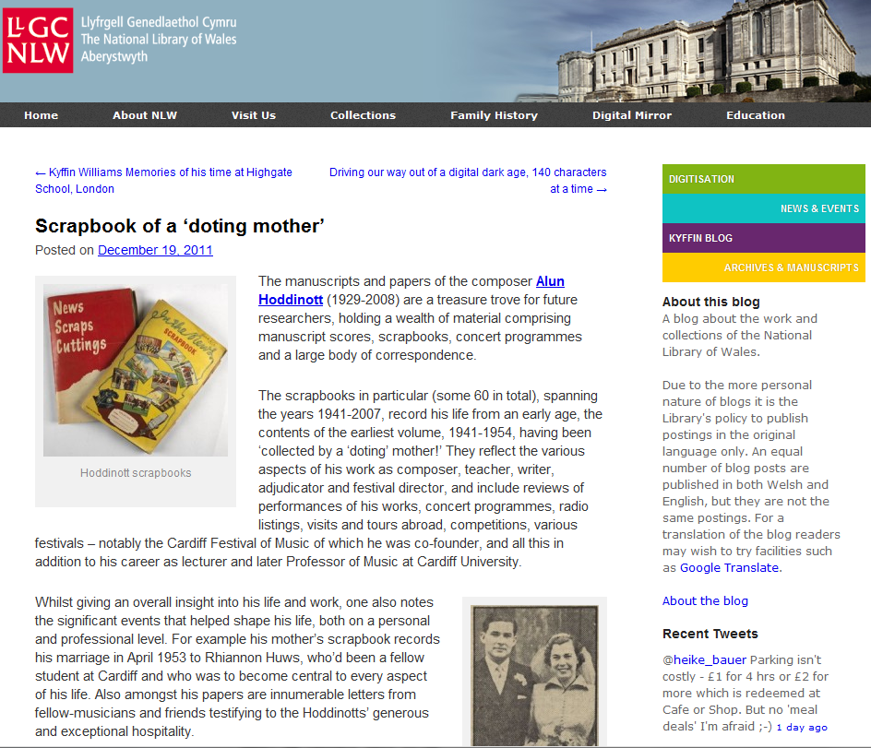
NLW Blog
The National Library of Wales web sites hosts a blog

Slide 21
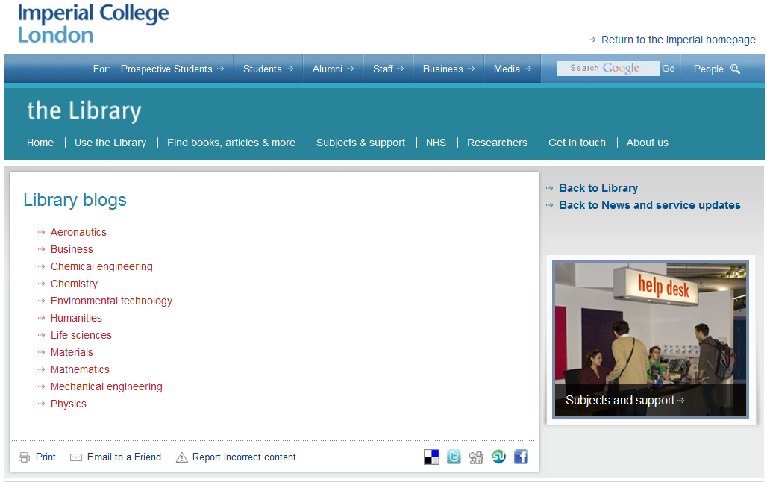
Academic Library
Imperial College uses blogs to provide information to faculties within the college

Slide 22
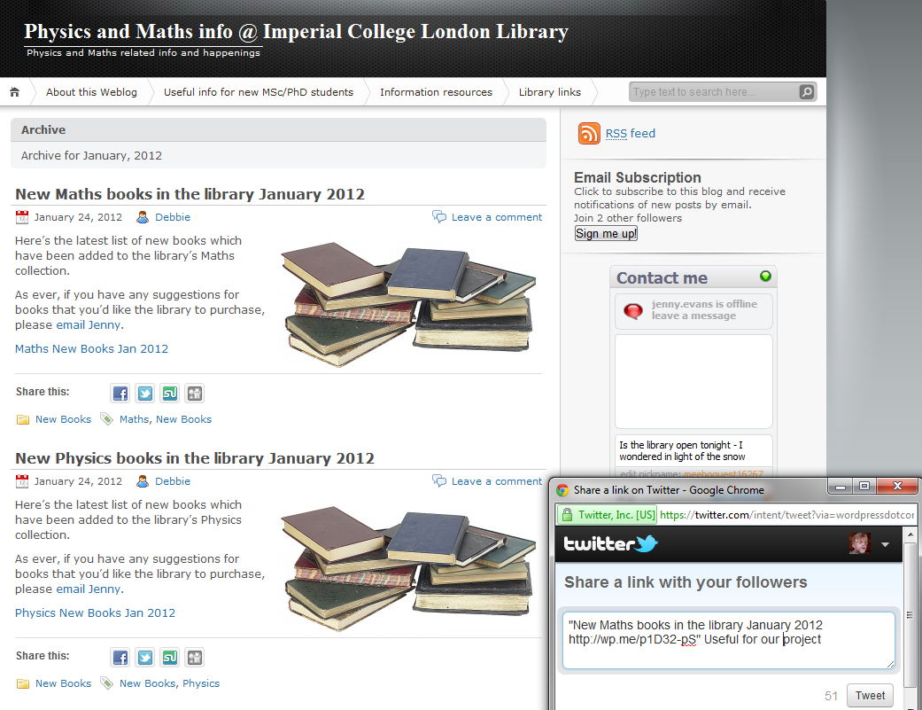
Academic Library
Imperial College blog

Slide 23
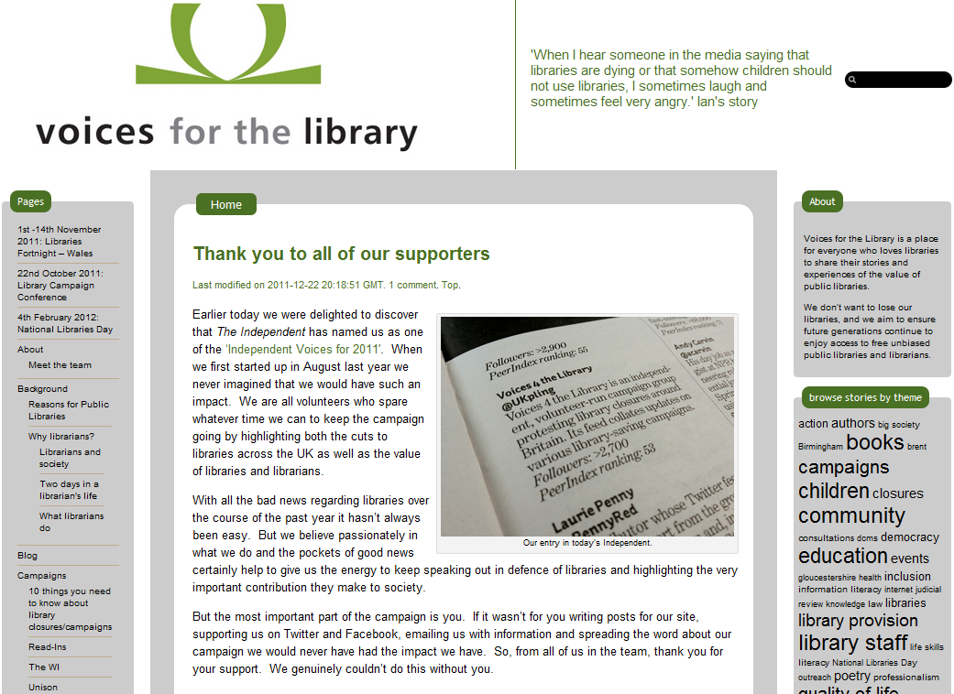
Voices for the Library
The Social Web can be particularly effective if contributors have a passion for their activities
This can be seen from the Voices for the Library Campaign
Notes:
The Social Web can be particularly effective if contributors have a passion for their activities
This can be seen from the Voices for the Library Campaign

Slide 24
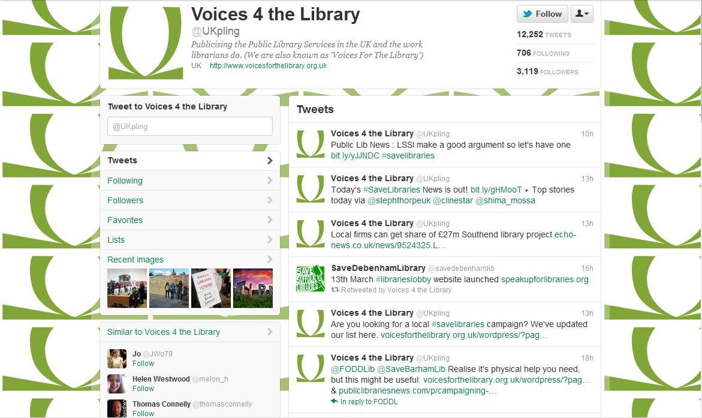
Voice for the Library: Twitter
UKPling Twitter account

Slide 26
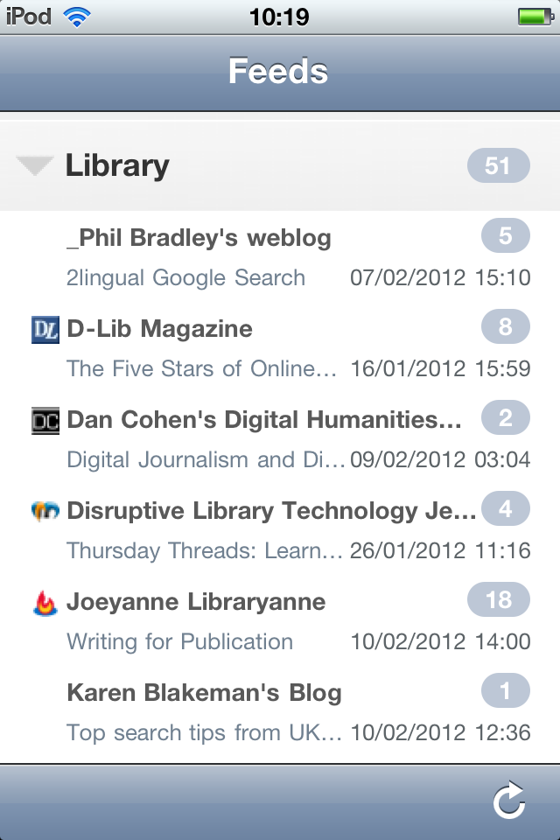
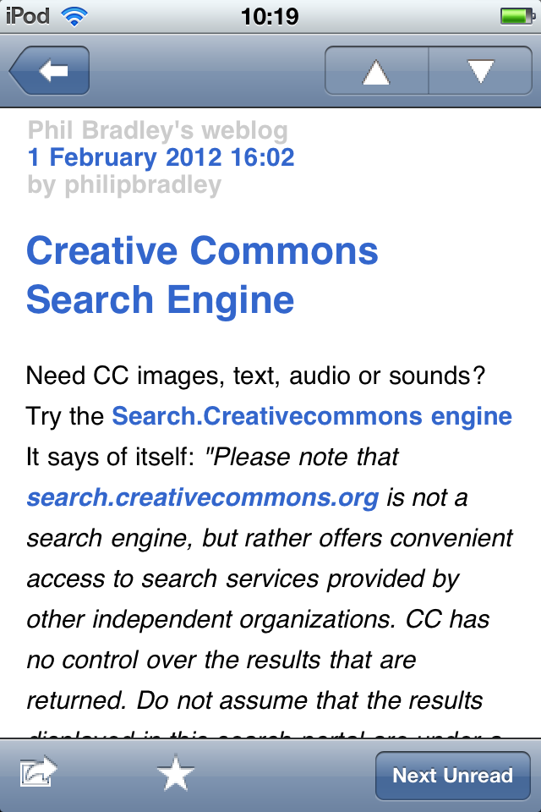
Key Technologies: Blogs
Reading blogs helps you to keep up-to-date with developments in a rapidly changing world

Slide 27
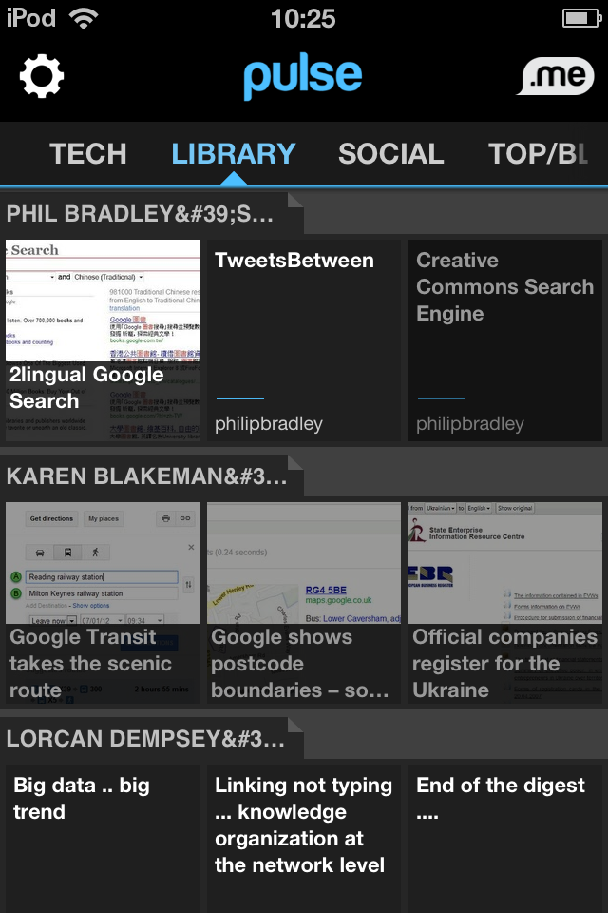
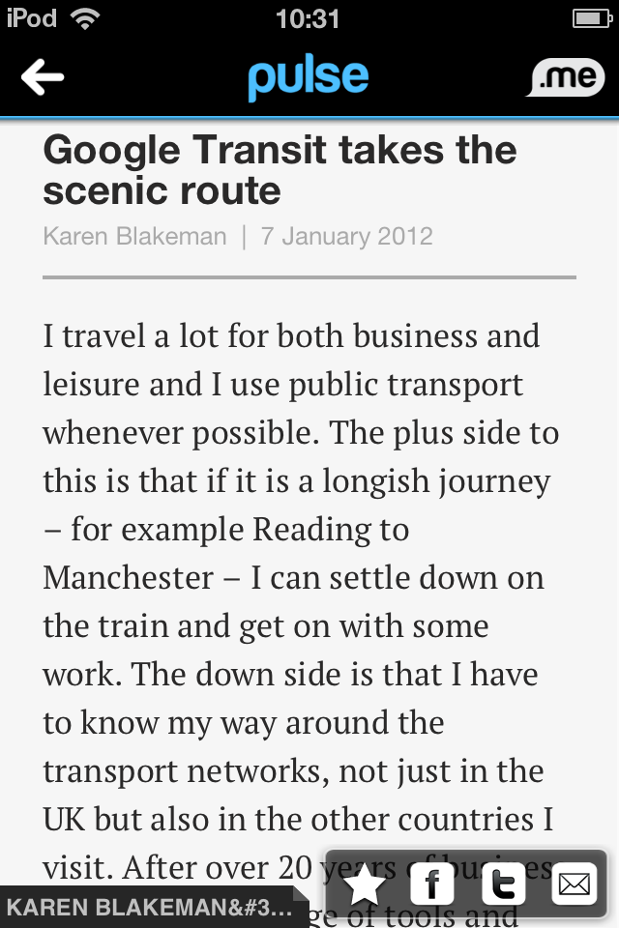
Key Technologies: Blogs
Blog posts can be read by RSS readers and personalised newspaper apps
They are easily read on smart phones and tablet computers

Slide 28
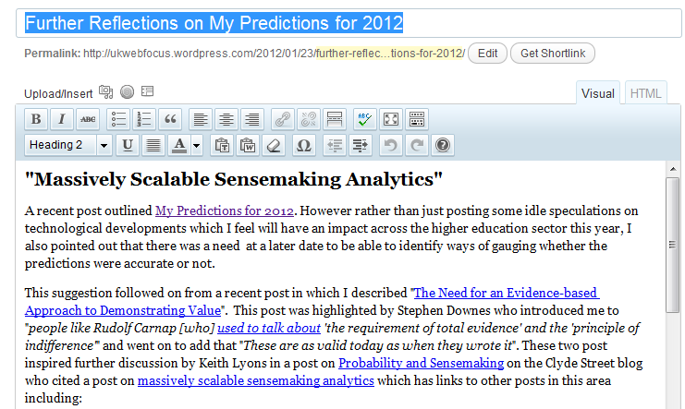
Key Technologies: Blogs
Why provide a blog?
Writing a blog post can be easy: a typical interface looks like a word processor

Slide 29
Key Technologies: Blogs
Why provide a blog?
If you don’t have a blog platform within the organisation (e.g. there are technical or policy barriers) you can use a blog service in the cloud (e.g. Wordpress.com or Blogspot.com)
Blogs provide comment facilities as standard
Blogs are often easy to read on mobile devices
The question should be:
Why not provide a blog?

Slide 30
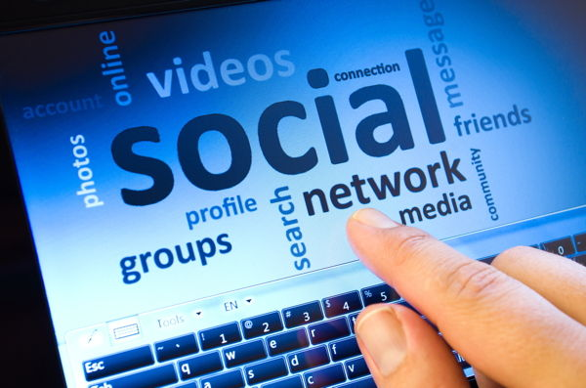
There are many social media services but we can’t ignore Twitter!

Slide 31
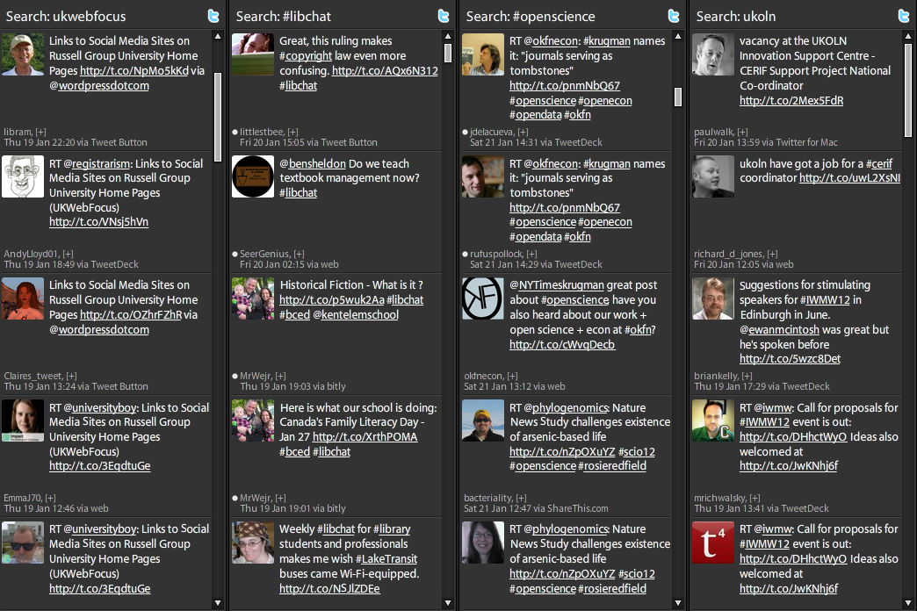
Twitter
The Tweetdeck Client (PCs, Mac for mobiles)
A dedicated Twitter client can provide rich filtering.
Twitter makes sharing links easy.
Tweeting at events is a form of collaborative note-taking.
Twitter encourages brevity and focus: how have people got the time to read and write long emails? ☺

Slide 32
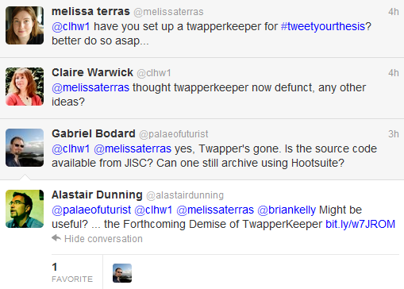
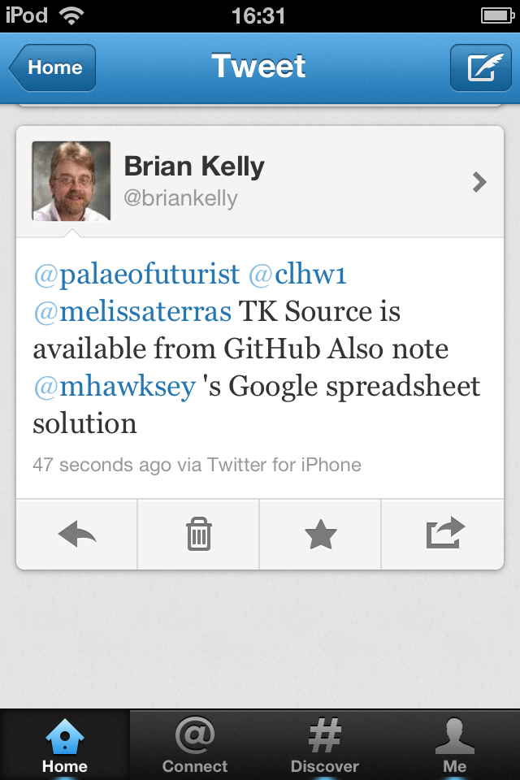
Rapid Support from Peers
Rapid support from one’s professional learning network (PLN)
3:58pm
4:17pm
4:23pm
4:30pm
4:27pm

Slide 33
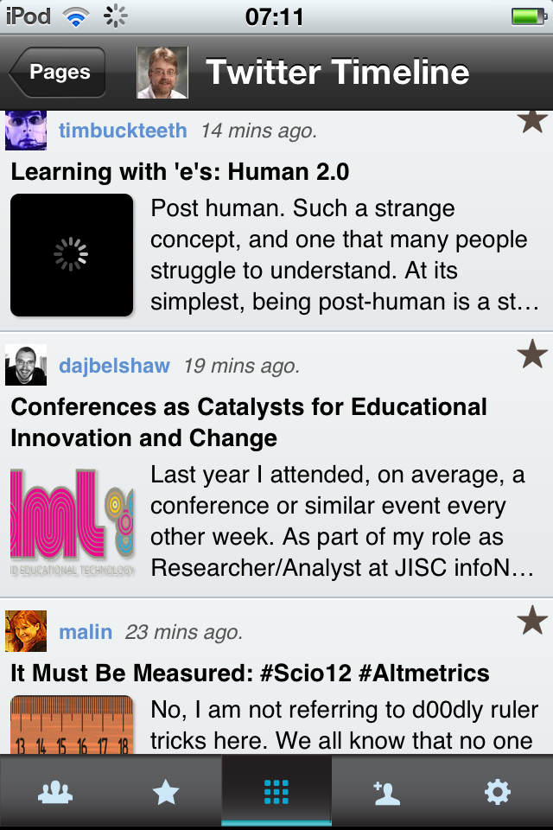
Getting Smartr
One approach to filtering is to use tools such as Smartr to provide access to the content of links posted on Twitter
Use Twitter lists to group the people you follow: I have a list of official JISC Services from which I receive quality links but prefer the serendipitous links from other groups of people I follow

Slide 34
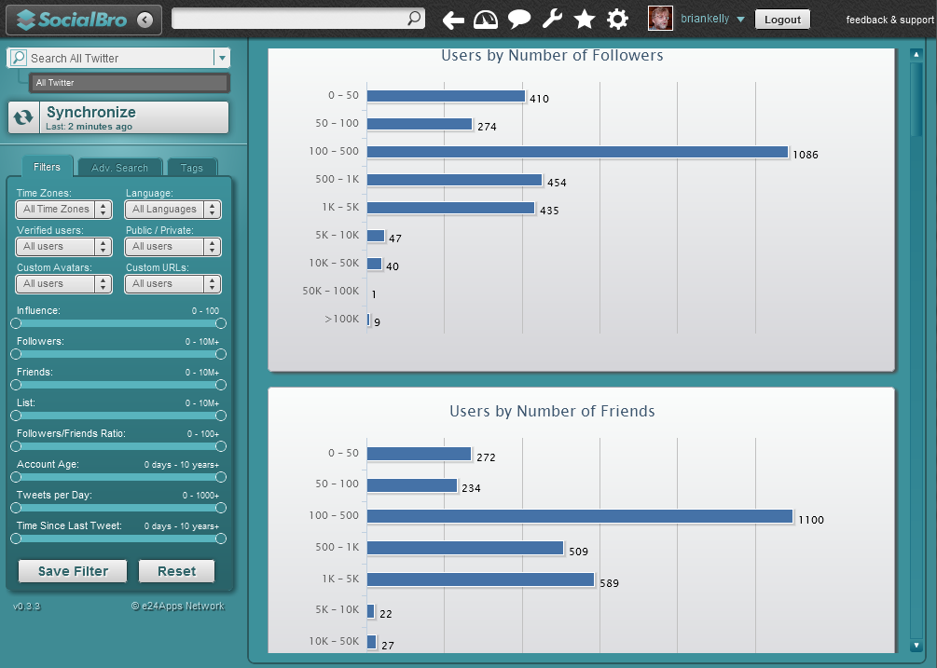
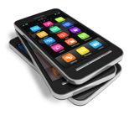
Understanding Social Media
We need to understand how we use social media in order to identify successful patterns
Many of my Twitter followers have between 100-500 followers

Slide 35
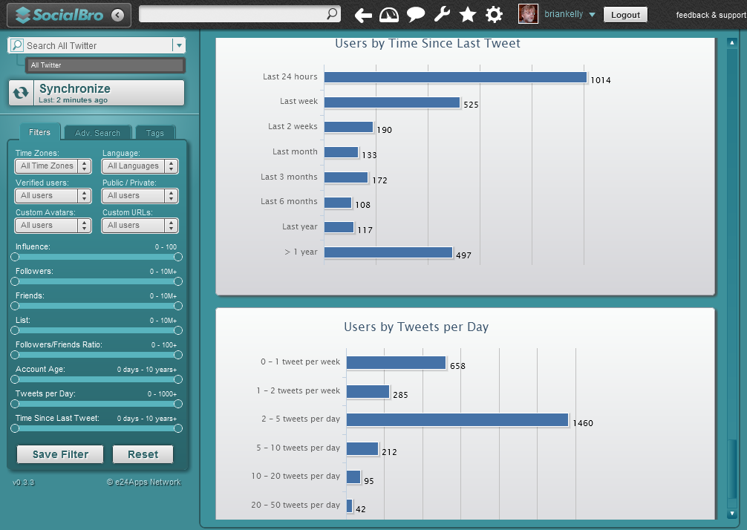
Understanding Social Media
We need to understand how we use social media in order to identify successful patterns
Many of my Twitter followers tweet on a daily basis

Slide 36
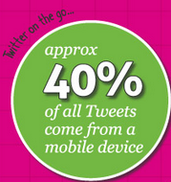
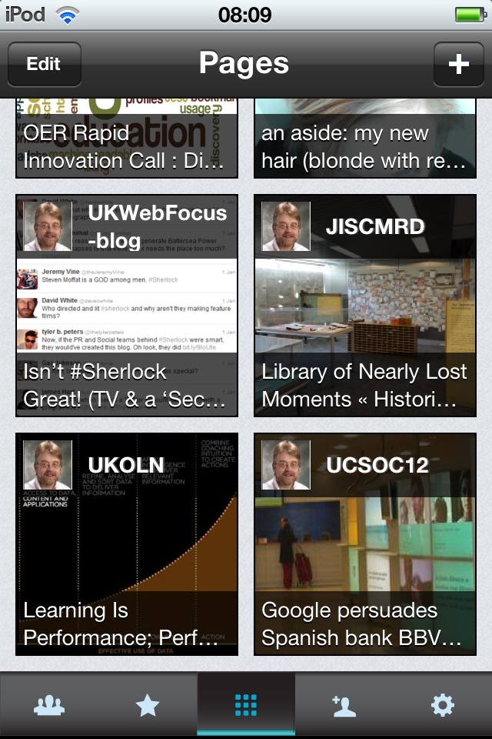
The Mobile Environment
Access to information on Mobile Devices is growing in importance
Personalised newspapers (Smartr, Flipboard, etc.) provide access to RSS feeds, tweets, etc. on mobile devices.
This is a few of the links tweeted by members of my Twitter lists

Slide 37
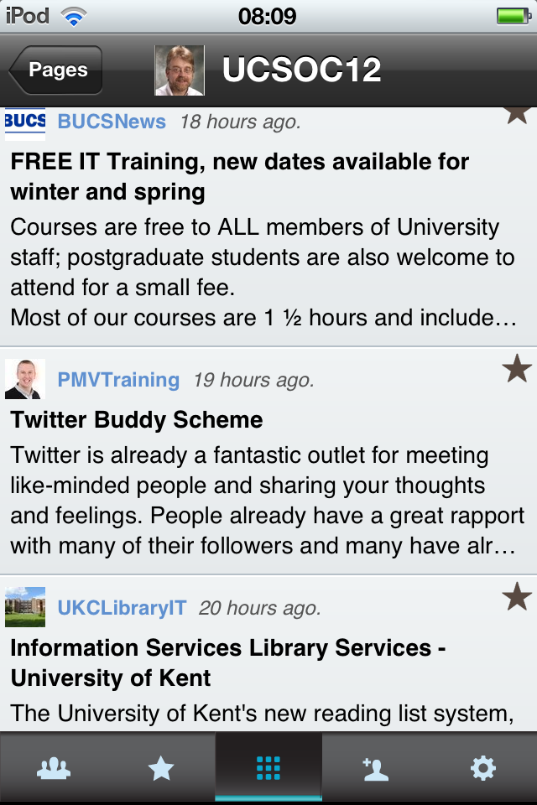
The Mobile Environment
Access to information on Mobile Devices is growing in importance
Personalised newspapers (Smartr, Flipboard, etc.) provide access to RSS feeds, tweets, etc. on mobile devices.
This is a few of the links tweeted by members of my Twitter lists
I now read useful and personalised content on the bus. Twitter provides a valuable productivity aid!

Slide 38
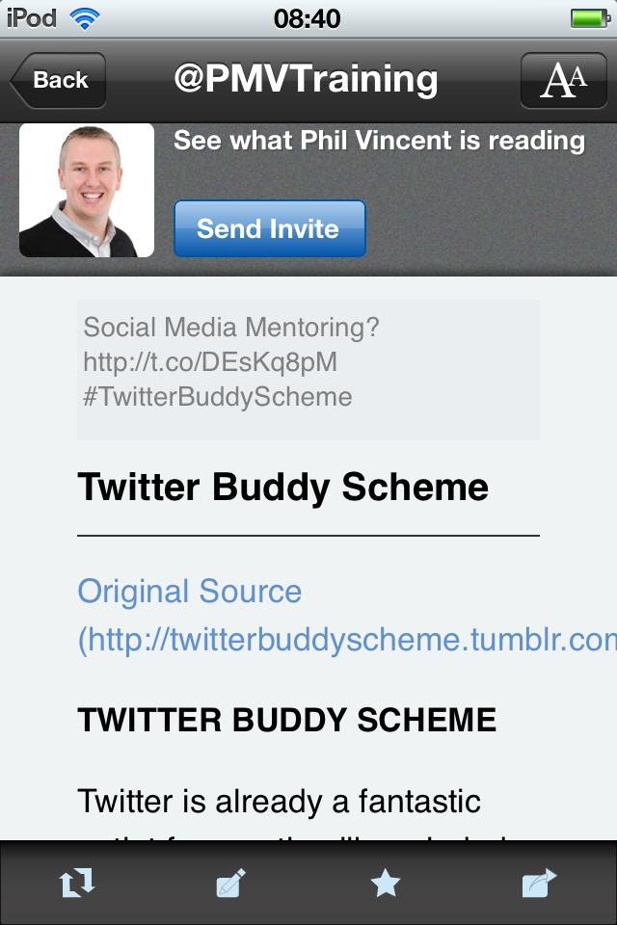
The Mobile Environment
Access to information on Mobile Devices is growing in importance
Personalised newspapers (Smartr, Flipboard, etc.) provide access to RSS feeds, tweets, etc. on mobile devices.
This is a few of the links tweeted by members of my Twitter lists
I now read useful and personalised content on the bus. Twitter provides a valuable productivity aid!

Slide 39
Challenges (1)
Most-liked tweets: questions to followers, information sharing and self-promotion (sharing links that you created)
Concerns:
“I wouldn’t know what to say”
First tweet is the hardest ☺ Write about things that interest you: CMU study, Feb 2012
“I’m too busy”
Nonsense! 5 tweets a day?
“My boss disapproves” “Access is blocked”
Is this still the case?
Need for evidence of value to your organisation
“I don’t agree that there are benefits”
Still need for case studies & evidence

Slide 40
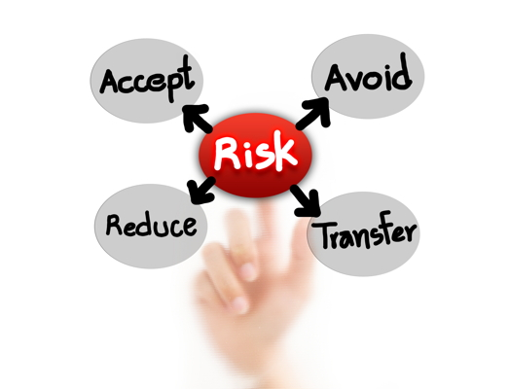
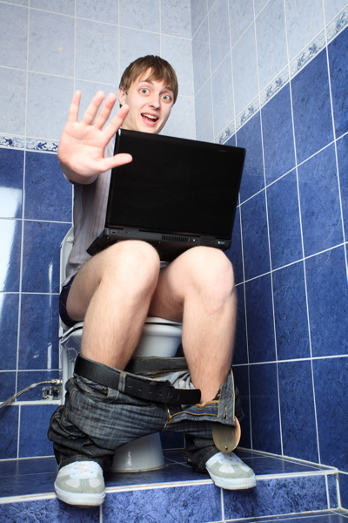
Challenges (2)
“I’ll get addicted”
That’s a challenge of success!
Worried about the risk of getting addicted to interesting content and discussions? Is that different from:
Joining the adult library as a young person?
The multi-channel TV environment?
Music on demand?
…

Slide 41
Challenges (3)
“I can’t keep up with tweets & blog posts ☹”
Don’t! It’s a stream for you to dip into and contribute to. Learn when it’s useful to take a dip
“I can see the merit – but it’s not for me”
OK – but don’t block others who wish to do it
”Plants” and “Resource investigators” in Belbin model may welcome opportunities provided by social media

Slide 42
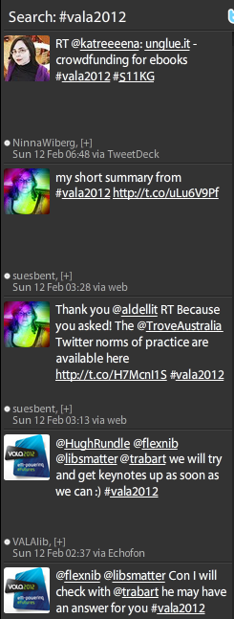
Looking To The Future (1)
Keeping Up-To-Date
Challenge: How to keep up-to-date at a time of decreasing budgets
Solution: Participate in ‘amplified events’
Amplified events:
Make use of networked technologies to ‘amplify’ learning & discussions at events
Attendees can summarise key points, provide links, etc. for remote audience
Valuable to build a professional network so you are alerted to amplified events

Slide 43
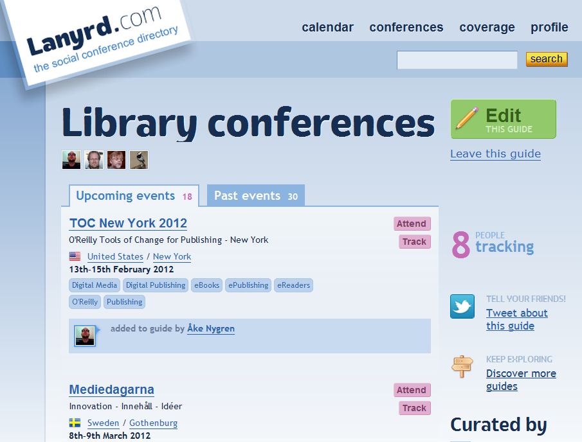
http://lanyrd.com/guides/library-conferences/
Lanyrd Library Guide

Slide 44
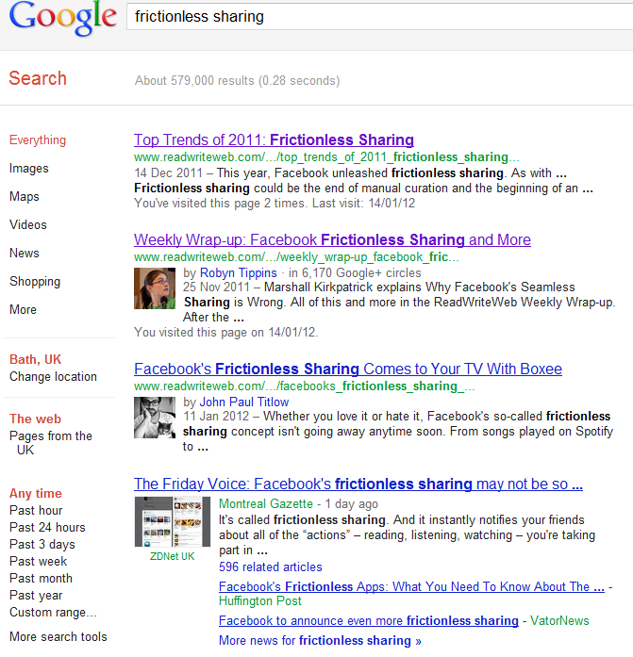
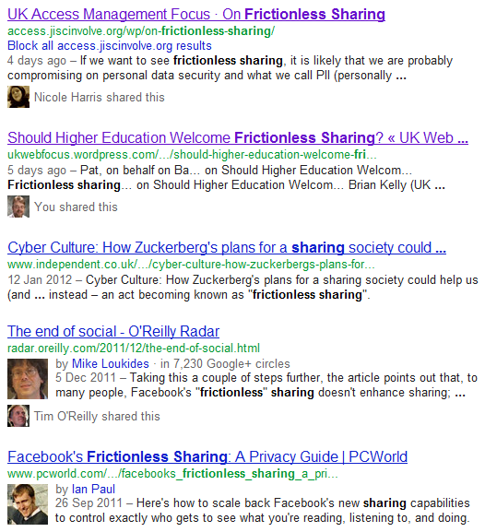
Looking To The Future (2)
Frictionless Sharing:
Low effort ways of sharing resources
Term used by Prof. Martin Weller in 2008
Recently popularised by Facebook
“Invisible Library Support”

Slide 45
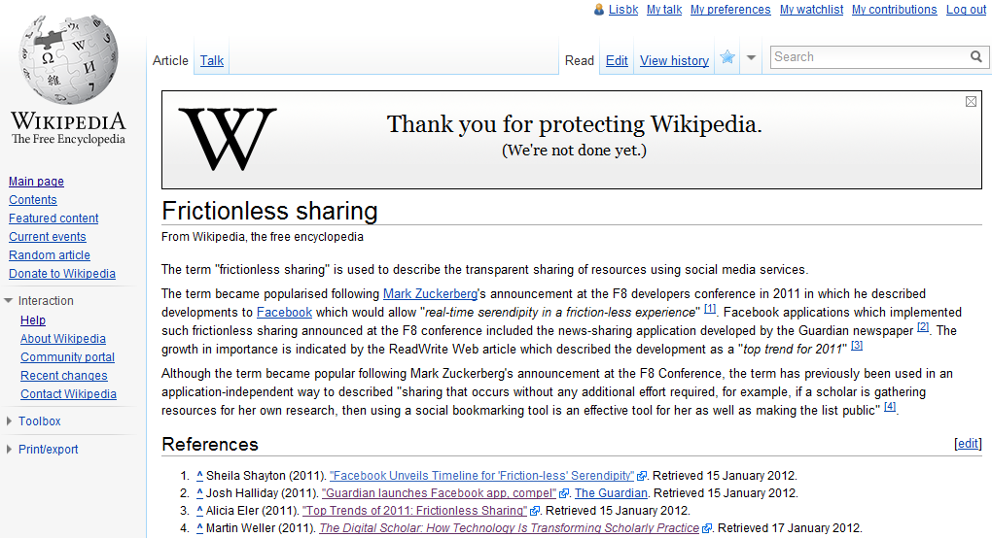
Don’t Just Listen - Participate
You can improve Wikipedia, such as this article

Slide 46
Conclusions
Social Web:
Focus on communication, community & collaboration
Services can get better as numbers of users grow
Provides diversity of tools for differing requirements and preferences
Will not go away!
Opportunity for Library Services to play a leading role
Opportunity for those with people / communication skills
Using cloud services can reduce costs
Being open fits with transparency agenda

