Slide 1
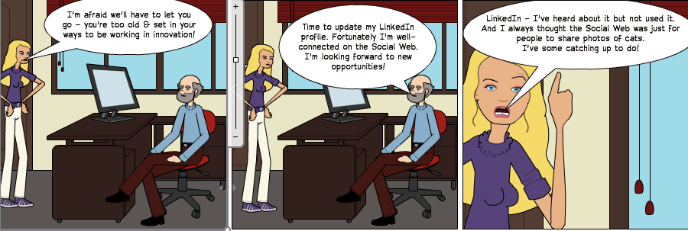
Managing Your Digital Profile
Managing Your Digital Profile
Brian Kelly, UKOLN
How can you manage your online profile in order to ensure that when people (including potential funders, collaborators, etc.) Google you, they find useful information about your professional activities?

Slide 2
Managing Your Digital Profile
Twitter:
#ukoln
http://www.ukoln.ac.uk/web-focus/events/meetings/ukoln-managing-digital-profile-2012/
Brian Kelly
UKOLN
University of Bath
Bath, UK
Acceptable Use Policy
Recording this talk, taking photos, discussing the content using Twitter, blogs, etc. is welcomed providing distractions to others is minimised.
Email:
b.kelly@ukoln.ac.uk
Blog:
http://ukwebfocus.wordpress.com/
Twitter: @briankelly
ORCID: 0000-0001-5875-8744
http://bit.ly/briankelly-orcid
LinkedIn:
http://www.linkedin.com/in/ ukwebfocus
UKOLN is supported by:
This work is licensed under a Creative Commons Attribution 2.0 licence (but note caveat)

Slide 3
Idea from Cameron Neylon
You are free to:
copy, share, adapt or re-mix;
photograph, film or broadcast;
blog, live-blog or post video of
this presentation provided that:
You attribute the work to its author and respect the rights and licences associated with its components.
Slide Concept by Cameron Neylon, who has waived all copyright and related or neighbouring rights. This slide only CCZero.
Social Media Icons adapted with permission from originals by Christopher Ross. Original images are available under GPL at:
http://www.thisismyurl.com/free-downloads/15-free-speech-bubble-icons-for-popular-websites
3

Slide 4
About This Session
This session will:
Describe ways of managing one's professional digital profile.
Cover general services such as LinkedIn together with services of particular relevance to researchers, such as Google Scholar, Academia.edu, ResearchGate and ORCID.
Describe ways in which other Social Web tools can be integrated with these services.
Provide an opportunity to discuss potential risks and concerns and ways of managing such concerns.

Slide 5
Your Interests?
What:
Specific tools and services
General issues
would you like to see addressed?
Which tools do you currently use for raising your professional profile?
What concerns do you have?

Slide 6
The Aims & Opportunities
A summary of the aims:
You want potential collaborators, funders and employers to easily find information about you and your previous work
You want your previous work to be easily found and for this to provide access to your current activities
A summary of the opportunities:
We work in a digital environment
We work for a Googleable organisation: ‘UKOLN’ rather than ‘bath’
Our outputs are (mostly) publically available
We have time to enhance our digital profile

Slide 7
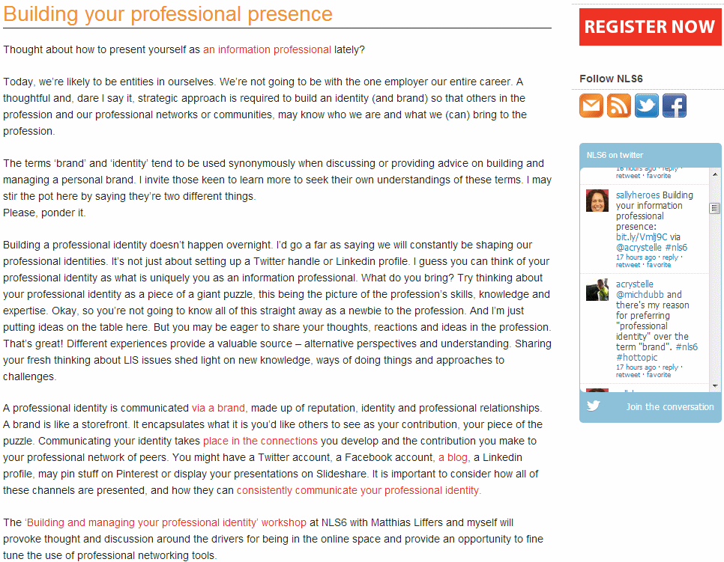
Building Your Professional Presence
New Librarian’s Symposium, Queensland, Feb 2013
Now mainstream (though arguments about terminology

Slide 8
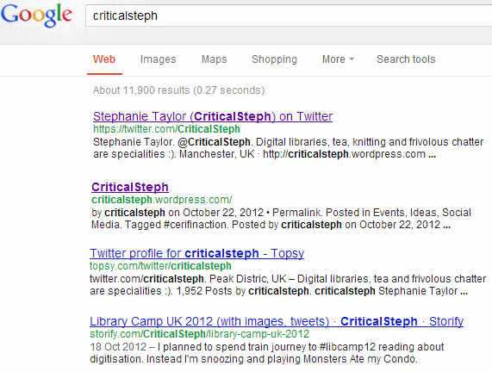
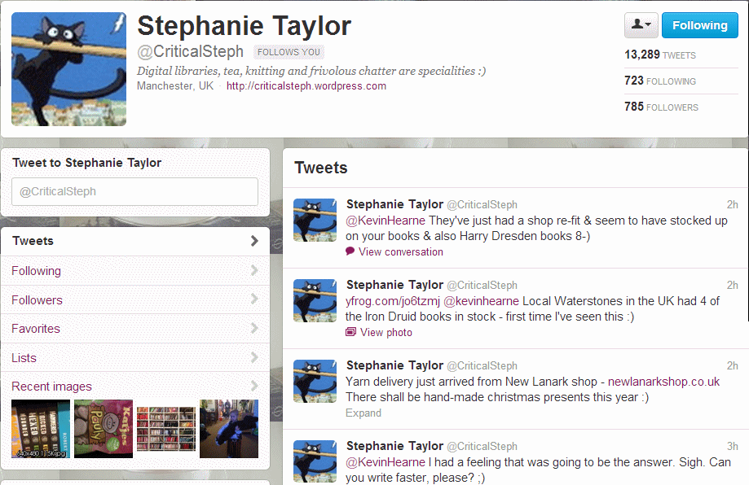
Your Personal Professional Brand
CriticalSteph: good example of a consistent digital brand.

Slide 9
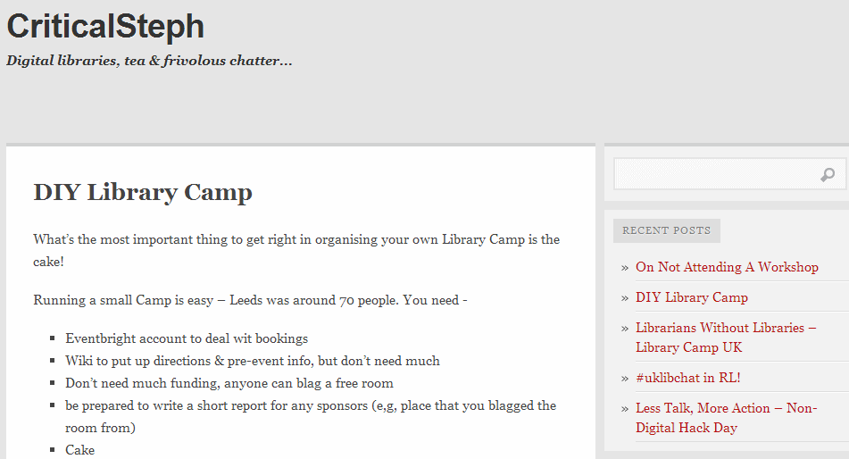
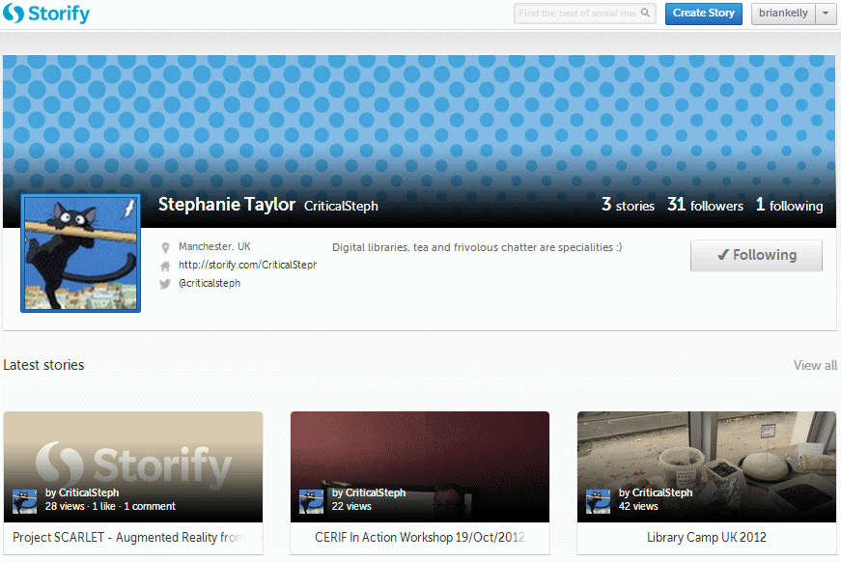
Your Personal Professional Brand
CriticalSteph: good example of a consistent digital brand.
CriticalSteph’s consistent brand

Slide 10
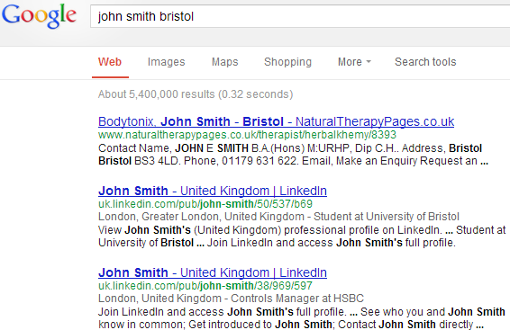
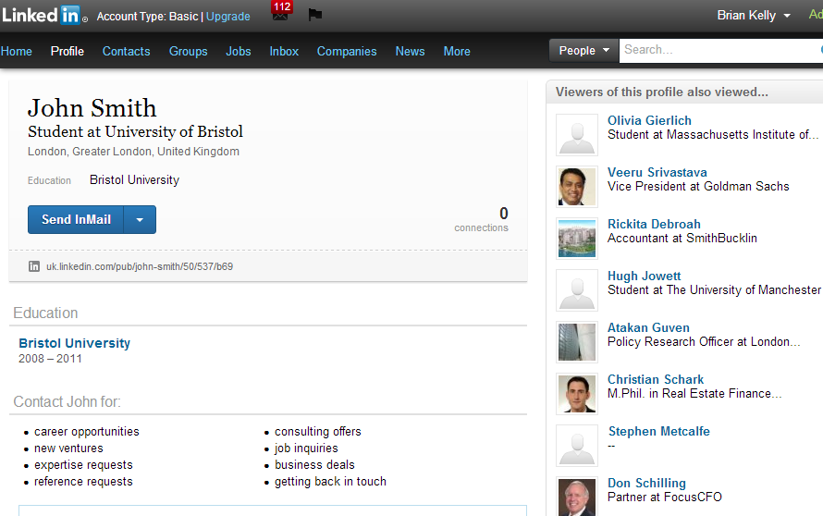
Everyone Uses Google!
Google search for “John Smith, Bristol”
Google search for people often find LinkedIn profiles

Slide 11
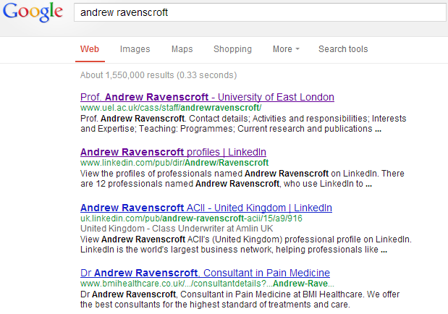
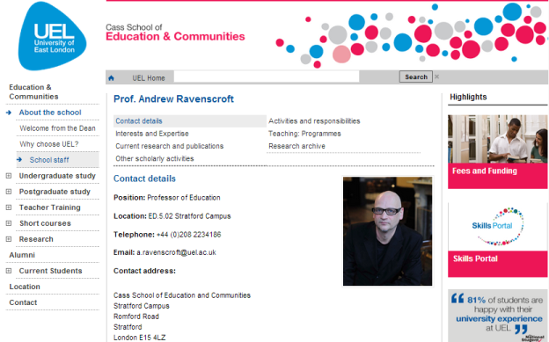
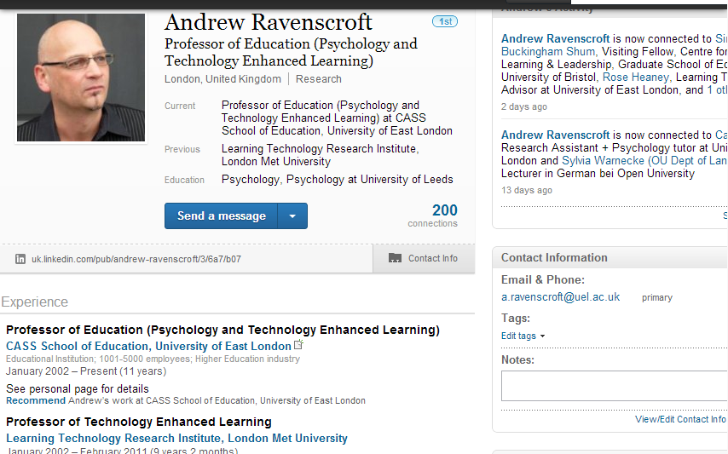
LinkedIn
Google search for an academic: Andrew Ravenscroft who visited India recently (to advise on elearning strategies)
Importance of LinkedIn

Slide 12
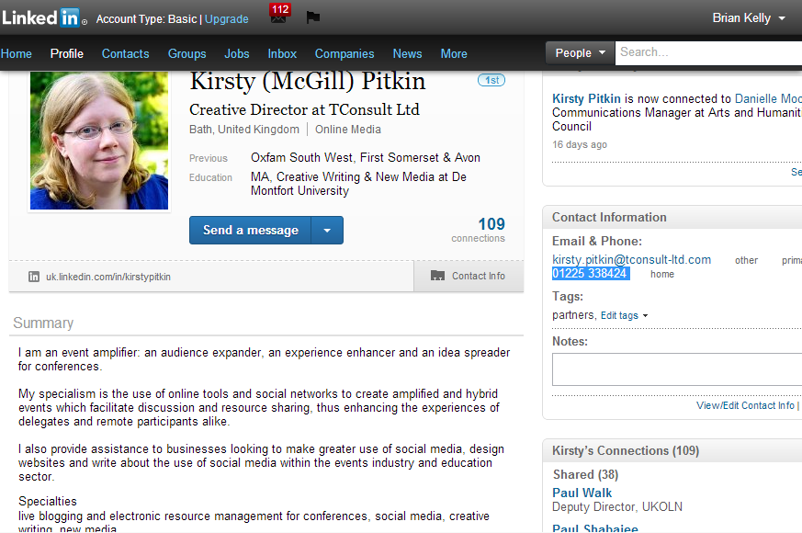
Getting the Message Across
LinkedIn
Kirsty Pitkin’s LinkedIn profile

Slide 13
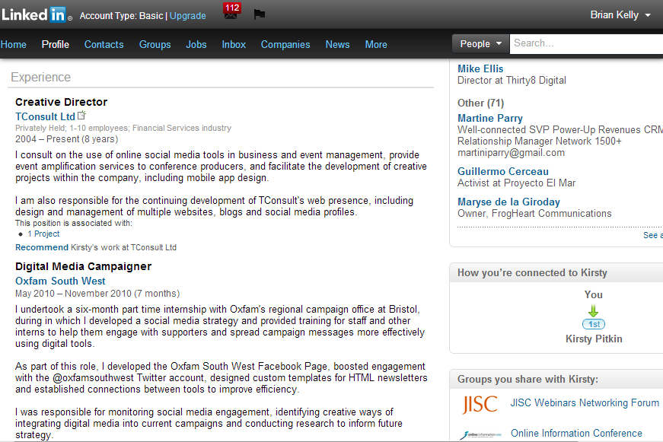
Getting the Message Across
Kirsty’s LinkedIn profile

Slide 14
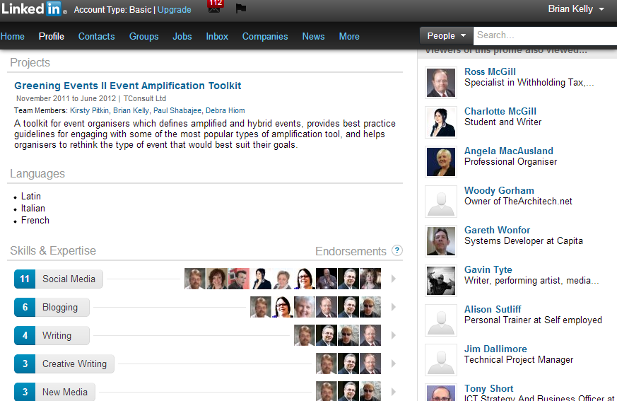
Getting the Message Across
Kirsty’s LinkedIn profile

Slide 15
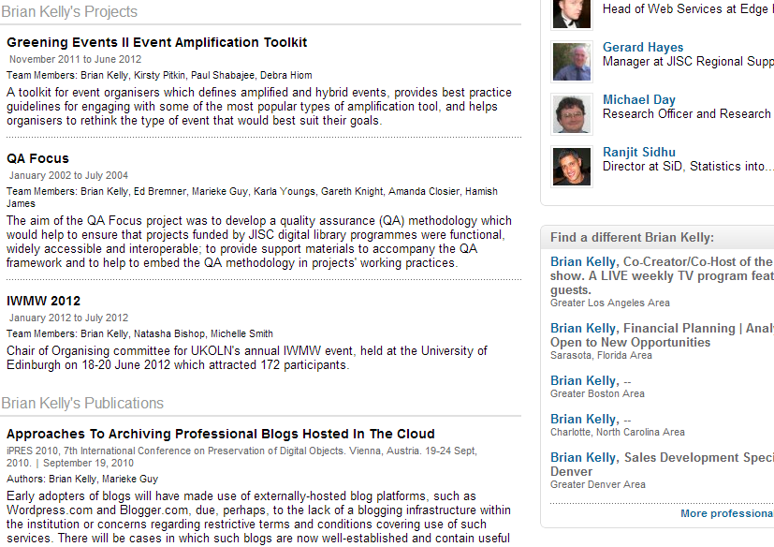
Getting the Message Across
My LinkedIn Profile
LinkedIn works because:
It’s Google-friendly (HTML SEO techniques)
It’s popular: lots of links = improved Google-ranking
It works

Slide 16
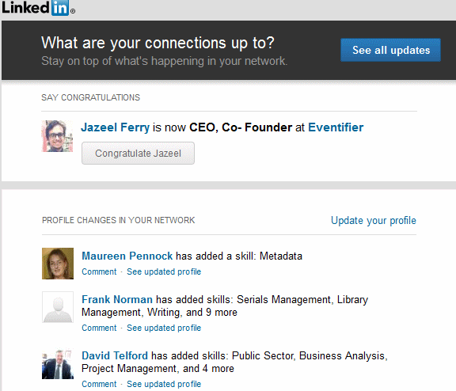
LinkedIn Notifications
You can receive email notifications
You can also change email preferences, update privacy settings, …
On December 11, 2012, you'll be getting the new LinkedIn profile, which has a simplified design, provides deeper insights, and surfaces new ways to connect and build relationships. You'll also be one of the first to preview a new way to showcase rich content on your profile -- like presentations, videos, documents, and more.

Slide 17
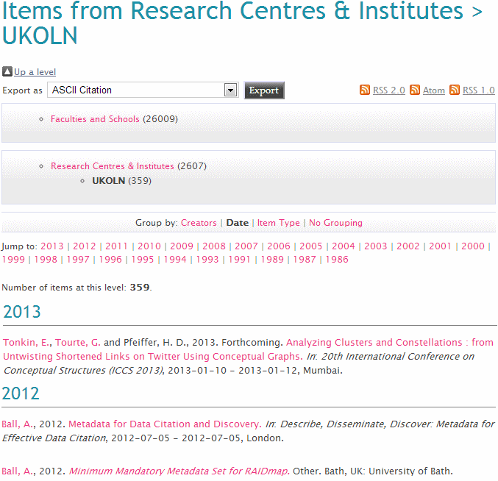
Opus
Opus
UKOLN staff would be expected to make significant use of institutional repository for hosted full-text items
Survey in June 2011 showed 43% full text items (only ~7% for Bath)

Slide 18
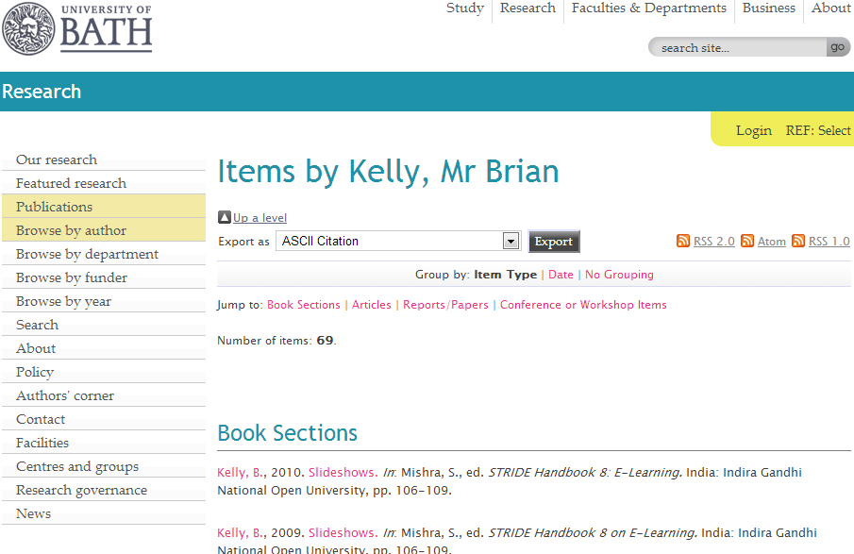
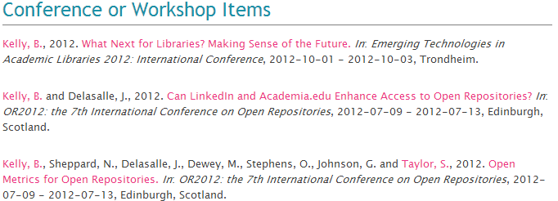
Opus
Important to have papers, reports, etc. in managed environment e.g. Opus.
Opus
http://opus.bath.ac.uk/view/person_id/588.html

Slide 19
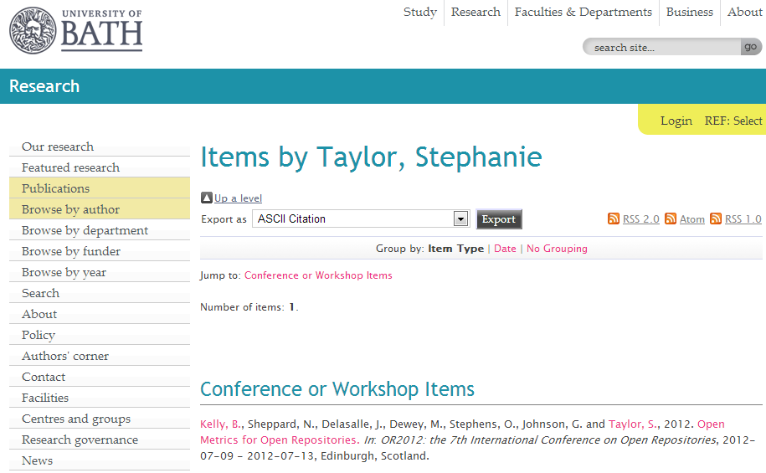
Opus
Connections are important: for people and for Google
Opus
http://opus.bath.ac.uk/view/person_id/2057.html
http://opus.bath.ac.uk/view/person_id/2057.html

Slide 20
Opus’s Limitations
Opus
“http://opus.bath.ac.uk/view/divisions/ cent=5Fukoln.html#group_D -
are only current employees indexed? What about browse?”
When staff leave, their ID (email address) is deleted. Content available, but no ‘owner’ information.
Therefore need to manage ‘ownership’ information (e.g. using LinkedIn, …).

Slide 21
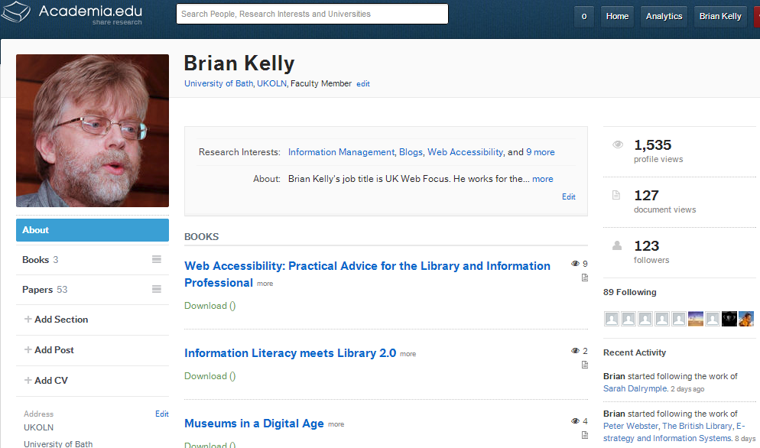
Academia.edu
Academia.edu
Academia.edu
http://bath.academia.edu/BrianKelly

Slide 22
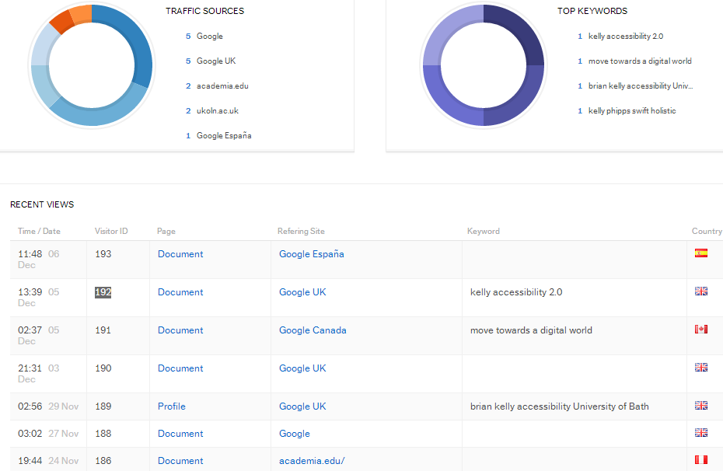
Academia.edu
Academia.edu
People do use it to find research papers (either directly or via Google)

Slide 23
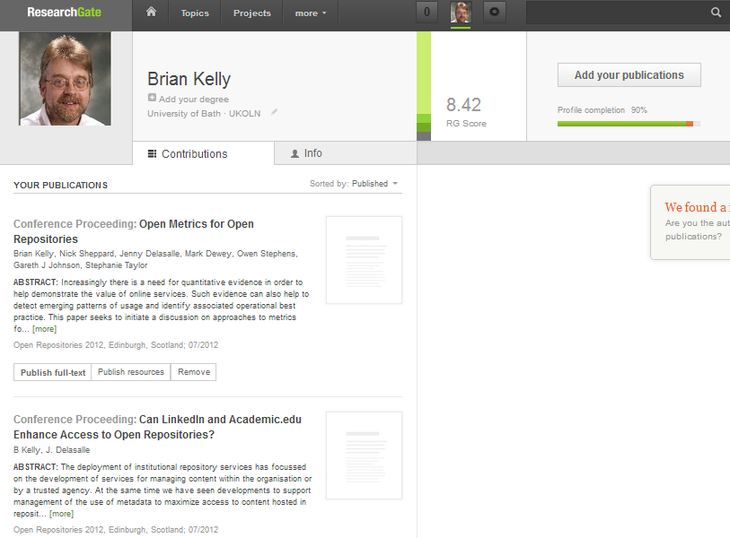
ResearchGate
Researchggate
ResearchGate: another list of research publications
https://www.researchgate.net/profile/Brian_Kelly/

Slide 24
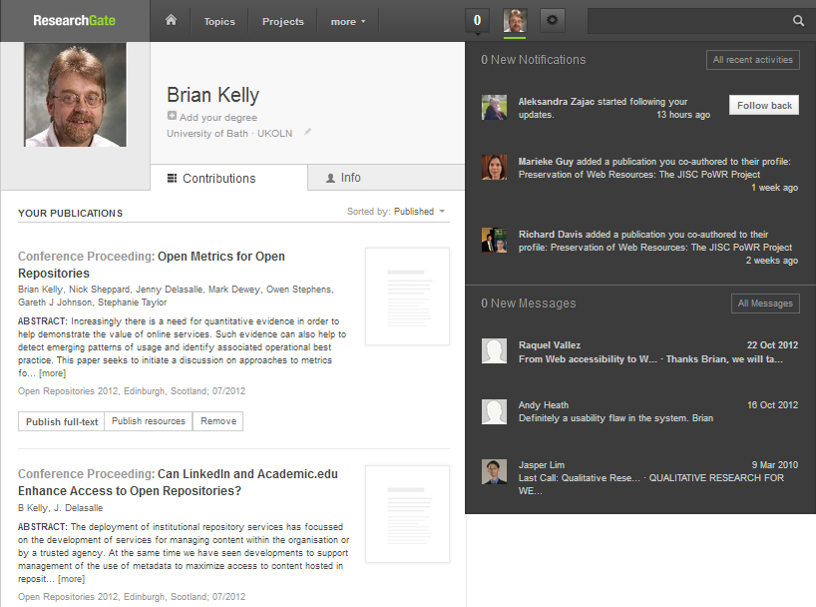
ResearchGate
To date Opus has hosted content & these services have had links (avoid fragmenting usage stats).
Now feel content should ideally be replicated (lockss).

Slide 25
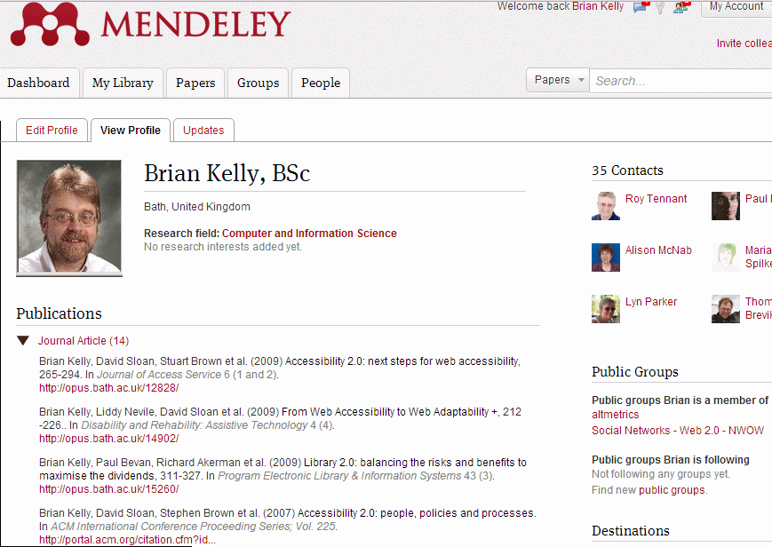
Mendeley
http://www.mendeley.com/profiles/brian-kelly/
Lot of buzz about Mendeley

Slide 26
Slideshare
Slideshare
Using Slideshare can help ensure:
Your presentations are available & embeddable
Evidence of reuse is available
But
Stats may be flawed
Links may be spam!

Slide 27
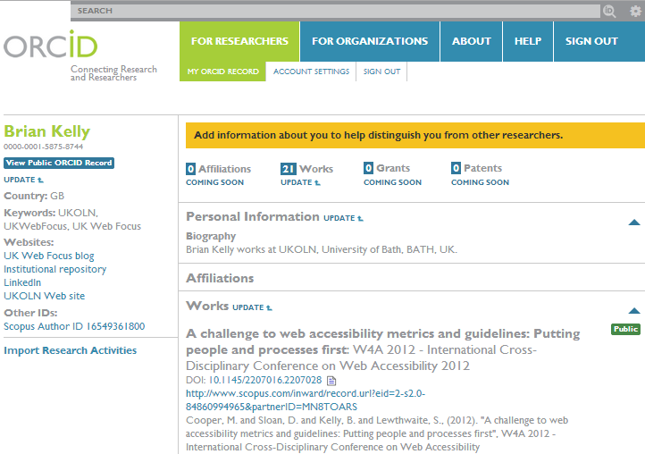
Who Am I? Where Am I Now?
ORCID (Open Researcher and Contributor ID):
New open approach for associating research content with researcher
30 seconds to create
Can be empty or private (used for workflow)
Longer to add content! (Unless content imported from elsewhere e.g. Scopus)
My ORCID: https://orcid.org/0000-0001-5875-8744
Or http://bit.ly/briankelly-orcid !

Slide 28
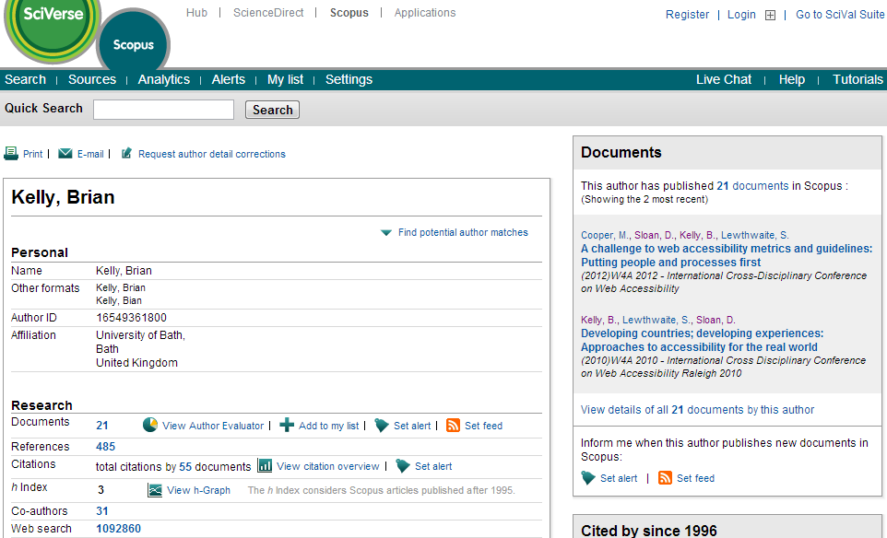
Scopus
Scopus
http://www.scopus.com/authid/detail.url?authorId=16549361800

Slide 29
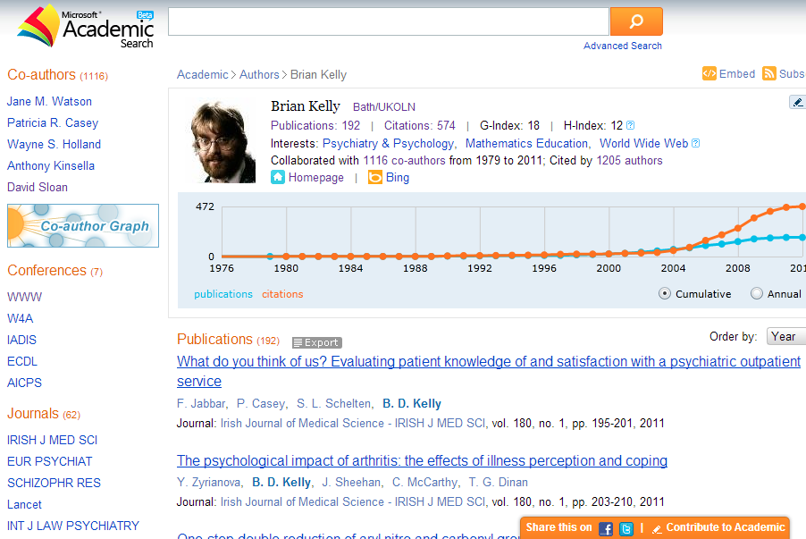
Microsoft Academic Search
Microsoft Academic Search provides nice visualisations – but data flawed!

Slide 30
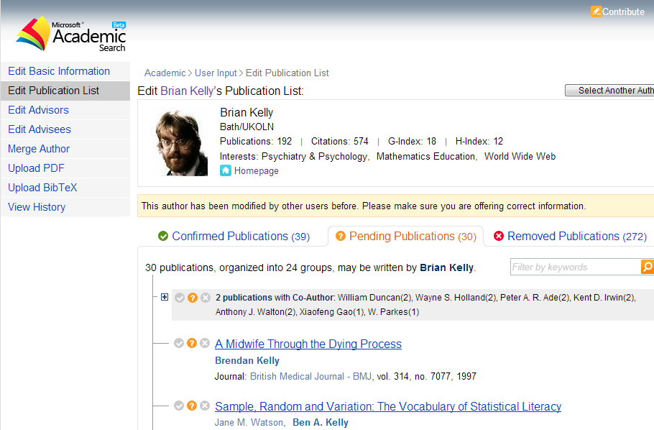
Microsoft Academic Search
You can edit data (but my corrections aren’t being displayed)

Slide 31
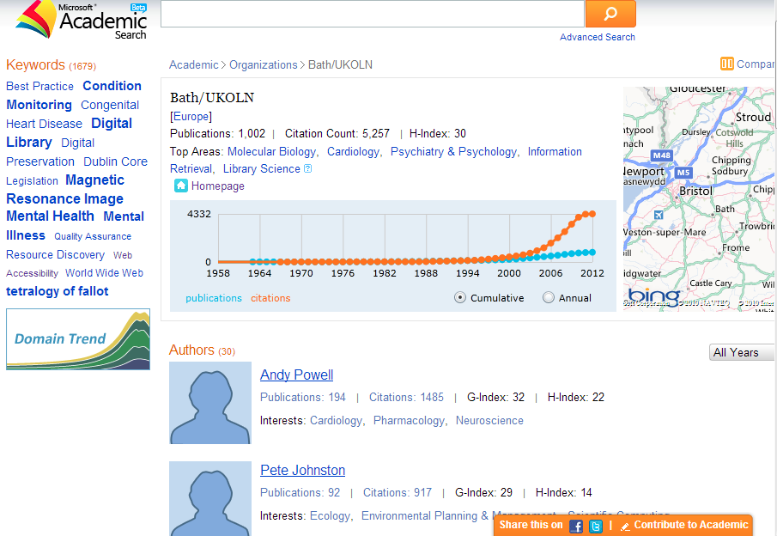
Microsoft Academic Search
If you don’t sign up, you’ll still probably have an (incorrect) account

Slide 32
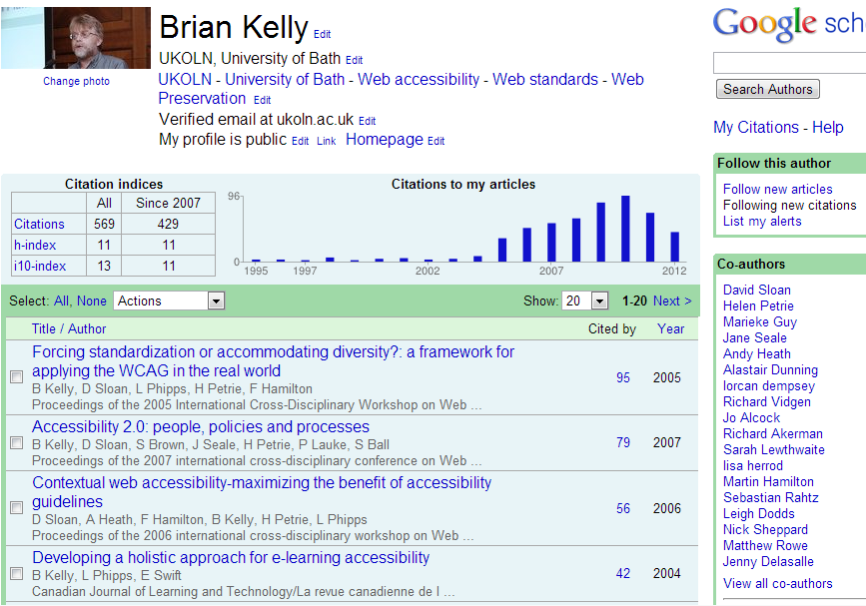
Google Scholar
Google Scholar is better!

Slide 33
Google Scholar
Google Scholar is better!

Slide 34
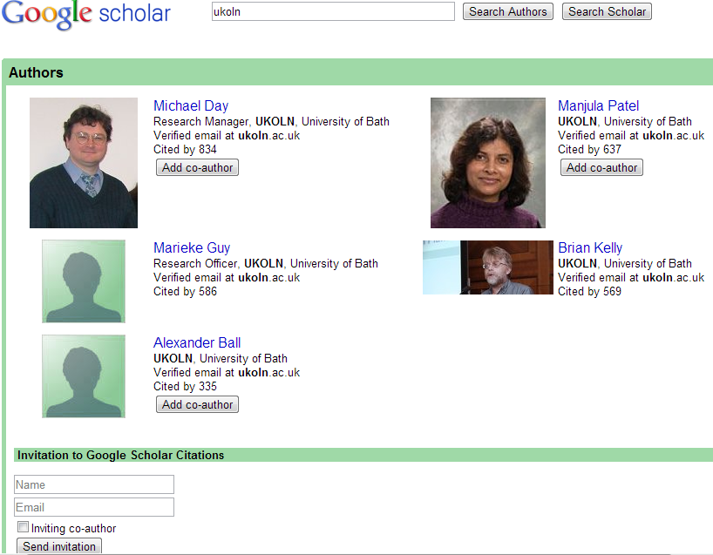
Google Scholar
You should claim your profile while your institutional email address is valid.

Slide 35
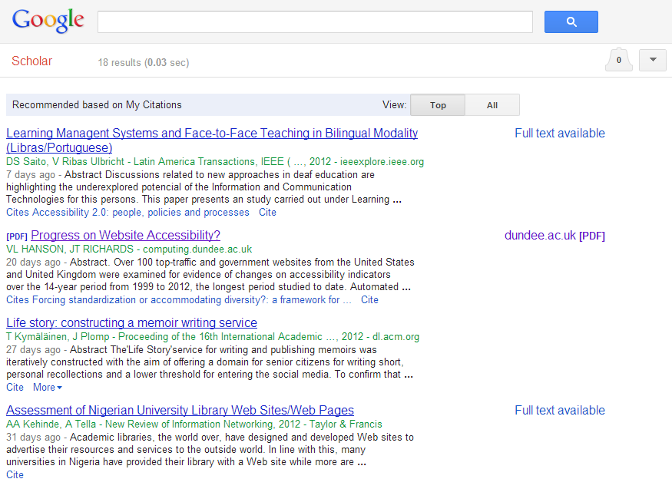
Google Scholar
You can also receive alerts of new citations

Slide 36
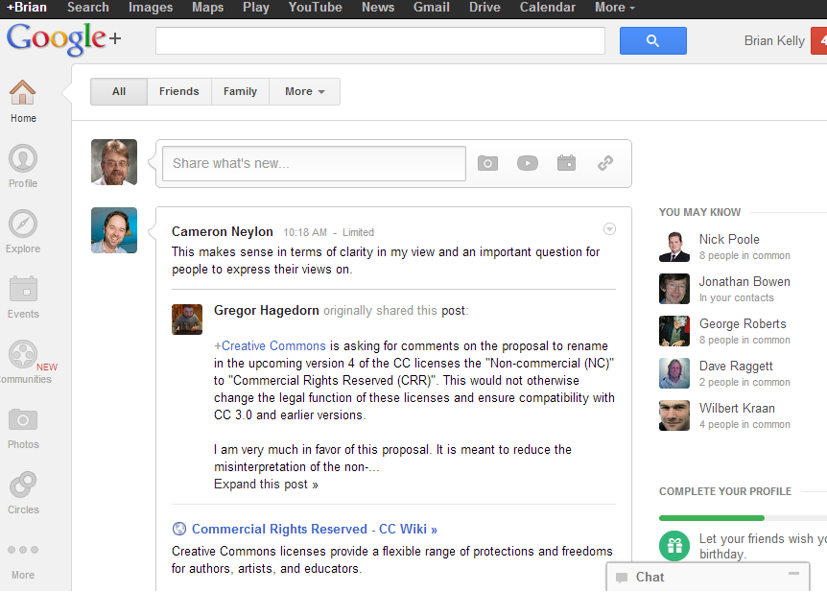
Google+
Don’t ignore Google+
My account: https://plus.google.com/u/0/110503999273000060034/
Or http://gplus.to/ukwebfocus (http://gplus.to/briankelly taken :-)

Slide 37
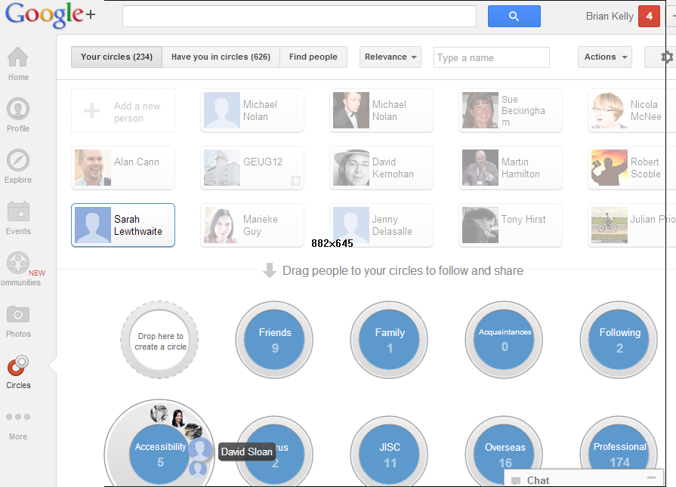
Google+
Manage contacts in Circles

Slide 38
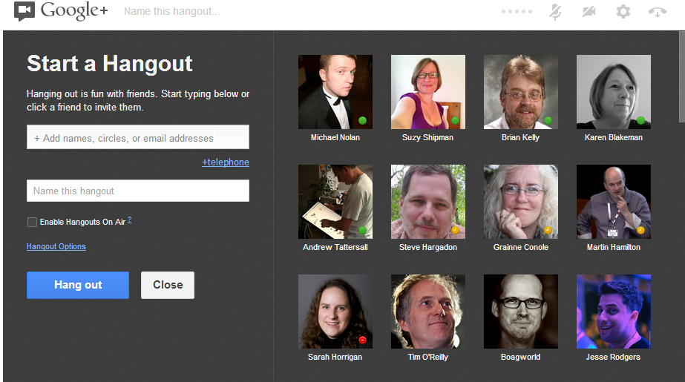
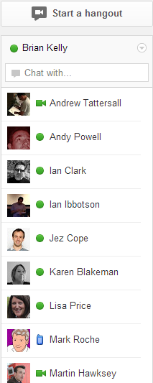
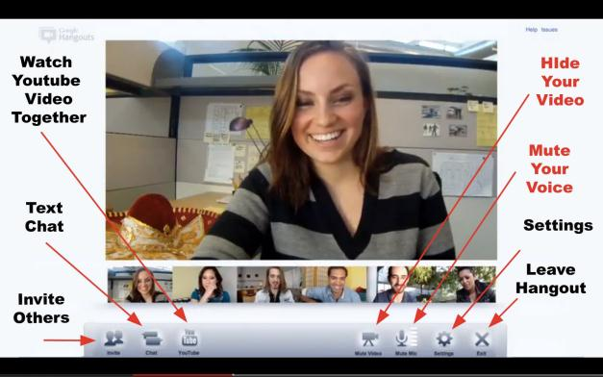
Google Hangouts
Video-conferencing

Slide 39
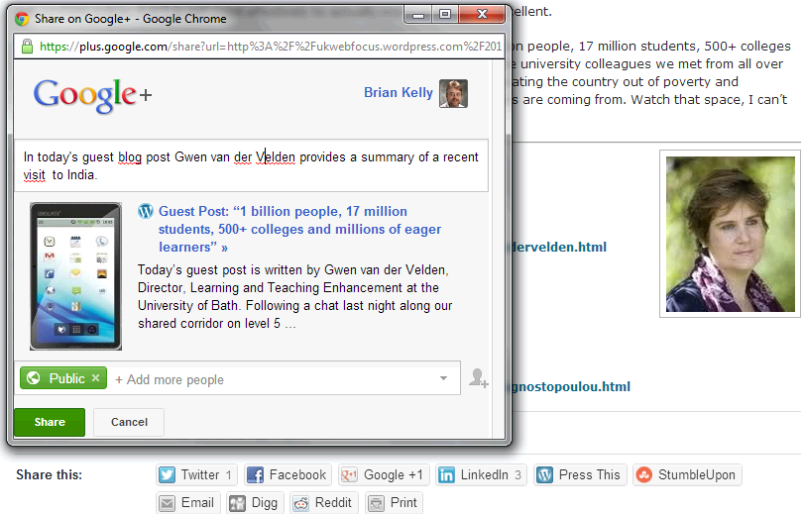
Google+ For Sharing
Google+ is part of the resource-sharing environment

Slide 40
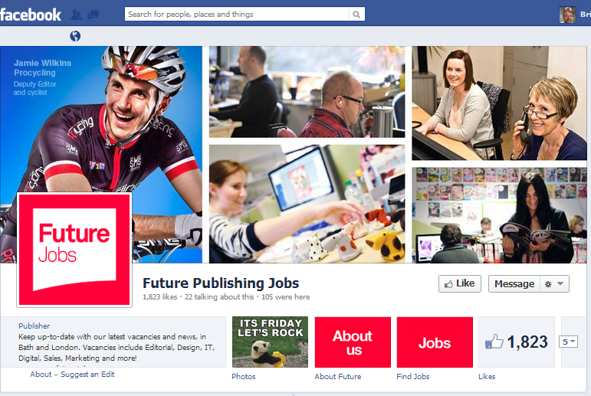
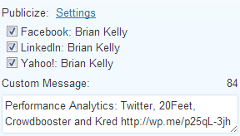
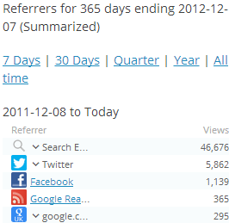
Facebook
Mainly used for ‘friends’ – but friends may also:
Work in the sector
Know of jobs, opportunities, …
Remember Facebook is very popular!
You can automatically post content from blogs, Twitter, … to Facebook (LinkedIn, ..)

Slide 41
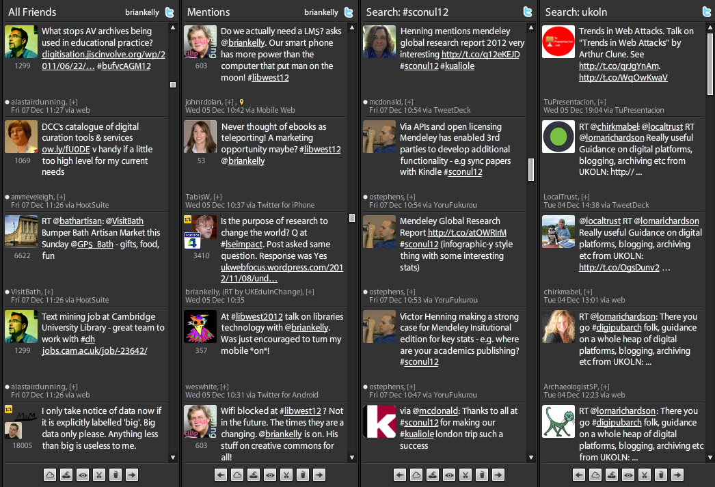
Twitter
You can’t ignore Twitter!

Slide 42
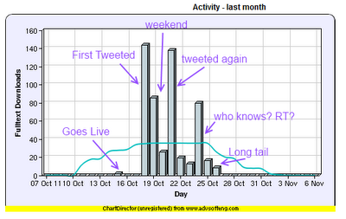
Twitter Works For Professionals
Mellisa Terras’ blog post on how Twitter increases downloads for peer-reviewed papers
Other potential areas for such use of Twitter
Promoting your project outputs
Promoting events
…

Slide 43
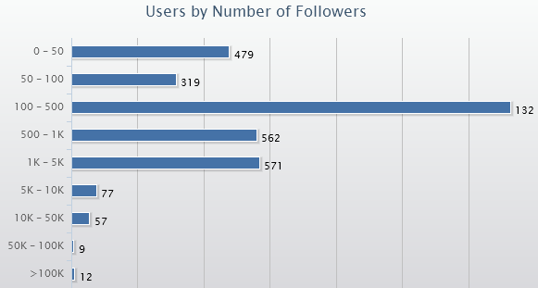
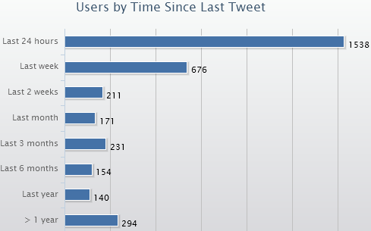
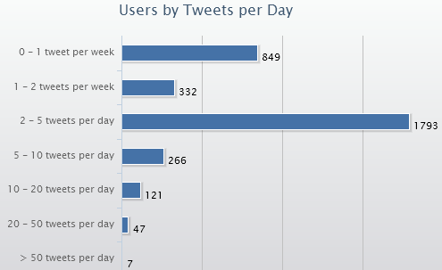
Understanding Twitter (1)
Applications such as SocialBro provide an understanding of how Twitter is being used
1329
Most follow >100
Most tweet daily
Most tweet <5 times

Slide 44
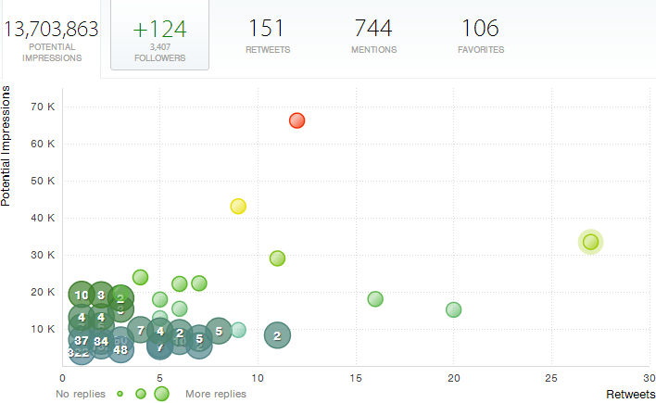
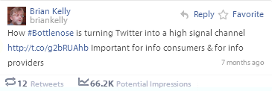
Understanding Twitter (2)
Crowdbooster is a free Web-based Twitter analytics tool
Note this is the ‘potential’ no. of impressions. Reality will be much less!

Slide 45
Using Twitter (For The Sceptic)
Not a natural Twitterer, but see benefits?
Have an avatar (portrait, animal, hobby)
Grow your community (cf the conversations you miss)
Participate in hashtagged events so likeminded people see you exist
Share links to resources you care about (your stuff; stuff you’re reading)
Favourite tweets (so others can see you’ve done so and maybe then follow you)

Slide 46
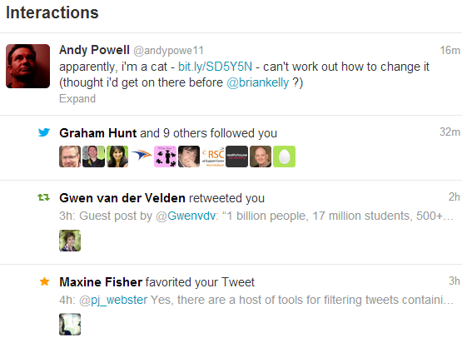
Understand Twitter Interactions
An @ message (can be delivered by SMS)
New followers: which should I follow back?
The tweets which have been retweeted (RTd)
Tweets which have been favourited (bookmarked)

Slide 47
Storify
Twitter now plays a key role in many events we attend.
@criticalsteph as a remote event amplifier using Storify.
Can help understand a community (e.g. CERIFiers)
Who are the key players?
Who should I follow on Twitter?

Slide 48
RebelMouse
RebelMouse shows the content of links you tweet (a personalised newspaper)

Slide 49
Tweetchats
#uklibchat Tweetchats take place fortnightly on Tuesdays from 18.30-20.30
A #uklibchat on “Innovative use of Technology in Libraries” took place recently
Look at the archives to see what you missed.
See blog post on “#uklibchat, #ECRchat, #PhDchat, #Socialchat and Other Tweetchats”

Slide 50
Lanyrd: your online presence at events

Slide 51
Being Seen as an Expert
Services such as Quora, Library Stack Exchange, etc. enable you to gain a reputation in your area of expertise.

Slide 52
Being Seen as an Expert
Pete Cliff’s profile on Libraries Stack Exchange

Slide 53
Open Badges
Open badges blog post

Slide 54
Concerns, Risks, …
Concerns:
I haven’t got the time
I’m worried about privacy
Social media is about LOL cats, …
I don’t like Google, Fb, … - I’ll stick with identi.ca, …
…
Risks:
Risks of being stalked, content stolen, ….
Risks of not understanding the risks and practices
Note also:
Risks of not raising one’s visibility
Competition from others
Missing the low-hanging fruit

Slide 55
Questions

