Slide 1
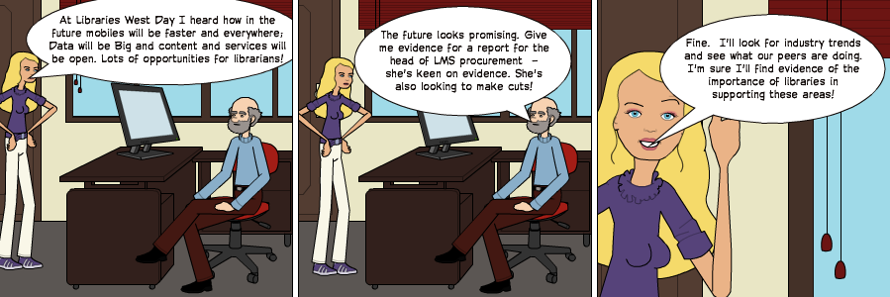
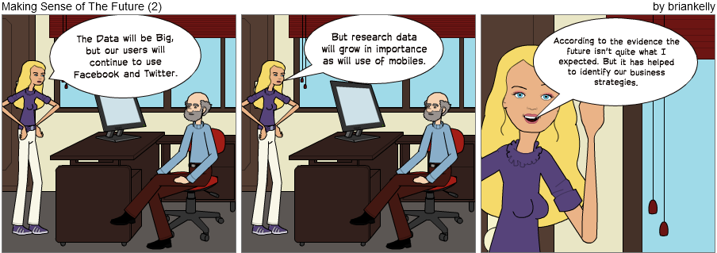
Making Sense of a Rapidly Changing Technical Environment
Making Sense of a Rapidly Changing Technical Environment
Presentation by Brian Kelly, UKOLN at a Libraries West Development Day held in Taunton on 5 Dec 2012
Brian Kelly, UKOLN

Slide 2
Making Sense of a Rapidly Changing Technical Environment
Twitter:
#libwest12
http://www.ukoln.ac.uk/web-focus/events/meetings/libraries-west-staff-development-2012/
Brian Kelly
UKOLN
University of Bath
Bath, UK
Acceptable Use Policy
Recording this talk, taking photos, discussing the content using Twitter, blogs, etc. is welcomed providing distractions to others is minimised.
Email:
b.kelly@ukoln.ac.uk
Blog:
http://ukwebfocus.wordpress.com/
Twitter: @briankelly
UKOLN is supported by:
This work is licensed under a Creative Commons Attribution 2.0 licence (but note caveat)

Slide 3
Idea from Cameron Neylon
You are free to:
copy, share, adapt or re-mix;
photograph, film or broadcast;
blog, live-blog or post video of
this presentation provided that:
You attribute the work to its author and respect the rights and licences associated with its components.
Slide Concept by Cameron Neylon, who has waived all copyright and related or neighbouring rights. This slide only CCZero.
Social Media Icons adapted with permission from originals by Christopher Ross. Original images are available under GPL at:
http://www.thisismyurl.com/free-downloads/15-free-speech-bubble-icons-for-popular-websites
3

Slide 4
About Me
Brian Kelly
Based at UKOLN, University of Bath
Involved in Web development since 1993
Excited about the potential of the Web to support University activities
Realistic about the challenges!
The Innovation Support Centre (ISC) at UKOLN
Funded by the JISC
Supports innovation in higher & further education
Provides the JISC Observatory in conjunction with JISC CETIS

Slide 5
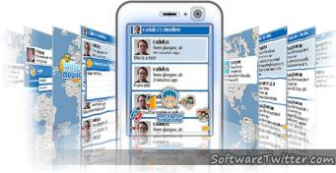
About This Talk
This talk:
Reviews the future by looking at the past
Distinguishes between invention, innovation and improvement
Highlights importance of evidence-gathering
Describes work funded by JISC in UK
Outlines a methodology which others can adopt
Discussions about the talk welcomed using Twitter hashtag #libwest12

Slide 6
The Context
What do we want technology to do for us?
LMS procurement: 2016 and beyond
We will soon have to tender for a new Library Management System (LMS) for LibrariesWest. Before we get to this point however, we must have a clear understanding of our requirements for a system over the lifespan of the new contract.
Issues:
What will we need technology to do for us over the next 10-15 years?
What will our library services look like in the future?
How will society in general be using technology, and how will we respond to that?

Slide 7
You’re Not A Couch Potato!
E
Later on I’ll ask you to:
State what you feel will be the significant technological changes which will affect the library service in 2016
Will the changes be beneficial or not for libraries?
What evidence will you need to gather to validate your predictions?
What processes will you need to support the interpretation of the evidence?
What actions should you be taking in order to respond to the changes?
You can start now (especially if you’re online).
Yes, you can use Google & Wikipedia!

Slide 8
In the Future
Data will be Big

Slide 9
In the Future
Content and services will be open

Slide 10
In the Future
We will own our services and content

Slide 11
In the Future
We will see a growth in use of online services

Slide 12
In the Future
We will see the importance of librarians acknowledged

Slide 13
In the Future
We will see greater investment in libraries

Slide 14
In the Future
We will travel to work by monorail

Slide 15
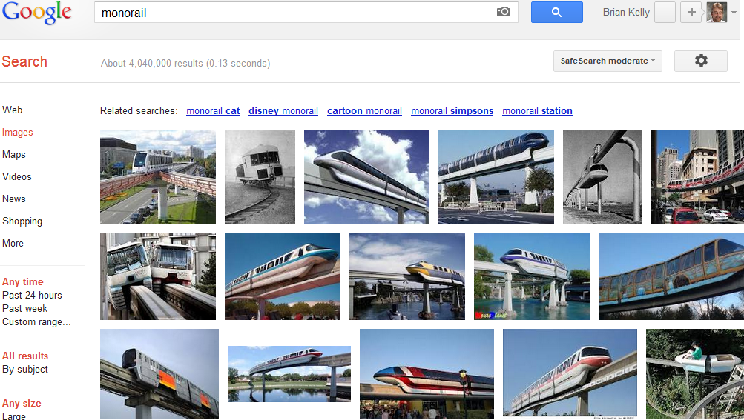
What I expected in the future
Monorails

Slide 16
In the Future
We will use jetpacks at weekends

Slide 17
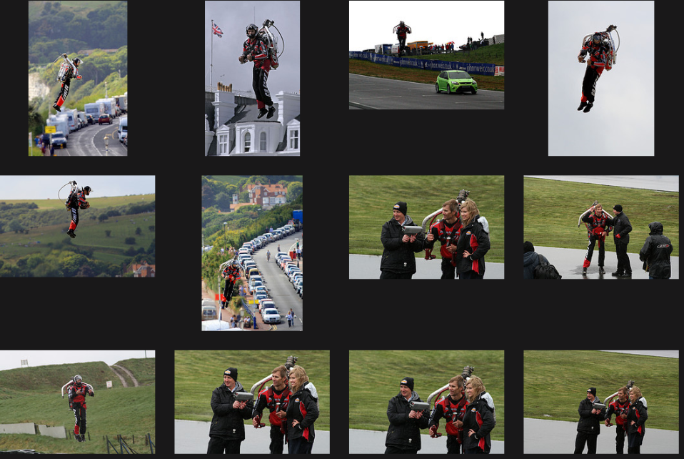
Has the Future Arrived?
Hoverpacks do exist

Slide 18
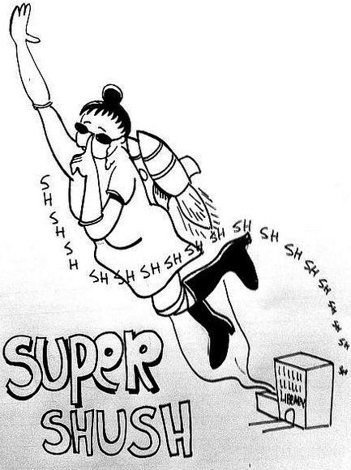
Shush!
Librarians will appropriate technological developments to support their activities!
Acknowledgements to Patrick Hochstenbach (@hochstenbach)

Slide 19
The Context
In the future mobiles will be smaller & faster; Data will be Big and content and services will be open. Lots of opportunities for librarians ☺

Slide 20
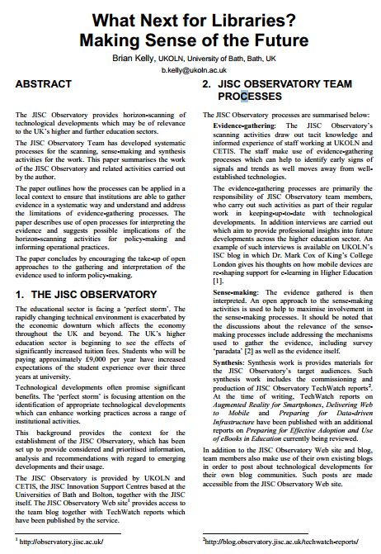
Accompanying Paper
Ideas described in paper presented at EMTACL (Emerging Technologies in Academic Libraries) conference
View paper at:
http://bitly.com/emtacl12-kelly
Available in PDF – MS Word formats from University of Bath repository.
CC-BY licence.

Slide 21
Your Thoughts
#libwest12 and #future or #wtf
What technical developments might be important?
Tweet your ideas
Feel free to add implications for users …
Making sense of the a rapidly changing environment!
and implications for libraries
Discuss the implications …
such as legal issues, business models, …

Slide 22
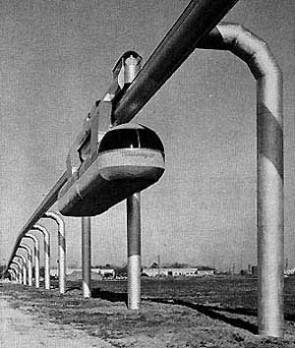
The Future from the Past
Monorail, Incorporated built a short test track of their suspended system at Arrowhead Park in Houston, Texas. Each bogie was powered by a 310-horsepower Packard automobile engine. The driver was seated high above the passenger carriage on one of the two bogies. After eight months of testing, the track was dismantled and rebuilt at the Texas State fairgrounds where it ran for many years. Its promoters claimed it could reach speeds of 160 km but no Skyway transit installations were ever built.
The future was exciting in 1956!

Slide 23
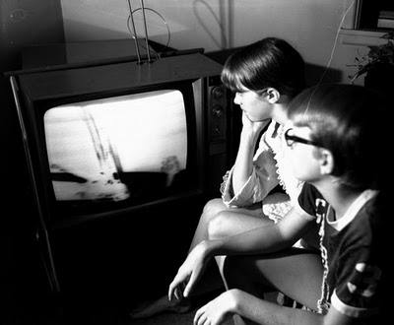
“Eagle has Landed”
Awoken at 3 am on 16 June 1969 to watch lunar landing on black and white TV.
But the future was exciting!

Slide 24
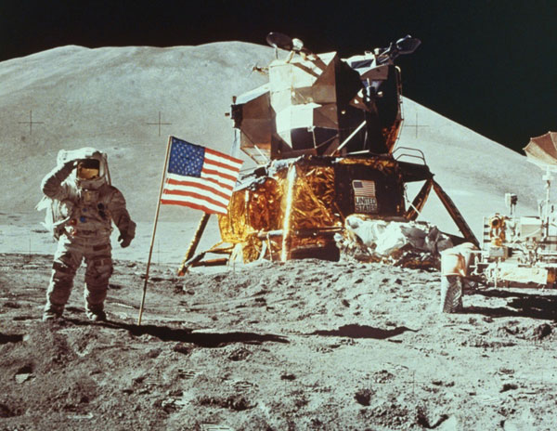
The Future from the Past
1969 was exciting!

Slide 25
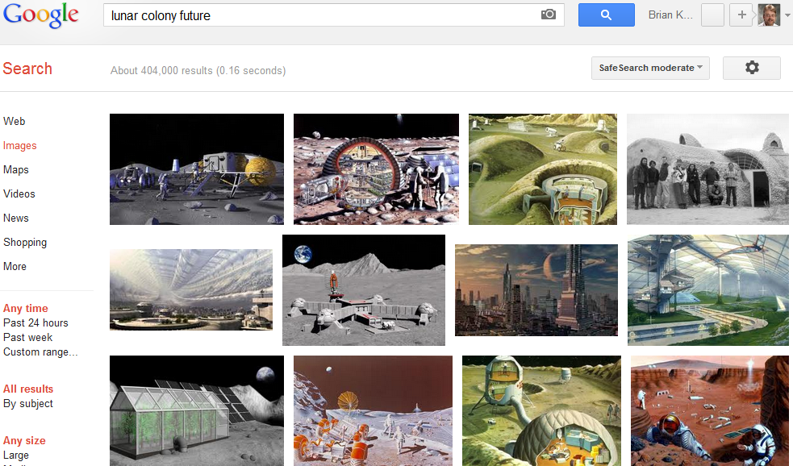
What I Expected in the Future
The future is exciting!

Slide 26
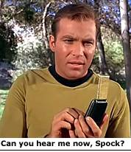
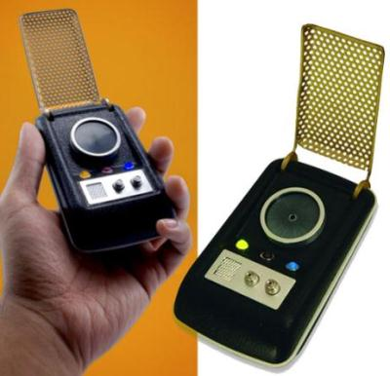
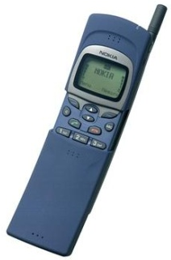
The Present: Better than Predicted
Star Trek’s predicted mobile phones
but not smart phones!
Nokia 8110 “stole the show in 1998”

Slide 27
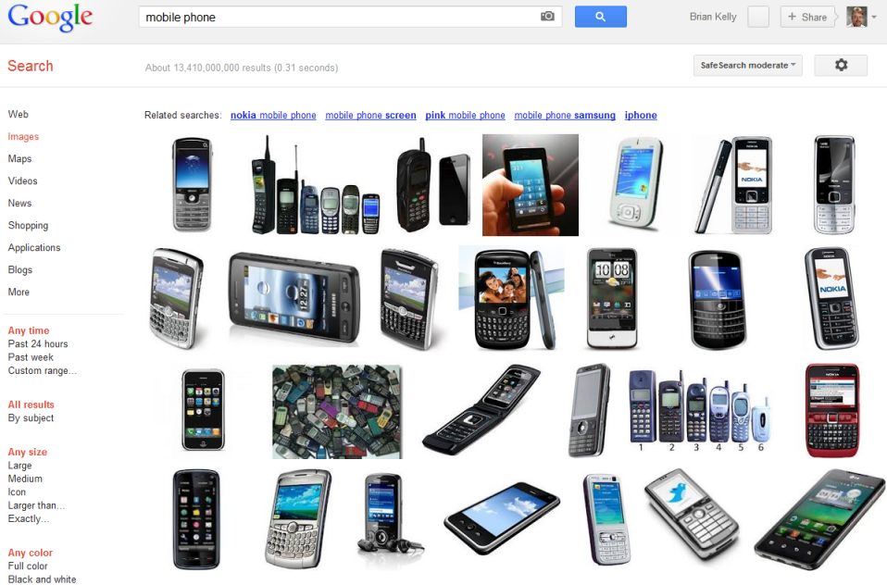
Has the Future Arrived?
Mobile phones

Slide 28
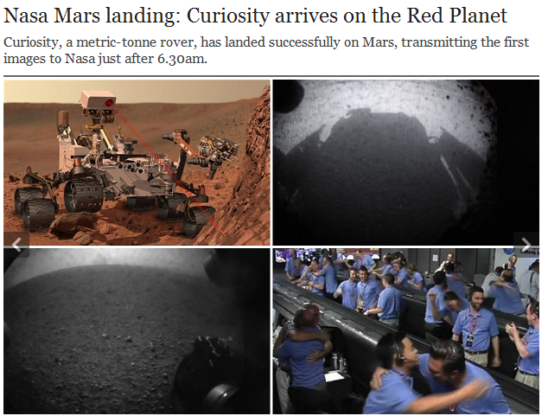
Has the Future Arrived?
Landing on Mars

Slide 29
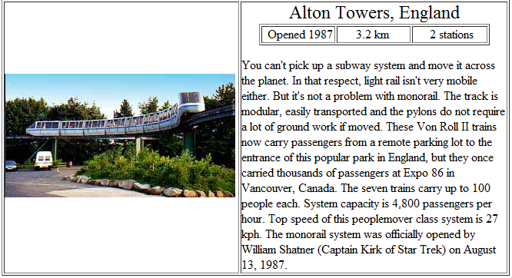
Has the Future Arrived?
Monorails

Slide 30
Has the Future Arrived?
Monorail
Please note that the monorails listed in these pages are MULTI-STATION systems. We do not include the dozens of recreation or view-giving minirails here. Our efforts are primarily geared towards proving monorail's ability to carry people from point to point as TRANSIT.

Slide 31
Has the Future Arrived?
Predictions & expectations from the past:
Have arrived
Sometimes have exceed expectations
Often fail to become widely embedded
Can we learn from past expectations of the future?
Note importance of evidence:
“Our efforts are primarily geared towards proving monorail's ability to carry people from point to point as TRANSIT”

Slide 32
Rich Opportunities
Web 2.0 provided many opportunities to support teaching & learning and research activities

Slide 33
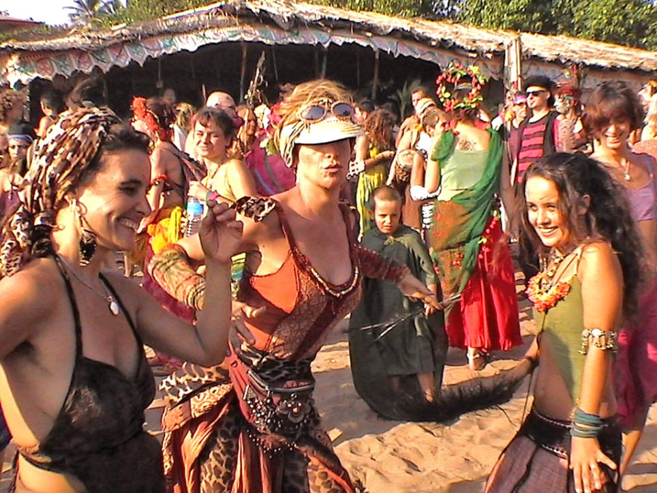
Optimism
Notes:
We should be happy. The future has arrived.
And we were happy – until a few years ago!

Slide 34
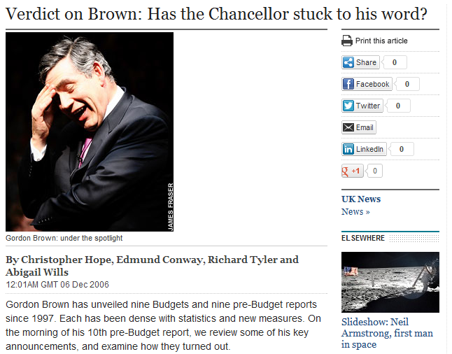
The Mid 2000s
Even the Daily Telegraph in 2006 gave a (qualified) conclusion of “Good” to Labour Government’s investment in education

Slide 35
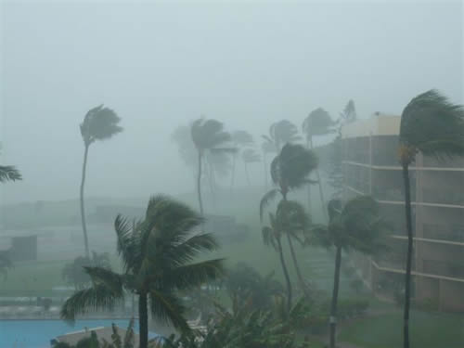
From the Sea of Tranquility to the Perfect Storm
Stormy times

Slide 36
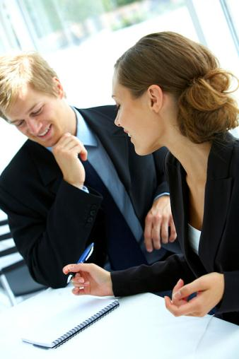
Time of Growth ☺
1990s & early 2000s saw:
Increased funding across education sector
Significant developments in IT sector
Willingness by senior managers & funding bodies to invest in innovative IT developments
“Great proposal – we’ll fund it”
Image from Flickr. CC BT-NC-SA licence: http://www.flickr.com/photos/inlinguamanchester/5036313154/

Slide 37
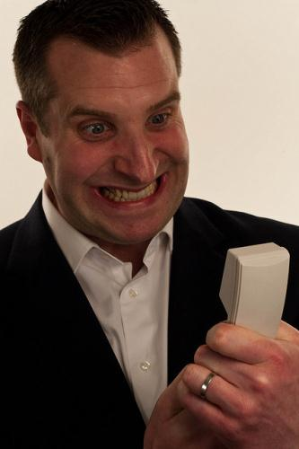
Time of Growth is Over ☹
Late 2000s and beyond:
Decreased funding across education & public sector
Acknowledgements that innovation can provide growth and cost savings
Significant developments continue in IT sector
Investment in innovative IT developments need to be based on evidence of benefits & likleyhood of success
“You want how much? And no evidence it will work! You’re crazy!”
Image from Flickr. CC BY-NC-ND licence: http://www.flickr.com/photos/drewleavy/339489258//

Slide 38
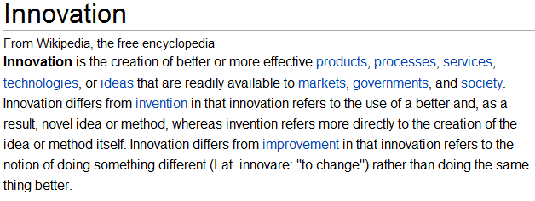
Innovation
Invention: Creating something new
Innovation: Using something new
Improvement: Using something that exists in a better way

Slide 39
JISC Observatory
JISC Observatory:
JISC-funded initiative
Systematises processes for anticipating and responding to projected future trends & scenarios
Provided by JISC Innovation Support Centres at UKOLN and CETIS
See <http://blog.observatory.jisc.ac.uk/>

Slide 40
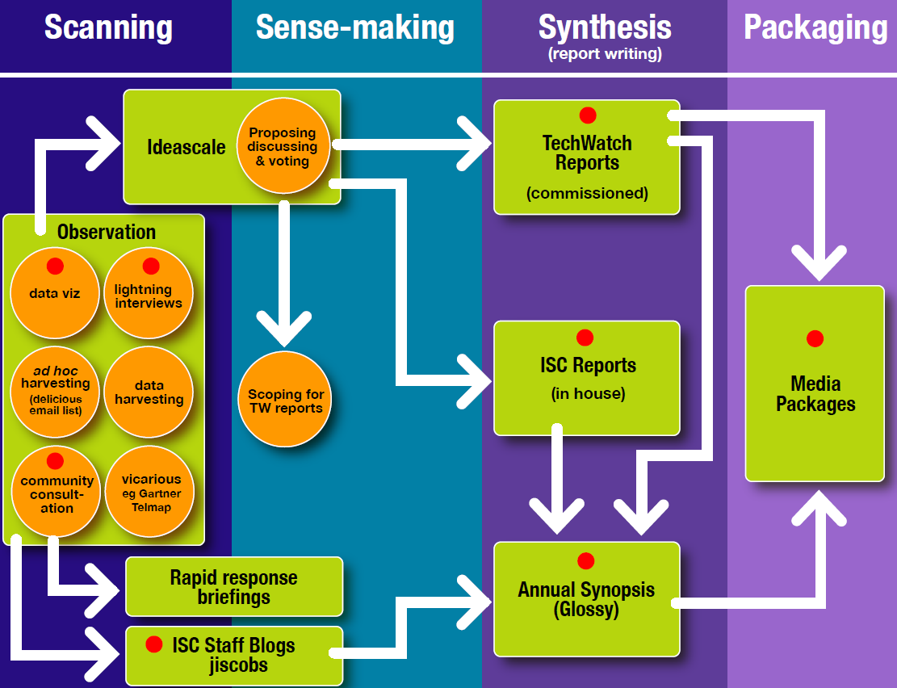
JIS Observatory process
JIS Observatory process

Slide 41
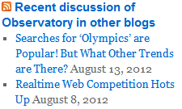
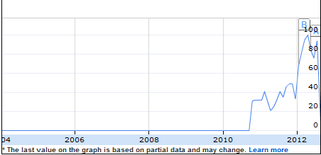
Scanning Activities
Blog posts: Posts published on JISC Observatory blog and on existing blogs.
Monitoring trends: Monitoring trends in order to:
Benchmark current usage patterns
Identify trends
Identify emerging patterns of usage
Google searches for “learning analytics” took off in 2010.
Possible indicator of relevance across sector & need for further investigation.

Slide 42
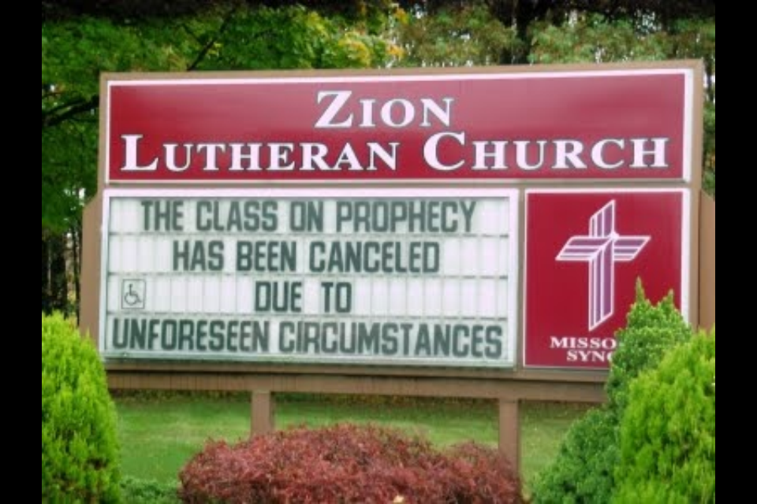
A known unknown
A known known
Apple to successfully sue Samsung
The bankers mess up the economy
Scepticism
An unknown unknown
xxx to unexpectedly yyy!

Slide 43
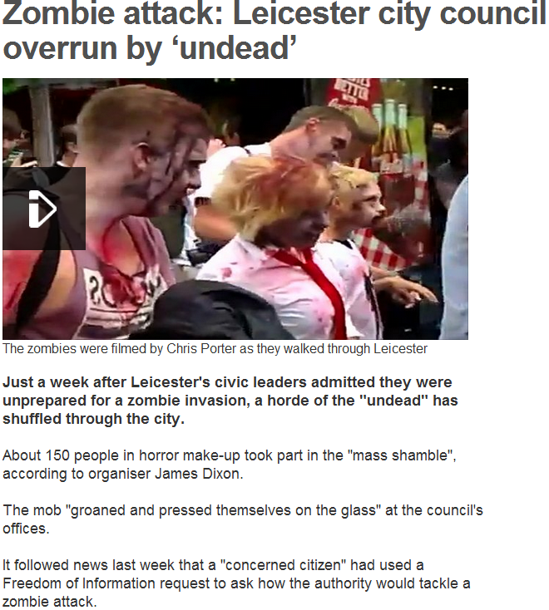
Zombie Attack
Note difficulties in:
Identifying unknown unknowns
Developing appropriate plans!

Slide 44
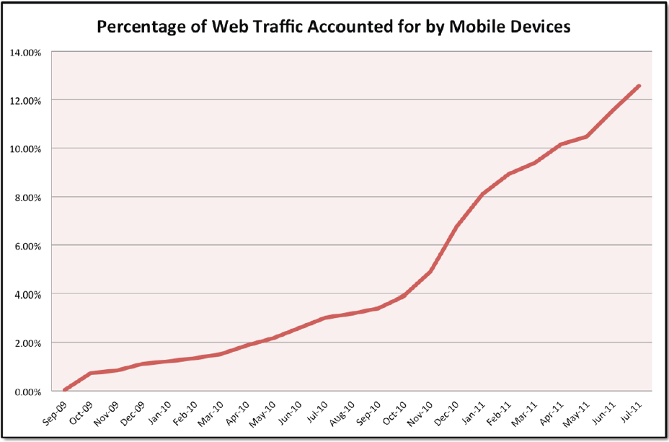
Significant Trends: Mobile
Tecmark Digital Marketing Agency
We now know of the importance of Mobile

Slide 45
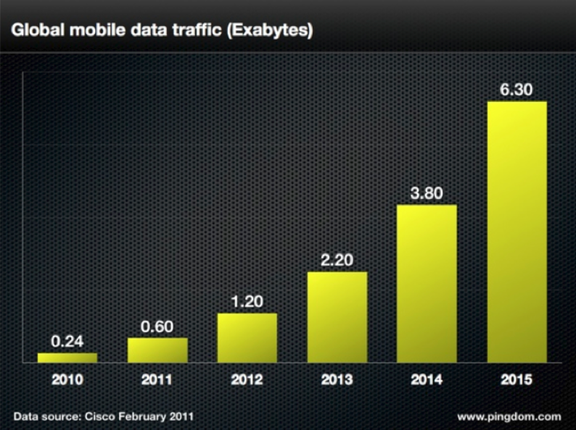
Significant Trends: Mobile
Cisco
We now know of the importance of Mobile

Slide 46
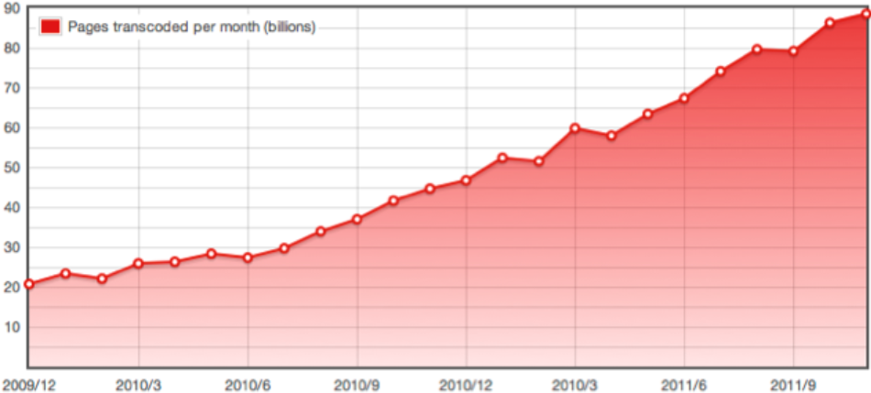
Significant Trends: Mobile
Opera
Q. What actions are you taking in order to gain experience of the mobile Web environment? What actions are your library taking?

Slide 47
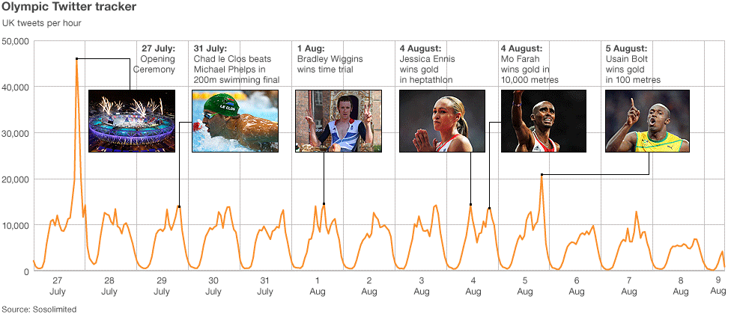
Significant Trends: Social Media
There were “more than 150 million Tweets about the Olympics over the past 16 days”. Twitter can provide a shared cultural / education experience. Is your library engaging?

Slide 48
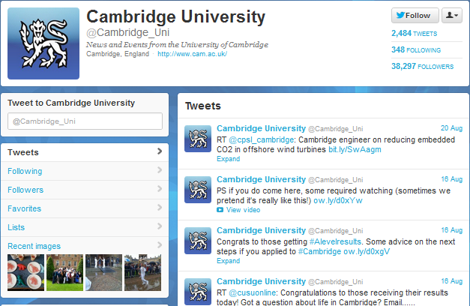
Significant Trends: Social Media
Learning from Higher Education
Survey in Aug 2012 of institutional use of Twitter across 24 Russell Group universities found >320K followers

Slide 49
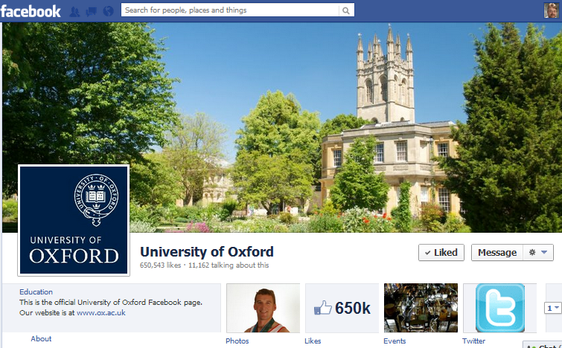
Significant Trends: Social Media
Learning from Higher Education
Survey in Aug 2012 of institutional use of Facebook across the 24 Russell Group universities found >1M ‘Likes’ followers

Slide 50
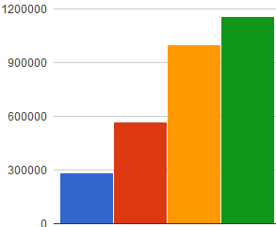
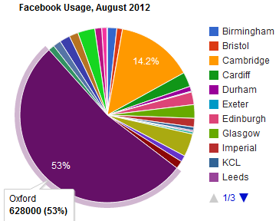
Behind The Facebook Page
Trends in Fb ‘Likes’ for Russell group Unis since Jan 2011 show steady increase
Learning from Higher Education
But note increase in Jul 2012 due to addition of 4 new universities!
Jan 11 Sep 11 May 12 Jul 12
But might trends hide a more complex story:
Usage & growth dominated by one significant player.
More modest usage generally

Slide 51
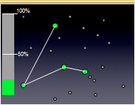
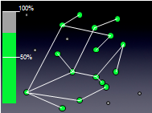
Sense-Making: Social Media
Social media:
Is about nodes and connections
Numbers do matter for effective engagement and disseminations
Experiences from other areas:
Nos. of mobile phones
Importance of email
“All bugs are shallow to many eyes”
Implications:
Importance of best practices for popular & well-used channels
Difficulties for new entrants e.g. Diaspora (open alternative to Facebook) and identi.ca and app.net (new open alternative to Twitter)

Slide 52
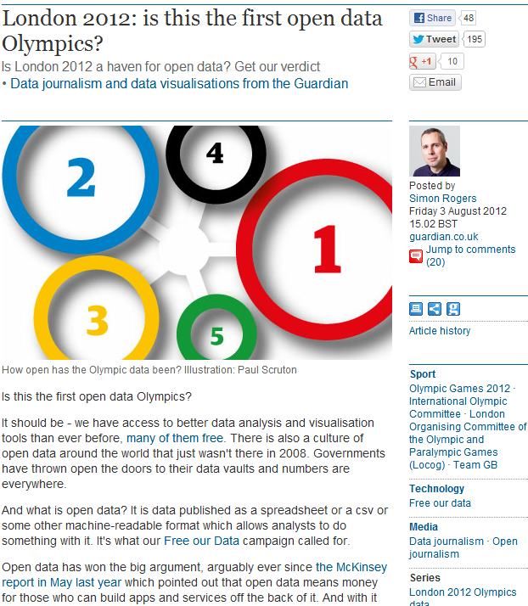
Open Data
“Is London 2012 a haven for open data?”
Conclusions:
“Not this time”
“But it is the first data Olympics”
“It's hard to see that by [Rio] 2016 this won't emerge as data we can all use”

Slide 53
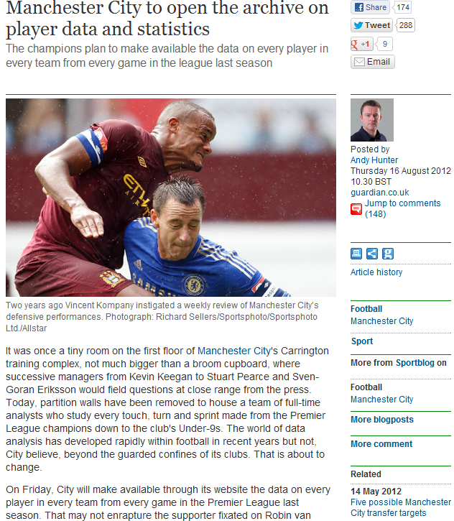
Open Data
“Manchester City to open the archive on player data and statistics”
Example of:
Public interest in open data
Interest from commercial sector

Slide 54
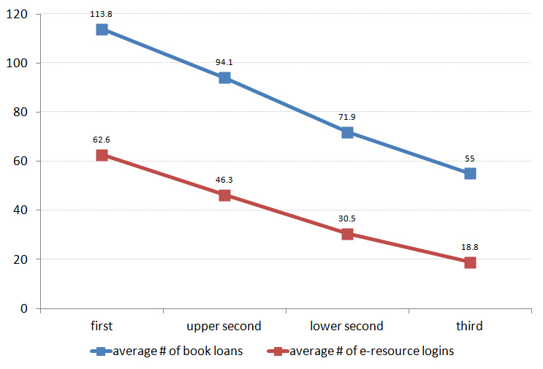
Use of Open Data in Libraries
Trends in reusing Library usage data, e.g. JISC’s Library Impact Data Project
Average number of books borrowed and e-resource logins for ~33,000 students in final year of studies
Image & data provided by Dave Pattern under a CC BY-NC-SA licence

Slide 55
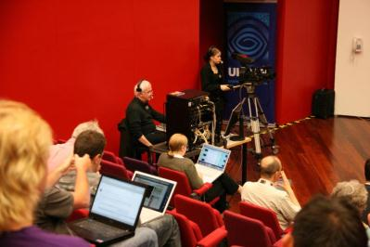
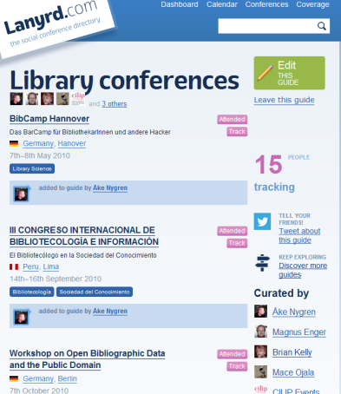
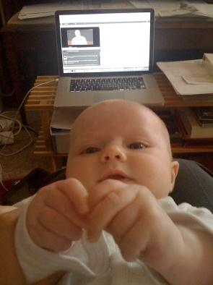
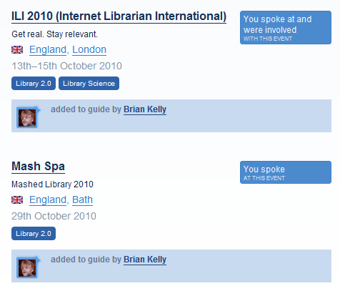
Significant Trends: Open Practices
Amplified events as an example of an open practice
Valuable for staff development

Slide 56
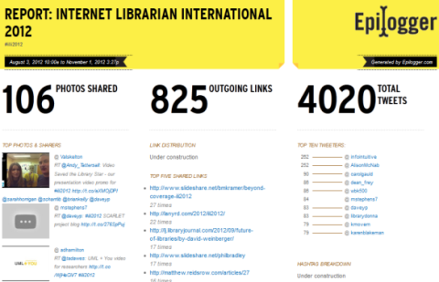
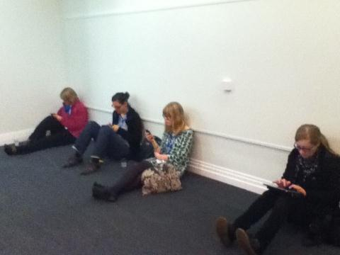
Sharing Is Caring?
Epilogger archive showed evidence of sharing of resources & exchange of ideas at ILI 2012
Sharing with one’s peers (& socialising later in the pub) or being unsocial?
Someone suggest that social interaction in the conference was inhibited by mobile devices. I don’t agree- the networking was great.
“mainly because I’m shy… my professional life is much better now I have this option [Twitter]”

Slide 57
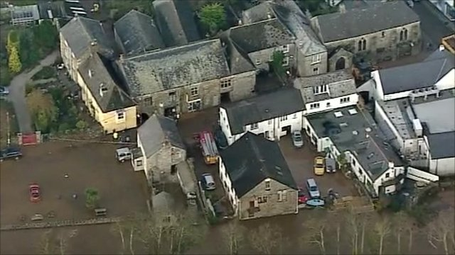
Floods in Cornwall, BBC News, 17 Nov 2012

Slide 58
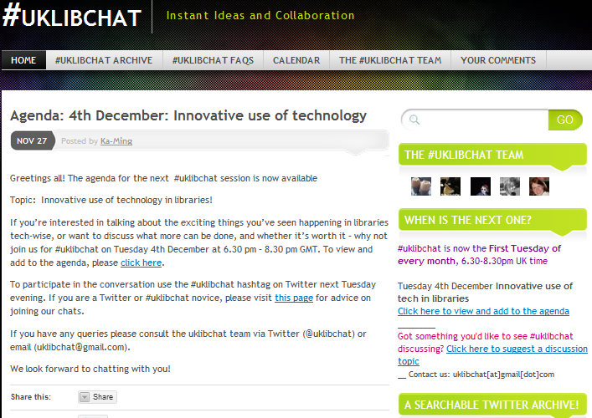
Tweetchats
#uklibchat Tweetchats take place fortnightly on Tuesdays from 18.30-20.30
A #uklibchat on “Innovative use of Technology in Libraries” took place last night
Look at the archives to see what you missed.

Slide 59
Innovating or Improving?
How should we enhance the visibility of research papers?
Search tools “better than Google”
Richer metadata?
Exploit potential of Linked Data?
Or
Make more effective use of existing infrastructure?

Slide 60
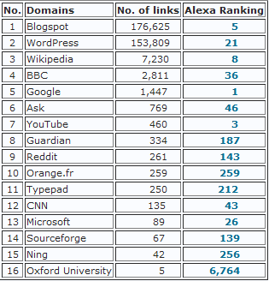
Evidence of IR Usage
Evidence suggests:
50-80% of traffic arrives via Google
Some traffic may not be recorded (direct links to PDFs)
SEO analysis of 24 Russell Group Universities
Importance of externally-hosted blog platforms!
Importance of blog platforms, Wikipedia & media sites

Slide 61
Implications
Implications of findings:
Innovation is important
But:
We shouldn’t ignore potential of implementing best practices on existing systems
Remember:
Today’s mainstream service was yesterday’s innovation
No guarantee that best practices for innovative systems will be implemented

Slide 62
TechWatch Reports
JISC Observatory TechWatch reports on key areas of growth & importance:
Data
eBooks
Mobile Web
Augmented Reality
But what other early signals are we seeing?

Slide 63
Early Signals?
News stories (Aug 2012) about plans for privatisation at London Metropolitan University

Slide 64
Early Signals?
Follow-up comment (20 Aug 2012):
“VC should be applauded for the classic business move of getting the university to concentrate on its core activity”
Carl Lygo is chief executive of the 'for profit' BPP Professional Education group and principal of BPP University College

Slide 65
Challenges For Librarians
In time of uncertainties:
Take an evidence-based approach to understanding the future
Understand the changed environment
Engage with opportunities in areas of growth and institutional importance
Be open and encourage discussion on analysis & interpretation of findings

Slide 66
Responding to Challenges
E
Working in groups:
State what you feel will be the significant technological changes which will affect the library service in 2016
Will the changes be beneficial or not for libraries?
What evidence will you need to gather to validate your predictions?
What processes will you need to support the interpretation of the evidence?
What actions should you be taking in order to respond to the changes?

Slide 67
Warning From The Past
Gopher
Tim Berners-Lee didn’t accept the evidence of the popularity of Gopher!

Slide 68
Serenity prayer
Serenity prayer:
God, grant me the serenity to accept the things I cannot change, Courage to change the things I can, And wisdom to know the difference.

Slide 69
Conclusions
The Data will be Big, but our users will continue to use Facebook and Twitter
But research data will grow in importance as will use of mobiles.
According to the evidence the future isn’t quite what I expected. But it has helped to identify our business strategies.

Slide 70
Continue the Conversation
See http://ukwebfocus.wordpress.com/

