Slide 1
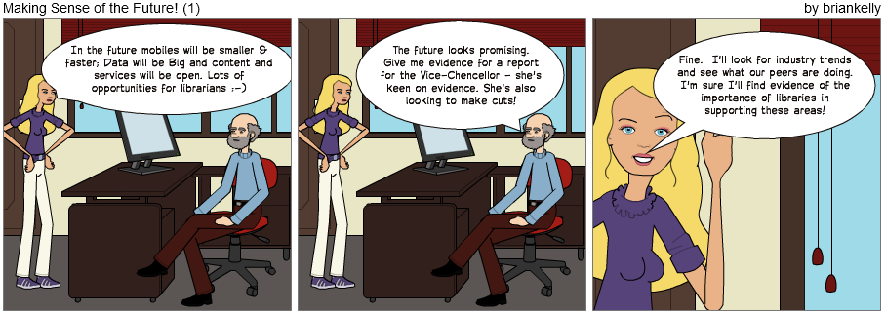
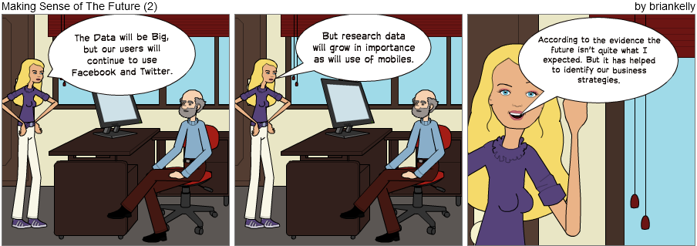
Making Sense of the Future
Spotting Tomorrow's Key Technologies
Brian Kelly, UKOLN
Presentation by Brian Kelly, UKOLN at the ILI 2012 conference

Slide 2
UKSG 2013 Spotting Tomorrow's Key Technologies
Twitter:
#uksglive
http://www.ukoln.ac.uk/web-focus/events/conferences/uksg-2013/
Brian Kelly
UKOLN
University of Bath
Bath, UK
Acceptable Use Policy
Recording this talk, taking photos, discussing the content using Twitter, blogs, etc. is welcomed providing distractions to others is minimised.
Email:
b.kelly@ukoln.ac.uk
Blog:
http://ukwebfocus.wordpress.com/
Twitter: @briankelly
UKOLN is supported by:
This work is licensed under a Creative Commons Attribution 2.0 licence (but note caveat)

Slide 3
Abstract
Brian Kelly will introduce a methodology being used by the JISC Observatory which can help to identify ‘weak signals’ for technologies that may have an impact on the sector, as well as ‘strong signals’ which may make it difficult for emerging technologies to become embedded.
The audience will have an opportunity to apply the methodology across a variety of emerging technologies.

Slide 4
In the Future
Data will be Big

Slide 5
In the Future
Content and services will be open

Slide 6
In the Future
We will own our services and content

Slide 7
In the Future
We will see a growth in use of online services

Slide 8
In the Future
We will see the importance of librarians and information professionals acknowledged

Slide 9
In the Future
We will see greater investment in libraries

Slide 10
In the Future
We will travel to work by monorail

Slide 11
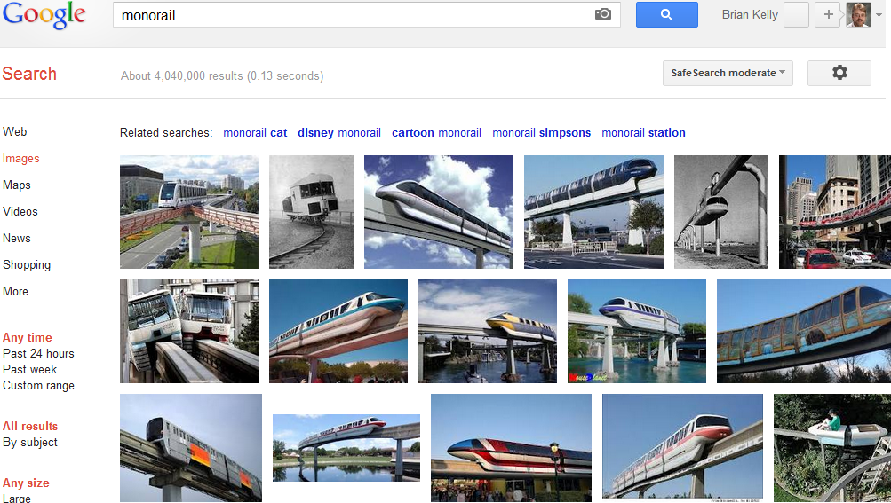
What I expected in the future
Monorails

Slide 12
In the Future
We will use jetpacks at weekends

Slide 13
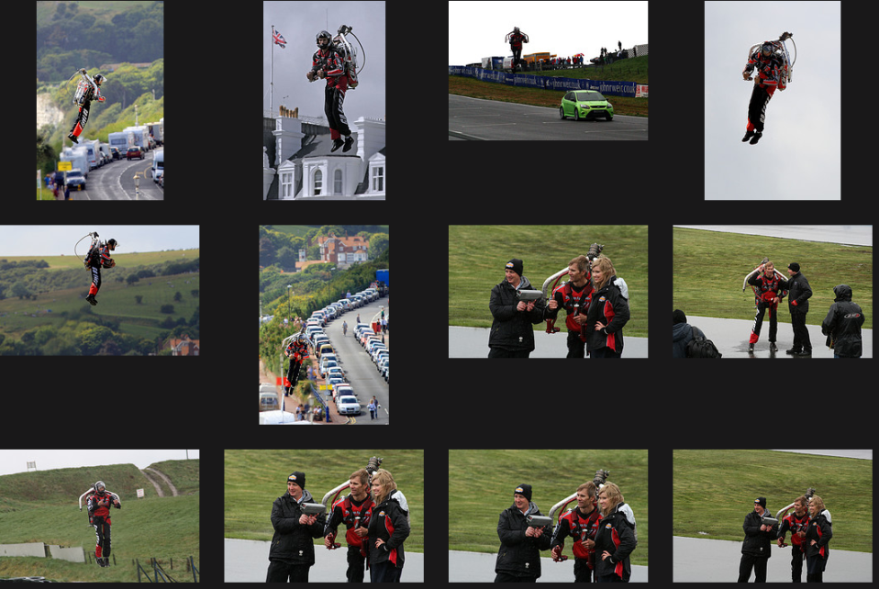
Has the Future Arrived?
Hoverpacks do exist

Slide 14
Shush!
Librarians will appropriate technological developments to support their activities!
Acknowledgements to Patrick Hochstenbach (@hochstenbach)

Slide 15
What Can We Conclude?
There is a need to:
Be wary of predictions which:
Simply justify our organisation’s current approaches (cf. music industry)
Reflect personal beliefs
Base predictions on evidence
Acknowledge that evidence may challenge organisational or personal beliefs / prejudices

Slide 16
The Context
In the future mobiles will be smaller & faster; Data will be Big and content and services will be open. Lots of opportunities for librarians ☺

Slide 17
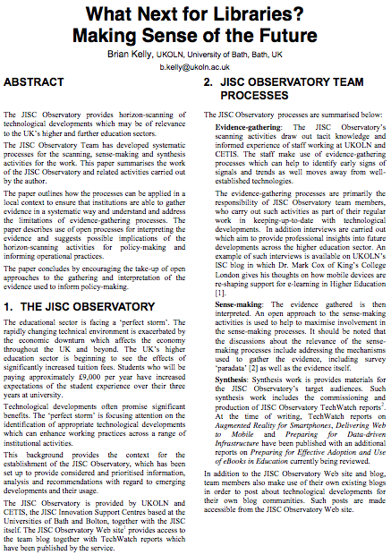
Accompanying Paper
Ideas described in paper presented at EMTACL (Emerging Technologies in Academic Libraries) conference
See bit.ly/emtacl12-kelly

Slide 18
Time of Growth ☺
1990s & early 2000s saw:
Increased funding across education sector
Significant developments in IT sector
Willingness by senior managers & funding bodies to invest in innovative IT developments (e.g. JISC development programmes)
“Great proposal – we’ll fund it”
Image from Flickr. CC BT-NC-SA licence: http://www.flickr.com/photos/inlinguamanchester/5036313154/

Slide 19
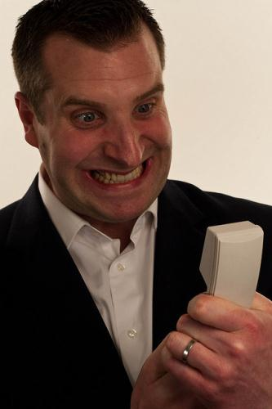
Time of Growth is Over ☹
Late 2000s and beyond:
Decreased funding across education & public sector
Acknowledgements that innovation can provide growth and cost savings
Significant developments continue in IT sector
Investment in innovative IT developments need to be based on evidence of benefits & likleyhood of success
“You want how much? And no evidence it will work! You’re crazy!”
Image from Flickr. CC BY-NC-ND licence: http://www.flickr.com/photos/drewleavy/339489258//

Slide 20
Lessons From The Past
Importance of open standards:
Open standards are essential for interoperability; preservation; …
Therefore use SMIL and SVG (open standards from W3C) and not Flash (proprietary)
The need to be realistic
What happened to SMIL and SVG?
The marketplace didn’t embrace the open standards
Adoption of open standards would have been costly
Flash is now being superceded by HTML5
Flash’s demise due to lack of support by Apple on mobile devices

Slide 21
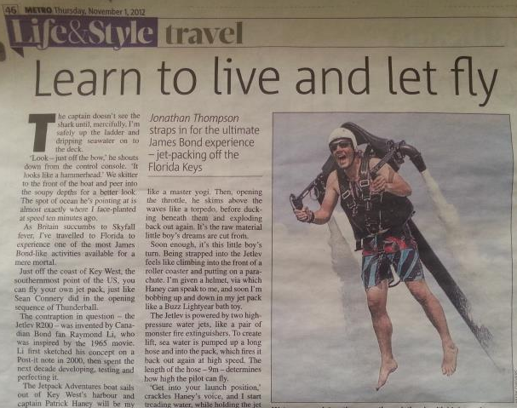
Why Future-Watch?
Sometimes future-watching may be irrelevant to our businesses
Metro, 1 Nov 2012

Slide 22
Why Future-Watch?
Need for future-watching to help identify tomorrow’s key technologies:
Change existing business processes
Decide to invest resources in finding out more (e.g. commissioning reports)
Invest in training and development in new areas
Explore ways of deprecating existing services (cf WH Smith’s decision to stop selling CD singles in 2004)
…

Slide 23
Audience Participation
Provide examples of relevant technological / societal developments which may affect your business:
Mainstream areas
Niche areas
HTML5
EPUB
“BYOD”
“Openness”

Slide 24
JISC Observatory
JISC Observatory:
JISC-funded initiative
Systematises processes for anticipating and responding to projected future trends & scenarios
Provided by JISC Innovation Support Centres at UKOLN and CETIS
See <http://blog.observatory.jisc.ac.uk/>

Slide 25
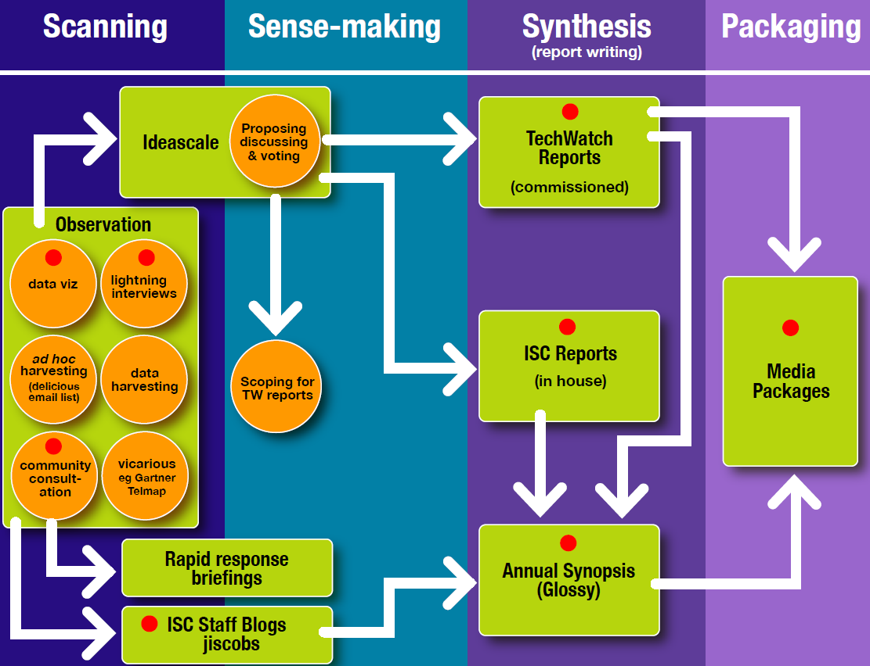
JIS Observatory process
JIS Observatory process

Slide 26
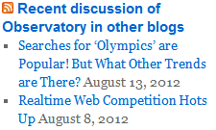
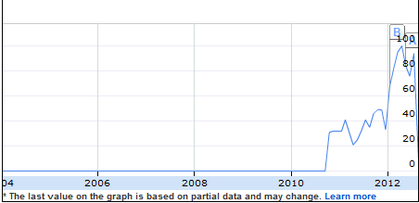
Scanning Activities
Blog posts: Posts published on JISC Observatory blog and on existing blogs.
Monitoring trends: Monitoring trends in order to:
Benchmark current usage patterns
Identify trends
Identify emerging patterns of usage
Google searches for “learning analytics” took off in 2010.
Possible indicator of relevance across sector & need for further investigation.

Slide 27
Sense-making
Need to:
Understand limitations of evidence-gathering techniques (including documenting ‘paradata’ so survey findings are reproducible & can be critiqued)
Provide suggestions of implications of developments for the sector
In addition need to encourage feedback on:
Evidence-gathering techniques
Interpretation of findings
Implications of developments
In order to inform:
Further investigation
Policy-making, planning and funding

Slide 28
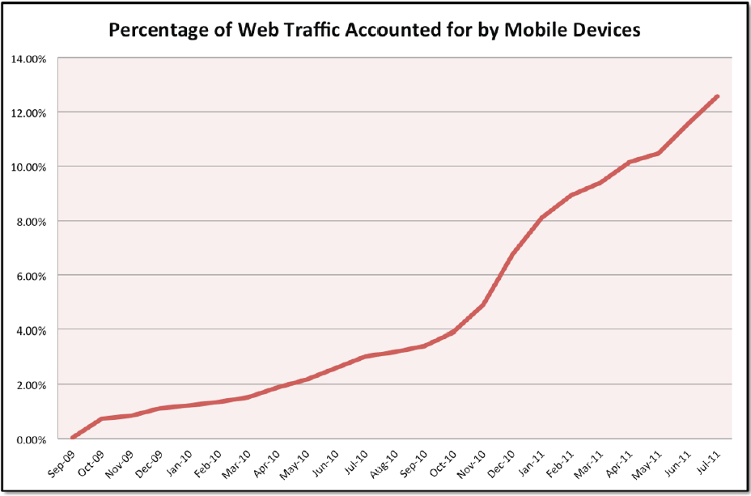
Significant Trends: Mobile
Tecmark Digital Marketing Agency
We now know of the importance of Mobile

Slide 29
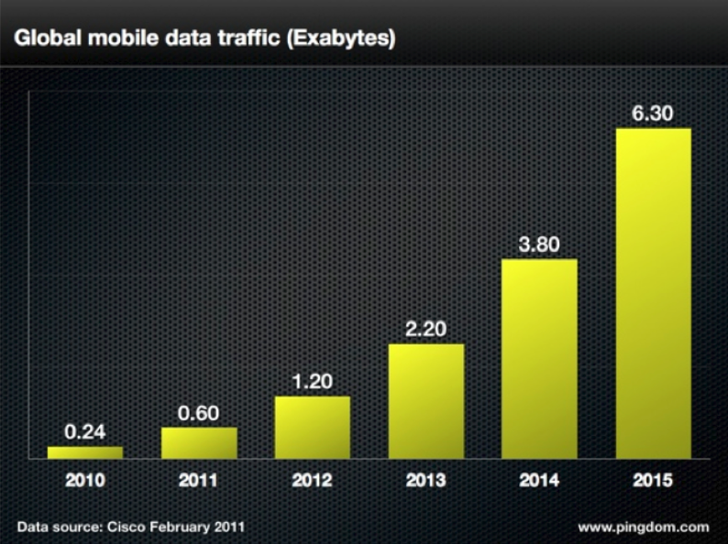
Significant Trends: Mobile
Cisco
We now know of the importance of Mobile

Slide 30
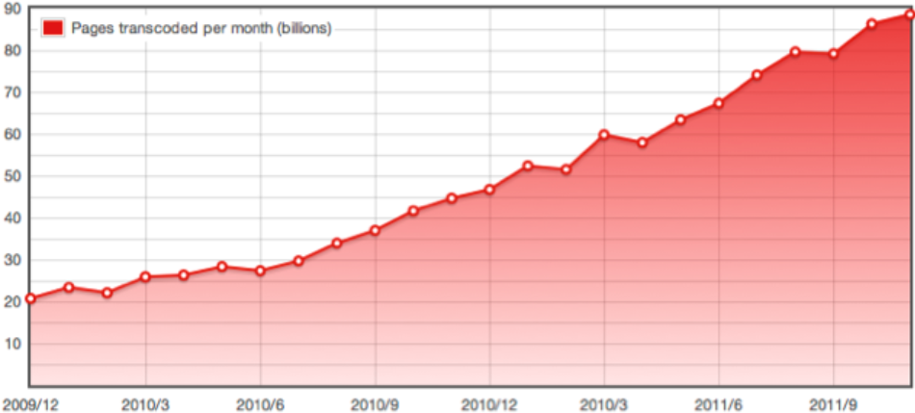
Significant Trends: Mobile
Opera
We now know of the importance of Mobile: but did we say the same when WAP came along?

Slide 31
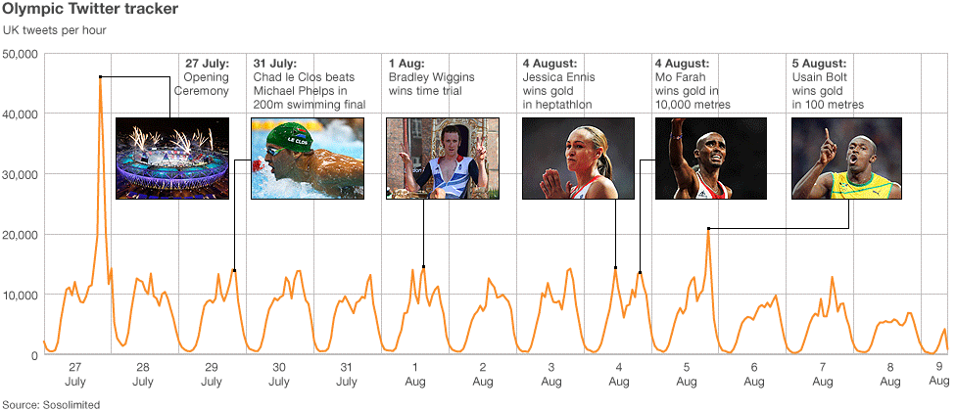
Significant Trends: Social Media
There were “more than 150 million Tweets about the Olympics over the past 16 days”. [Twitter blog]

Slide 32
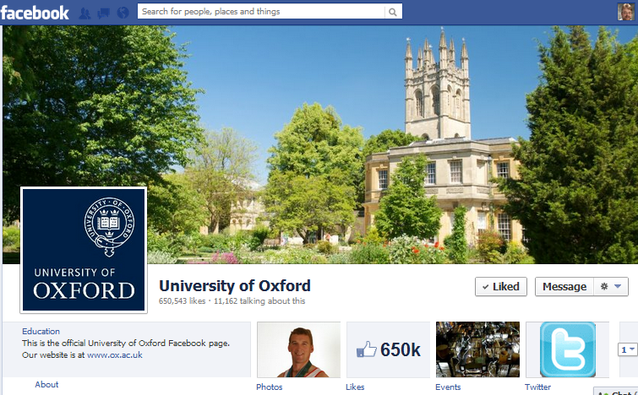
Significant Trends: Social Media
Survey in Aug 2012 of institutional use of Facebook across the 24 Russell Group universities found >1M ‘Likes’ followers

Slide 33
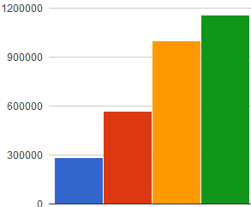
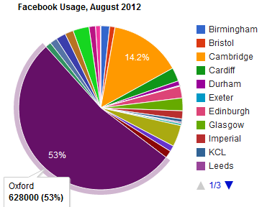
Behind The Data
Trends in Fb ‘Likes’ for Russell group Unis since Jan 2011 show steady increase
But note increase in Jul 2012 due to addition of 4 new universities!
Jan 11 Sep 11 May 12 Jul 12
But might trends hide a more complex story:
Usage & growth dominated by one significant player.
More modest usage generally

Slide 34
Need for Paradata and Discussion
Surveys carried out to monitor usage & trends for:
Institutional use of social media
Use of researcher profiling services (e.g. Google Scholar, Academia.edu, …) across institutions
Observations (and feedback):
Differing results found if quotes used
Possible inclusion of wrong Unis (e.g. Newcastle University, Australia)
Personalised results depending on client environment
Need to provide paradata and encourage feedback on processes and intrepretation of findings

Slide 35
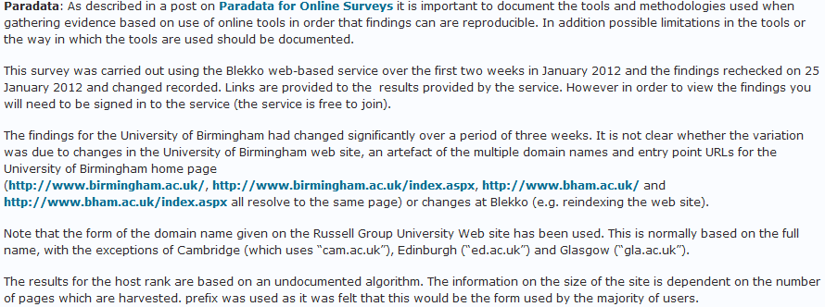
Paradata Example
Dates of survey
An example of paradata for a blog post on use of Blekko for an SEO analysis of Russell Group Universities
Summary of unexpected findings
Limitations of survey methodology
People in host institution can provide contextual knowledge if open approaches used

Slide 36
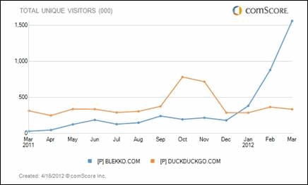
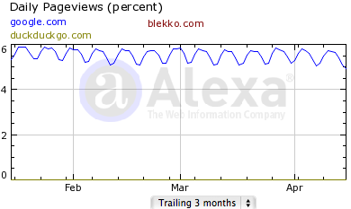
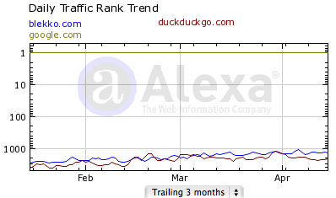
Lies, Damned Lies and Graphs
“#Blekko traffic goes through the roof – for good reason. Try it out!”
Based on blog post entitled “Blekko’s Traffic Is Up Almost 400 Percent; Here Are The CEO’s Five Reasons Why” (includes dissatisfaction with Goole)
Is Blekko’s Traffic Really Going Through The Roof? Will It Challenge Google?, UK Web Focus blog, 18 April 2012

Slide 37
Open Sense-making
Importance of open approaches to interpretation of signals:
Evidence-gathering methodologies may have flaws
Incorrect or inappropriate implications may be made
This may lead to wrong decisions being made
Open sense-making approaches may be difficult – your marketing department may wish a consistent, positive message to be made.

Slide 38
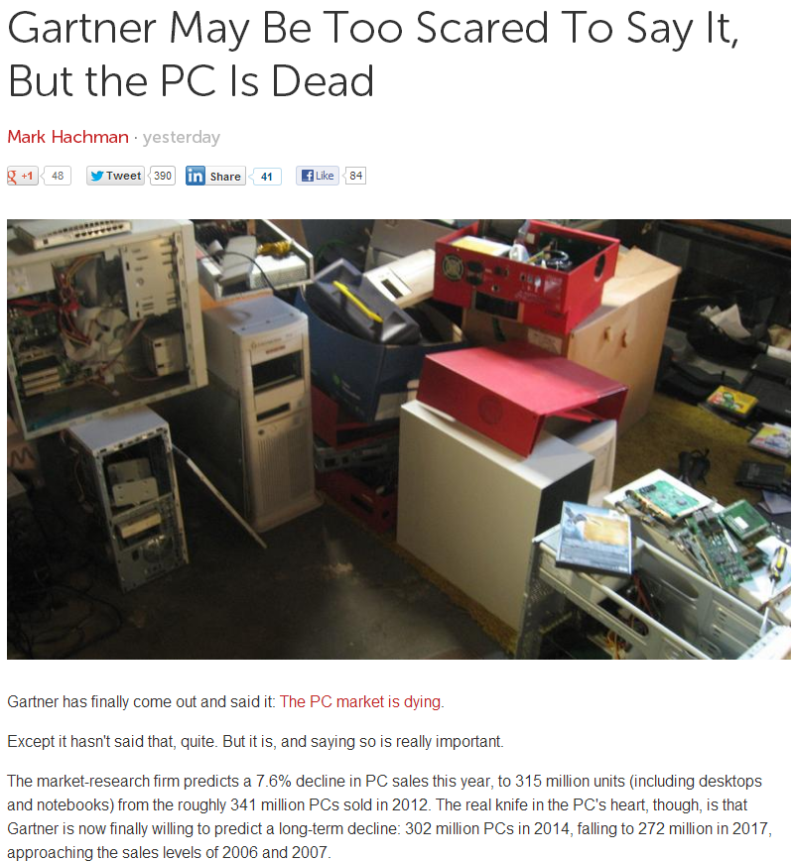
Beware vested interests who may be threatened by implications of predictions
Developments may
Be aligned with current plans
Challenge current plans

Slide 39
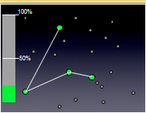
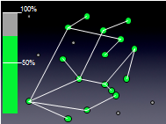
Sense-Making: Social Media
Social media:
Is about nodes and connections
Numbers do matter for effective engagement and disseminations
Experiences from other areas:
Nos. of mobile phones
Importance of email
“All bugs are shallow to many eyes”
Implications:
Importance of best practices for popular & well-used channels
Difficulties for new entrants e.g. Diaspora (open alternative to Facebook) and identi.ca and app.net (new open alternative to Twitter)

Slide 40
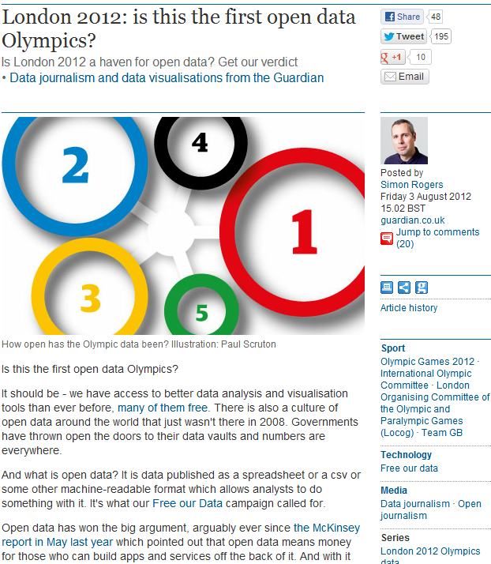
Open Data
“Is London 2012 a haven for open data?”
Conclusions:
“Not this time”
“But it is the first data Olympics”
“It's hard to see that by [Rio] 2016 this won't emerge as data we can all use”

Slide 41
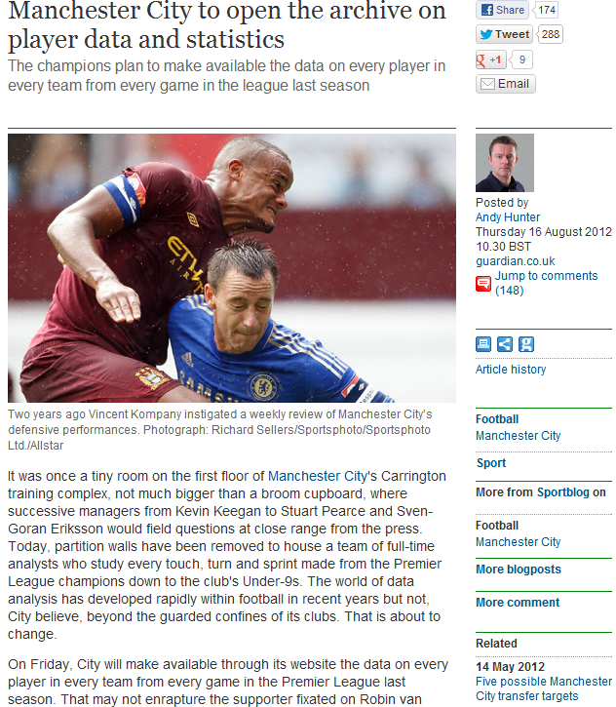
Open Data
“Manchester City to open the archive on player data and statistics”
Example of:
Public interest in open data
Interest from commercial sector

Slide 42
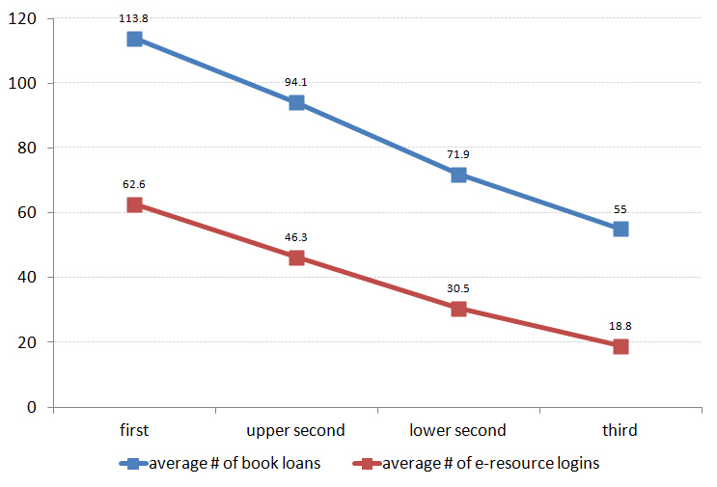
Use of Open Data in Libraries
Trends in reusing Library usage data, e.g. JISC’s Library Impact Data Project
Average number of books borrowed and e-resource logins for ~33,000 students in final year of studies
Image & data provided by Dave Pattern under a CC BY-NC-SA licence

Slide 43
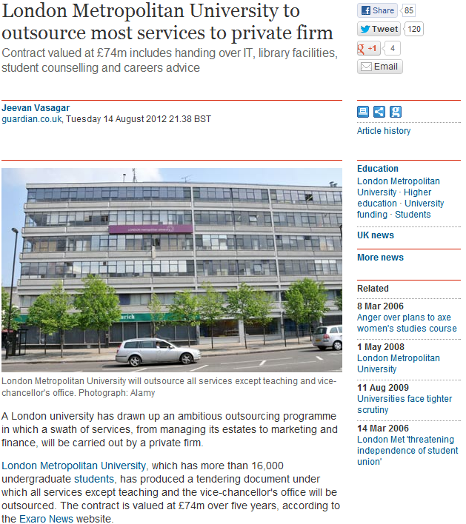
Early Signals?
News stories (Aug 2012) about plans for privatisation at London Metropolitan University

Slide 44
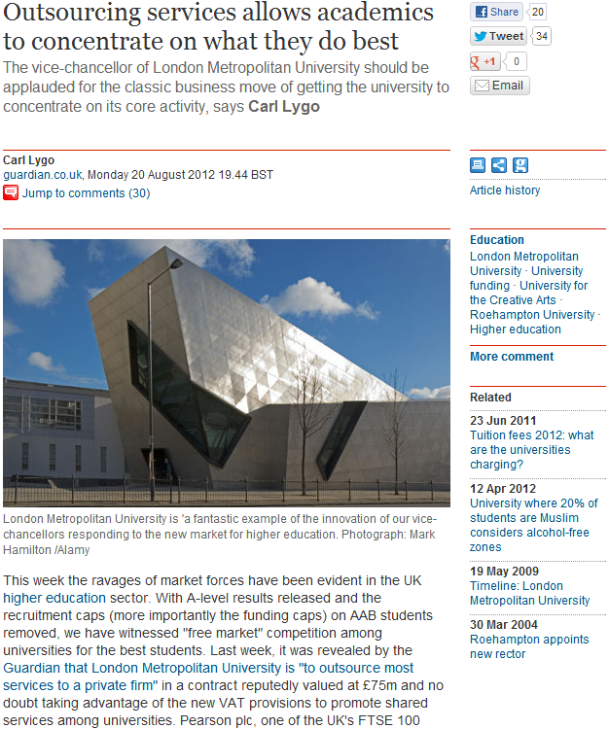
Early Signals?
Follow-up comment (20 Aug 2012):
“VC should be applauded for the classic business move of getting the university to concentrate on its core activity”
Carl Lygo is chief executive of the 'for profit' BPP Professional Education group and principal of BPP University College

Slide 45
Recap
Within your organisation / sector there is a need to have mechanisms for identifying technological developments which may have an impact on the business:
Observing trends and signals
Observing signals from diversity of sources
Interpreting the implications
Identifying changes which may be needed within the organisation
Inviting feedback and critiques of the evidence-gathering processes and the interpretations of the findings

Slide 46
Revisiting Your Key Areas
How might we apply the methodology:

Slide 47
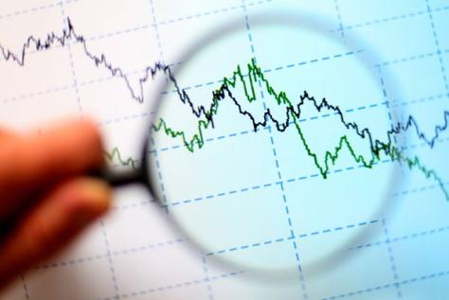
Challenge For Librarians
In time of uncertain futures:
Use evidence-based approaches to understanding the future
Understand the changing environment
Engage with opportunities in areas of growth and institutional importance
Be open and encourage discussion on analysis & interpretation of findings

Slide 48
Serenity prayer
Serenity prayer:
God, grant me the serenity to accept the things I cannot change, Courage to change the things I can, And wisdom to know the difference.
Tim Berners-Lee didn’t accept the evidence of the popularity of Gopher!

Slide 49
Conclusions
The Data will be Big, but our users will continue to use Facebook and Twitter
But research data will grow in importance as will use of mobiles.
According to the evidence the future isn’t quite what I expected. But it has helped to identify our business strategies.

