Slide 1


Social Media: For Ourselves and For Our Customers
Brian Kelly,
UKOLN

Slide 2




Social Media: For Ourselves and For Our Customers
Twitter:
#ussc12
http://www.ukoln.ac.uk/web-focus/events/conferences/ucisa-support-service-2012/
Brian Kelly
UKOLN
University of Bath
Bath, UK
Acceptable Use Policy
Recording this talk, taking photos, having discussions using Twitter, etc. is encouraged - but try to keep distractions to others minimised.
Blog:
http://ukwebfocus.wordpress.com/
Twitter: @briankelly / @ukwebfocus
UKOLN is supported by:
This work is licensed under a Creative Commons attribution 2.0 licence (but note caveat)

Slide 3










Idea from Cameron Neylon
You are free to:
copy, share, adapt, or re-mix;
photograph, film, or broadcast;
blog, live-blog, or post video of
this presentation provided that:
You attribute the work to its author and respect the rights and licences associated with its components.
Slide Concept by Cameron Neylon, who has waived all copyright and related or neighbouring rights. This slide only CCZero.
Social Media Icons adapted with permission from originals by Christopher Ross. Original images are available under GPL at:
http://www.thisismyurl.com/free-downloads/15-free-speech-bubble-icons-for-popular-websites
3

Slide 4
About Me
Introduction
Brian Kelly:
  UK Web Focus: national advisory post to UK HEIs
  Based at UKOLN ISC at the University of Bath
  Prolific blogger (1,090+ posts since Nov 2006)
  User of social media to support work activities
  Prolific speaker (~380 talks from 1996-2011)
  “Gamekeeper turned poacher”: former IT support / information officer at Loughborough, Liverpool & Leeds IT service departments
UKOLN Innovation Support Centre (ISC):
  Supporting innovation across HE and FE
  Funded by JISC

Slide 5

Contents
Computing Service culture
Is ‘Social’ a term to worry us?
Community & collaboration
Tools for sharing:
  ■ Blogs  Twitter
Addressing barriers
Context
  Reduced funding
  User as customer
  Technological developments
  Increasing expectations
  Need to work differently

Slide 6
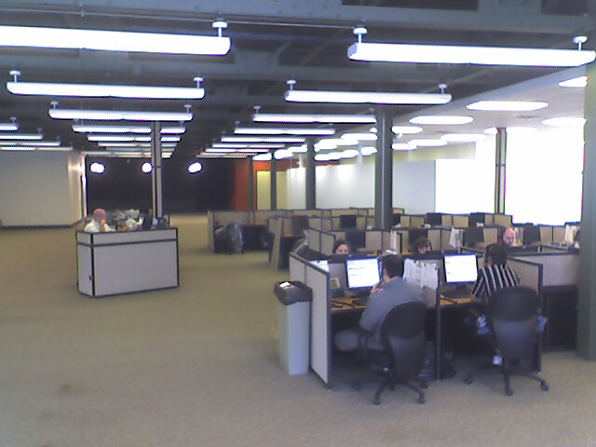

X
Management Information Systems
Taken from slide by Wildish & Howell, UCISA CISG 2008
http://www.flickr.com/photos/pwz/2096587340/sizes/o
http://www.flickr.com/photos/pwz/2096587340/sizes/o

Slide 7
Management Information Systems
“Our needs”
“Business Processes”
“Security”
“Risk analysis”
“Data Protection”
Taken from slide by Wildish & Howell, UCISA CISG 2008
http://www.flickr.com/photos/pwz/2096587340/sizes/o
http://www.flickr.com/photos/pwz/2096587340/sizes/o

Slide 8
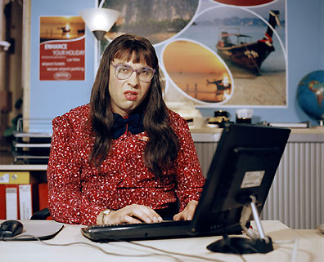
“Computer Says No”
Computer Says No!
Time to ditch this catch phrase
X

Slide 9
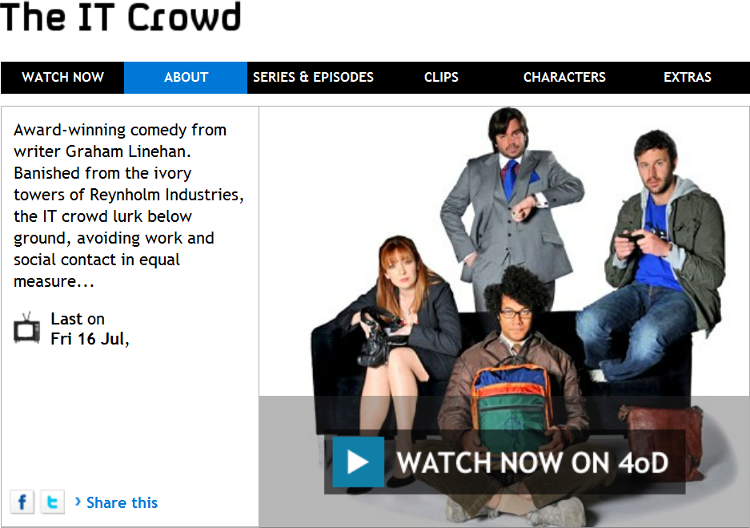
“Have You Tried Rebooting?”
It’s not a supported product
Have you tried rebooting your PC?
The IT Crowd
You’re only allowed to connect approved devices to WiFi
Skype will turn your PC into a supernode!
Sorry, Google owns your data!
Sorry, Facebook claim ownership of your first born!

Slide 10
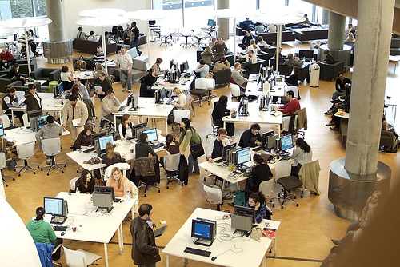
IT Service Culture
Traditionally the need to:
  Manage scarce resources
  Ensure resources used for ‘scholarly purposes’
But times they are a-changing’

Slide 11
Michael Nowlan, TCD
I attended a session of the EUNIS 2005 conference in Manchester entitled "IT Services - Help or Hindrance to National IT Development Programmes?" given by Brian Kelly of UKOLN.
The session opened my eyes about attitudes to technology in university Computer Centres. Brian challenged the basic tenets that I had observed as the Director of Information Systems Services in Trinity College Dublin for the previous 10 years.
Returning back to Trinity the following week, I started to ask my staff questions that had never really been properly considered before:
  Why do we have such a poor email system when Google give away email with a 4GB quota and Trinity 20MB?
  Why do we ban Skype?
  Why do we not allow "unapproved" devices connect to the network?
  Why is the automatic answer to a request "no, but" rather than "yes but"?
Following on the EUNIS paper by Brian, I started to try to change the environment in Trinity from negative to positive and made some successes. …

Slide 12
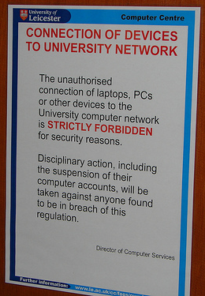
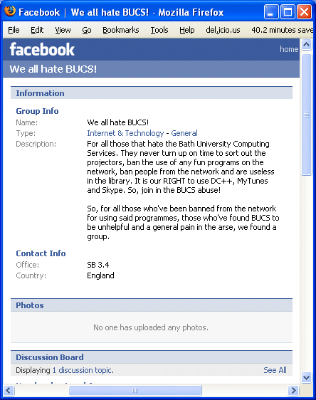
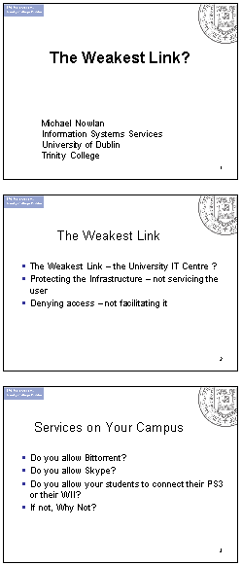
Strictly Forbidden!
IT Services as the weakest link

Slide 13
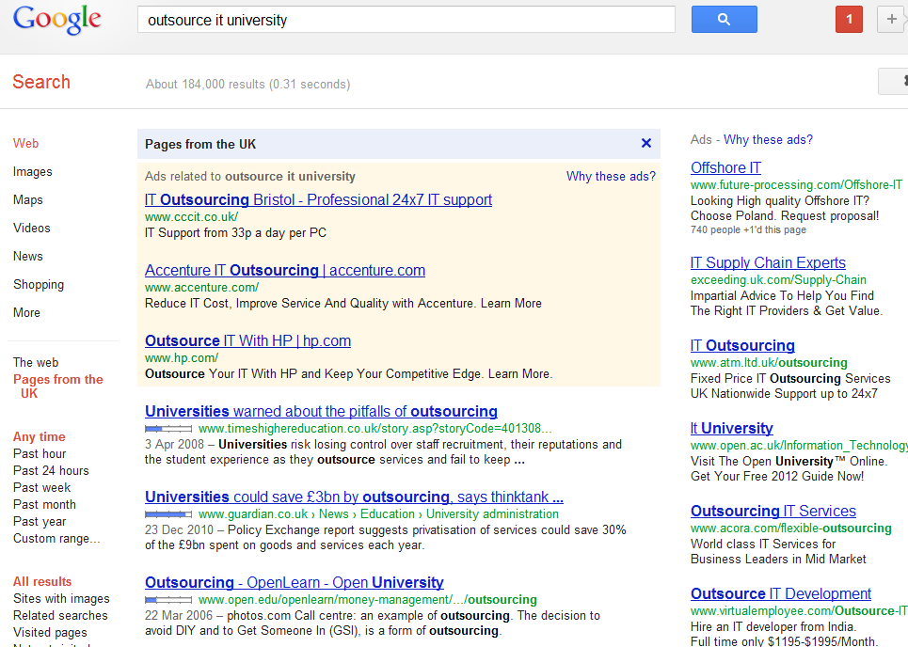
Outsource IT in Universities
Google search for “outsource IT university”

Slide 14

The Cloud
Taken from http://www.flickr.com/photos/nirak/644335254/sizes/o/in/photostream/

Slide 15
Accept the Importance of The Cloud
We Must Own The IT Infrastructure!
  “The Cloud seems appealing. But you are giving your content to complete strangers and letting them do whatever they want with it!”
We Must Nationalise The Banks!
  “Banks seems appealing. But you are giving your money to complete strangers and letting them do whatever they want with it!”
Avoid Pension Schemes!
  “Pensions seems appealing. But you are giving your money to complete strangers and letting them do whatever they want with it!”

Slide 16
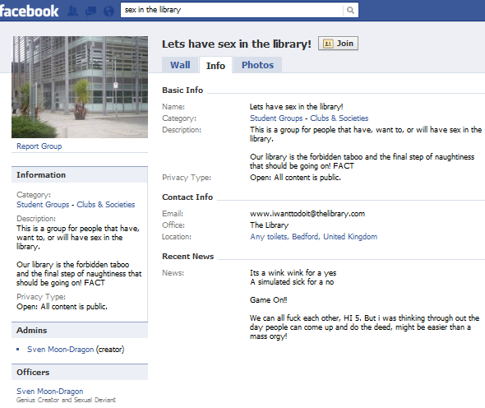
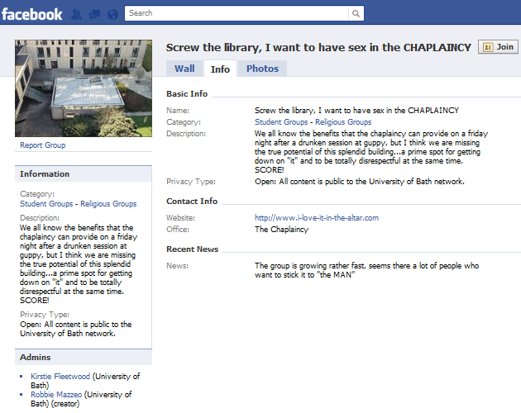
What Is Social Media?
Technologies which:
Distract for teaching, learning & research purposes
Can be used to bully (including staff)

Slide 17
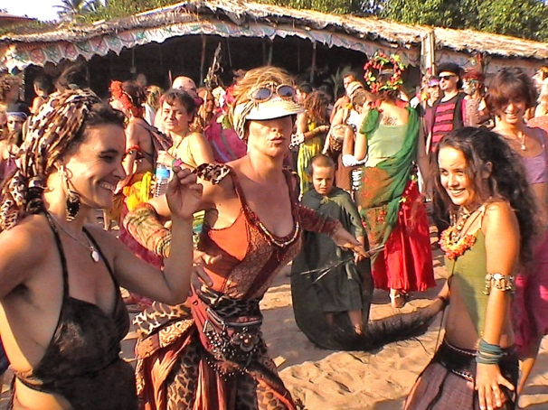

The Problem With ‘Social’
Does ‘Social’ mean:
  Trivial
  Personal
  Unrelated to academia
Or:
  Collaborative
  Collective
  Team working
The term social refers to a characteristic of living organisms as applied to populations humans and other animals. It always refers to the interaction of organisms with other organisms and to their collective co-existence, irrespective of whether they are aware of it or not, and irrespective of whether the interaction is voluntary and involuntary.
Wikipedia

Slide 18
Redefining ‘Social’
Social media / Social web:
  Collaborative technologies
  Interactive technologies
which support:
  Social constructivism / social constructionism theories of knowledge: “individual's learning that takes place because of their interactions in a group”

Slide 19

Another View
Social networks get better as numbers increase (cf telephones) Remember 1-9-90 rule.

Slide 20
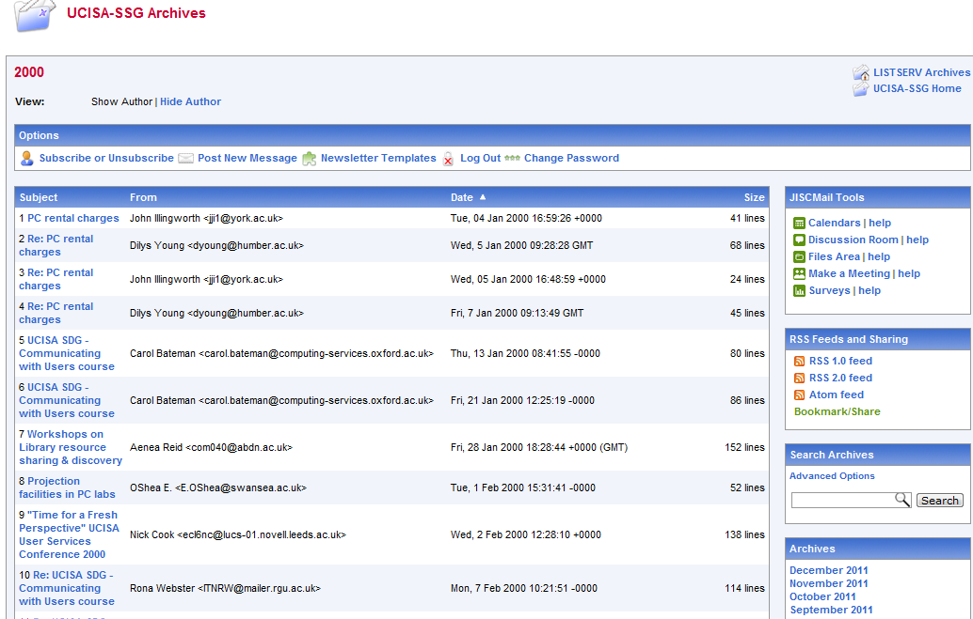
Collaboration & IT Services
JISCMail lists
UCISA events
…

Slide 21
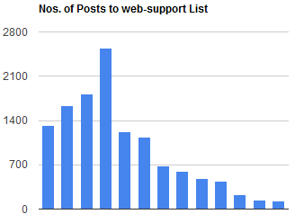
Today’s Environment
Today we are seeing:
  Decline in mailing lists
  Better understanding of diversity of needs: (indicating, informing, alerting, sharing, collaborating, critiquing, …)
  Wide variety of social media tools for carrying out diversity of functions (e.g. Twitter for indicating: “About to install Debian. Any1 else done this?”
List now used mainly for ads for events, jobs, etc.
1999-2011
See posts on The Decline in JISCMail Use Across
the Web Management Community and
Are Mailing Lists Now Primarily A Broadcast Medium?

Slide 22


Slide 23
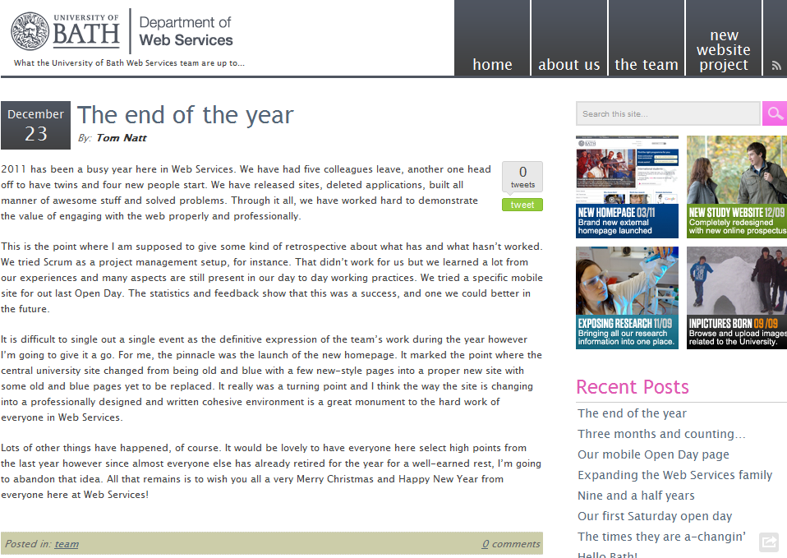
Blogging
Blogging provides an easy-to-use way of providing public documentation

Slide 24
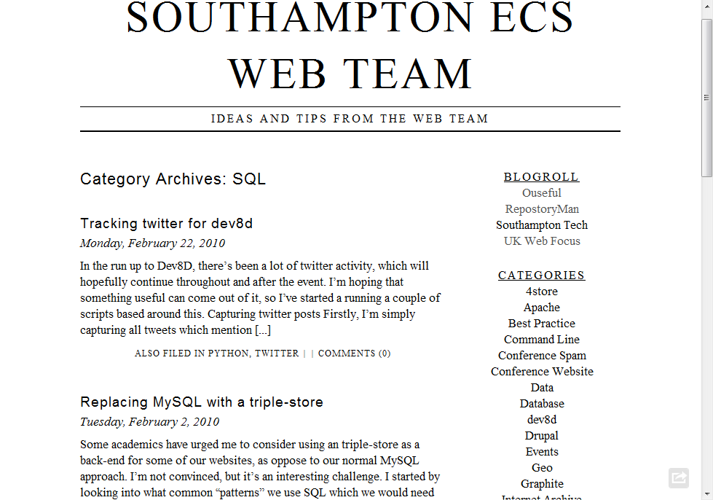
Blogs can also be technical

Slide 25


There are many social media services but we can’t ignore Twitter!

Slide 26
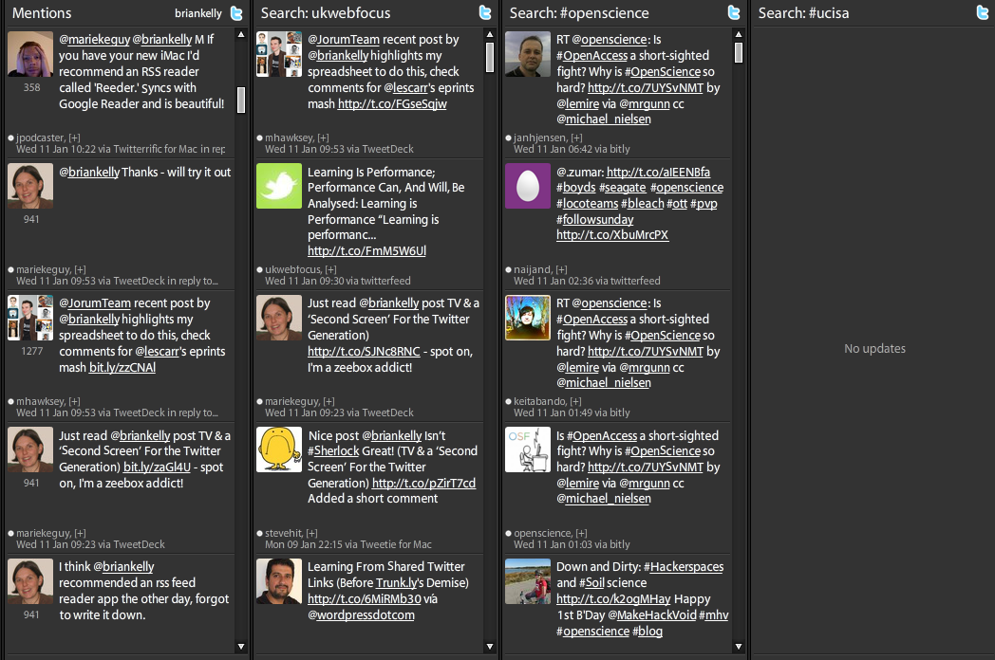
Twitter
A dedicated Twitter client can provide rich filtering.
How have people got the time to read and write long emails? ☺

Slide 27
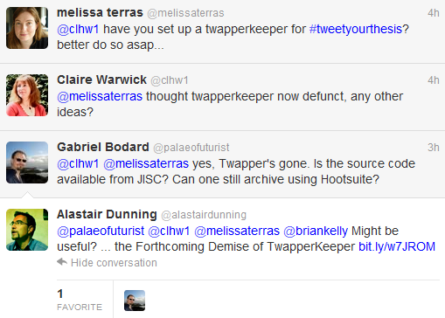
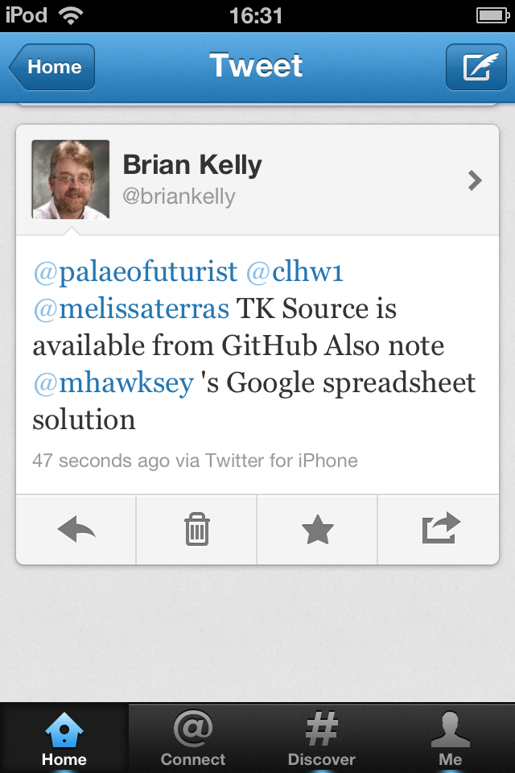
Rapid Support from Peers
Twitter can provide rapid support from one’s professional learning network (PLN)
3:58pm
4:17pm
4:23pm
4:30pm
4:27pm
To maximise opportunities you need to develop filtering skills (e.g. click ‘Read all’ in Twitter client)

Slide 28
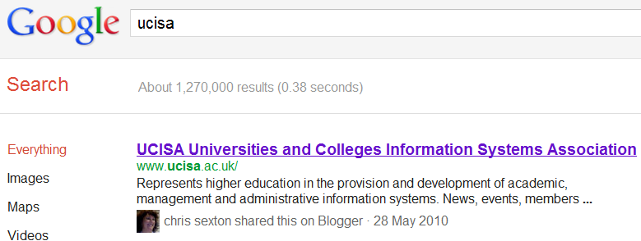
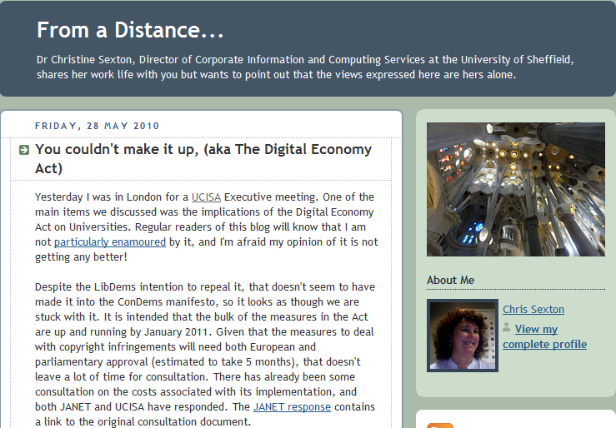
Social Search
“Know any good pubs in Birmingham?”
Who do you ask:
  Google?
  Your friend, whom you trust?
Invisible Library Support – Now You Can’t Afford Not to be Socials?
“you could start to make frictionless recommendations by influencing the search engine results returned to your patrons ”
Tony Hirst, ouseful.info blog

Slide 29
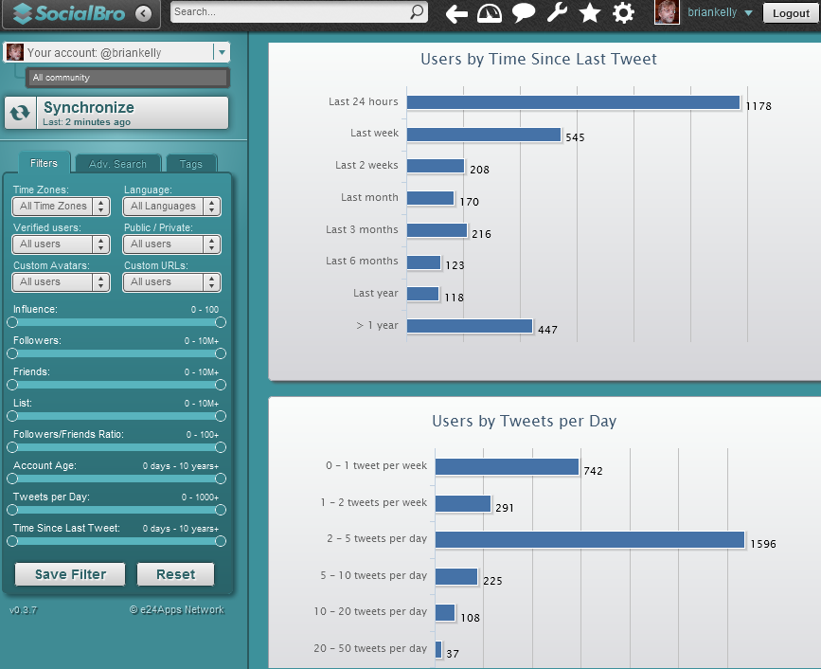
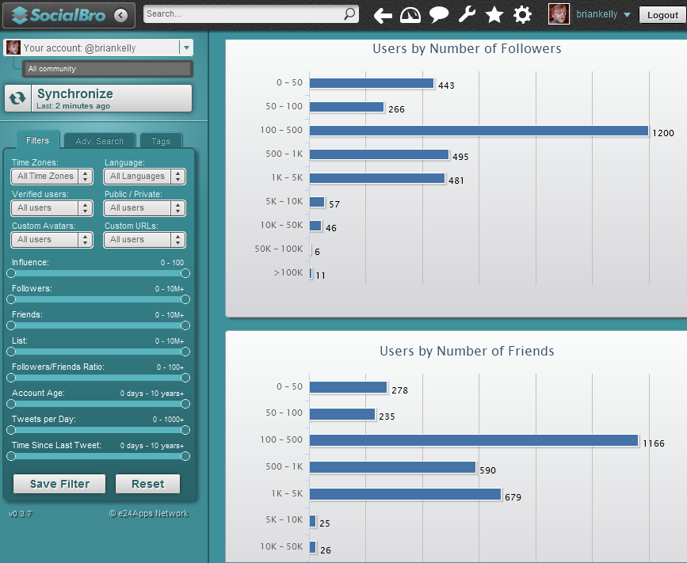
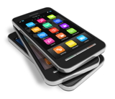
Understanding Social Media
We need to understand how we use social media in order to identify successful patterns
Info captured on Thu, 28 Jun 2012

Slide 30
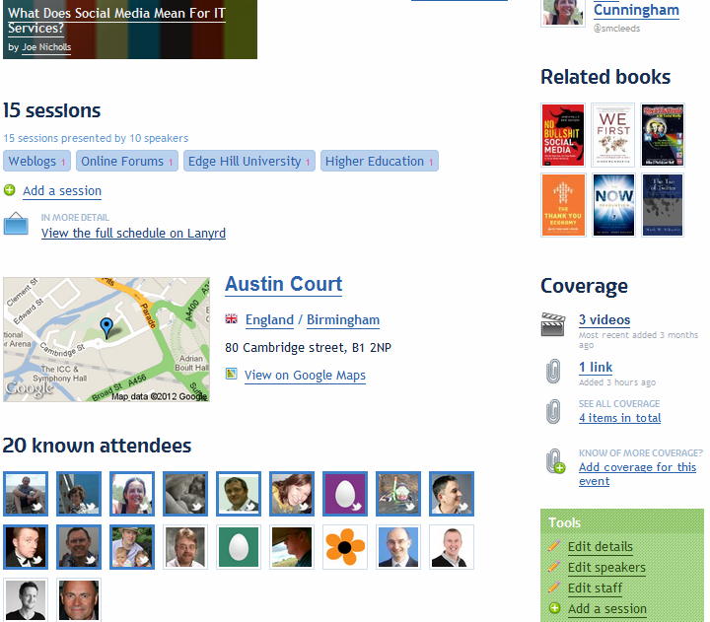
Growing Your Community
The challenge:
  Developing connections with peers
The opportunity:
  Join Twitter
  Follow others (via Lanyrd page for event )

Slide 31

Challenges (1)
Concerns:
  “I’m too busy”
    Nonsense! 5 tweets a day?
  “I wouldn’t know what to say”
    First tweet is the hardest.
  “My boss disapproves”
    Is this still the case?
  “Access is blocked”
    Is this still the case?
  “I don’t agree that there are benefits”
    Still need for case studies & evidence

Slide 32
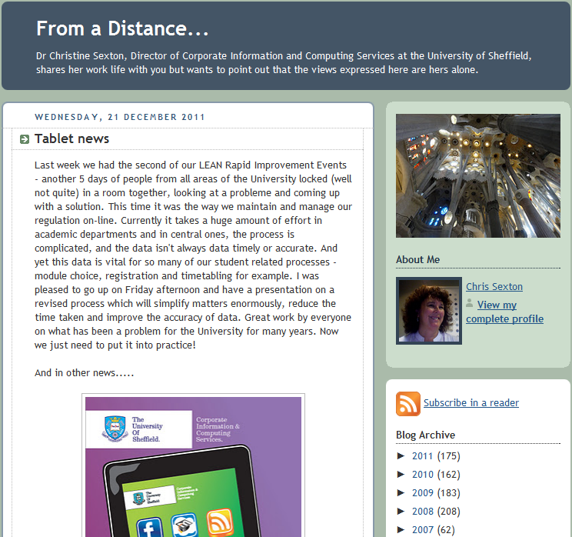
Too Busy To Blog?
Chris Sexton, IT Services Director at Sheffield University and former UCISA chair posts ~3 posts per week over ~5 years.

Slide 33

Challenges (2)
“I’ll get addicted”
  That’s a challenge of success!
“I can’t keep up with tweets, & blog posts ☹”
“I want to blog. How do I start?”
“I can see the merit –
but it’s not for me”

Slide 34

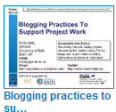
Challenges (2)
“I’ll get addicted”
  That’s a challenge of success!
“I can’t keep up with tweets, & blog posts ☹”
  Don’t! It’s a stream for you to dip into and contribute to. Learn when it’s useful to take a dip
“I want to blog. How do I start?”
  See UK Web Focus blog & talk
“I can see the merit –
but it’s not for me”
  OK – but don’t block
  others who wish to do it
”Plants” and “Resource investigators” in Belbin model may welcome opportunities provided by social media

Slide 35
UCISA Community of Practice
Community of Practice (from Wikipedia):
  Group of people who share a craft and/or a profession.
  Can evolve naturally because of the common interests in a particular area, or can be created specifically with the goal of gaining knowledge related to their field.
  Through the process of sharing information & experiences with the group that the members learn from each other, and have an opportunity to develop themselves personally and professionally

Slide 36

UCISA Community of Practice
Social media provides opportunity to develop an effective community of practice:
  Open sharing of resources,
  experiences, successes
  & failures
  Exploit sectors expertise
  in IT
  Ability to inform users of
  experiences gained
  Ability to use experiences in
  personal lives
Keep aspect is culture of openness: a willingness to share, rather than the technologies
Photo from http://www.flickr.com/photos/mag3737/1914076277/

Slide 37
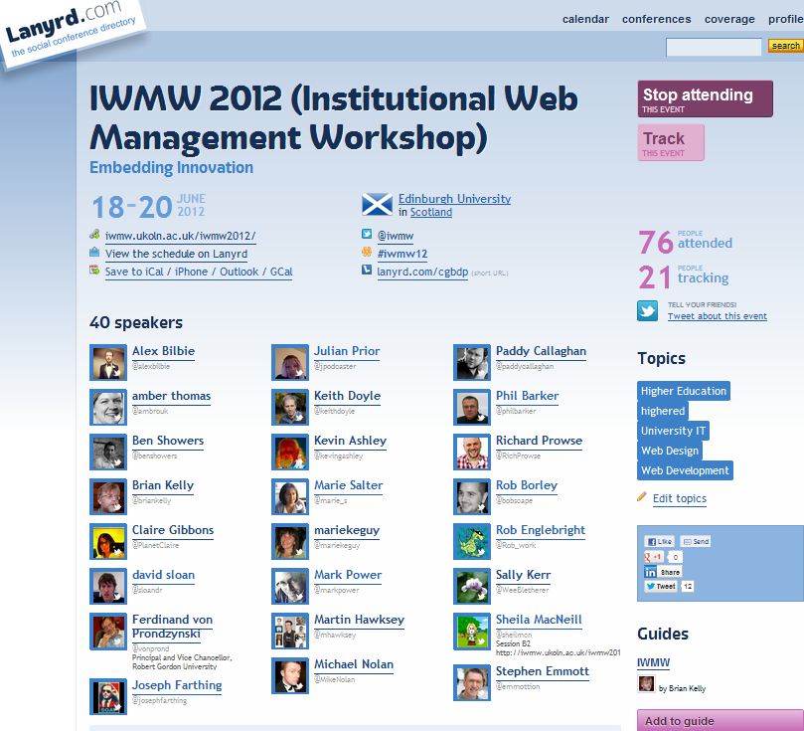
Lanyrd
Lanyrd for IWMW 2012

Slide 38
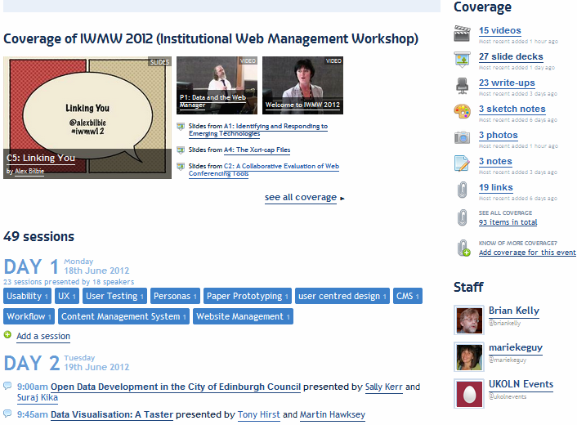
Lanyrd
Links to reports, slides, photos, etc. can be added by anyone with Twitter ID: avoids bottlenecks.

Slide 39
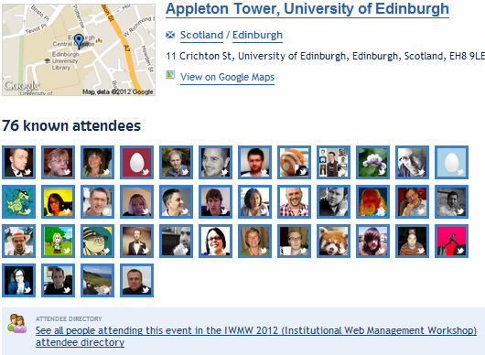
Lanyrd
Lanyrd for IWMW 2012

Slide 40
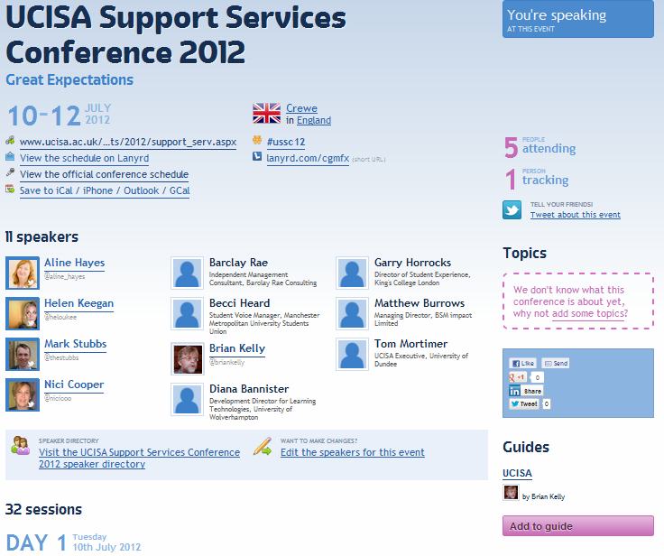
Lanyrd
Why wouldn’t you:
  Add your details on Lanyrd for USSC12
Why wouldn’t UCISA:
  Use Lanyrd for public-facing information for events?

Slide 41
Outsource IT in Universities
Our University
  Uses IT to support its core business
  IT Services are willing to outsource aspects if that provides business benefits
  IT staff make use of social media and cloud services to support the aims of the university
  IT staff are well-connected with their peers to provide a cost-effective service across the UK HE sector

Slide 42
Conclusions
Social Web:
  Is about communication, community & collaboration
  Can get better as numbers of users reaches critical mass
  Provides diversity of tools for differing requirements and preferences
  Will not go away; will grow!
  Opportunity for IT Services to play a leading role
  Openness fits with transparency agenda
And the Sex in the Library; Screw the Library, Let’s Have Sex in the Chaplaincy and We All Hate BUCS! Fb groups quickly became defunct

Slide 43
Questions
Any questions or comments?

