Slide 1
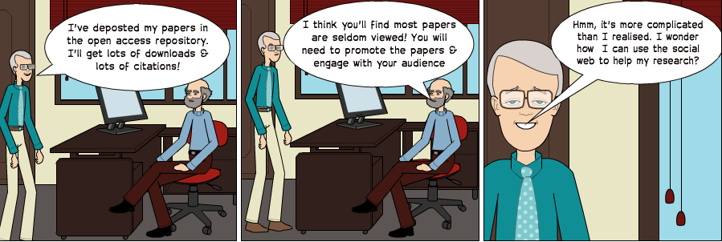
Open Practices for the Connected Researcher
Using Social Media to Enhance Your Research Activities
Talk by Brian Kelly, UKOLN on 24 June 2013 at the 3rd annual Social Media in Social Research conference
Presentation by Brian Kelly, UKOLN on 25 October 2012 for an Open Access Week event at the University of Exeter

Slide 2
Using Social Media to Enhance Your Research Activities
Twitter: #SRAconf
http://www.ukoln.ac.uk/web-focus/events/conferences/sra-2013/
Brian Kelly
UKOLN
University of Bath
Bath, UK
Acceptable Use Policy
Recording this talk, taking photos, having discussions using Twitter, etc. is encouraged - but try to keep distractions to others minimised.
Blog:
http://ukwebfocus.wordpress.com/
Twitter: @briankelly / @ukwebfocus
UKOLN is supported by:
Caveat: images may not be available with a CC licence. Where possible, links to source of images are provided to help you assess risks of reuse.
This work is licensed under a Create Commons Attribution 2.0 licence (but note caveat)

Slide 3
Idea from Cameron Neylon
You are free to:
copy, share, adapt, or re-mix;
photograph, film, or broadcast;
blog, live-blog, or post video of
this presentation provided that:
You attribute the work to its author and respect the rights and licences associated with its components.
Slide Concept by Cameron Neylon, who has waived all copyright and related or neighbouring rights. This slide only CCZero.
Social Media Icons adapted with permission from originals by Christopher Ross. Original images are available under GPL at:
http://www.thisismyurl.com/free-downloads/15-free-speech-bubble-icons-for-popular-websites
3

Slide 4
About Me
Introduction
Brian Kelly:
UK Web Focus: national advisory post to UK HEIs
Long-standing Web evangelist (since 1993)
Based at UKOLN at the University of Bath
Prolific blogger (1,100+ posts since Nov 2006)
User of various devices to support professional (and social) activities
Prolific speaker (~400 talks from 1996-2012)
Research profile:
Peer-reviewed papers published on Web accessibility, standards, preservation, …
Largest no. of downloaded papers from Bath IR
Highly-cited papers in Web accessibility (e.g. W4A)

Slide 5
About This Talk: Aims
Introduction
Abstract:
In this paper the author summarises the benefits which can be gained from use of social media to support research activities.
The paper is based on personal experiences* in using social media to engage with fellow researchers, meet new collaborators and co-authors and enhance awareness and impact of research papers.
* Your mileage may vary! Talk describes personal successes in specific discipline area.

Slide 6
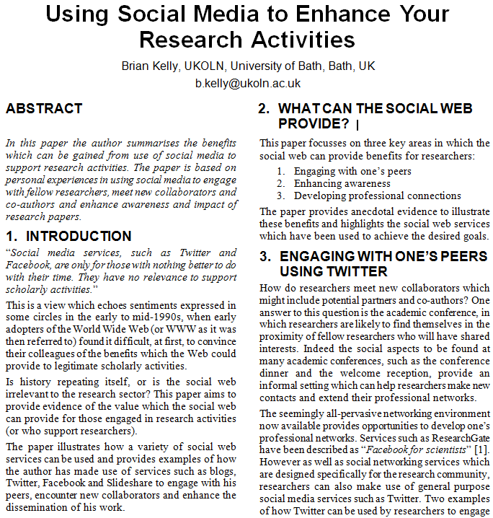
Paper
Accompanying paper available on:
ResearchGate
Academia.edu
Opus, University of Bath IR
Share with your friends and provide real-time peer-reviewing: http://bit.ly/sra13-kelly

Slide 7
Structure of the Talk
About me
About the talk
About you
Why is social media relevant to researchers?
Examples of the benefits:
Developing one’s professional networks
Engaging with peers and practitioners
Maximising readership
Implementation plan for peer-reviewed paper
Understanding and addressing concerns

Slide 8
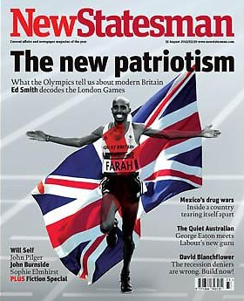
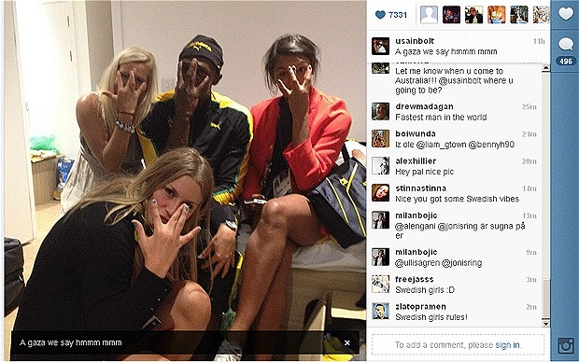
Are you a Roundhead or a Cavalier?
Are you a Roundhead or a Cavalier?
“In the century, Britain was devastated by a civil war that divided the nation into two tribes – the Roundheads and the Cavaliers. The Cavaliers represent a Britain of panache, pleasure and individuality. They are confronted by the Roundheads, who stand for modesty, discipline, equality and state intervention.”
X
Who is most like you?
Mo Farrah for winning the 5,000 and 10,000m?
Usain Bolt for partying with Swedish handball team after winning 100m, & before 200m & relay?

Slide 9
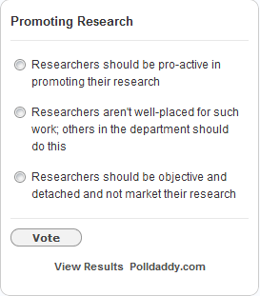
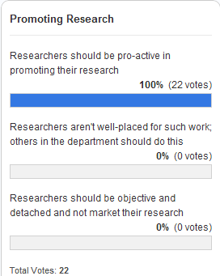
Do You Want to Change the World?
X
Introduction
“Hitherto, philosophers have sought to understand the world; the point, however, is to change it”
Do you seek to change the world through your research or simply understand the world:
You want to pro-actively market your research
You want others to market your research
You have a detached view of your research

Slide 10
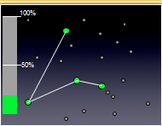
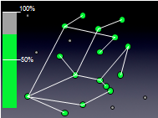
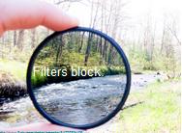
“It’s About Nodes and Connections”
Theory
Cameron Neylon keynote at OR 2012: “Networks qualitatively change our capacity”
With only 20% of a community connected only limited interaction can take place
This increases drastically as numbers of connected nodes grows
Examples:
Phone networks (no use with only 1 user!)
Tweeting at this event
Galaxy Zoo
“Filters block. Filters cause friction”
Need for client-side, not supply-side filters.

Slide 11
SEO (Search Engine Optimisation)
Web sites
Google (Bing, DuckDuckGo, …)
Real world
Databases (e.g. IRs)
Summary of key approaches:
Apply various techniques to Web resources to make resources easier to find in Google, …
Resources may include organisational Web suites, third party Web sites, databases, …
Resources may also include real world objects and ideas (e.g. your research ideas, …)
Based on understanding of importance of Google to end users
Directories

Slide 12
Beyond SEO, SMO
Web sites
Social Services (Facebook, Slideshare, Twitter, …)
Real world
Databases (e.g. IRs)
Summary of key approaches:
Make use of social networking services which people may use of discuss your services
Services may include Facebook, LinkedIn, Slideshare, Twitter, …
No need to touch your Web sites (therefore useful if you can’t!)
Based on understanding of popularity of SNs and people’s interests in chatting and sharing
Directories

Slide 13
Give Me The Evidence!
The Evidence

Slide 14
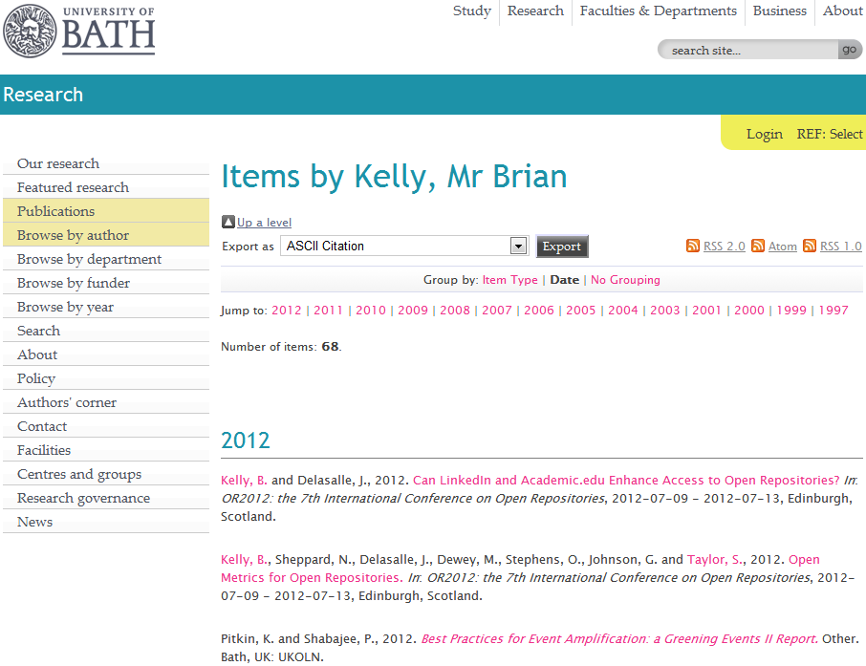
My Papers
My papers in the University of Bath Opus repository

Slide 15
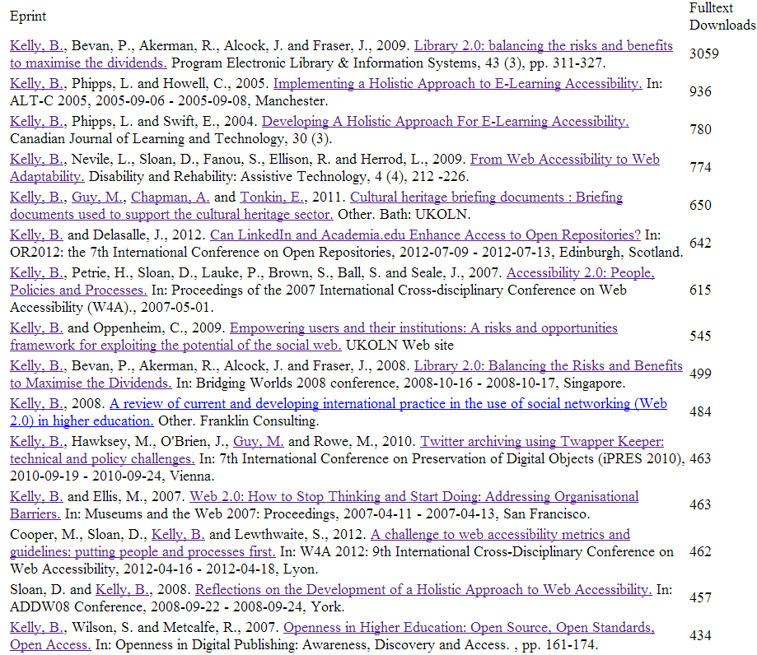
Open Access enhances access
Downloads for Brian Kelly
Download figures for my papers
11 Jun 2013

Slide 16
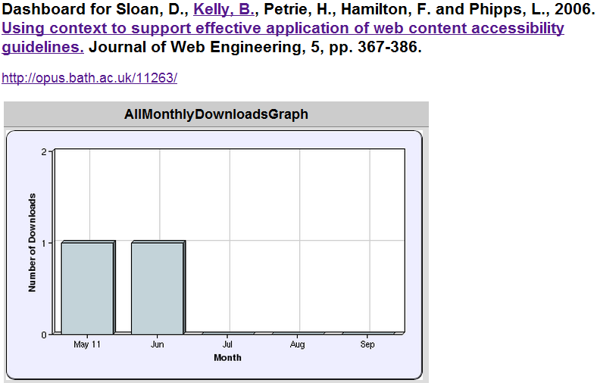
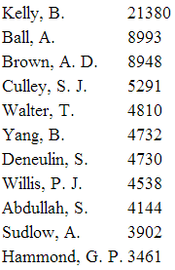
Least Downloaded Papers
Will papers in a repository be seldom seen?
What can be learn from approaches taken for the popular and unpopular papers?
Most downloaded papers in Bath IR

Slide 17
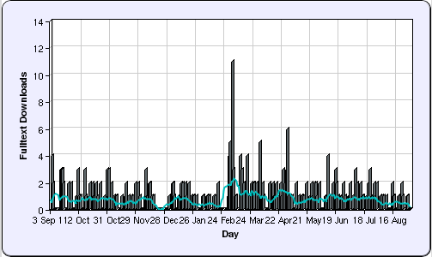
Learning From Success
“Library 2.0: balancing the risks and benefits to maximise the dividends”
Seventh most downloaded paper in repository (Jun 2013) ☺
But only recent download statistics available ☹
2012

Slide 18
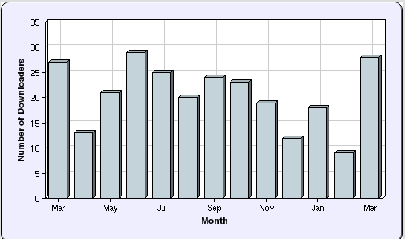
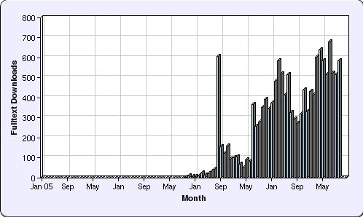
Evidence
How do we find out more?
Peak statistics for repository only available for 1 year
But:
Blog post about availability in Opus published on 11 August 2009
Further investigation (of all my paper downloads) confirms large peak in August 2009
Conclusion: Blog post responsible for initial popularity

Slide 19
Beyond the Edge Cases
Little-downloaded paper:
Uploaded to repository 6 years after paper written
I was not lead author
Only PDF version uploaded
Never blogged about; never tweeted
Most popular paper:
Available in IR on launch of journal issue
I was lead author
Blog post published on day of launch
Available in PDF, MS Word & HTML formats
Link to paper subsequently tweeted & retweeted
About Web 2.0, so likely to be read by bloggers
But what about the majority of papers?

Slide 20
SEO or SMO
SEO:
Helping Google find your papers through:
Writing style, document structure, …
In-bound links
SMO:
Helping other people find your papers through:
Viral marketing
Sharing on social media services
X
SMO: Good for new papers, but not relevant for popular papers written from 2004-8
SEO: Document structure consistent. Difference appears to be significant nos. of in-bound links

Slide 21
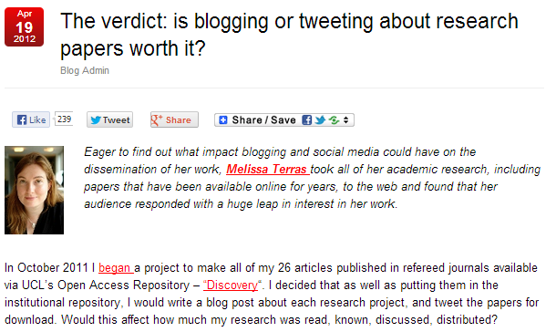
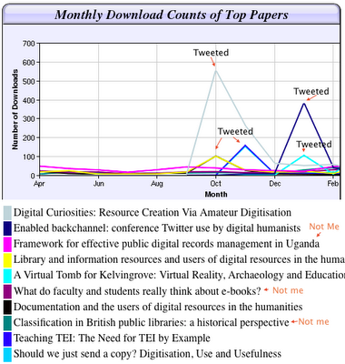
Further Evidence
Blog post by Melissa Terras, 19 April 2012
The findings

Slide 22
What Did You Do?
The Evidence

Slide 23
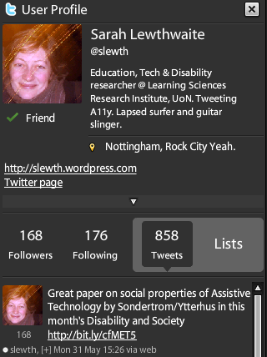
Developing New Connections
Developing New Connections
Tweet sent asking for researchers to complete survey on use of Web 2.0 in research
Response from @slewth
Who is she?
Twitter bio: disability researcher
Link in bio to her blog
Blog gives insights which complement my research
Follow @slewth and have Twitter chat
Follow-up
Shall we write a paper?
Paper written
Paper accepted
Paper wins prize for best paper ☺
See blog posts on “It Started With A Tweet”
and “Winner of John M Slatin Award at W4A 2010”

Slide 24
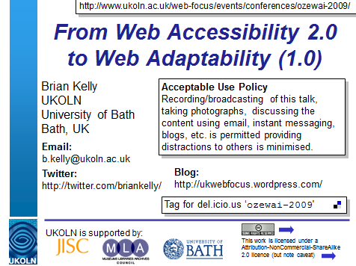
Event Amplification
‘Amplified event’: networked technologies at events to maximise (‘amplify’) ideas mentioned and subsequent discussions, including discussions between event attendees and remote participants.
Talks designed for ease-of-engagement
Slides on Slideshare & easily found
Twitter ID on Title slides
OzeWAI 2009 Conference
Invited keynote talk given in Melbourne, Jan 2009
Tweets received after talk: “@briankelly enjoyed your presentation this morning about a holistic approach to accessibility #ozewai” & “@briankelly Fantastic talk this morning, I will come up and say hi at lunch ;)”
We spoke, and they agreed to contribute to a paper. Paper published 6 months later ☺

Slide 25
Being Pro-active: An Implementation Plan
The Evidence

Slide 26
W4A 2012 Paper
Case study:
Paper on “A challenge to web accessibility metrics and guidelines: putting people and processes first” given at W4A 2012 conference in Lyon in Apr 2012
Four co-authors agreed:
To collaborate in raising awareness of paper and presentation of the paper
How:
Writing blog posts on or just before conference
Participate on conference Twitter hashtag (e.g. responding to comments while speaker is presenting)
Benefits:
Reaching out to a wider audience based on our 4 professional networks

Slide 27
Preparation
We:
Uploaded paper to repository so URL was known
Provided a link to the paper in speaker’s slides
Uploaded holding slide to Slideshare so URL was known (slides were finalised shortly before talk)
We could then:
Prepare blog posts in advance
Create short URLs in advance
Examples of approaches to follow

Slide 28
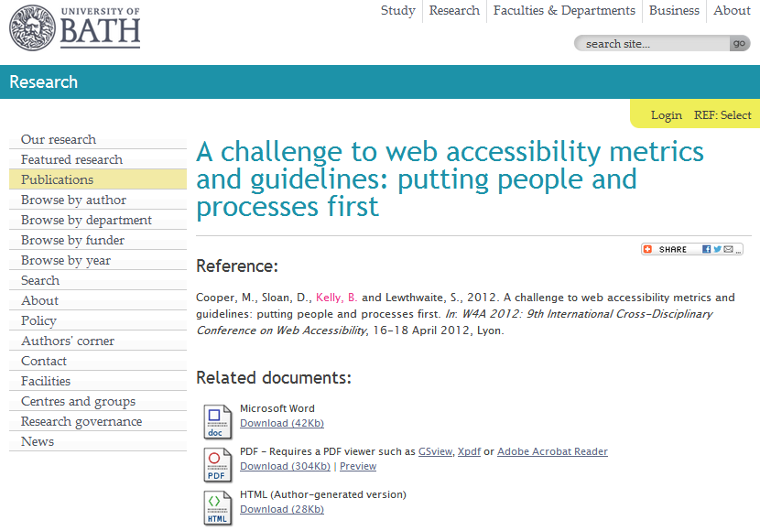
Opus Repository
Paper uploaded to Opus repository
Note lack of social features for repository: no discussions, sharing, metrics or ability to embed content
http://opus.bath.ac.uk/29190/

Slide 29
Slideshare
Note:
Sharing icons
Discussion (not shown)
Related content
Metrics
Embedability (not shown)
Metadata provided to give context to slides

Slide 30
Final slide provides (active) links to related work

Slide 31
Capture Statistics
On 18 Apr 12:
1,391 views on Slideshare
Other slides had 3 and 311 views
By 12 Jun 13:
9,080 views on Slideshare
“Lies, damned lies & statistics” – but my third most downloaded paper in 2012

Slide 32
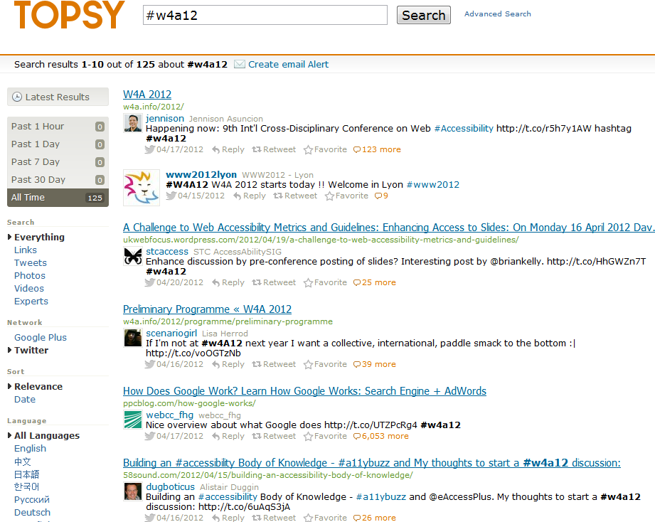
Topsy and Event Hashtag
Buzz around event hashtag captured by Topsy

Slide 33
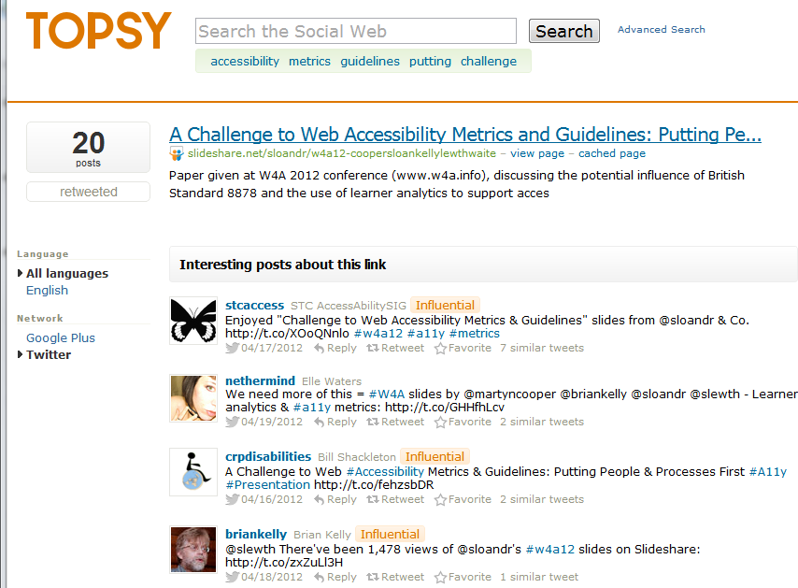
Topsy & Discussion About Slides
Topsy recorded discussions about slides
Twitter names suggest accessibility interests

Slide 34
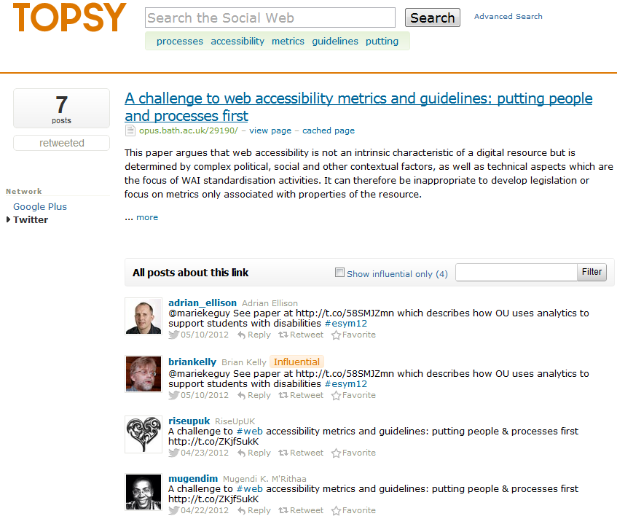
Topsy & Discussion About Paper
Topsy recorded discussions about paper
Note tweets about event (25) and slides (20) more popular than paper (7)

Slide 35
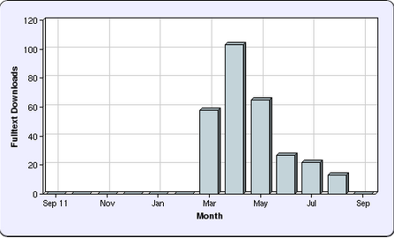
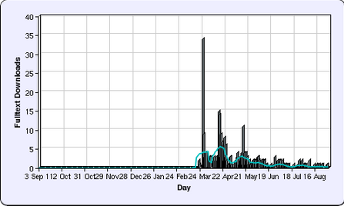
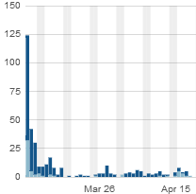
Repository Statistics
Opus repository stats:
Views began in March (before conference).
Largest downloads took place on 7 March, day blog post published (about collaborative tools for writing paper)

Slide 36
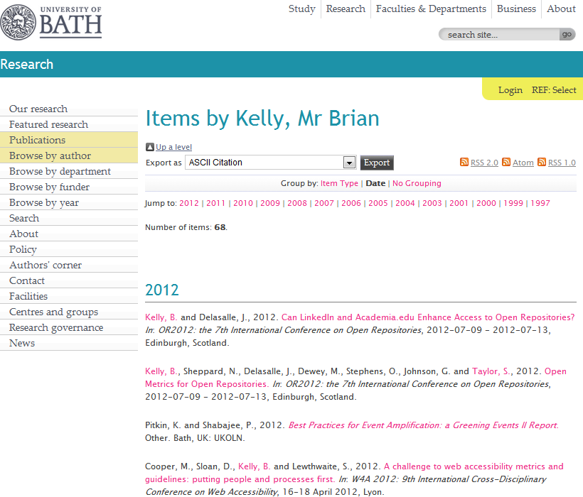
The IR
Your papers may be hosted on your institutional repository – but you need ‘link love’

Slide 37
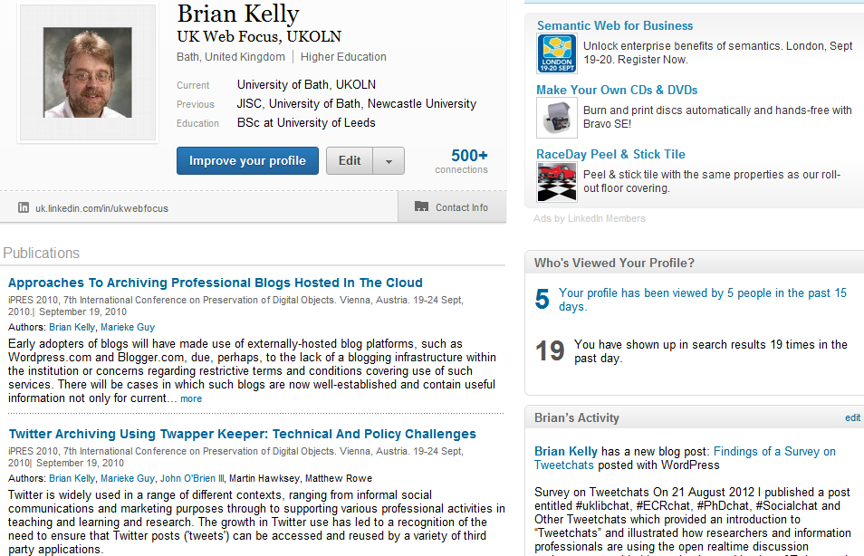
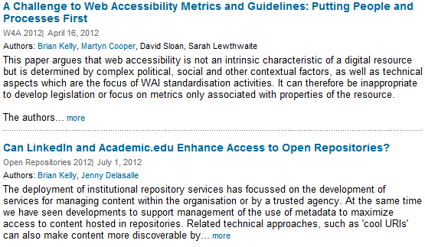
LinkedIn
LinkedIn is popular, so links from LinkedIn may be highly ranked
Therefore motivation to include links to papers
Links to paper added to
LinkedIn
Academia.edu
My pages on UKOLN Web site and blog
…

Slide 38
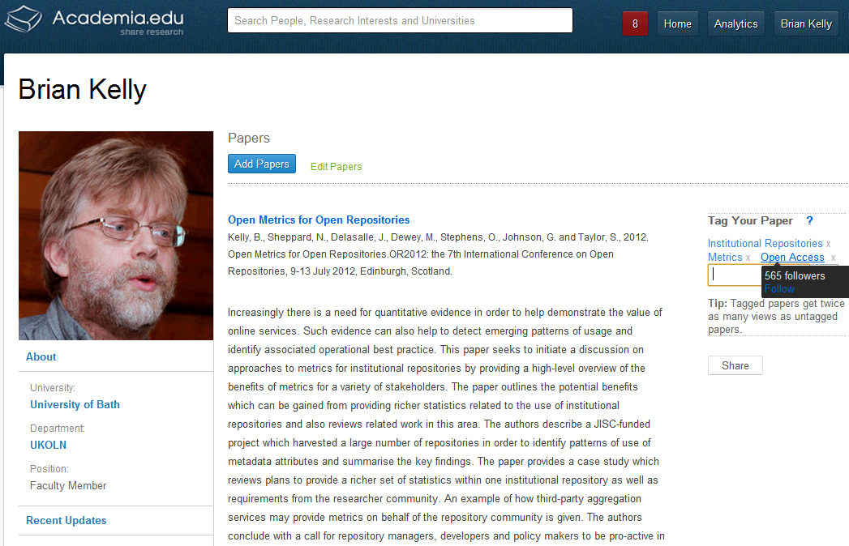
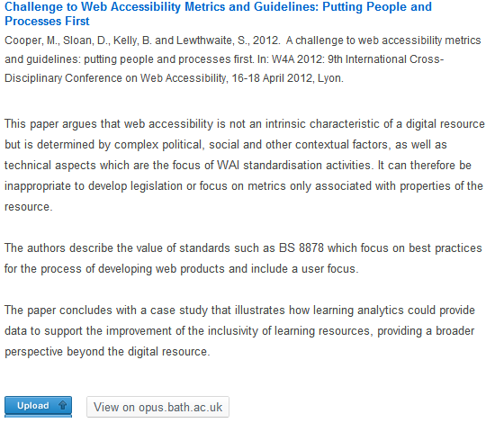
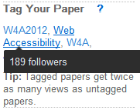
Academia.edu
Academia.edu
Academia.edu users may find my papers here and LinkedIn users in LinkedIn. Why would I make it difficult for them?
Note:
Links to papers in IR (not uploaded)
Importance of tags

Slide 39
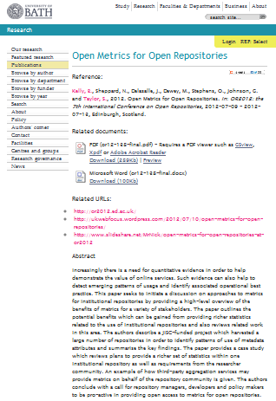
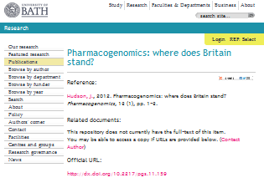
Importance of Google
Context:
Between 50-80% of traffic to IRs are from Google (may be higher if direct links to PDFs not recorded by Google Analytics)
What provides ‘Google juice’:
On-page SEO techniques (structure, writing style, …)
Links to pages, especially from highly-ranking sites
What’s different about IRs?
Same page structure
Therefore importance of links to repository

Slide 40
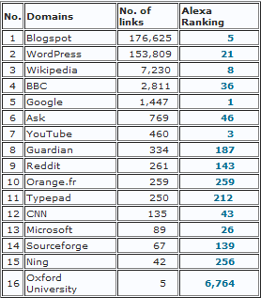
What Delivers Google Juice?
Survey of SEO ranking of 24 Russell Group IRs carried out in Aug 2012.
Findings:
Google, YouTube, Blogspot, Wikipedia and Microsoft are highest ranking domains with links to IRs
Blogspot.com & WordPress.com have significantly larger number of links to IRs
Blogspot.com
Wordpress.com
Links from institutional domain (e.g. locally-hosted blogs) provide little Google juice!

Slide 41
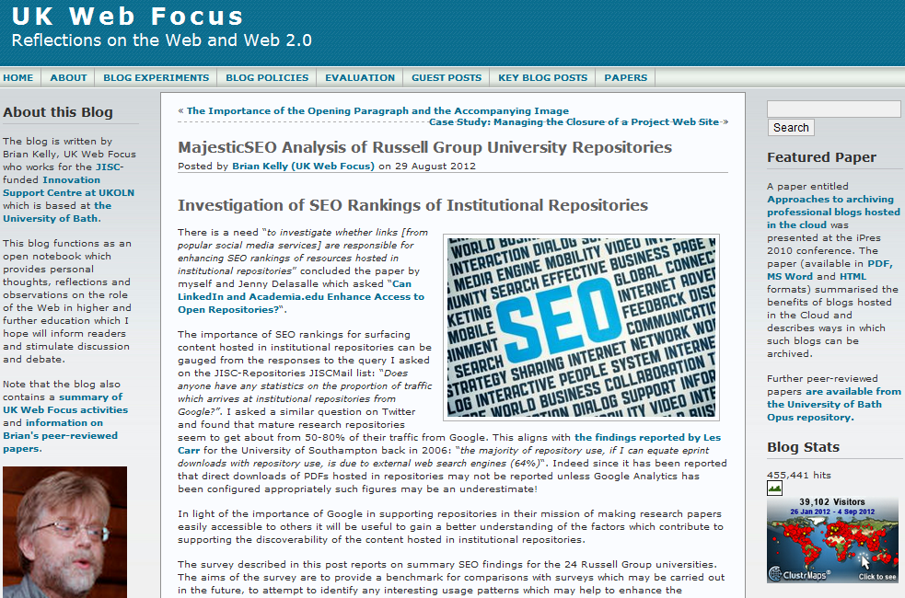
UK Web Focus has links to all papers
UK Web Focus has timely blog posts about papers
UK Web Focus blog has a rotating Featured Paper link

Slide 42
Barriers
The Evidence

Slide 43
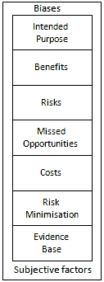
But …
But what about:
Legal, ethical & privacy concerns
My boss doesn’t approve
My institution doesn’t approve
It doesn’t work in my discipline
It doesn’t work for me
Risks and opportunities framework:
It’s not about ‘social media’ it’s about ‘social media for a particular purpose’
Be clear of potential benefits & associated risks
Remember the risks of not doing things
There will be costs (but may be small)
Adopt risk minimisation strategies
Base decisions on evidence
Be aware of biases and subjective factors

Slide 44
Health Warning!
Suggestions given can help to enhance the visibility of one’s research.
Highly visible and popular research is not necessarily an indication of quality!

Slide 45
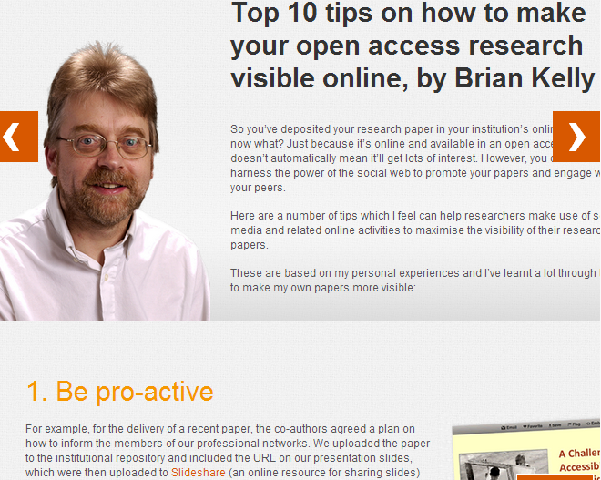
Top Ten Tips
Be pro-active
Monitor what works for you
Don’t forget the links
Don’t forget the Google juice
Develop your network
Encourage feedback and discussion
Understand your network
Know your limits
Seek improvements
Participate
See Top 10 tips on how to make your open access research visible online, JISC Inform, 35, Winter 2012

Slide 46
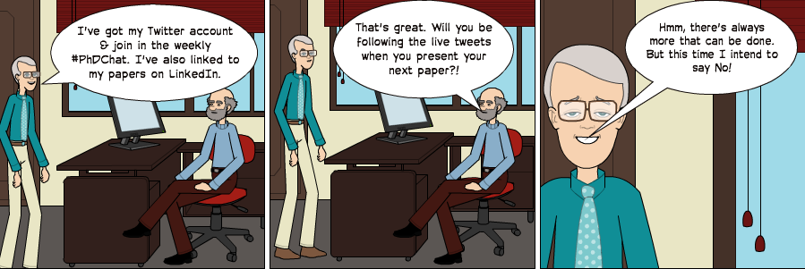
Any Questions?
Cartoon

