Slide 1
OR 2012: Working With Text Workshop Can We Mine JISCMail Lists? Can We Talk About MailMine?
Twitter:
#or2012
http://www.ukoln.ac.uk/web-focus/events/conferences/or12/working-with-text/
Brian Kelly
UKOLN
University of Bath
BATH, UK
Acceptable Use Policy
Recording this talk, taking photos, discussing the content using Twitter, blogs, etc. is permitted providing distractions to others is minimised.
Email:
b.kelly@ukoln.ac.uk
Blog:
http://ukwebfocus.wordpress.com/
Twitter:
http://twitter.com/briankelly/
UKOLN is supported by:
This work is licensed under a Creative Commons Attribution 2.0 licence (but note caveat)

Slide 2
The Context
Mailing lists:
Value role to play in scholarly, research and development work over several decades
Still used - actively in some areas – but not ‘fashionable’
Opportunity for mining mailing list archives in order to understand:
Our history
Roles played in development work
How mailing lists have been / are being used
…
Use case: Provide evidence of UKOLN’s involvement in development of Web standards since late 1990s.

Slide 3
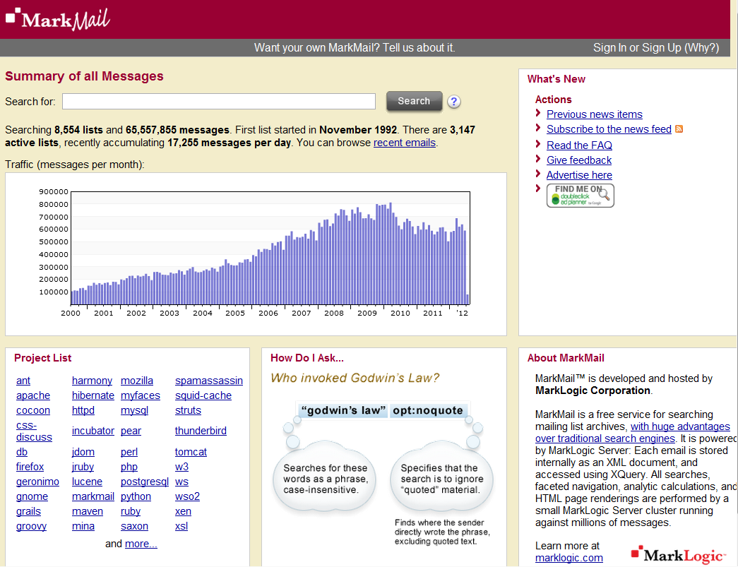
Work in Other Areas: Markmail
Markmail

Slide 4
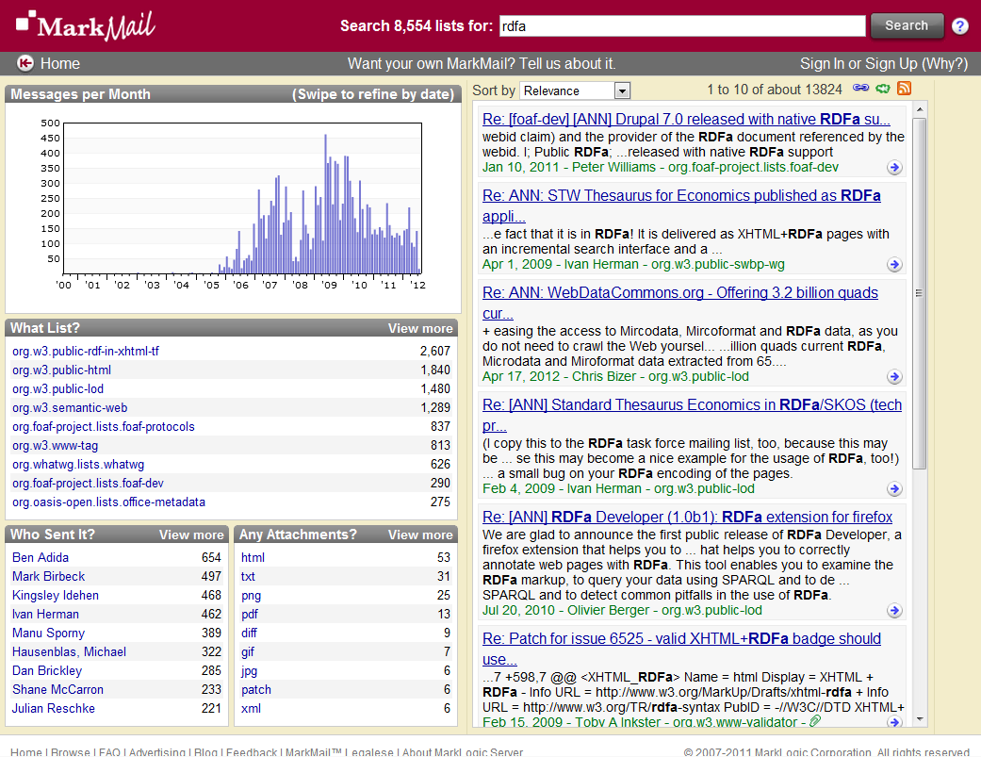

Slide 5
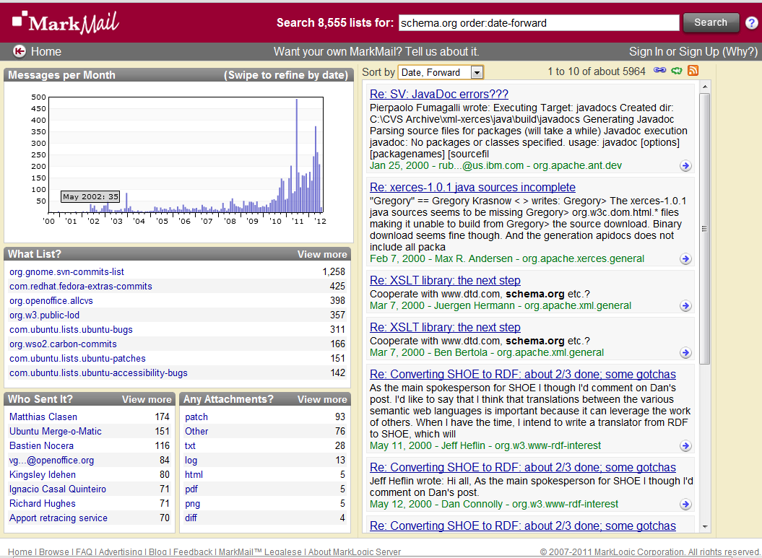

Slide 6
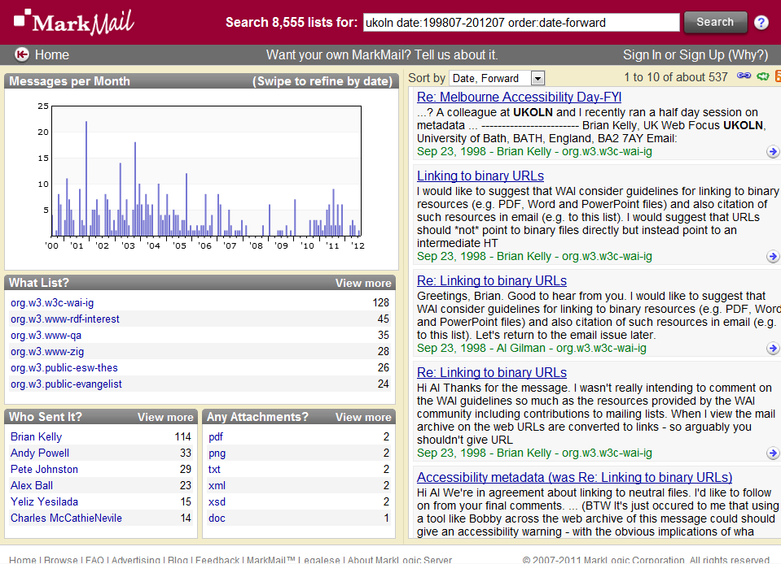
Active in early years. What happened next?

Slide 7
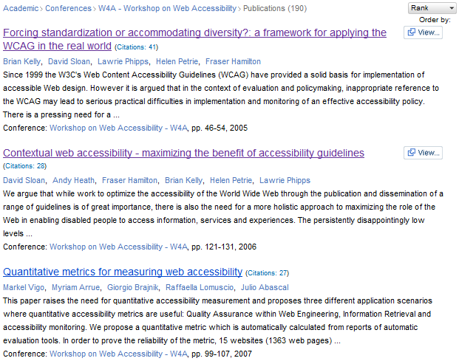
What Happened Later?
Peer-reviewed papers published at W4A conference & elsewhere from 2004
Quality of papers known from citations, etc.
But what of discussions on UK mailing lists between 1998-2004 (and beyond)?
Two most highly ranked papers at W4A conferences, according to Microsoft Academic Search.

Slide 8
What of the UK HE Sector?
Mailbase service:
Funded from 1989-2001
Hosted at Newcastle University
Home-grown software
Archives no longer available online
JISCMail service:
Funded from 2001
Provided by RAL/CCRC/STFC/JISC Advance
Now managed by JISC Advance
Uses LSoft’s LISTSERV software
Dated software; not native Web application; no APIs; …

Slide 9
Risk of Losing Our Digital Record
Wish to:
Understand our digital communications hosted on key mailing list provider
Identify ways of maintaining such understandings
Challenges:
Limitations of software
Concerns over AUP, privacy, legal issues, …
Available resources
Can I demonstrate Mark’s MailMine software?
Will Scottish law mean he shouldn’t set foot north of the border?

Slide 10
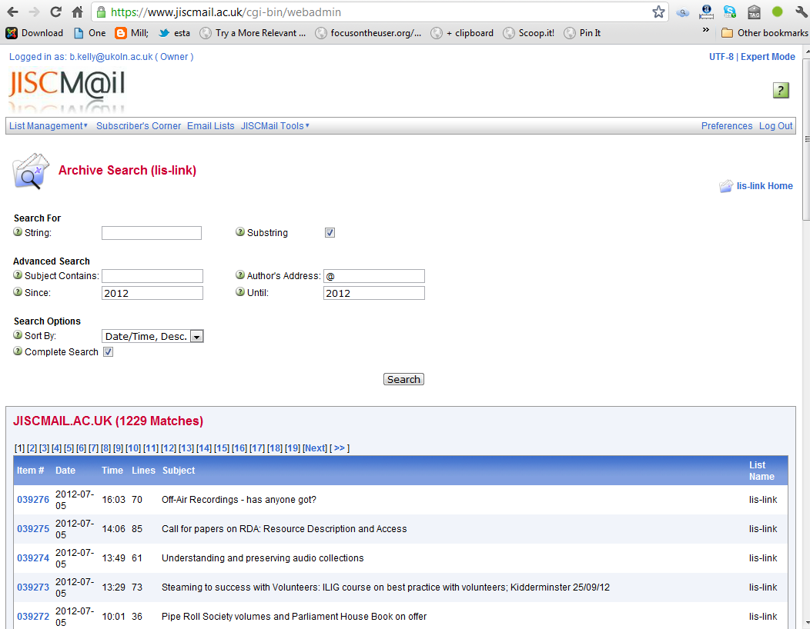
JISCMail search
Technical barriers to processing JISCMail content (not covered further)

Slide 11
Legal & Ethical Issues
Legal barriers in processing JISCMail content
See https://www.jiscmail.ac.uk/policyandsecurity/acceptableuse.html
Disclosure: I was a member of the JISCMail Advisory Group in May 2001 when this AUP was agreed!

Slide 12
A Way Forward?
Is there a way forward?

Slide 13
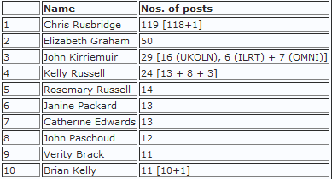
Case Study (1)
LIS-Elib-Managers:
Closed list, used by managers of large-scale national digital library programme
Preparing for Change:
Discussions with list owners
Audit of contributors, discussions & contact with significant contributors
One post of personal nature deleted
Making Changes

Slide 14
Case Study (2)
List now open up after announcement of change of policy sent to list (most bounced!)
Suggested approach for others:
Audit archive in order to identify the numbers of people who have posted messages & numbers of messages that have been posted.
Identify the reasons why the list was set up as a closed list.
Gain an understanding of possible risks in opening up access to list archives.
Formulate a policy decision with key stakeholders.
Communicate the policy and gathering feedback.
Analyse the feedback and review changes to the proposed policy.
Implementing the policy.
See Case Study: Opening Access to a Closed and Unused Mailing List <http://ukwebfocus.wordpress.com/2011/08/31/ >

Slide 15
What Do We Want?
Some questions:
Do we want to be able to mine the text of scholarly mailing lists?
If so, who wants to do this and what do they want?
Should we simply make use of US lists top avoid UK technical & legal silos?
If there is a need and a community:
How do we address the legal and ethical issues?
What technical approaches should we take?
Note comment on UK Web Focus blog from previous JISCMail director:
“The difference between MarkMail & Google for us here at JISCMail, is that to be in the free version of Markmail we have to give them the content for them to index whereas Google, & other search engines, come & index us. This difference gives rise to issues around ownership & management of live lists which is why we are not in MarkMail”

Slide 16
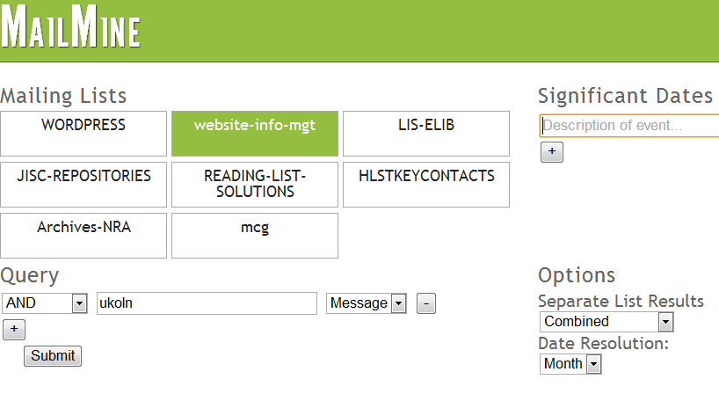
What Next for the Prototype?
MailMine prototype

Slide 17
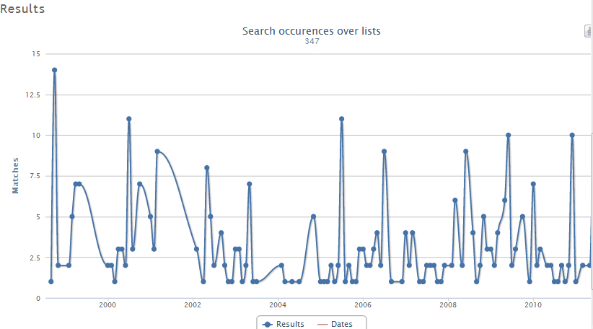
What Next for the Prototype?
MailMine prototype

Slide 18
Questions
Any questions?

