Slide 1
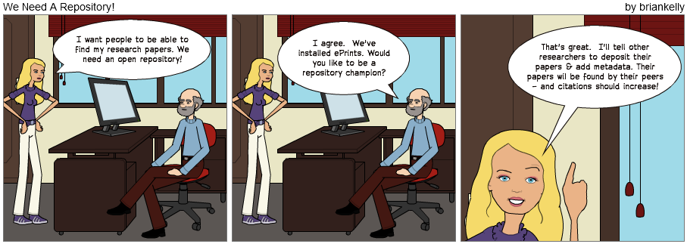
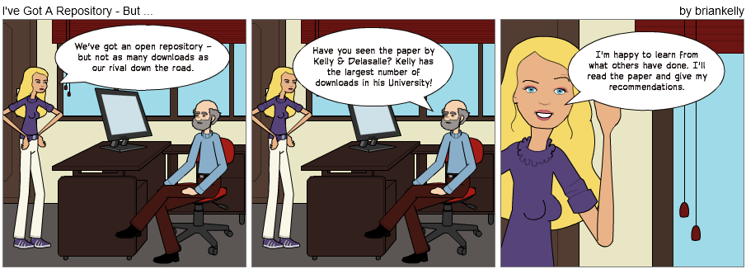
We Need a Repository!
Can LinkedIn and Academia.edu Enhance Access to Open Repositories?

Slide 2
Open Repositories 2012: Can LinkedIn and Academia.edu Enhance Access to Open Repositories?
Twitter:
#or2012
http://www.ukoln.ac.uk/web-focus/events/conferences/or12/
Brian Kelly
UKOLN
University of Bath
Jenny Delasalle
Academic Services Manager (Research)
University of Warwick
Email:
J.Delasalle@warwick.ac.uk
Blog:
http://blogs.warwick.ac.uk/ libresearch
Twitter: @JennyDelasalle
Email:
b.kelly@ukoln.ac.uk
Blog:
http://ukwebfocus.wordpress.com/
Twitter: @briankelly
UKOLN is supported by:
This work is licensed under a Creative Commons Attribution 2.0 licence (but note caveat)

Slide 3
We Need a Repository!

Slide 4
We’ve Got a Repository, But …

Slide 5
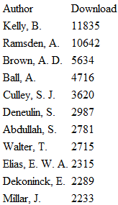
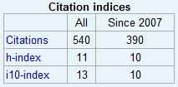
The Evidence
The evidence:
16 of the top 20 departmental papers
Most downloads of all authors
Possible reasons:
Quality of the papers
Promotion of the papers (but why are old papers popular?)
Formats of the papers (possibility)
Incoming links from LinkedIn, Academia.edu, ...
The benefits:
Citations (4 papers with 40-80 citations)
Impact on practitioners

Slide 6
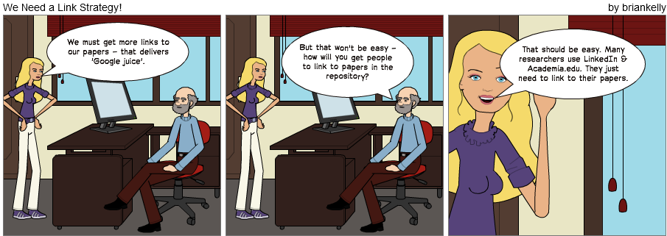
We Need a Link Strategy!

Slide 7
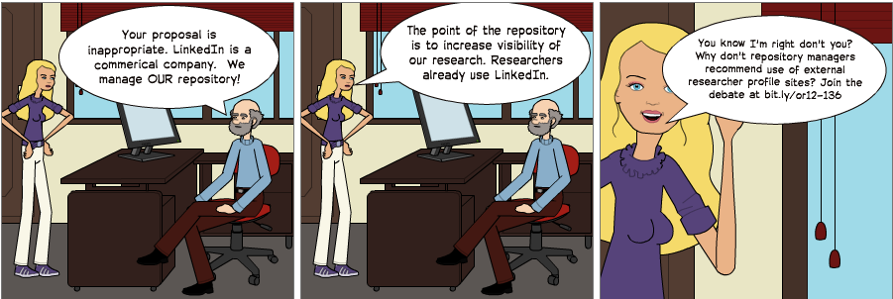
What Next?
Join the debate at http://bit.ly/or12-136/

Slide 8
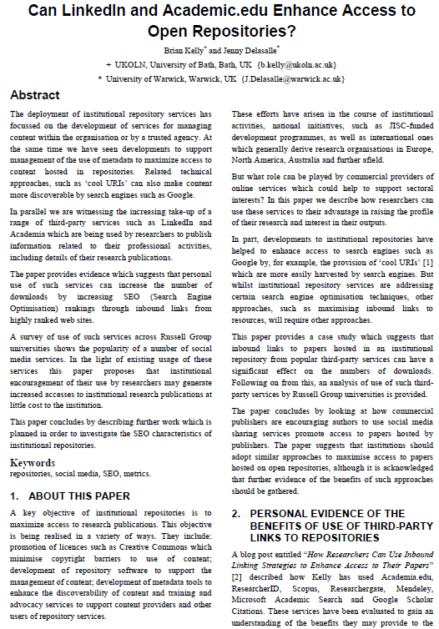
Further Information
Can LinkedIn and Academia.edu Enhance Access to Open Repositories? B. Kelly & J. Delasalle, OR 2012, 9-13 July 2012,
Edinburgh
See:
Repository copy at http://opus.bath.ac.uk/30227/
Blog post about this paper on UK Web Focus blog at http://bit.ly/or12-136

