Slide 1
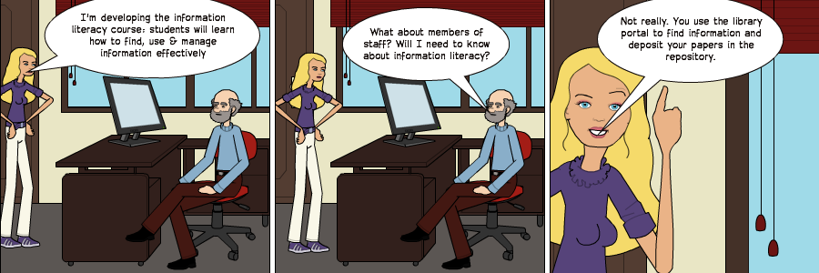
When Staff and Researchers Leave Their Host Institution
When Staff and Researchers Leave Their Host Institution
Brian Kelly, UKOLN

Slide 2
LILAC2013: When Staff and Researchers Leave Their Host Institution
Twitter:
#lilac2013
http://www.ukoln.ac.uk/web-focus/events/conferences/lilac-2013/
Brian Kelly
UKOLN
University of Bath
BATH, UK
Acceptable Use Policy
Recording this talk, taking photos, having discussions using Twitter, etc. is encouraged - but try to keep distractions to others minimised.
Email:
b.kelly@ukoln.ac.uk
Blog:
http://ukwebfocus.wordpress.com/
Twitter: @briankelly
UKOLN is supported by:
This work is licensed under a Creative Commons Attribution 2.0 licence (but note caveat)

Slide 3
Information Literacy
Defined as “the ability to find, use, evaluate and communicate information”
Felt to be “an essential skill in this digital age and era of life-long learning”
LILAC Conference home page

Slide 4
About This Talk
What happens when:
“The axeman cometh” and staff are made redundant or take early retirement?
They wish to continue to exploit their professional interests as:
A consultant
An itinerant researcher
A means of developing their CV
Who has responsibilities for ensuring staff and researchers are able to respond appropriately to such ‘life events’?

Slide 5
Assumptions
The University service environment may assume:
You can trust the institution
We will provide the appropriate IT infrastructure
We are here to help you
But:
When you leave we don’t care (unless you donate money!)
Our auditors tell us we must delete accounts when people leave
We run courses for new staff & students (our assets) but not when they are about to leave (our liabilities)

Slide 6
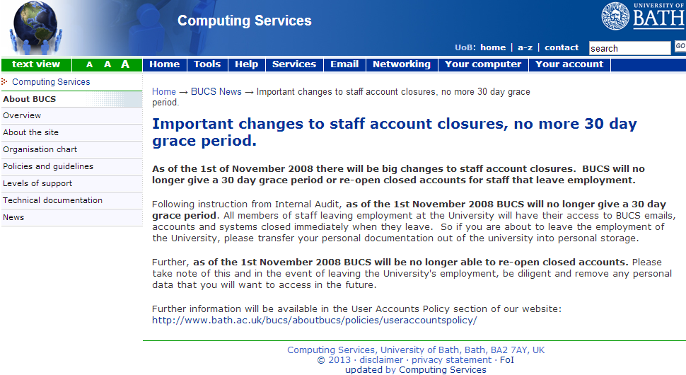
Policy at Bath University
When staff leave
See http://www.bath.ac.uk/bucs/news/news_0013.html

Slide 7
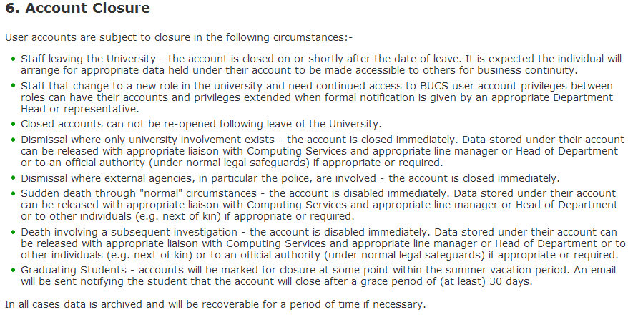
Policy at Bath University
Detailed policies
University gives very brief details when:
Staff leave
Staff have a new job in the Uni
Staff are dismissed
Staff die

Slide 8
Revisiting Information Literacy
Information literacy is defined as
“the ability to find, use, evaluate and communicate information”
And is regarded as
“an essential skill in this digital age and era of life-long learning”
Therefore let’s explore ways of:
Supporting staff who wish to continue use and communicate information after they leave the host institution
Ensure staff have the life-long skills to use, evaluate and communicate information beyond their host institution’s IT environment

Slide 9
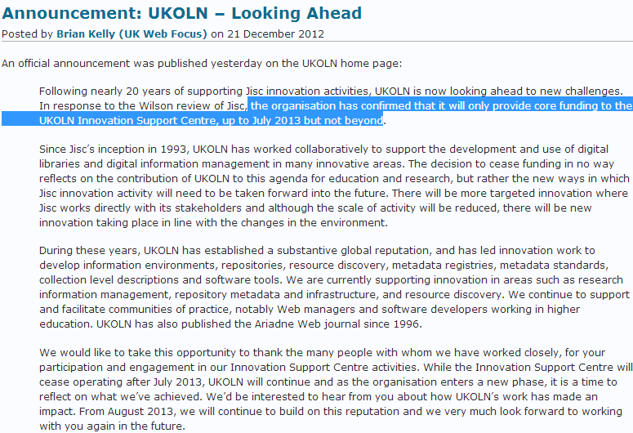
The Context
Cessation of core funding for UKOLN, CETIS and OSS Watch.
UK Web Focus blog, 21 December 2012

Slide 10
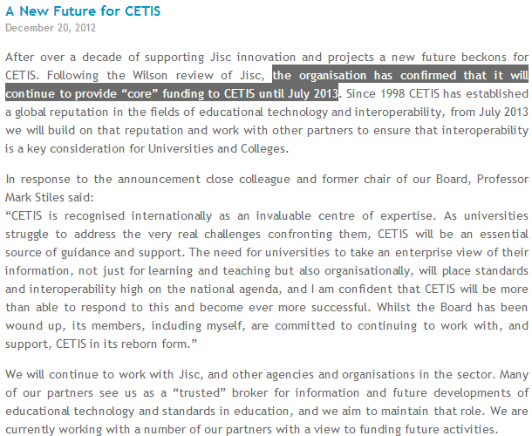
The Context
Cessation of core funding for UKOLN, CETIS and OSS Watch.
Paul Hollins’ blog, 20 December 2012

Slide 11
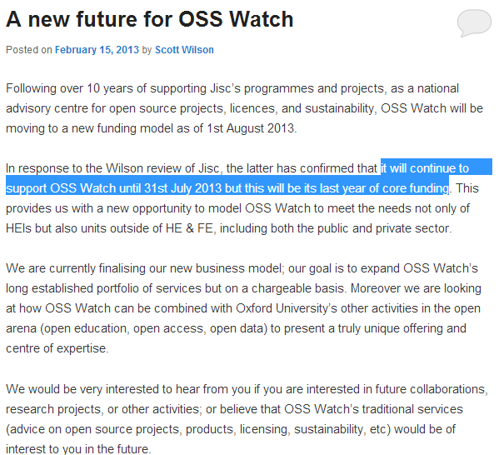
The Context
Cessation of core funding for UKOLN, CETIS and OSS Watch.
We are seeing staff at well-established JISC-funded organisations having to prepare for a “new future”
JISC OSS Watch blog, 15 February 2013

Slide 12
Personal Motivations
My interests are to ensure that:
My professional ‘brand’ persists when I leave my host institution
My research publications continue to be an asset after I leave my host institution
My authorship of papers is correctly attributed
I can continue to engage with my professional communities after I leave my host institution
I can continue to access and manage relevant services after I leave my host institution
I do not undermine relationships with my current host institution after I leave

Slide 13
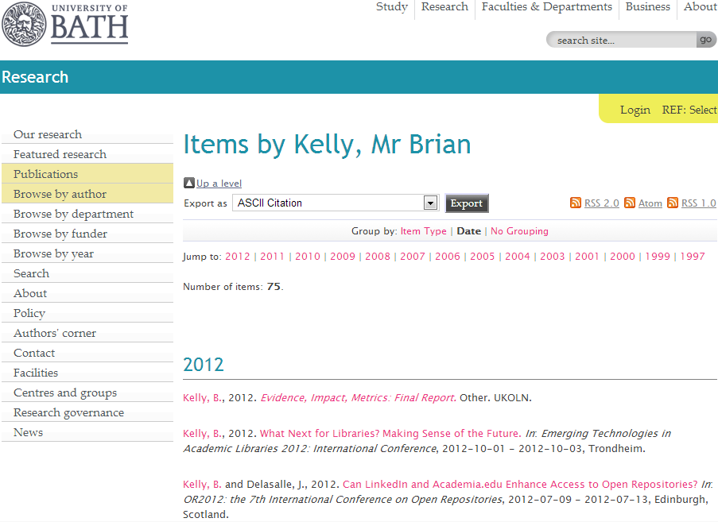
The Institutional Repository
Opus, the University of Bath institutional repository, provides a secure, reliable & maintained repository for my research papers, project reports, etc.

Slide 14
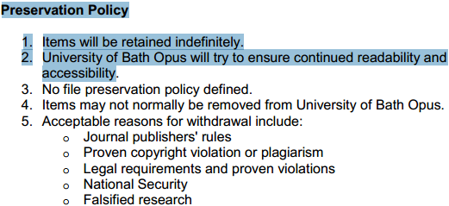
Persistency of Records
Policy seeks to ensure long-term persistency of content
When people leave will they still have their contributions listed?

Slide 15
Persistency of Records
Informal feedback:
"Records disappear when someone leaves because that's entirely appropriate."
"Staff leaving the university have a different relationship to the organisation. By rights we should shut off ALL accounts the day the relationship with the organisation ends."
Institutional context:
“this is obviously down to institutional management of people records”
Where does your policy fit in the spectrum?
We’re focussing on the REF and our CRIS (Current Research Information System)
We are loyal to former employees

Slide 16
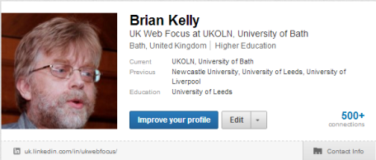
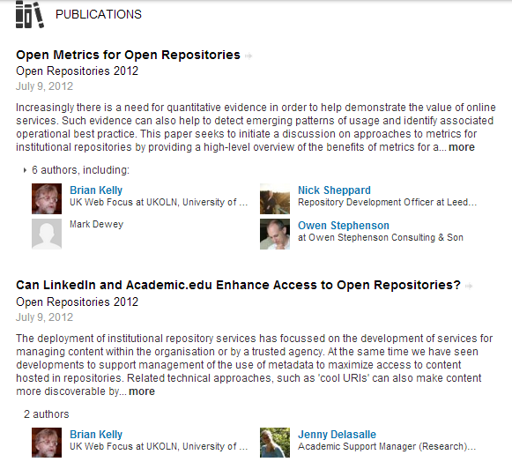
Manage Your Own Records
Ensure that a record of your work (e.g. your publications) is available beyond the institution (e.g. on LinkedIn)

Slide 17
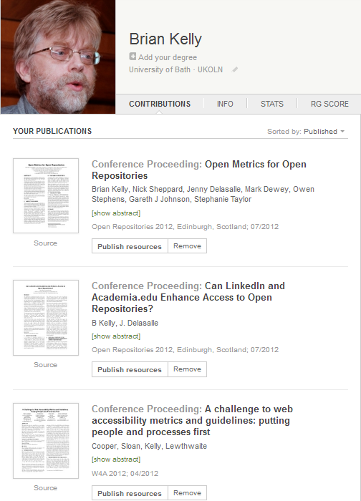
Manage Your Own Data
Ensure that your (open access) publications are hosted in an environment you can maintain when you leave the institution.
For example:
ResearchGate
Papers hosted initially in local open access repository

Slide 18
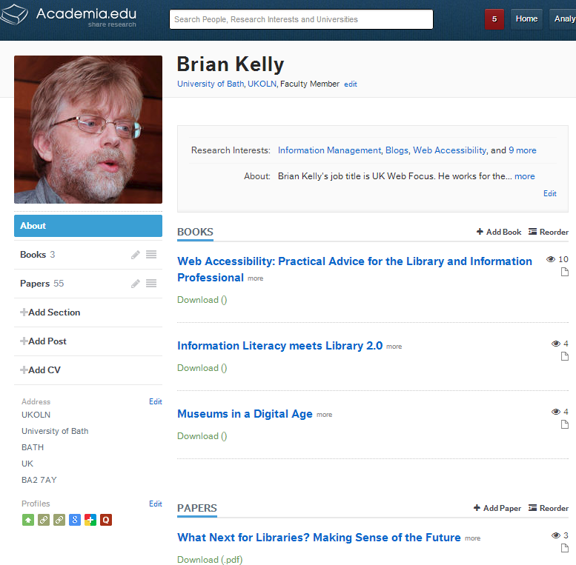
Manage Your Own Data
Ensure that your (open access) publications are hosted in an environment you can maintain when you leave the institution.
For example:
ResearchGate
Academia.edu
No permission to upload book chapter, so metadata-only records

Slide 19
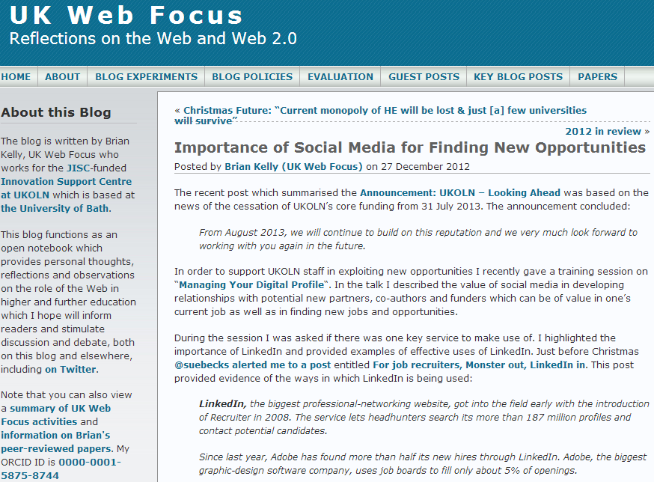
My Own Thoughts, Ideas
Ensure that if you have a blog it isn’t trapped in the institution:
Create a blog in the Cloud initially
Migrate your blog

Slide 20
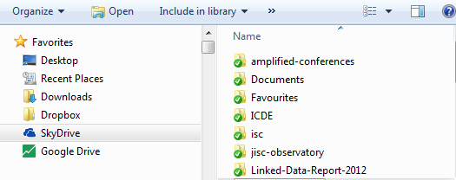
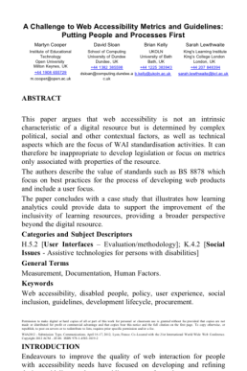
Use Cloud Sharing Services
Have you got your drive Skydrive, Google Drive & Dropbox accounts?
Collaborative peer-reviewed papers since 2012 have been written using Skydrive:
File in once place (avoids multiple master copies problem).
Can be viewed (and updated) on mobile devices
Can use MS Word in the Cloud
Display of W4A 2012 paper on iPod Touch

Slide 21
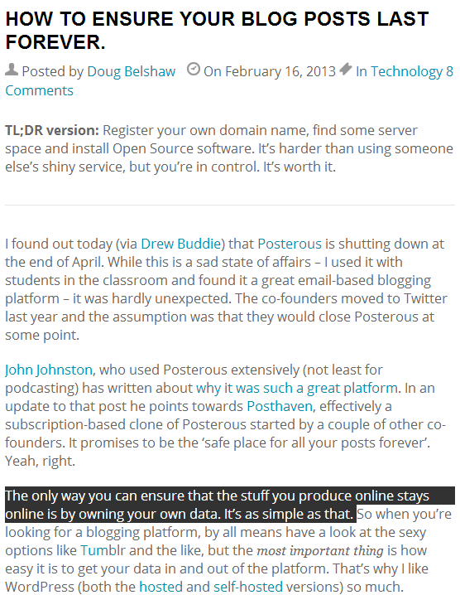
Manage Your Own Server
The spectrum of ownership:
Your CV and list of publications
Your publications themselves
Your blog content
The server for your blog

Slide 22
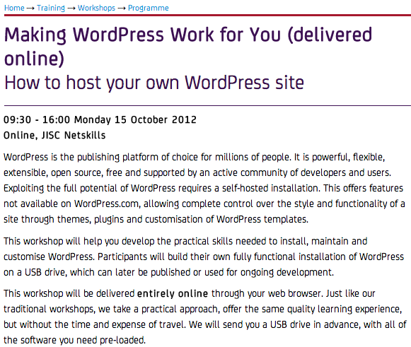
Netskills Training
Netskills course

Slide 23
View of a retired academic
“Last night, I wrote reference for an ex-colleague, and noticed that the form expected me to belong to an institution. I guess that identity formation is ongoing work. Am I retired just because I have a pension? Retired is a deadly label I think.”
Recently retired academic from a northern university

Slide 24
Your Digital Identity
What is your digital identity?
What makes you you online?
Your ideas (e.g. express on your blog)?
Your email engagement?
Your community engagement?
Your community?
Your resources?
Your affiliation with your institution (e.g. (1) you are a ‘corporate’ person; (2) “blue till I die”; …)?
Your work colleagues
…?

Slide 25
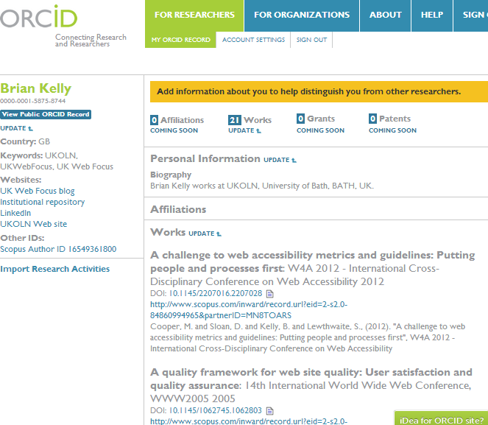
ORCID
Take control of your research identity!
ORCID:
Open Researcher and Contributor ID
Non-proprietary alphanumeric code to uniquely identify scientific / academic authors
Managed by ORCID Inc. an open & independent registry
My ORCID: 0000-0001-5875-8744

Slide 26
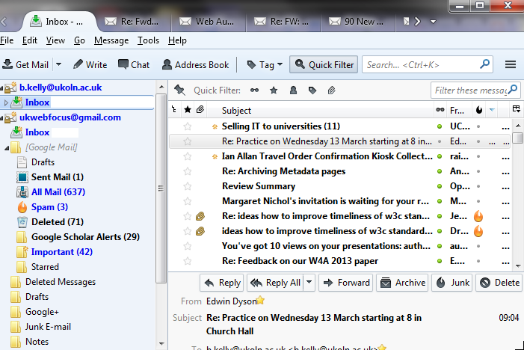
Email
Over 17 years of email use have:
Large number of messages
Large number of contacts
Personal & professional uses
Need to be able to:
Migrate content
Manage connections
Migrate list usage
How do I:
Manage Gb of email messages?
Migrate content to alternative location
Associate new location with email client?

Slide 27
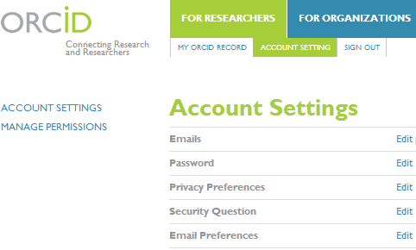
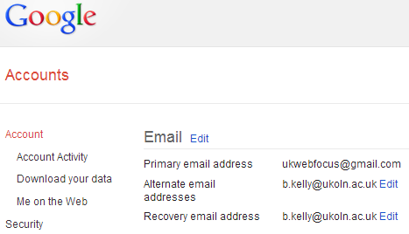
Email As Authentication Tool
Change your email address to ensure you aren’t locked out of Cloud services!
Claim your papers in Google Scholar while your institutional email is valid – otherwise you might not be able to claim them!
Without access to valid email address you won’t be able to use & manage your content (info literacy!)

Slide 28
Links with the Institution
“You’ve rejected me / Our relationship was fated to finish.
But I still care about you”

Slide 29
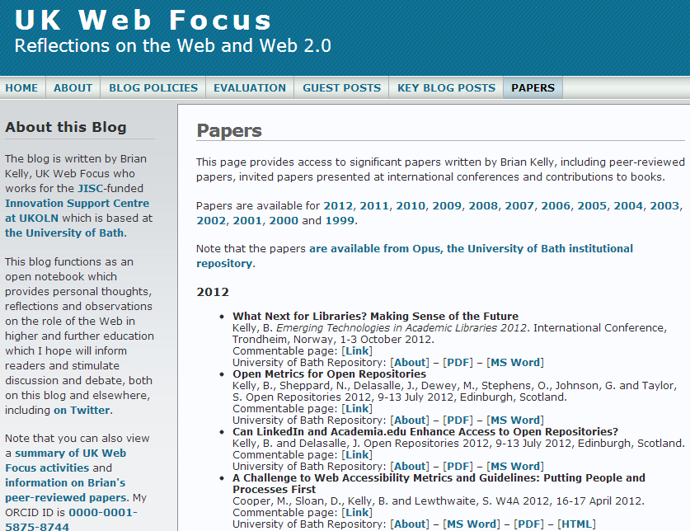
My ‘Link Love’
I wish to continue to provide benefits to host institution by:
Ensuring valuable content is not lost
Transfer digital assets where appropriate
Provide ‘link love’ to institutional Web site
As described in OR 12 paper, links from popular blogs & social media sites can enhance Google ranking of repositories

Slide 30
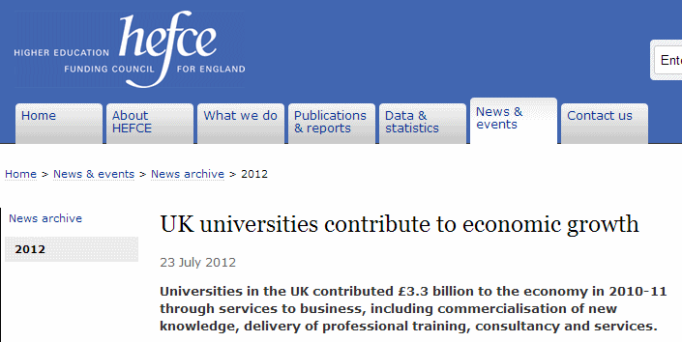
Stimulating the Economy
Helping to ensure that the departure of researchers can stimulate the economy:
Support the migration of intellectual assets so that they can continue to be used
Ensure that training to do so is embedded in institution

Slide 31
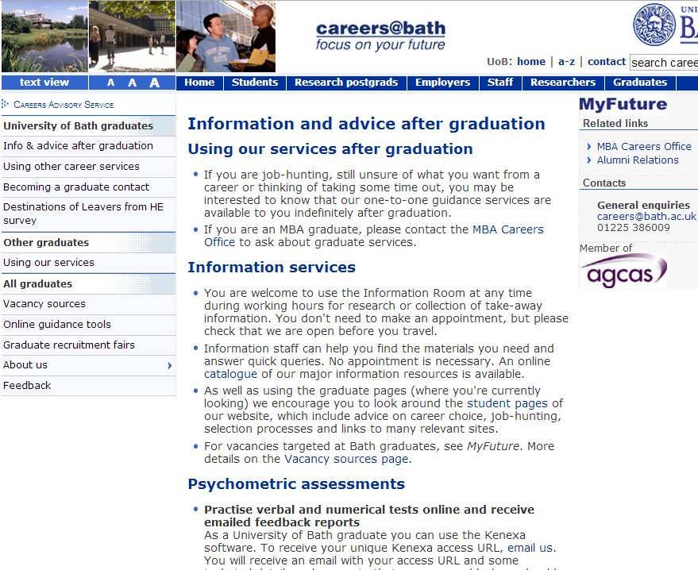
“After Bath”
Advice for graduates provided by Careers Service

Slide 32
Research Concordance
Shouldn’t life-long skills to manage digital content be address in Research Concordance?

Slide 33
Conclusions
To conclude:
Staff & researchers will spend only a part of their working lives within their current host institution
They should develop skills in being productive beyond the institutional environment
This can enhance the productivity of UK plc.
Opportunities for librarians to support such work
But do librarians see their role primarily to support use of institutional services?
Opportunity to address this as part of a Research Concordance suitable for changed economic environment?

Slide 34
Conclusions
The Data will be Big, but our users will continue to use Facebook and Twitter
But research data will grow in importance as will use of mobiles.
According to the evidence the future isn’t quite what I expected. But it has helped to identify our business strategies.

