Slide 1
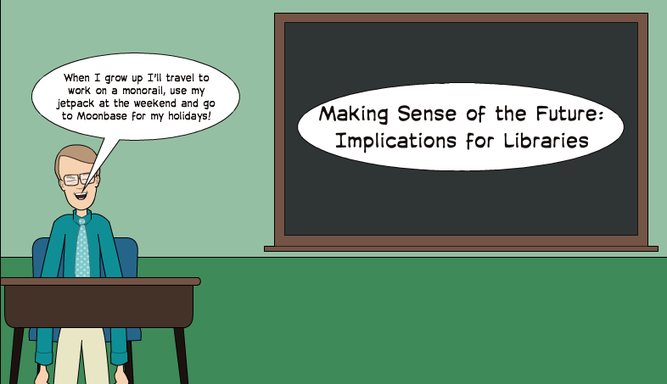
Making Sense of the Future
What Next for Libraries? Making Sense of the Future
Reflections on the past & thoughts on the future
What Next for Libraries? Making Sense of the Future
Talk by Brian Kelly, UKOLN at the EMTACL 2012 conference

Slide 2
EMTACL12 What Next for Libraries? Making Sense of the Future
Twitter:
#emtacl12
http://www.ukoln.ac.uk/web-focus/events/conferences/emtacl-2012/
Brian Kelly
UKOLN
University of Bath
Bath, UK
Acceptable Use Policy
Recording this talk, taking photos, discussing the content using Twitter, blogs, etc. is welcomed providing distractions to others is minimised.
Email:
b.kelly@ukoln.ac.uk
Blog:
http://ukwebfocus.wordpress.com/
Twitter: @briankelly
UKOLN is supported by:
This work is licensed under a Creative Commons Attribution 2.0 licence (but note caveat)

Slide 3
About Me
Brian Kelly
Based at UKOLN, University of Bath
Involved in Web development since 1993
Excited about the potential of the Web to support University activities
Realistic about the challenges!
The Innovation Support Centre (ISC) at UKOLN
Funded by the JISC
Supports innovation in higher & further education
Providing the JISC Observatory in conjunction with JISC CETIS

Slide 4
About This Talk
This talk:
Reviews the future by looking at the past
Distinguishes between invention, innovation and improvement
Highlights importance of evidence-gathering in identifying relevant areas of innovation & ways of making improvements
Describes work funded by JISC in UK
Outlines a methodology which others can adopt
Welcomes feedback during talk using Twitter #emtacl12

Slide 5
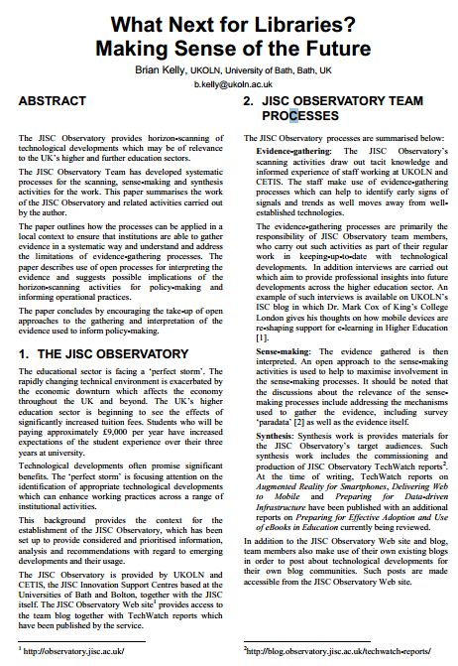
Accompanying Paper
View paper at:
http://bitly.com/emtacl12-kelly
Available in PDF – MS Word formats from University of Bath repository.
CC-BY licence.

Slide 6
Your Thoughts
#emtacl12 and #future or #wtf
What technical developments might be important?
Tweet your ideas
Feel free to add implications for users …
Making sense of the future!
and implications for libraries
Discuss the implications …
such as legal issues, business models, …

Slide 7
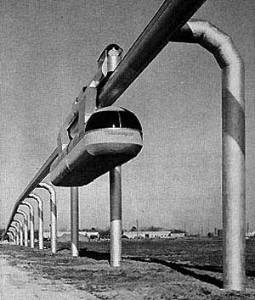
The Future from the Past
Monorail, Incorporated built a short test track of their suspended system at Arrowhead Park in Houston, Texas. Each bogie was powered by a 310-horsepower Packard automobile engine. The driver was seated high above the passenger carriage on one of the two bogies. After eight months of testing, the track was dismantled and rebuilt at the Texas State fairgrounds where it ran for many years. Its promoters claimed it could reach speeds of 160 km but no Skyway transit installations were ever built.
The future was exciting in 1956!

Slide 8
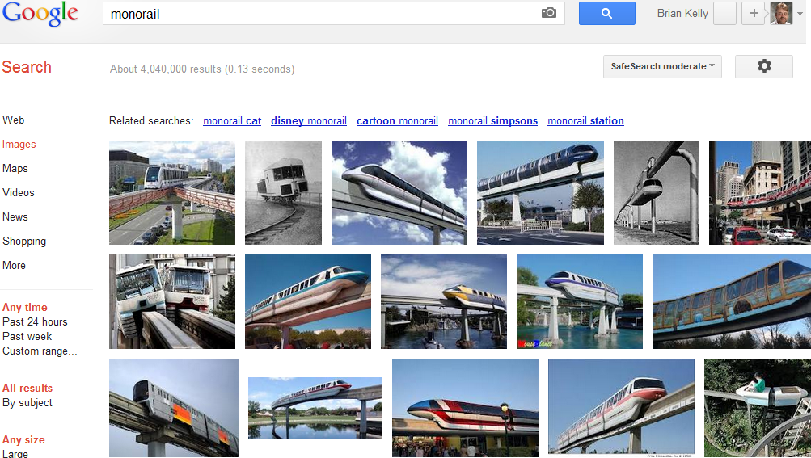
What I Expected in the Future
Monorails

Slide 9
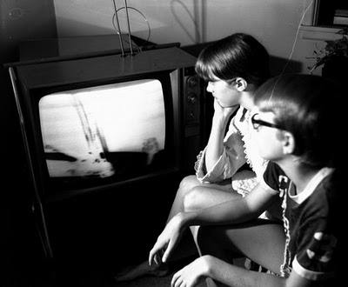
“Eagle has Landed”
Awoken at 3 am on 16 June 1969 to watch lunar landing on black and white TV.
But the future was exciting!

Slide 10
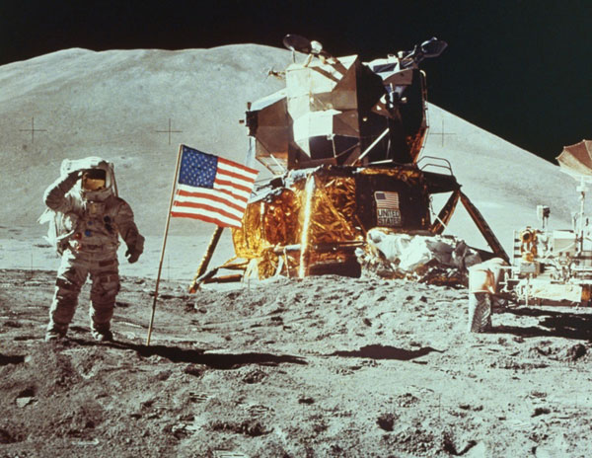
The Future from the Past
1969 was exciting!

Slide 11
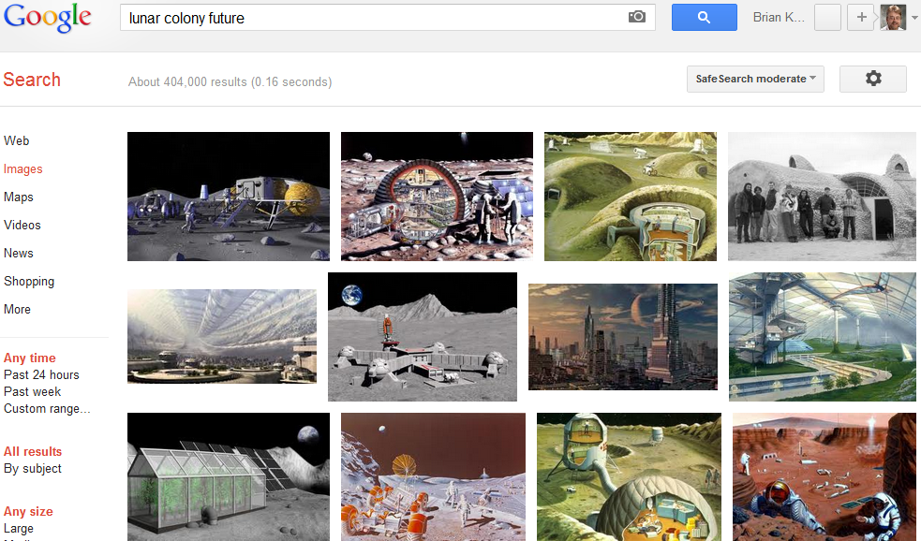
What I Expected in the Future
The future is exciting!

Slide 12
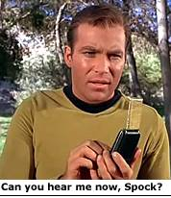
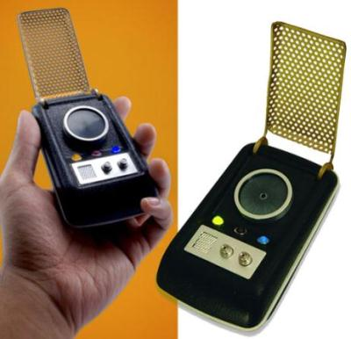
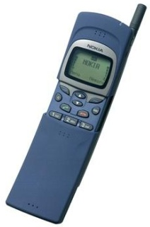
The Present: Better than Predicted
Star Trek’s predicted mobile phones
but not smart phones!
Nokia 8110 “stole the show in 1998”

Slide 13
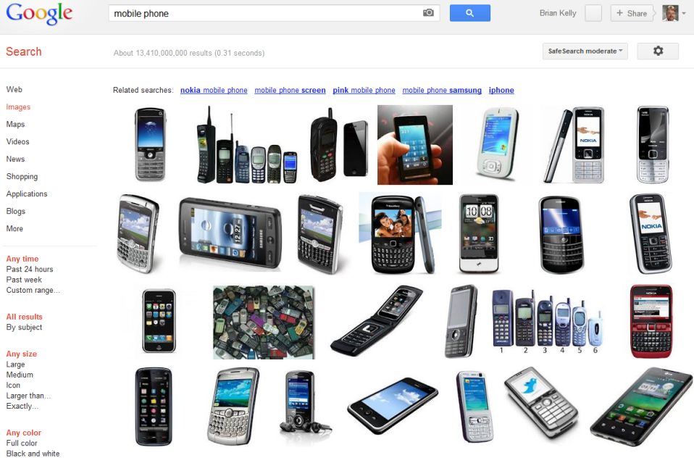
Has the Future Arrived?
Mobile phones

Slide 14
The Future from the Past
The future is exciting!

Slide 15
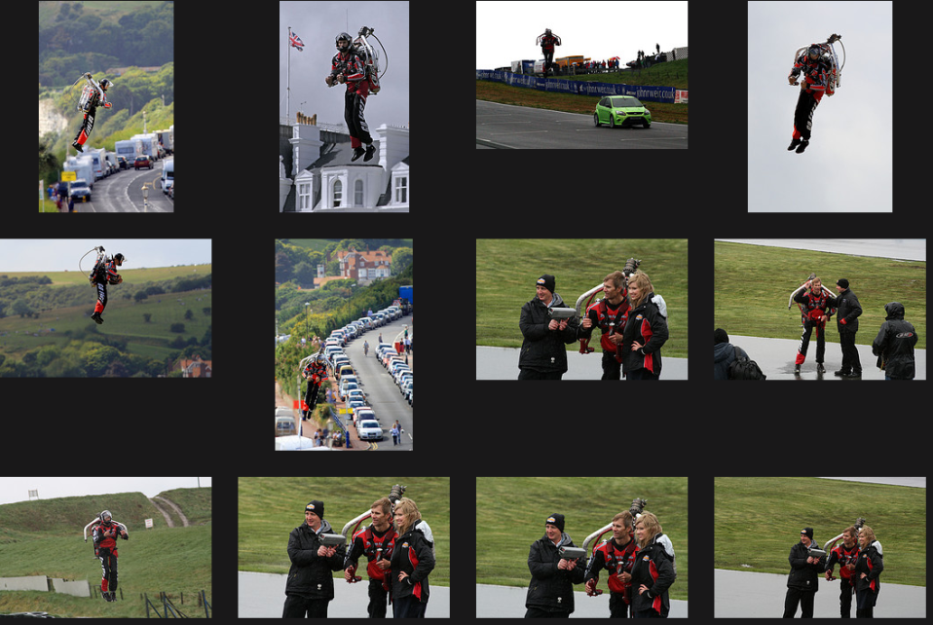
Has the Future Arrived?
Hoverpacks do exist

Slide 16
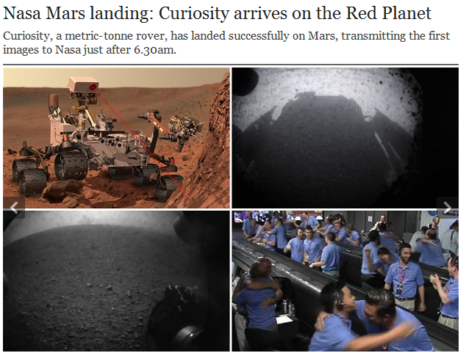
Has the Future Arrived?
Landing on Mars

Slide 17
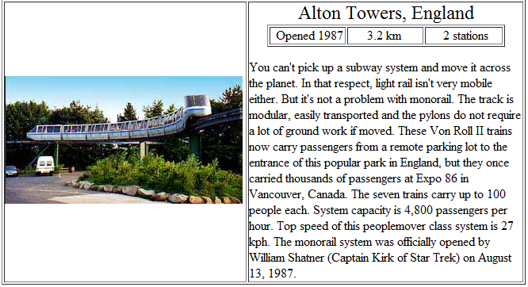
Has the Future Arrived?
Monorails

Slide 18
Has the Future Arrived?
Monorail
Please note that the monorails listed in these pages are MULTI-STATION systems. We do not include the dozens of recreation or view-giving minirails here. Our efforts are primarily geared towards proving monorail's ability to carry people from point to point as TRANSIT.

Slide 19
Has the Future Arrived?
Predictions & expectations from the past:
Have arrived
Sometimes have exceed expectations
Often fail to become widely embedded
Can we learn from past expectations of the future?
Note importance of evidence:
“Our efforts are primarily geared towards proving monorail's ability to carry people from point to point as TRANSIT”

Slide 20
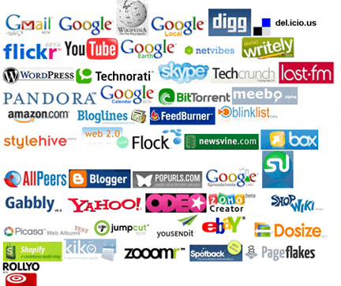
Rich Opportunities
Web 2.0 provided many opportunities to support teaching & learning and research activities

Slide 21
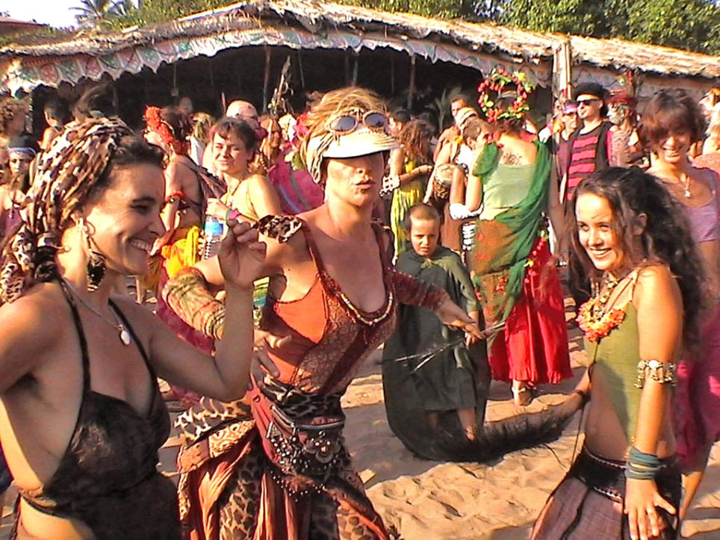
Optimism
Notes:
We should be happy. The future has arrived.
And we were happy – until a few years ago!

Slide 22
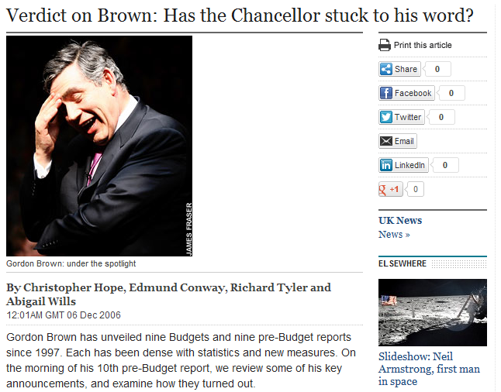
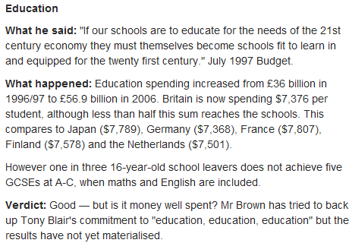
The Mid 2000s
Even the Daily Telegraph in 2006 gave a (qualified) conclusion of “Good” to Labour Government’s investment in education

Slide 23
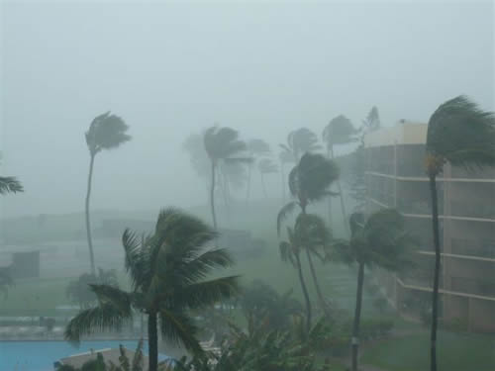
From the Sea of Tranquility to the Perfect Storm
Stormy times

Slide 24
Time of Growth ☺
1990s & early 2000s saw:
Increased funding across education sector
Significant developments in IT sector
Willingness by senior managers & funding bodies to invest in innovative IT developments (e.g. JISC development programmes)
“Great proposal – we’ll fund it”
Image from Flickr. CC BT-NC-SA licence: http://www.flickr.com/photos/inlinguamanchester/5036313154/

Slide 25
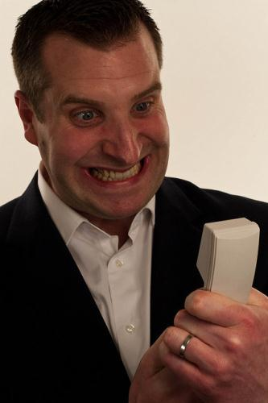
Time of Growth is Over ☹
Late 2000s and beyond:
Decreased funding across education & public sector
Acknowledgements that innovation can provide growth and cost savings
Significant developments continue in IT sector
Investment in innovative IT developments need to be based on evidence of benefits & likleyhood of success
“You want how much? And no evidence it will work! You’re crazy!”
Image from Flickr. CC BY-NC-ND licence: http://www.flickr.com/photos/drewleavy/339489258//

Slide 26
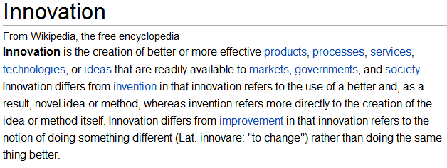
Innovation
Invention: Creating something new
Innovation: Using something new
Improvement: Using something that exists in a better way

Slide 27
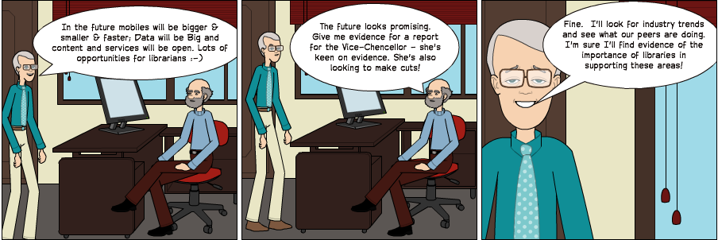
The Context
In the future mobiles will be smaller & faster; Data will be Big and content and services will be open. Lots of opportunities for librarians ☺

Slide 28
JISC Observatory
JISC Observatory:
JISC-funded initiative
Systematises processes for anticipating and responding to projected future trends & scenarios
Provided by JISC Innovation Support Centres at UKOLN and CETIS
See <http://blog.observatory.jisc.ac.uk/>

Slide 29
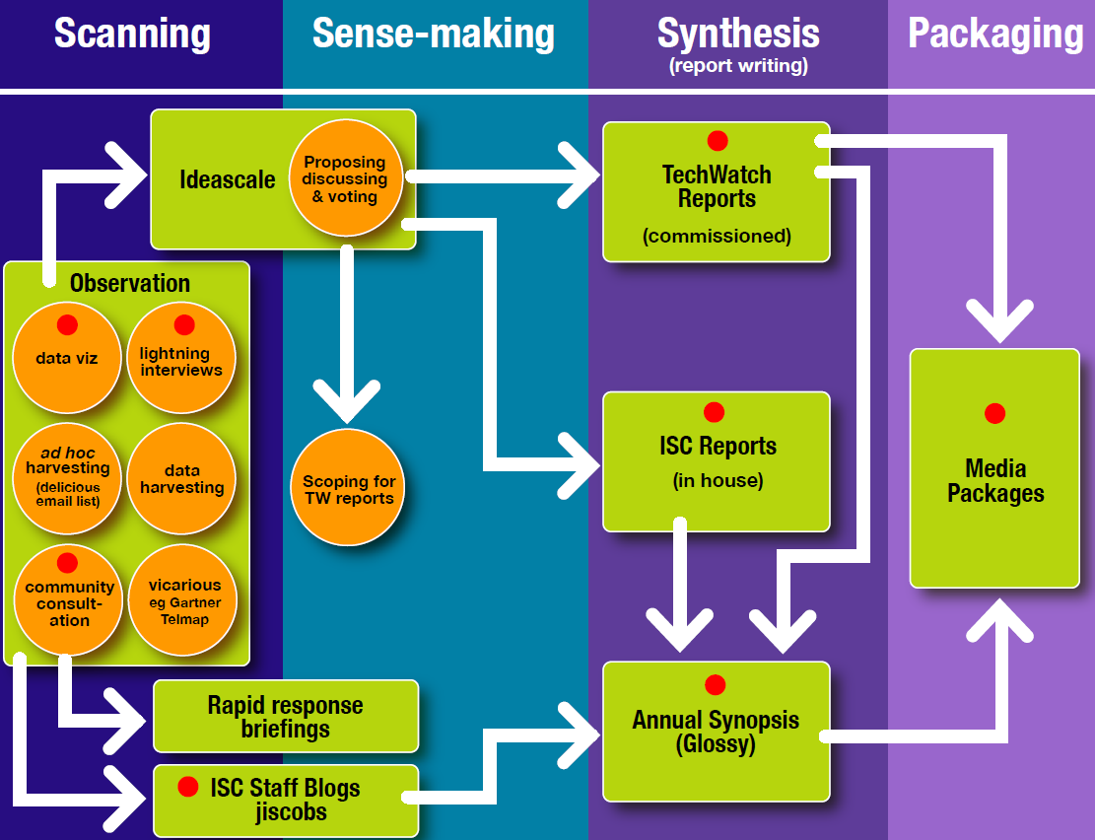
JIS Observatory process
JIS Observatory process

Slide 30
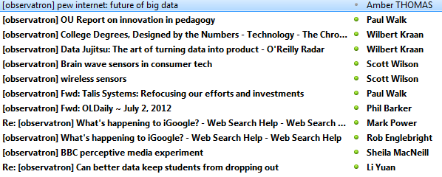
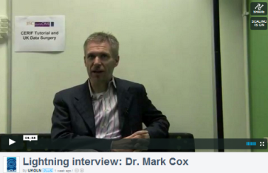
Scanning Activities
Scanning developments:
Observatron list: Sharing snippets we encounter in our daily monitoring activities
Interviews: Short interviews with developers, practitioners, … who share their thoughts on how developments may affect their working practices

Slide 31
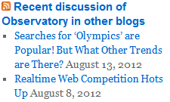
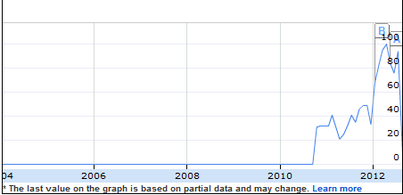
Scanning Activities
Blog posts: Posts published on JISC Observatory blog and on existing blogs.
Monitoring trends: Monitoring trends in order to:
Benchmark current usage patterns
Identify trends
Identify emerging patterns of usage
Google searches for “learning analytics” took off in 2010.
Possible indicator of relevance across sector & need for further investigation.

Slide 32
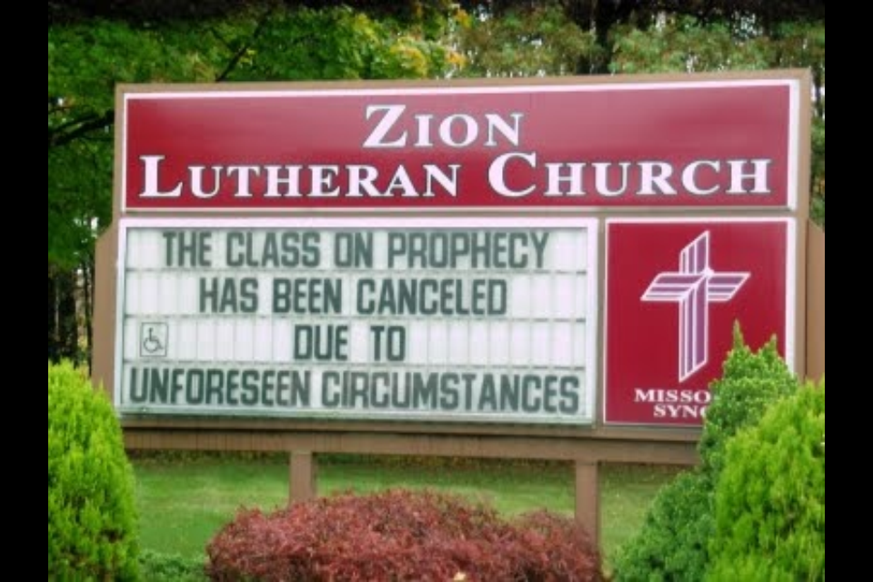
A known unknown
A known known
Apple to successfully sue Samsung
The bankers mess up the economy
Scepticism
An unknown unknown
xxx to unexpectedly yyy!

Slide 33
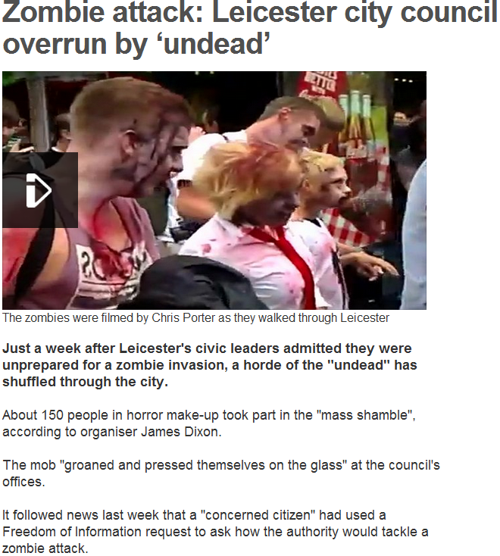
Zombie Attack
Note difficulties in:
Identifying unknown unknowns
Developing appropriate plans!

Slide 34
Sense-making
Need to:
Understand limitations of evidence-gathering techniques (including documenting ‘paradata’ so survey findings are reproducible & can be critiqued)
Provide suggestions of implications of developments for the sector
In addition need to encourage feedback on:
Evidence-gathering techniques
Interpretation of findings
Implications of developments
In order to inform:
Further investigation
Policy-making, planning and funding
Make sense of my talk in realtime: tweet if you agree, but especially if you don’t!

Slide 35
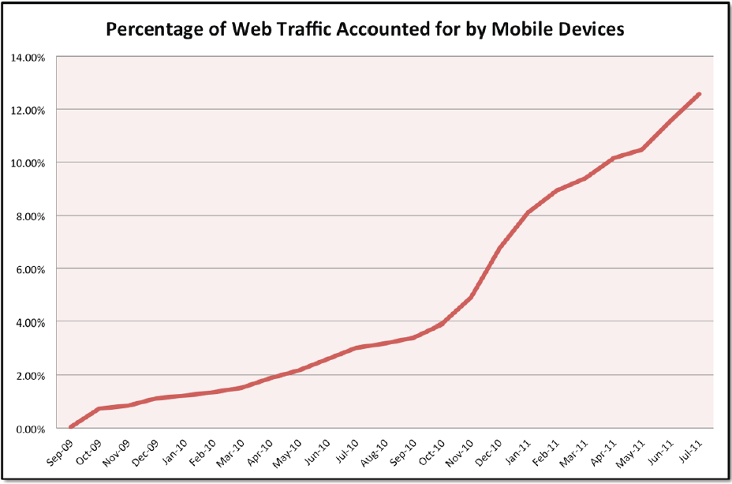
Significant Trends: Mobile
Tecmark Digital Marketing Agency
We now know of the importance of Mobile

Slide 36
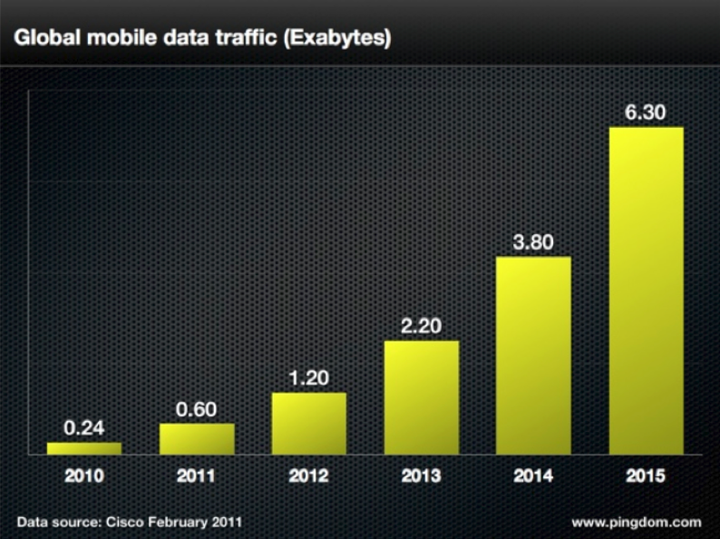
Significant Trends: Mobile
Cisco
We now know of the importance of Mobile

Slide 37
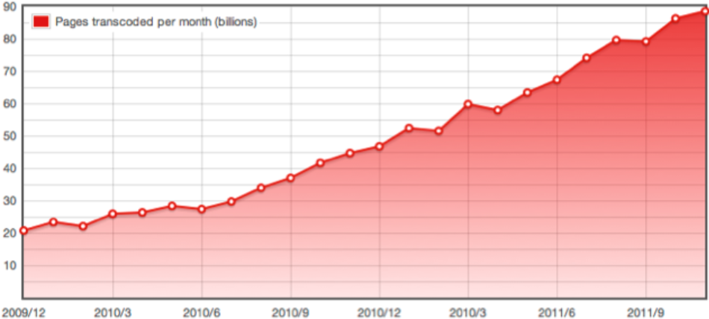
Significant Trends: Mobile
Opera
We now know of the importance of Mobile: but did we say the same when WAP came along?

Slide 38
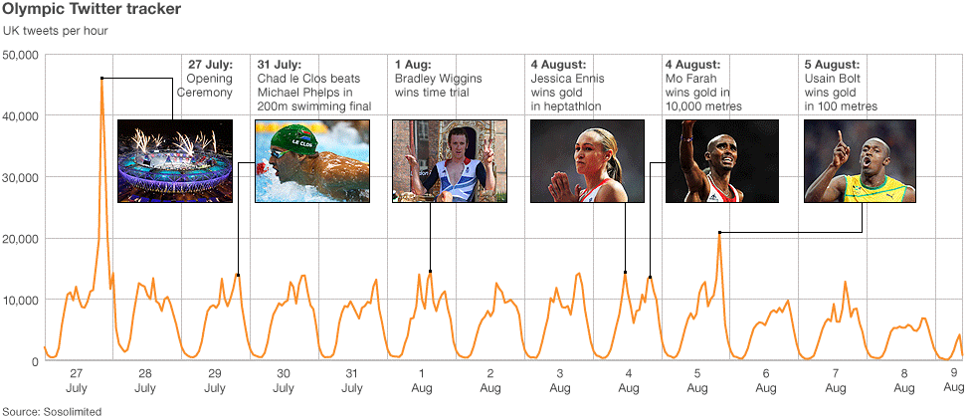
Significant Trends: Social Media
There were “more than 150 million Tweets about the Olympics over the past 16 days”. [Twitter blog]

Slide 39
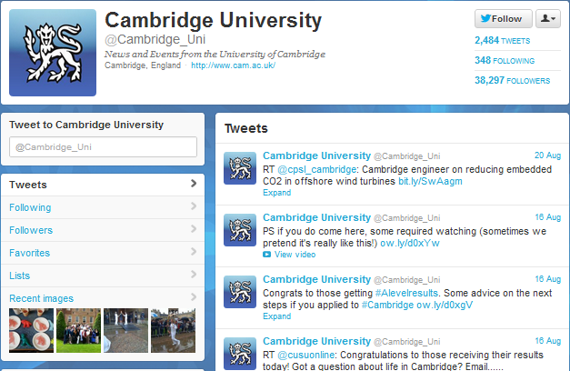
Significant Trends: Social Media
Survey in Aug 2012 of institutional use of Twitter across 24 Russell Group universities found >320K followers

Slide 40
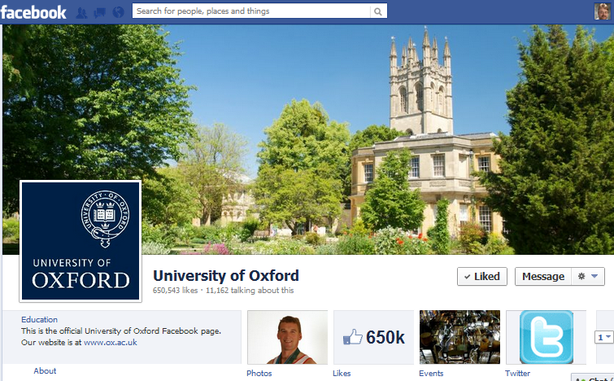
Significant Trends: Social Media
Survey in Aug 2012 of institutional use of Facebook across the 24 Russell Group universities found >1M ‘Likes’ followers

Slide 41
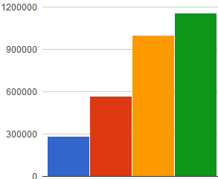
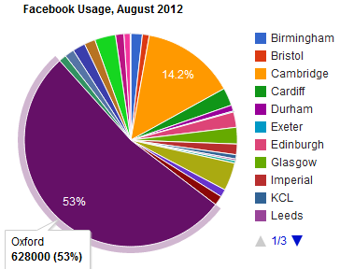
Behind The Facebook Page
Trends in Fb ‘Likes’ for Russell group Unis since Jan 2011 show steady increase
But note increase in Jul 2012 due to addition of 4 new universities!
Jan 11 Sep 11 May 12 Jul 12
But might trends hide a more complex story:
Usage & growth dominated by one significant player.
More modest usage generally

Slide 42
Need for Paradata and Discussion
Surveys carried out to monitor usage & trends for:
Institutional use of social media
Use of researcher profiling services (e.g. Google Scholar, Academia.edu, …) across institutions
Observations (and feedback):
Differing results found if quotes used
Possible inclusion of wrong Unis (e.g. Newcastle University, Australia)
Personalised results depending on client environment
Need to provide paradata and encourage feedback on processes and intrepretation of findings

Slide 43
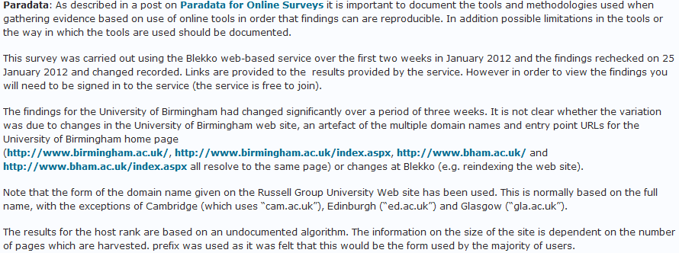
Paradata Example
Dates of survey
An example of paradata for a blog post on use of Blekko for an SEO analysis of Russell Group Universities
Summary of unexpected findings
Limitations of survey methodology
People in host institution can provide contextual knowledge if open approaches used

Slide 44
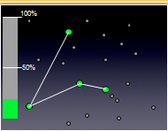
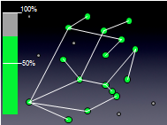
Sense-Making: Social Media
Social media:
Is about nodes and connections
Numbers do matter for effective engagement and disseminations
Experiences from other areas:
Nos. of mobile phones
Importance of email
“All bugs are shallow to many eyes”
Implications:
Importance of best practices for popular & well-used channels
Difficulties for new entrants e.g. Diaspora (open alternative to Facebook) and identi.ca and app.net (new open alternative to Twitter)

Slide 45
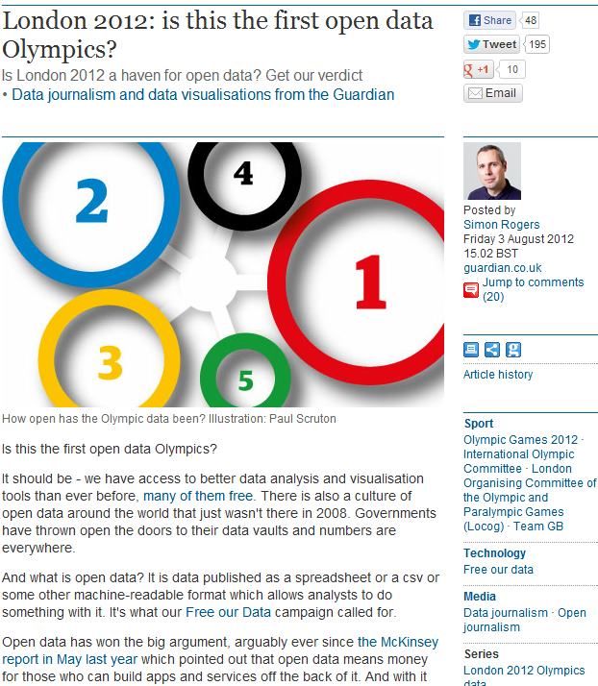
Open Data
“Is London 2012 a haven for open data?”
Conclusions:
“Not this time”
“But it is the first data Olympics”
“It's hard to see that by [Rio] 2016 this won't emerge as data we can all use”

Slide 46
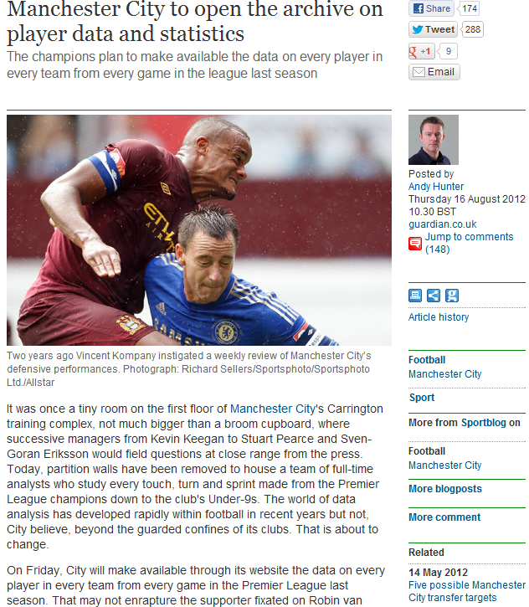
Open Data
“Manchester City to open the archive on player data and statistics”
Example of:
Public interest in open data
Interest from commercial sector

Slide 47
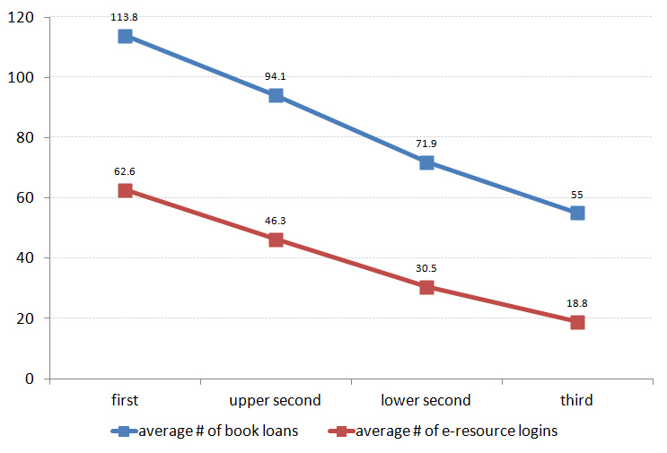
Use of Open Data in Libraries
Trends in reusing Library usage data, e.g. JISC’s Library Impact Data Project
Average number of books borrowed and e-resource logins for ~33,000 students in final year of studies
Image & data provided by Dave Pattern under a CC BY-NC-SA licence

Slide 48
Innovating or Improving?
How should we enhance the visibility of research papers?
Search tools “better than Google”
Richer metadata?
Exploit potential of Linked Data?
Or
Make more effective use of existing infrastructure?

Slide 49
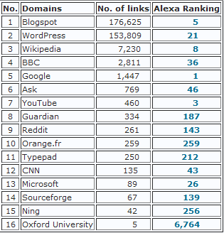
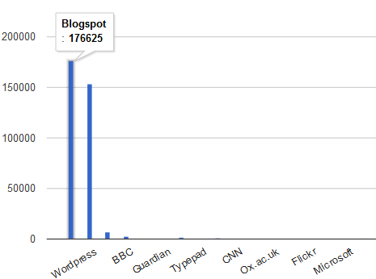
Evidence of IR Usage
Evidence suggests:
50-80% of traffic arrives via Google
Some traffic may not be recorded (direct links to PDFs)
SEO analysis of 24 Russell Group Universities
Importance of externally-hosted blog platforms!
Importance of blog platforms, Wikipedia & media sites

Slide 50
Implications
Implications of findings:
Innovation is important
But:
We shouldn’t ignore potential of implementing best practices on existing systems
Remember:
Today’s mainstream service was yesterday’s innovation
No guarantee that best practices for innovative systems will be implemented

Slide 51
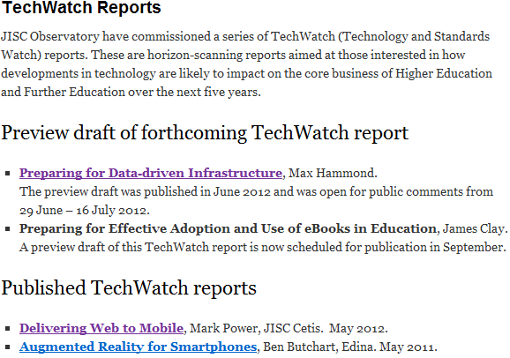
TechWatch Reports
JISC Observatory TechWatch reports on key areas of growth & importance:
Data
eBooks
Mobile Web
Augmented Reality
But what other early signals are we seeing?

Slide 52
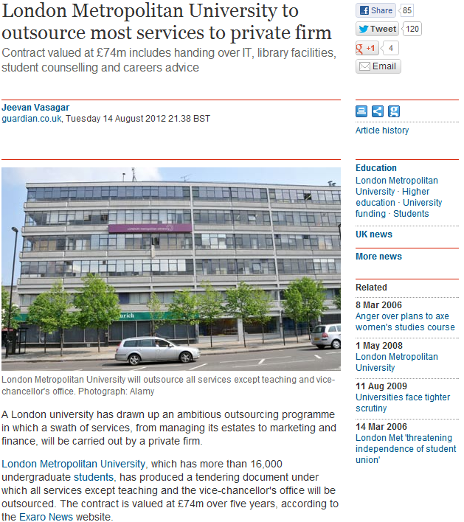
Early Signals?
News stories (Aug 2012) about plans for privatisation at London Metropolitan University

Slide 53
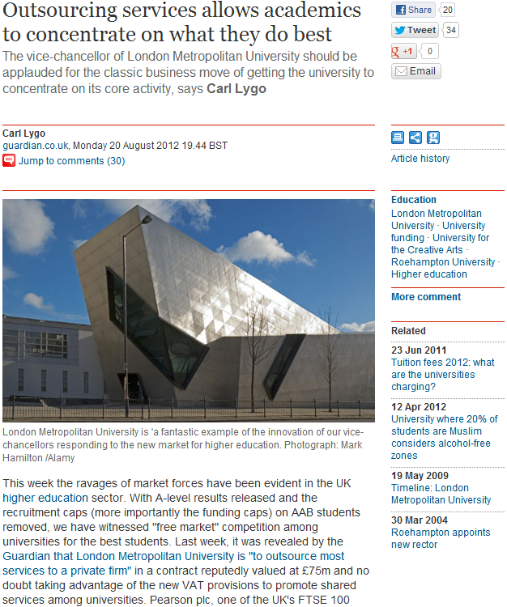
Early Signals?
Follow-up comment (20 Aug 2012):
“VC should be applauded for the classic business move of getting the university to concentrate on its core activity”
Carl Lygo is chief executive of the 'for profit' BPP Professional Education group and principal of BPP University College

Slide 54
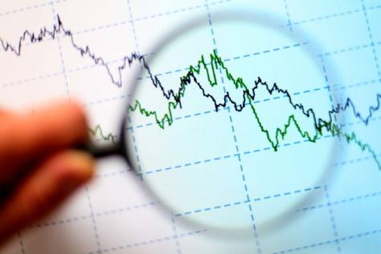
Challenge For Librarians
In time of uncertainties:
Take an evidence-based approach to understanding the future
Understand the changed environment
Engage with opportunities in areas of growth and institutional importance
Be open and encourage discussion on analysis & interpretation of findings

Slide 55
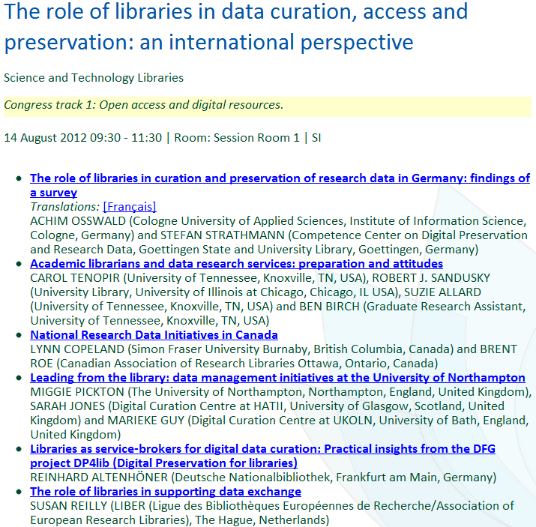
Exploiting Opportunities: Data
Opportunities for (academic) librarians to engage in data management activities

Slide 56
Exploiting Opportunities: Data
Opportunities for Librarians in engaging with research data management – see IFLA paper
PDF

Slide 57
Warning From The Past
Gopher
Tim Berners-Lee didn’t accept the evidence of the popularity of Gopher!

Slide 58
Serenity prayer
Serenity prayer:
God, grant me the serenity to accept the things I cannot change, Courage to change the things I can, And wisdom to know the difference.

Slide 59
Conclusions
The Data will be Big, but our users will continue to use Facebook and Twitter
But research data will grow in importance as will use of mobiles.
According to the evidence the future isn’t quite what I expected. But it has helped to identify our business strategies.

Slide 60
Continue the Conversation
See http://ukwebfocus.wordpress.com/

