Slide 1
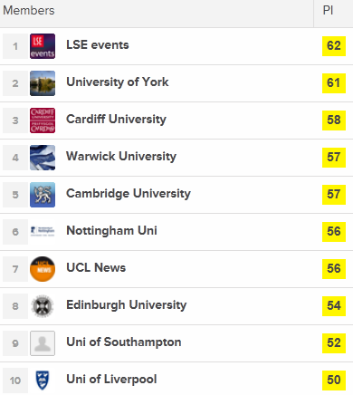
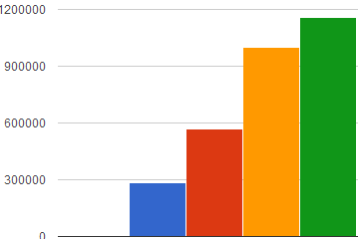
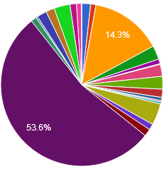
Observing Our Community: The Reasons, the Methodology, Some Conclusions & Some Concerns Brian Kelly, UKOLN
Methodology: use online tools to record usage, typically in Russell Group universities
Aims: monitor use of online services in order to identify patterns which can inform policies and practices
Examples: institutional use of Twitter, Facebook, iTunes, ..; use of research profiling services; …
>1 million ‘likes’
Jan 2011
Sep 2011
May 2012
Aug 2012
PeerIndexing rankings
How might you interpret such steady growth?
Can you spot Oxbridge?

Slide 2
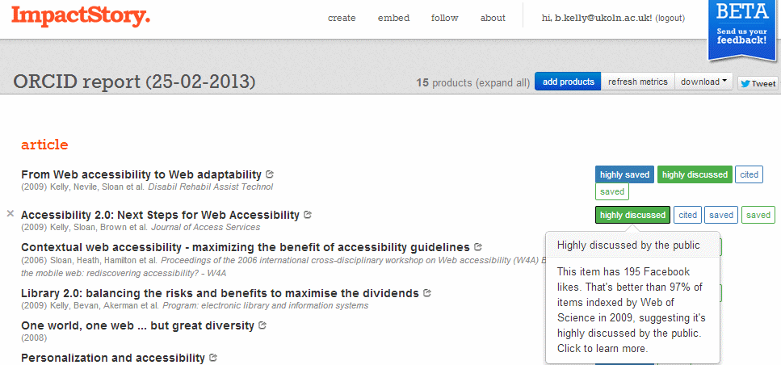
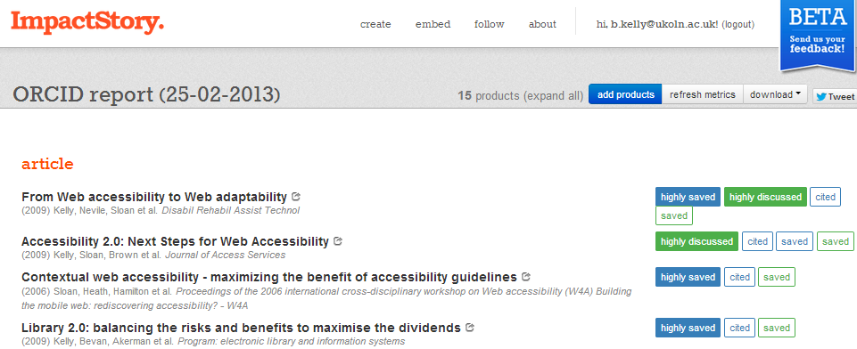
Conclusions: Further analyses would be interesting such as:
How many research papers are deposited in ResearchGate? How does this compare with institutional repositories?
Conclusions: (1) Outliers are interesting (2) Comparisons can identify good (& bad) practices)
(3) Findings may challenge IT orthodoxies
Observing Our Community: The Reasons, the Methodology, Some Conclusions & Some Concerns Brian Kelly, UKOLN
Concerns:
Survey is flawed (e.g. Google personalisation)
Interpretation is flawed
Politics
Addressed by open discussion on UK Web Focus blog

