Slide 1
Simon Foster
RMAS Project Manager

Slide 2
RMAS Update
RMAS Procurement Framework
Pathfinder system developments

Slide 3
RMAS Background
RMAS architecture framework
RMAS Procurement Framework
Module A
Module B
Module C
Research Management and Administration
Electronic Research Administration
RMAS
Background
Drivers
Processes
Constraints
Architecture Framework
Governance
JISC Advance/SSPS HE Cloud & ESB
HE ESB
Pathfinder X
Communications Bus
Research Module A
Research Module D
Research Module B
Research Module C
HR
Student System
Finance

Slide 4
RMAS – Procurement framework
Easy route to market
Opportunity to help shape the market
CERIF compliance
Cloud enabled
RMAS schema and vocabulary

Slide 5
RMAS Background
RMAS modules
CRM
Workflow
Academic Expertise
Electronic Document Management
Research Management and Administration
Electronic Research Administration
RMAS
Background
Drivers
Processes
Constraints
Architecture Framework
Governance
Funding Sourcing Tool
Proposal Management
Costing & Pricing Management
Post Award Management
Outputs & Outcomes

Slide 6
Pathfinder Development Work
University of Kent
University of Sunderland
University of Exeter

Slide 7
Pathfinder Development Work
CERIF alone is unsuitable for RMAS data as we require a concrete data dictionary which is simple for suppliers to incorporate into their tools.
RMAS requires that each RMAS-compliant tool agrees on an identical taxonomy for research entities
List of requirements to work with EuroCRIS to deliver

Slide 8
EuroCRIS/CERIF Development Work
Develop a CERIF-backed, CASRAI-informed standard for the interchange of research information.
In consultation with the pathfinders, incorporate RMAS-specific requirements into the above CERIF standard:
Incorporate a means of attaching a message ID (which is different to the entity ID).
A web-accessible method to look up classifications and get their associated UUIDs.
All of the above provided via a web-accessible schema

Slide 9
EuroCRIS/CERIF Development Example
Use case
Supplier tool creates a new proposal (research activity)
New CERIF message is created with a unique message ID
The message type is declared as ‘proposal created’
Research Activity entity is declared inside this message
Based on the message type (‘proposal created’), all mandatory Research Activity fields must be declared in the message, and their contents must conform to the CASRAI definitions (this must be syntactically verifiable via schema).

Slide 10
Research Output Monitoring tool (ROMe) Overview
Linked Server
Symplectic
ROMe
S
S
I
S
Publication data
Widget
CERIF XML
CERIF XML
CERIF XML

Slide 11
Steps
2) Un-mapable CERIF data is extracted.
Linked Server
Symplectic
ROMe
S
S
I
S
3) SSIS imports XML and merges data to produce data set needed for ROMe interface.
Publication data
Widget
CERIF XML
CERIF XML
CERIF XML
1) Widget schedules extract into CERIF XML files.

Slide 12
Adapter
Action
ESB Message forwarding invokes action in subscribed tools.
HTTP interface to present user with the ability to invokes action in subscribed tools.
ESB
I1
PM
Tool
Message Flow Control
A1
I2
Costing
Tool
A2
ACTION
Template
Message Queue
Awards
Tool
Identifier Registry
I3
A3
I4
HR
Tool
Converter to CERIF 2
A4
I5
Publications
Tool
A5
TABULAR
HTTP
Decoder
Action

Slide 13
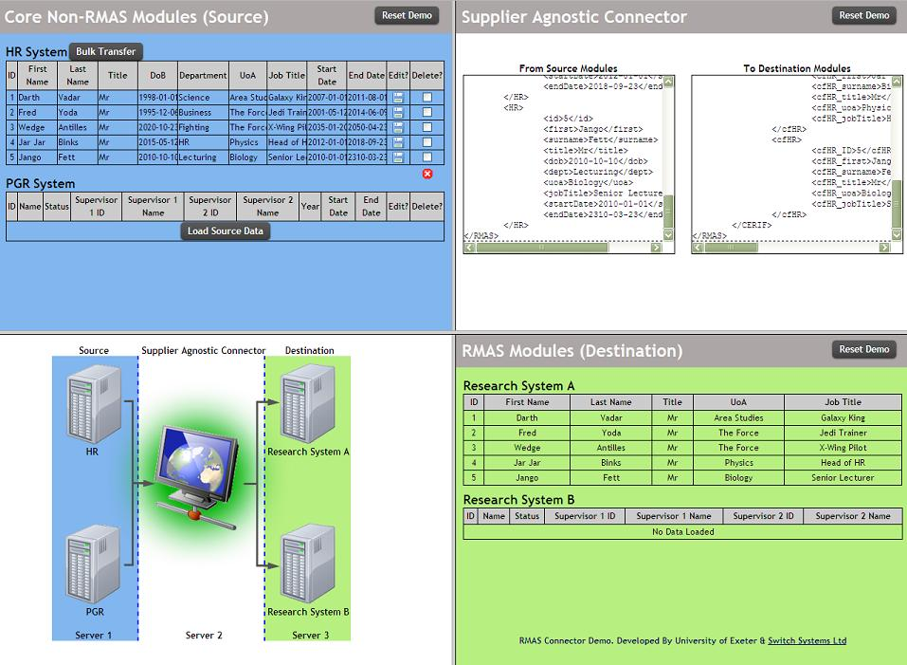

Slide 14
Connector Definition
‘Each module/system that needs to share RMAS data will need a connector. A connector enables data transfer between separate systems. The term adapter can be used interchangeably with connector. An adapter converts native data from source systems into XML messaging formats, and vice versa. A connector may constitute simply this adapter function, or may also include transport functionality to deliver the data via a communications bus to a specified destination or destinations’.

Slide 15
RMAS Background
Research Management and Administration
Electronic Research Administration
RMAS
Background
Drivers
Processes
Constraints
Architecture Framework
Governance
Simon Foster
RMAS Project Manager
University of Exeter
S.foster@exeter.ac.uk
01392 72 5838
07799 861 224

